Slide 1
STATEBENCH
v1
Working state for
reliable multi-step
tool use
API
T
v2
X
Representative FuncBenchGen reproduction + controlled Qwen3.6-27B extension
hidden dependency graph
Research question
Does state representation change exact success and context cost?
75 paired executions • 15 frozen graphs • 5 state strategies
LebNet Tech Fellows 2026

Slide 2
PAPER CONCEPT
The model must traverse a graph it cannot see
What the model sees
What the evaluator hides
Initial values
f1
typed inputs already known
Tool schemas
v0
T
randomized function list
Target
f2
one value to produce
X
edges + valid dependency path
Success requires the exact target value—not merely plausible tool calls.
02

Slide 3
PAPER CONCEPT
Difficulty is controlled, not guessed
Easy
Deep
Connected distractors
depth 1
depth 4
+10 type-compatible tools
Y
B
B
T
T
A
T
A
A
C
C
X
short dependency path
more state must survive
irrelevant routes look valid
Connected irrelevant nodes are hard because they share valid types with the solution graph.
03

Slide 4
EXECUTION
A faithful core plus a model-compatible extension
01
02
03
04
05
Paper-style calibration
Shared interface
Frozen fixtures
Five state strategies
Exact evaluator
Opaque schemas
2/5 easy → 0/5 deep
Visible variable names
explicit premature-call errors
5 seeds × 3 conditions
identical tasks per strategy
History • restatement • JSON
static prune • live prune
target value within
2× minimum calls
75 paired executions
Fixed across strategies
15 graphs × 5 strategies
model • prompts • graph • tool order • call budget • success rule
Live pruning is reported as a post hoc mechanism-driven follow-up.
04

Slide 5
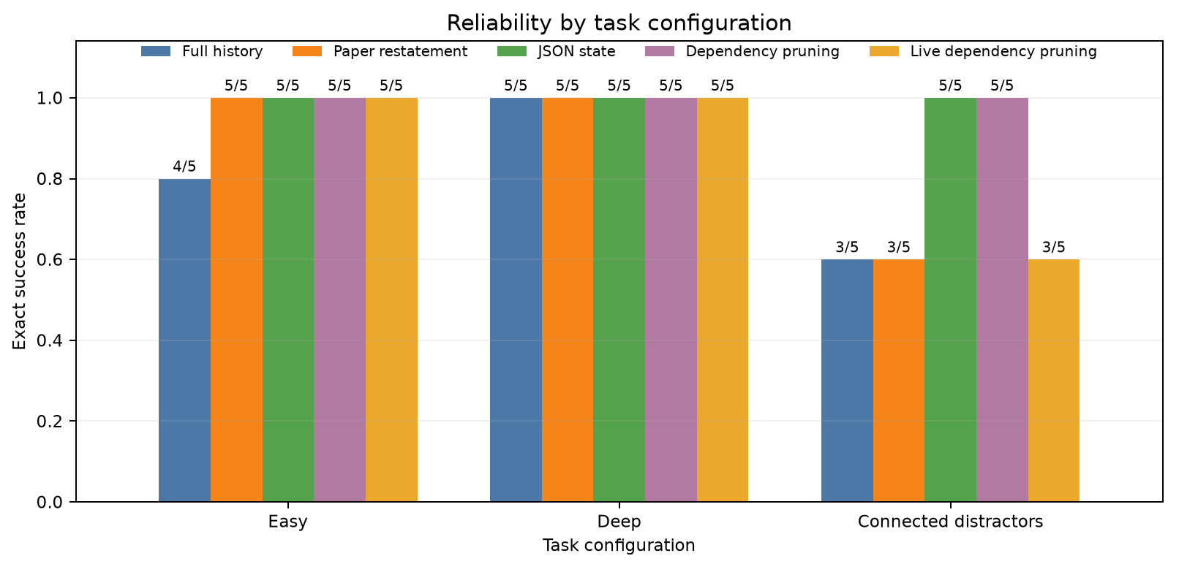
RESULTS
Structured state wins—until compression becomes too aggressive
Compact-state trade-off
Cumulative reminder bytes
JSON
15/15
405 B
Static prune
15/15
405 B
Live prune
13/15
157 B
61.2% less state
but two connected failures
JSON + static pruning
Connected distractors
Live pruning
15/15 exact success
full history falls to 3/5
61.2% smaller • 13/15 success
05

Slide 6
CONCLUSION
Smaller state is useful only when it preserves the right evidence
Submission package
What changed
The paper’s state-tracking problem
was reproduced and then reframed
as a state-representation experiment.
Reproducible repository
01
runner • frozen fixtures • resume
Four-page report
02
Explicit structured state recovered failures. Repeating every value helped only slightly. Aggressive live pruning reduced context but weakened connected-task reliability.
method • results • limitations
Three-minute video
03
concept → execution → output
Conclusion: reliability depends on what state remains—not only how little state remains.
06

