Slide 1
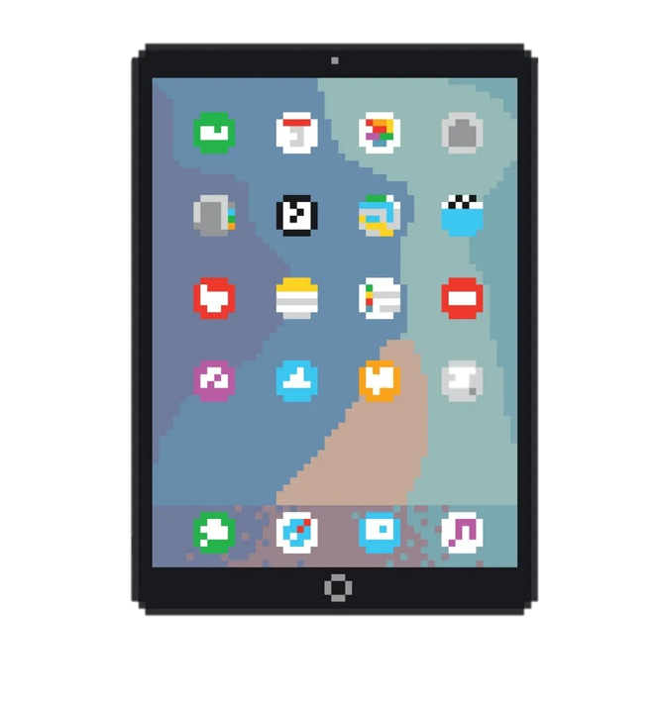
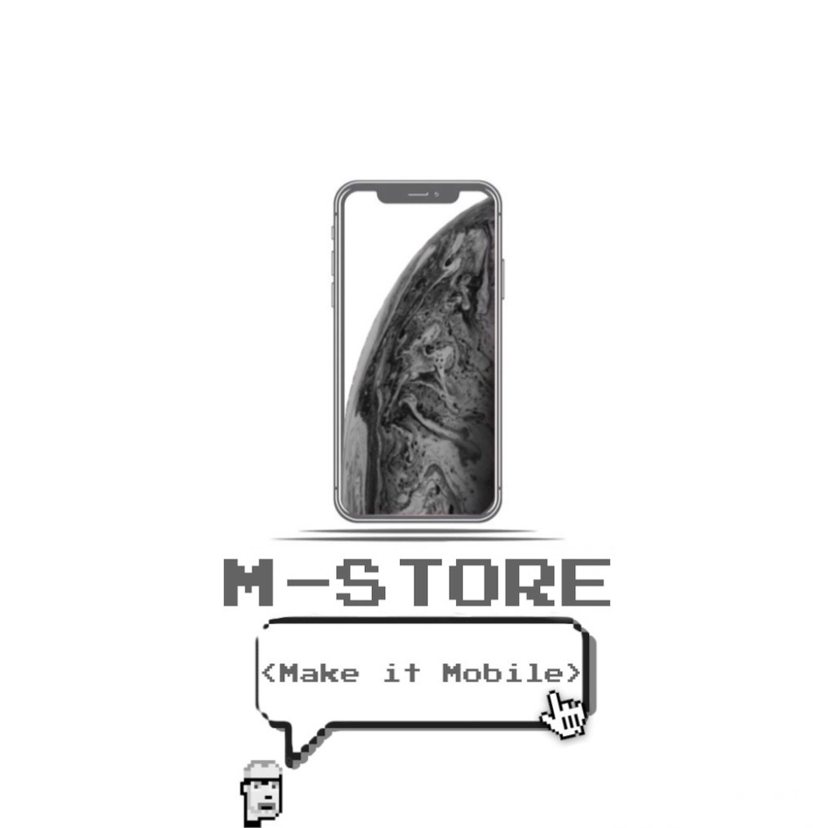

Slide 2
HOW DOES THAT WORK
After logging in or registering on the site, you are directed to a catalog with all kinds of products. The customer can choose between various brands and various accessories that are most interesting and useful for his device. Each brand has its own section for both telephone devices and dedicated accessories. After the customer has chosen the product to buy, he will choose the payment method he prefers and within 24 hours the package will be entrusted to a courier and the customer will be provided via email with the tracking code of the shipment. After 48/72 hours the customer will receive the phone with the possibility of making a return before 30 days from delivery. The idea is to create a platform where you can buy both new or refurbished phones and accessories.

Slide 3
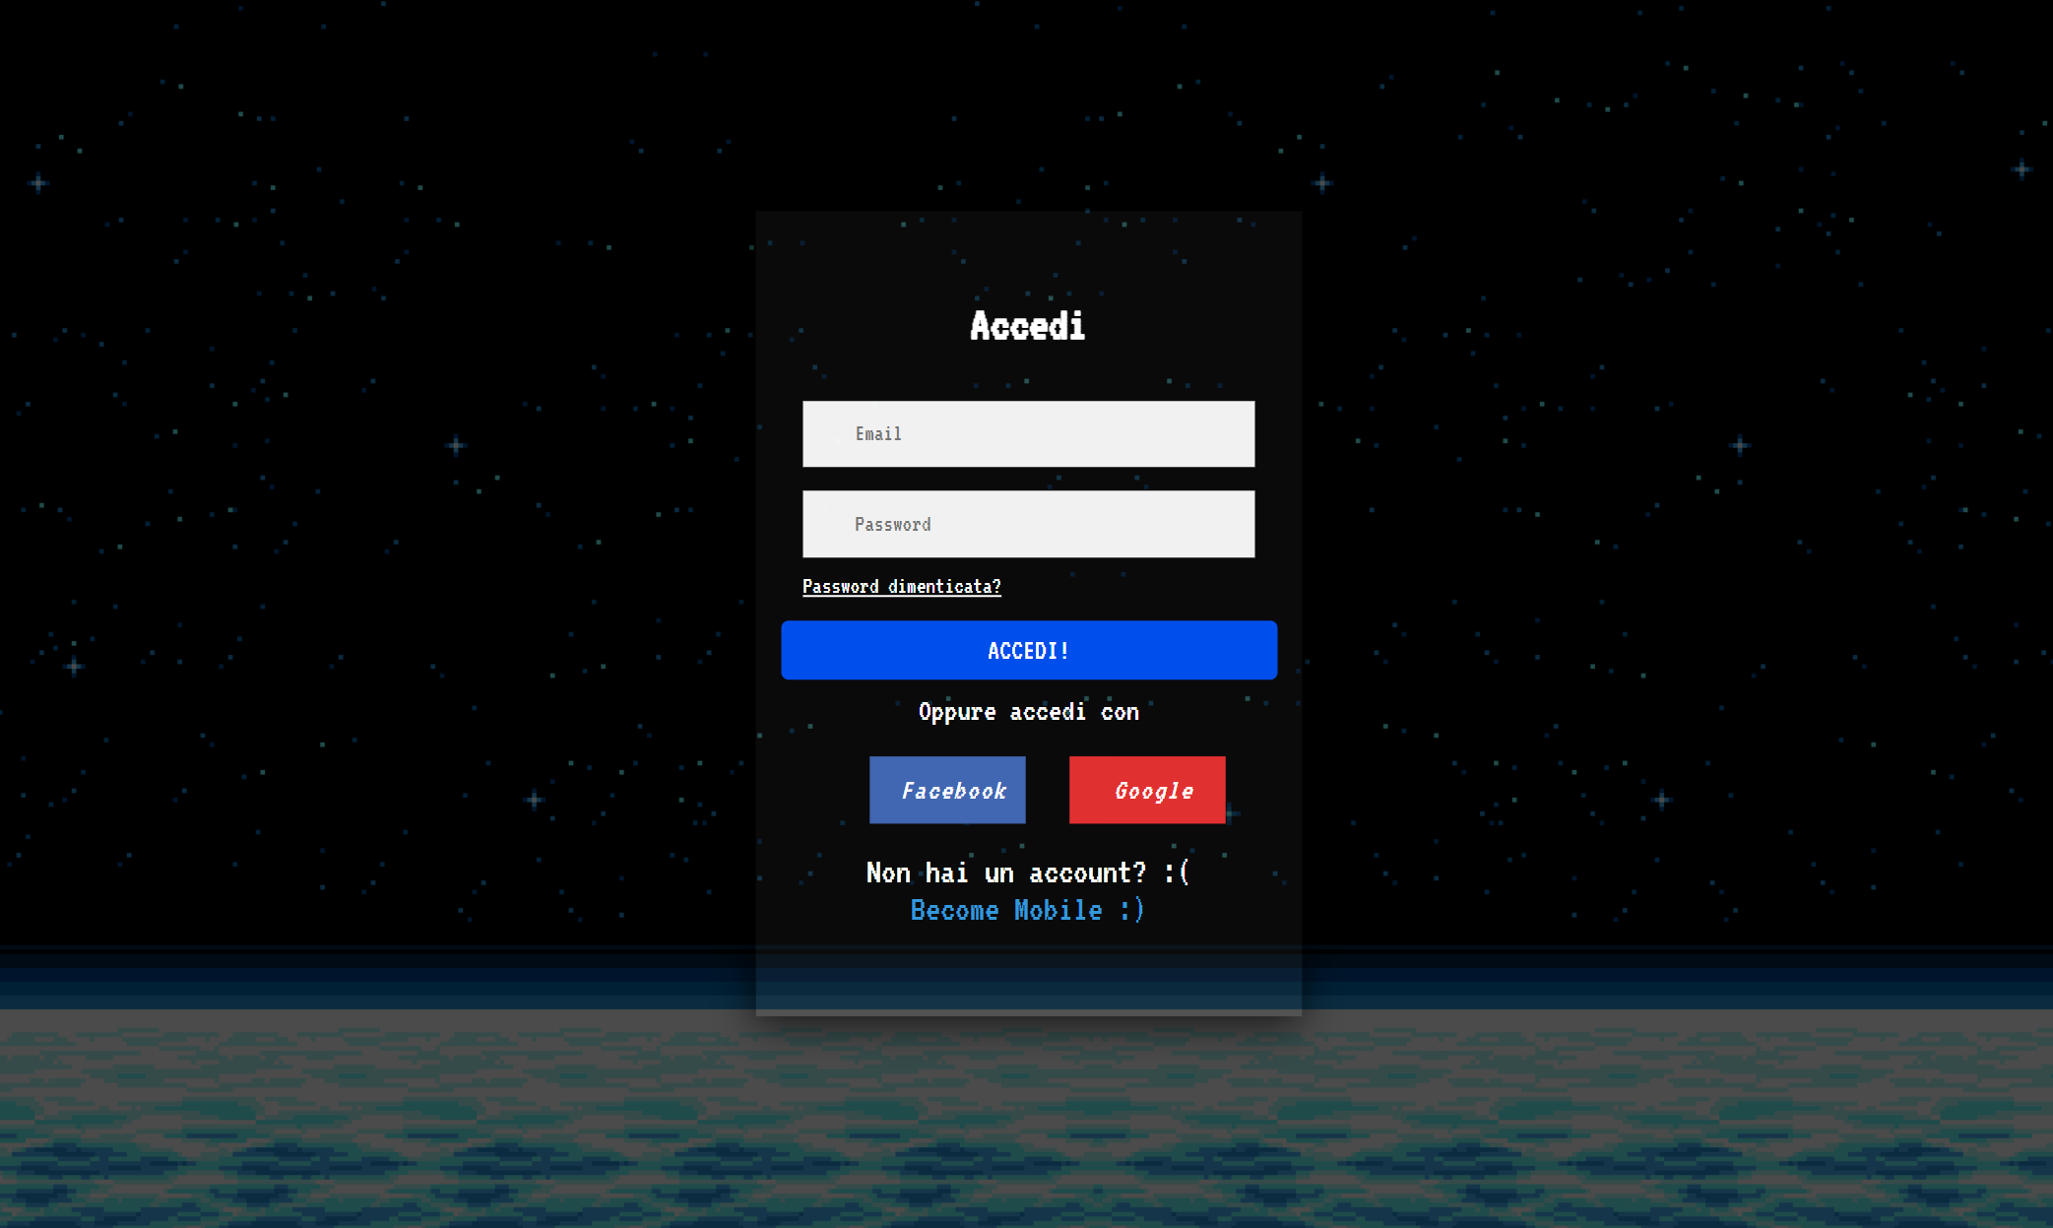
LOGIN PAGE

Slide 4
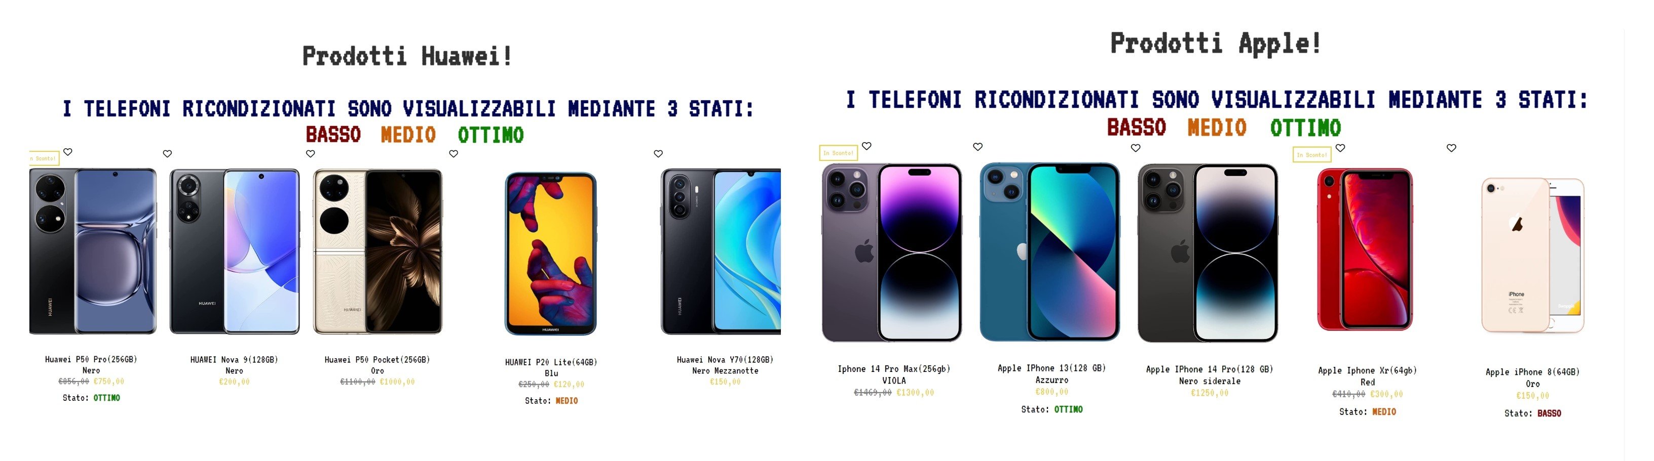
P
PRODUCT PAGE

Slide 5
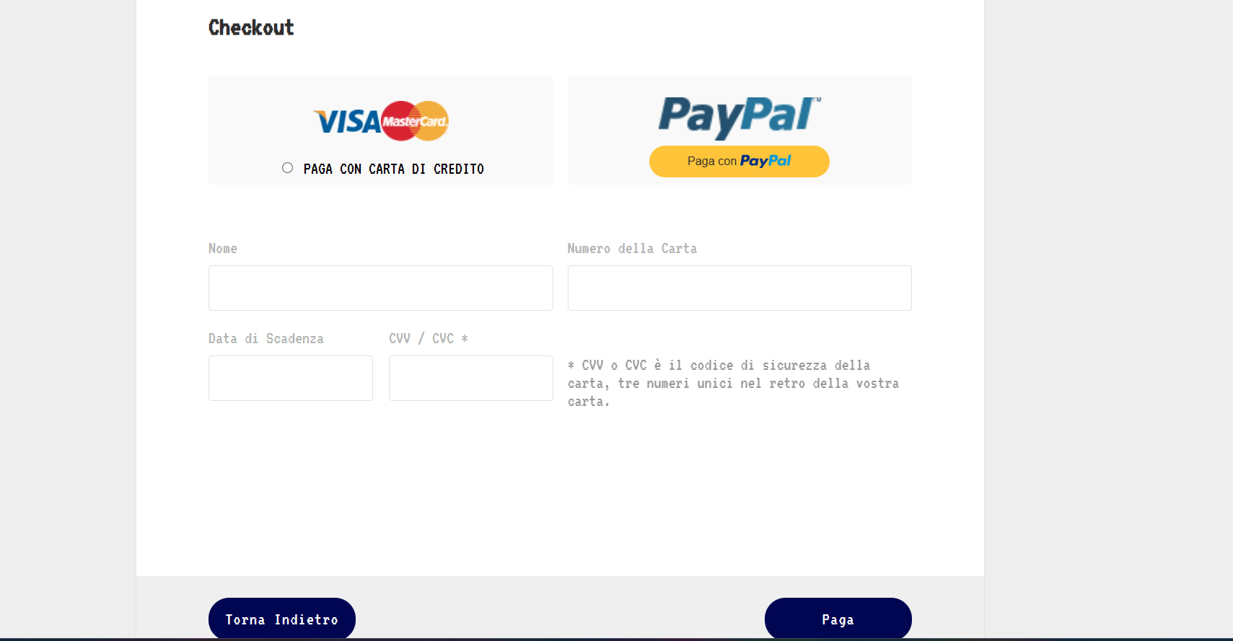
PAYMENT
The method presented here is our payment method. The customer can choose to make the payment either through his credit card (Visa, Mastercard and others) or by accessing his PayPal profile and then accessing his preferred current account.

Slide 6
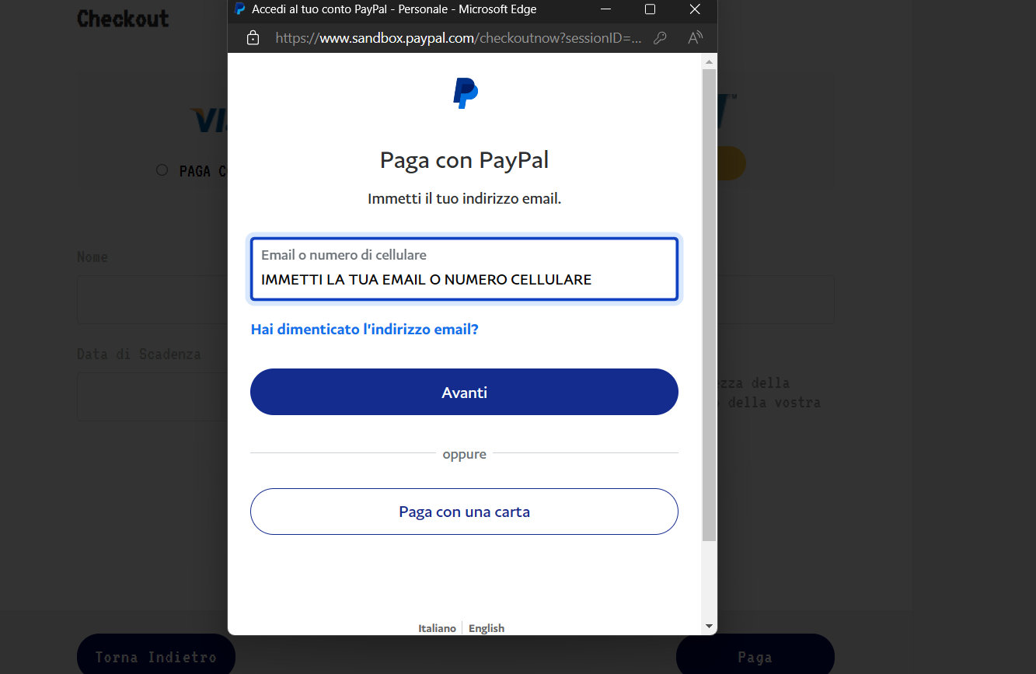
In this scenario, the customer will have decided to log in with PayPal and choose the current account they prefer.

Slide 7
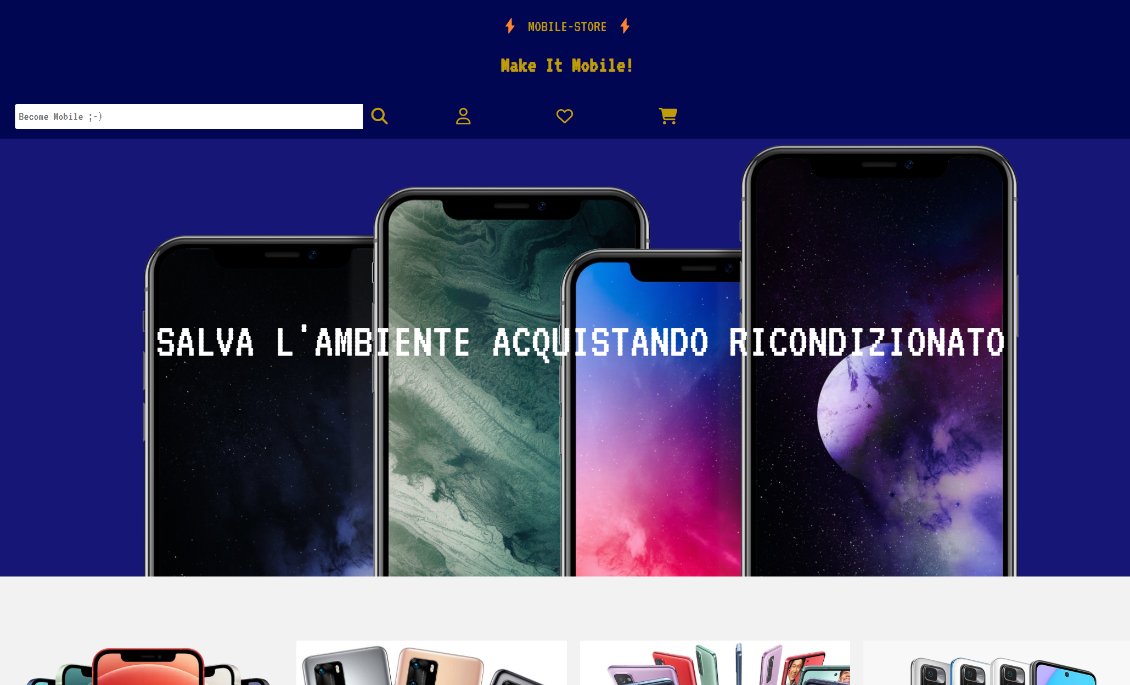
SEARCH BAR
With the search bar shown in the picture, the customer can search for the name of the phone he prefers, in order to avoid looking for it in the various catalogs and arriving directly at the phone concerned with the necessary characteristics represented on our site.

Slide 8
TEAM
Domenico Sodano
0124002300
Alessandro Antonio Pio Ungaro
0124002360

