Slide 1

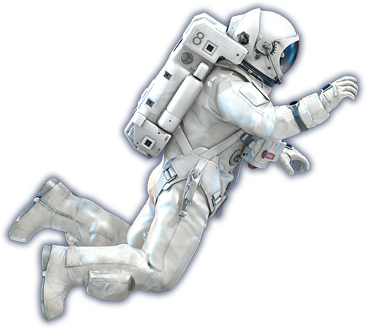
Facility and Infrastructure

Slide 2

1 Transportation Infrastructure
You should show a schematic diagram illustrating the interconnected structure of Demeter’s transportation system, emphasizing crucial infrastructure elements, transportation modes, and clearly illustrating the flow lines for both personnel and goods.

Slide 3
2 Communication Infrastructure
You should design a conceptual diagram of the communication system, and specify the adopted technologies and bandwidth specifications for each communication link.

Slide 4
3 AI System
You should design a system architecture diagram of the communication system to illustrate how the AI system collaborates with humans to jointly operate Demeter and support long-term human activities.

Slide 5
4 Mining Robot
You should design a robot that can work under Psyche’s low-gravity environment and complete excavation and mining work and provide its design drawing with clear labeling of functions and dimensions.

