Slide 1
DIP 2013 – Smart Fast Forward

Slide 2
Overview

Slide 4
Background Subtraction

Slide 5
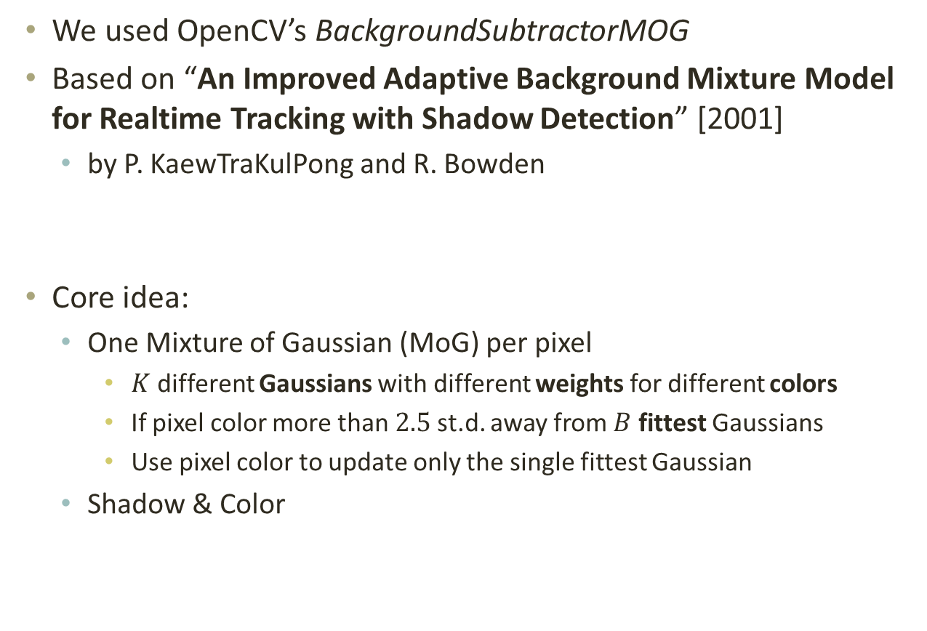
Background Subtraction
We used OpenCV’s BackgroundSubtractorMOG
Based on “An Improved Adaptive Background Mixture Model for Realtime Tracking with Shadow Detection” [2001]
by P. KaewTraKulPong and R. Bowden
Core idea:
One Mixture of Gaussian (MoG) per pixel
$K$ different Gaussians with different weights for different colors
If pixel color more than $2.5$ st.d. away from $B$ fittest Gaussians
Use pixel color to update only the single fittest Gaussian
Shadow & Color

Slide 6
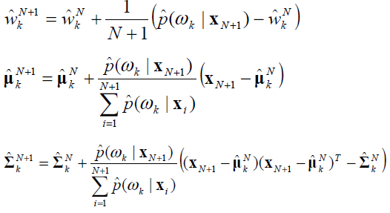
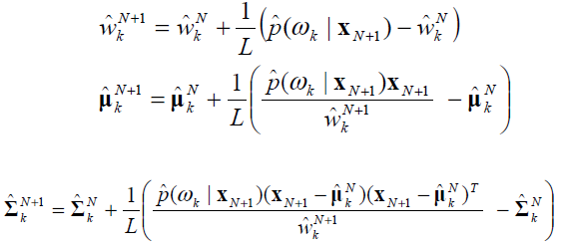
Background Subtraction TODO MoG
Initialization:
“Expected
Sufficient
Statistics”
Update:
“L-recent
Window”

Slide 7
Background Subtraction Shadow Detection & Color Model

