Slide 1
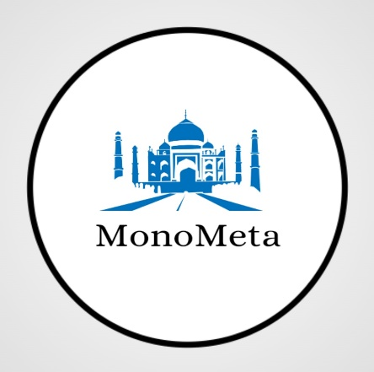

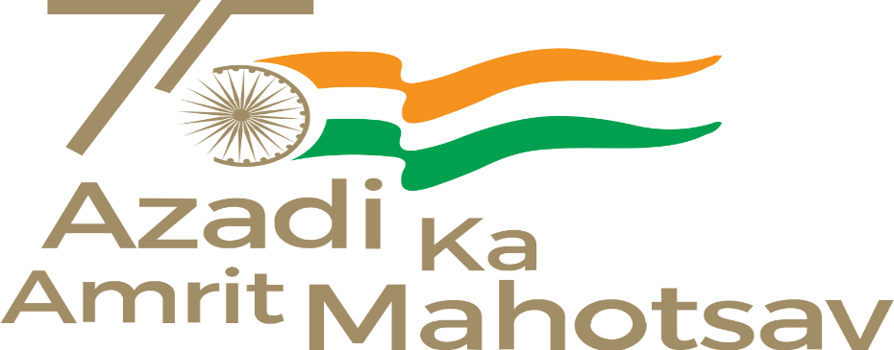


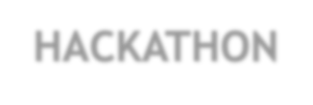

SMART
INDIA HACKATHON
Team name: Dominatrix-101 College ID: 79875
Organization name: Ministry of Culture Problem statement ID: GM752
Problem Statement: AR App for Monuments
Problem Details:
Background: History plays an eminent role in the cultural representation of any place as heritage sites and monuments reflect the tradition, art, and culture of the previous golden era. This can be achieved through AR in historical recreation. Using a smartphone, the user can visit historic buildings and learn more about the past, swipe through monuments and see events of the past come alive in 3D. Summary: To develop an AR application for visitors so that they can scan any area in a monument and can see history come alive through augmented animations. Objective:? An "Immersive Augmented Reality" based App to explore the Cultural Heritage of India.

Slide 2
Solution
We are providing an Android App featuring Indian ‘Art and Culture’ that displays the model in a 3-D way along with the amazing historical facts and its myriad attractions in India.
Texts and Audio will be displayed according to the user’s known language. Hence removing the problem of language translation.
Through our Product both the traditional and modern worlds meet interestingly thus boasting a great user engagement experience.
“History lovers and foreigners” will now discover a trove of artifacts, traditional customs, multicultural, sacred site belief systems, and ancient encounters in India in just one click.
Working of App
Users will Register or log in to the app with their respective accounts or can create a new one.
They can choose any monuments from the drop-down list.
Accordingly user will direct to the monument’s 3-D appearance.
For getting facts displayed they can choose the language and can experience both the audio and text features.

Slide 3
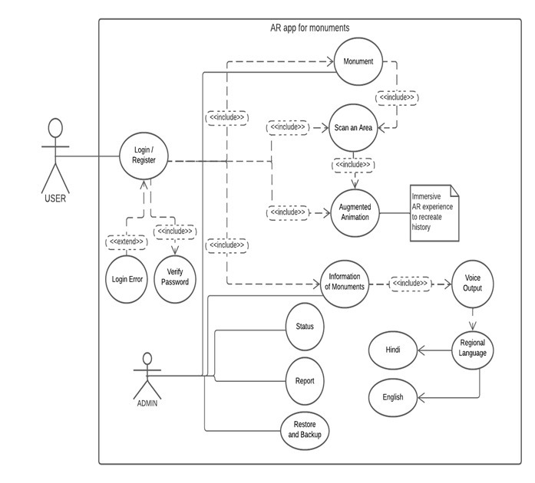
Applications Used:
Unity 3D Engine
Firebase
Blender
MakeHuman
Dependencies:
.
It works better on devices having Android 6.0-Marshmallow API (level 23) or above
Minimum of 4 GB RAM Required.
Unity Remote for Testing Purposes.

Slide 4
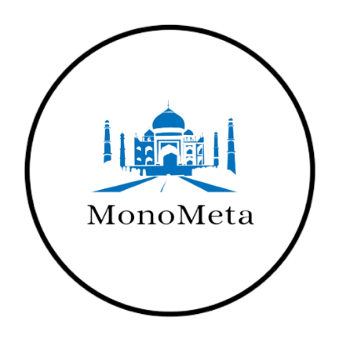

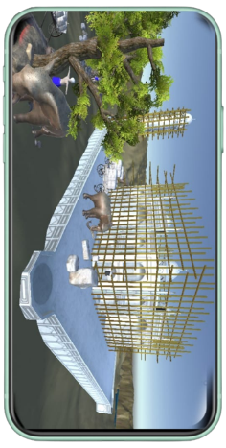
FLOWCHART
DATA 1
User Login Data like Email, Name, and password
DATA 2
DATA 3
List of Monuments
Selection of Monuments
App Server
MonoMeta App
An immersive Experience
Scan an Area
After Selection
User Sign-in/Sign-up
Marker-Based AR
To instantiate the object in the real world

Slide 5
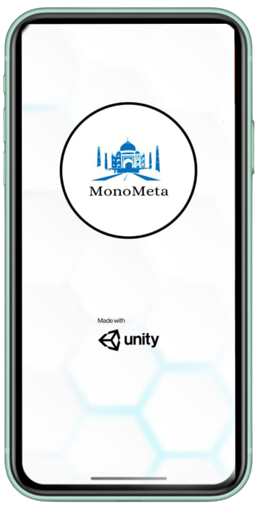
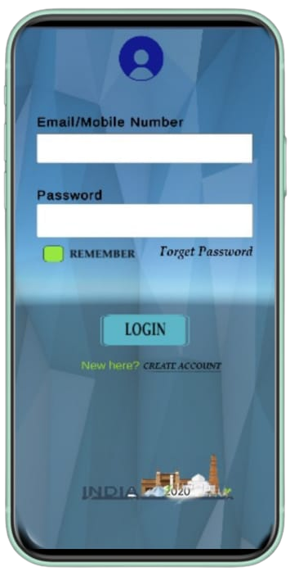
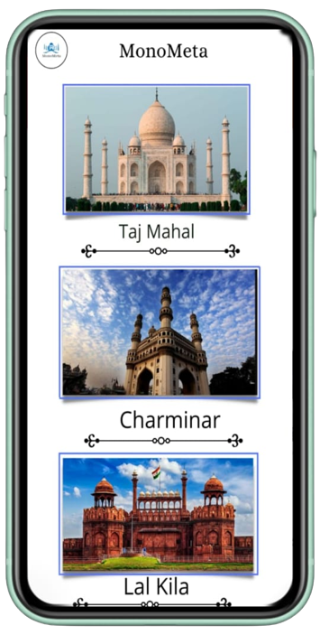
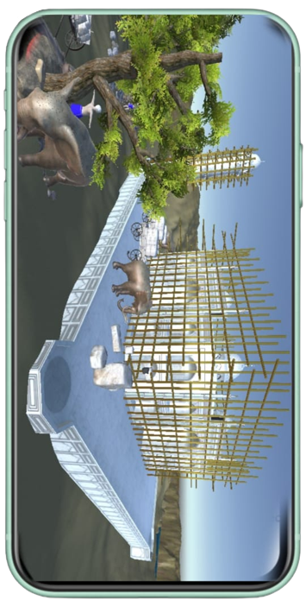
OVERVIEW

Slide 6
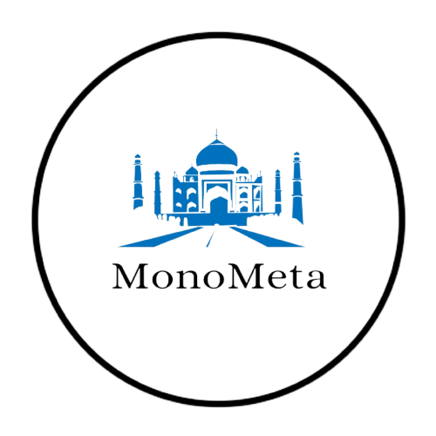
Why use MonoMeta?
Scan any area of a Monument and get information.
Immersive 3-D User Experience.
Attractive UI Layouts.
Text and Audio Features.
Facts are displayed in multiple languages.
Easy to access.
Historical facts at one click.
Promoting Tourism in and across India.
An awareness for upcoming generations.
Revealing the mystery of history.

Slide 7
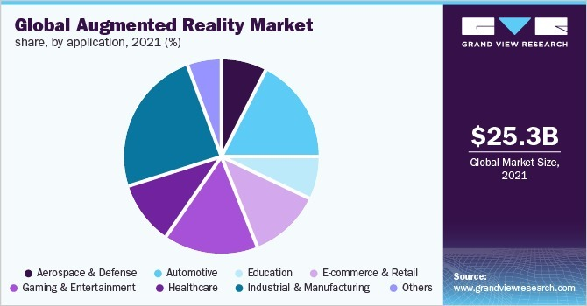
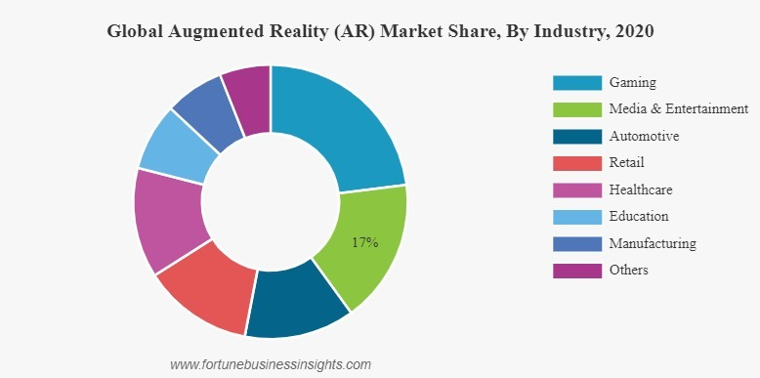
AR TRENDS :
The market size value in 2022 is USD 38.56 billion
The revenue forecast for 2030 is USD 597.54 billion

Slide 8
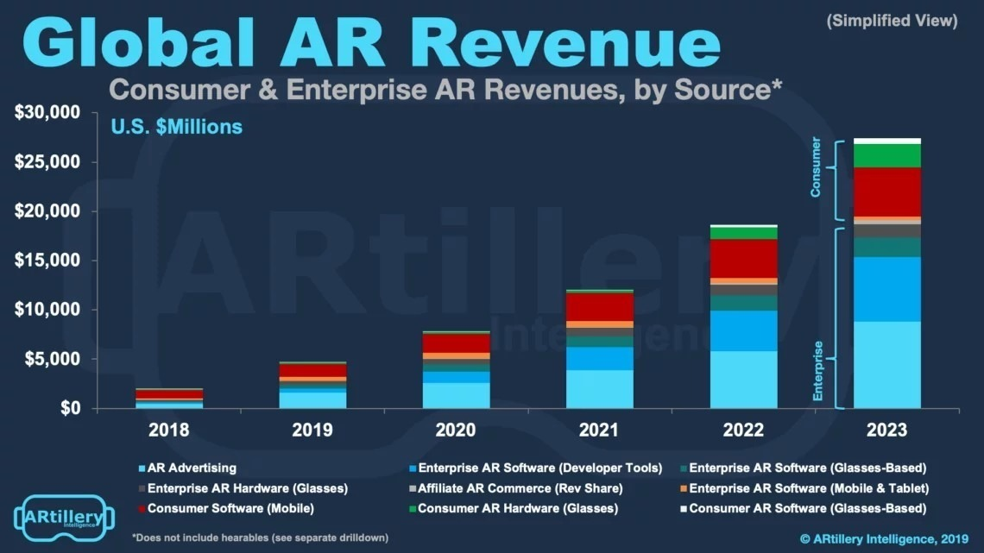
Business Model
Market Overview:
Augmented reality (AR) is a real-world interactive experience in which objects in the real world are enhanced by computer-generated image features, sometimes across multiple modalities such as auditory, visual, somatosensory, haptic, and olfactory. AR is defined as a system in that The sensory information overlaid can be constructive (i.e., beneficial to the natural environment) or destructive (i.e., masking of the natural environment). This experience is so intertwined with the physical world that it is interpreted as an immersive part of the real world. In this way, augmented reality changes one's continual perception of a real-world situation.

Slide 9
Advertising sales :
For app and content developers (not selling hardware, goods, or services), advertising sales could be the most valuable business model at around $1 of every $10 generated by AR.
AR entrepreneurs don’t need to reinvent the virtual wheel. They get to augment it.
AR advertising is more immersive than any rich media (when done right), and ad spending should follow the eyeballs.
Freemium :
The whole world has already noticed how fruitful this business model can be for mobile-based applications.
AR users have to get familiar with the freemium model and find a profitable way to engross with monuments across a platform.
AR content is something that users will gladly use, especially if applications provide immersive, ad-free content

Slide 10
Future Scope of MonoMeta :-
Regional Language Support will be provided for user friendly experience on application to avoid multiple language barrier and users will get a immersive experience of a monument.
Cloud Integration under which we can get the on-hand virtual storage and application storage separately due to which the size of the application will reduce and make application more scalable.
Real time Navigation will be provided within the application to help users to get the shortest path to reach their intended destination.

Slide 11
References
Content References:
a)- Books
Bharat ka Prachin Itihas
(by Ram Sharan Sharma)
Bharat ka Itihas
(by AL Shrivastava)
A History of Medieval India
(by Satish Chandra)
b)- Web Sources
indiaculture.nic.in
livehistoryindia.com

Slide 12
THANK YOU!

