Slide 1
COVID – 19 Analysis
23, 2020

Slide 2
Executive Summary
Now a days COVID-19 is a worldwide interest topic due to the impact it has in all sectors (economic and social). That’s the reason why CBX has developed a tool to forecast and analyze this phenomenon.
This tool has 3 main levels:
N-day forecast (currently 10 but can be modified)
Growth rate
Curve-flattening Index
In order to make this solution some assumptions were taken into consideration:
Fatality rate is 3.3%
People take 17 days to die
People take 22 days to recover
The information used in this analysis has one day lag and it’s consistent with the one published by WHO (World Health Organization).

Slide 3
N – days forecast
This level has 3 sublevels :
Active cases
N-days forecast with a confidence interval
Detection rate
 |  | 10-days forecast
Country | Active | Min | Max | Detection rate | Possible Cases
Mexico | 400 | 3,097 | 6,105 | 6.4% | 6,208
US | 65,660 | 1,056,135 | 2,531,488 | 2% | 3,168,482
China | 1,400 | 299 | 463 | 100% | 1,400
South Korea | 3,951 | 1,639 | 2,955 | 100% | 3,951
Notes:
Active cases: to approximate the number of recoveries it’s assumed it takes 22 days for recovery. Active cases is Total cases (now) - Total cases 22 days ago (excluding deaths).
N-days forecast: projection is based on total cases in a log scale: exponential growth presents as a straight line on the log scale. So the estimate fits a straight line to the last n (10 in this case) days of data, extrapolate it by n days, and project that up onto the original scale of total cases.
Detection rate: It’s a rough (because lack of reliable data) estimate of the proportion of cases that are being detected in each country. The fatality rate of symptomatic people is about 3.3% and it takes about 17 days for people to die. Under these assumptions the tool looks at the number of deaths in a five-day period and calculates the number of symptomatic infections required to generate these deaths (expected = deaths/0.033). Then, the expected value is compared to the number of new cases detected in the five-day period 17 days earlier (observed), and use observed/expected to estimate a detection probability.

Slide 4
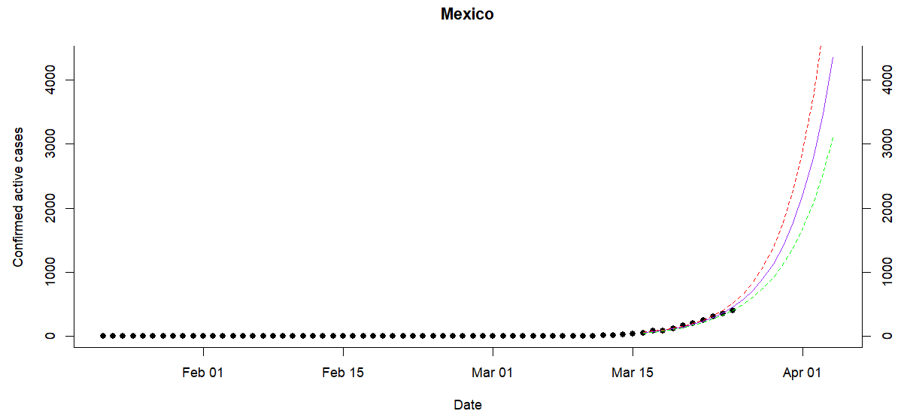
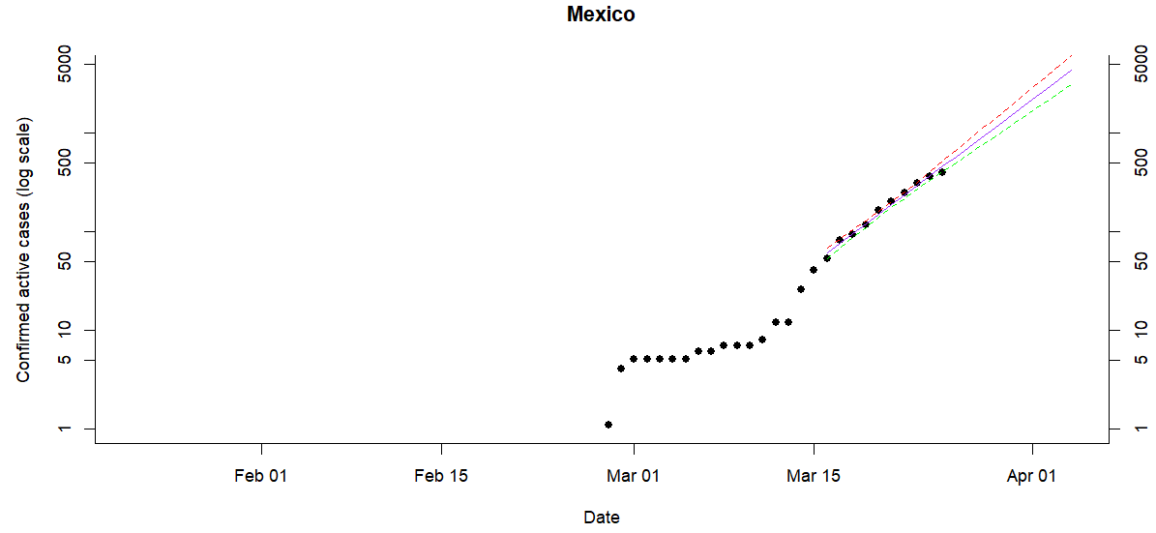
N – days forecast
The top graph gives the total number of cases each day, with a ten-day projection.
The projection is based on the bottom graph, which are the same data plotted on a log scale: exponential growth presents as a straight line on the log scale.
The tool fits a straight line to the last ten days of data, extrapolate it by ten days, and project that up onto the original scale in the top graph.
The bottom graph shows better the magnitude and speed of the change on total cases

Slide 5
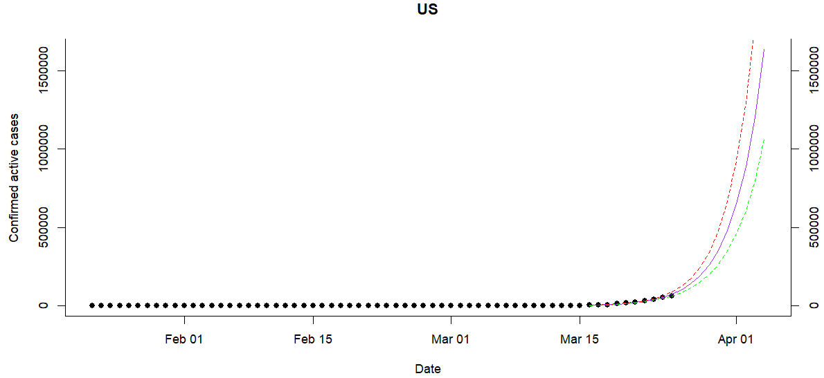
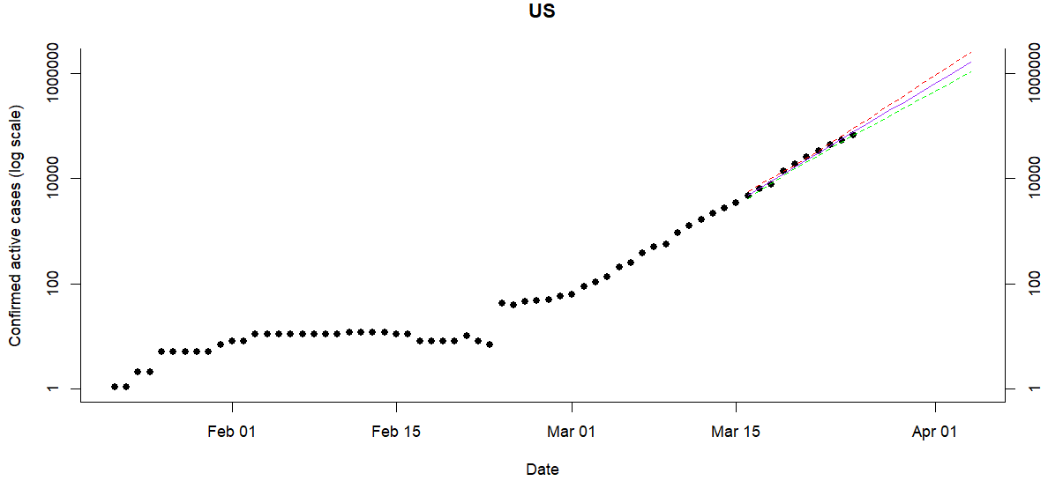
N – days forecast

Slide 6
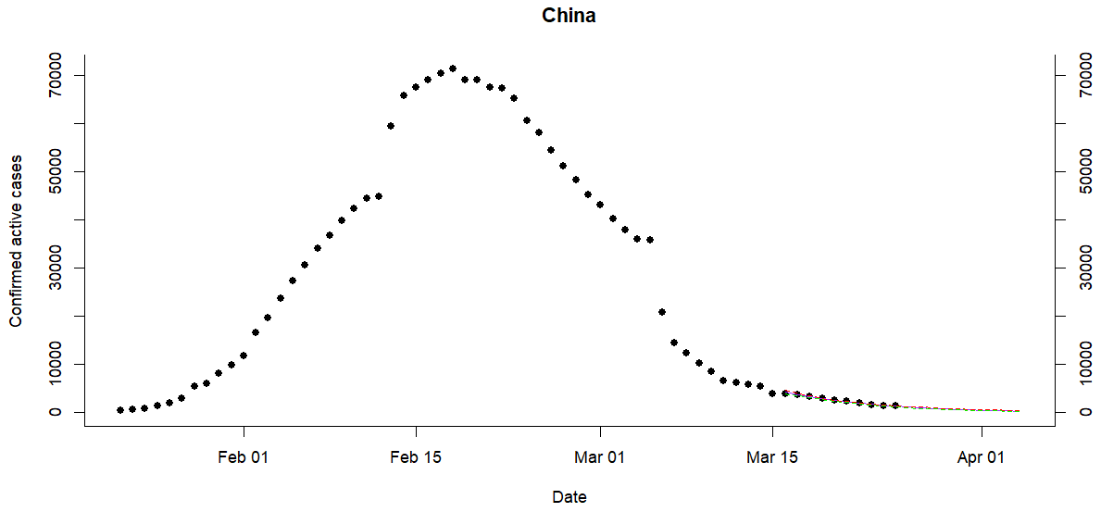
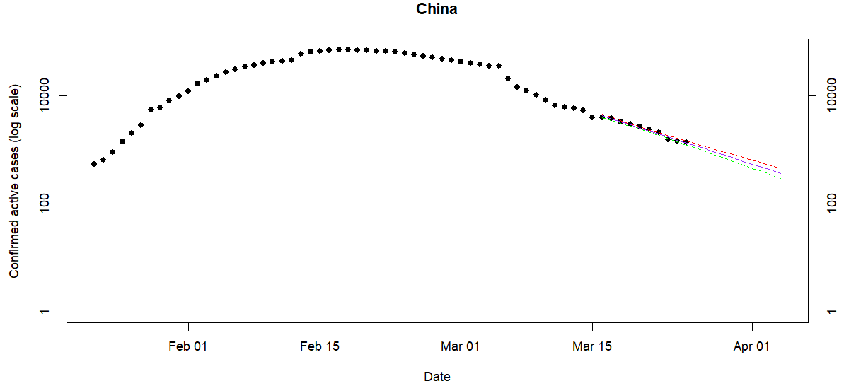
N – days forecast

Slide 7
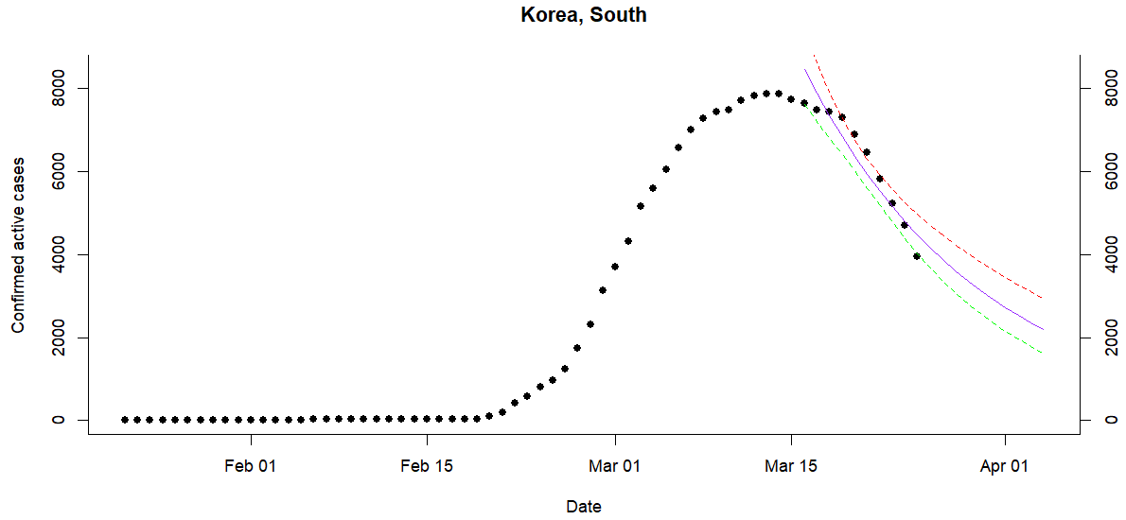
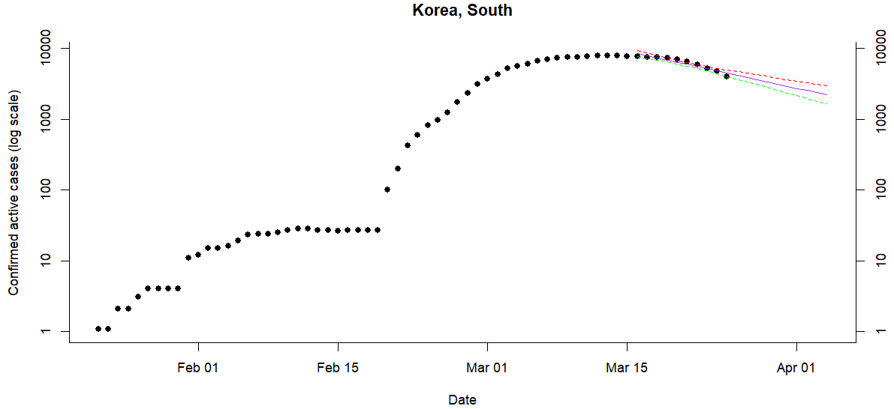
N – days forecast

Slide 8
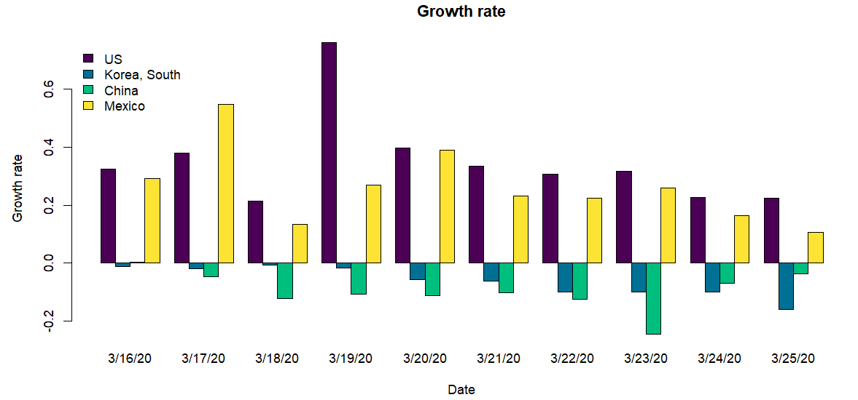
Growth Rate
Progress in control is indicated by a steady decrease in the growth rate over time and staying in negative territory.
Notes:
1) Growth Rate: it’s calculated as the change in number of infected people between day t and day t-1, divided by the number infected on day t-1.

Slide 9
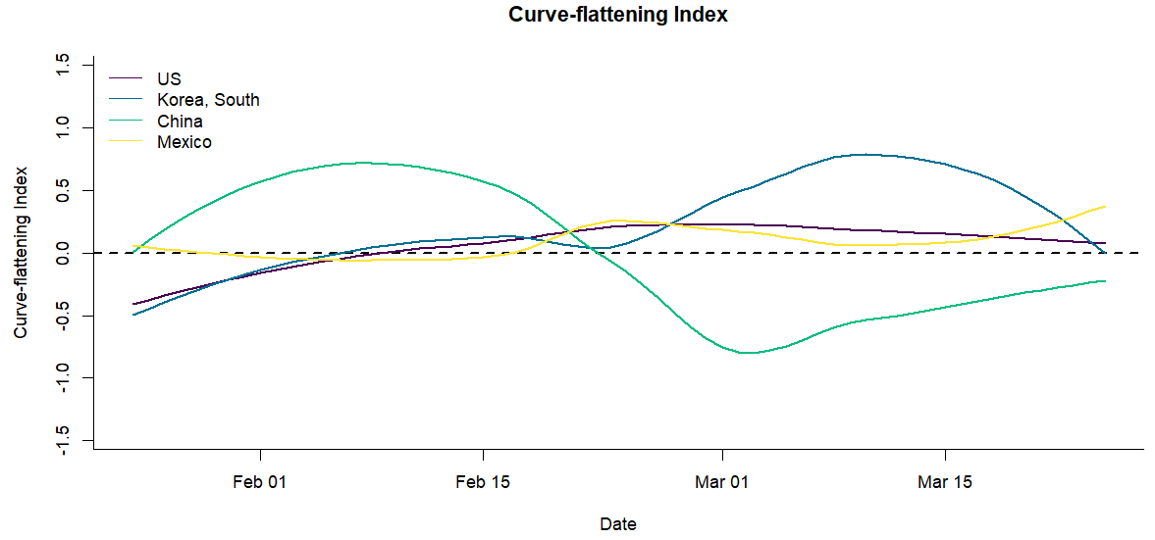
Curve – flattening Index
The goal of each country should be to flatten the pandemic curve. So this is a measure of how well a country is flattening the pandemic curve at any time. Positive values indicate success in flattening.
Notes:
1) Curve-flattening Index: the index is calculated as the change in slope (log total cases vs time) divided by the absolute value of slope (so the change you are achieving at any time is relative to steepness of the slope at that time). Then, the result is multiplied by negative one (positive numbers are good, negative numbers are bad)

Slide 10
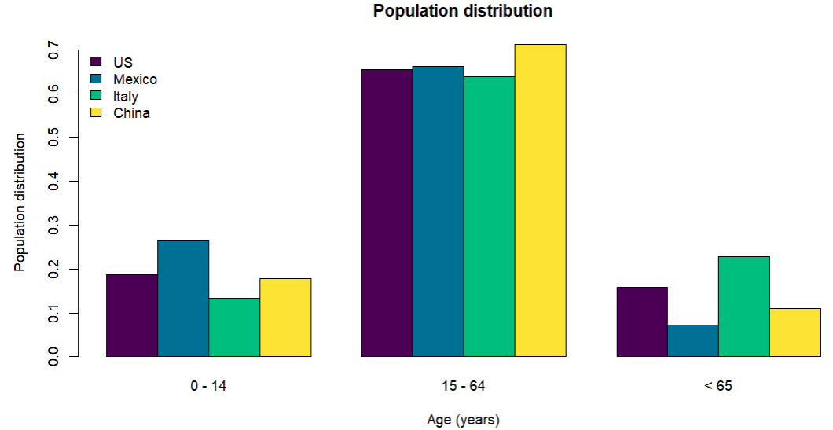
Population Distribution (Age)
In COVID-19 analysis age distribution should be considered since ~60% of hospitalized cases and ~80% of fatal cases are people over 65 years.
The graph below shows that Italy (the most serious case currently) has a high percentage of its population in the vulnerable group. This could explain why Italy has been so affected and what to expect in US and Mexico depending on the population distribution.

Slide 11
Conclusions
Analyzing the different outputs of the tool it’s possible to make the following conclusions:
Given the experience in China and South Korea (only two countries in which the COVID-19 is “controlled”) the time between the actual start (exponential growth) of the contagion and its maximum point is 2 to 3 weeks.
Also after the contagion reaches its maximum it take 3 to 5 weeks to stabilize/control the epidemy.
Following these experiences US and Mexico should be reaching the top of the propagation curve in 1 to 2 weeks (April 3-4 to April 10-11).
The lag in propagation between US and Mexico is approximately 1 week, US forward Mexico.
China reached ~ 80,000 cases in 2 months, while US ~65,000 cases in less than a month of real contagion. This will turn US in the epicenter of the COVID-19.
This should be a warning sign, but not an alert due to the low Fatality Rate of US (~1.4%) and Mexico (~1.2%) compared to the global rate (~3.3%).
The case of US should be analyzed by state in order to have an unbiased picture as the number of cases changes radically from one state to another. (For example New York represent ~47.5% of total cases while California ~4%.)

