Slide 1
Ahmed 2011-2012 fall学期工作总结

Slide 2
Outline
Mobile OS- Android Framework API summarizing
LBS based user location protection research
Lab related Papers reading
GoYallah App

Slide 3
Mobile OS- Android Framework API summarizing
From the beginning of the Project I started to research and understand the Android Framework APIs.
At the end of the semester I wrote a summary document(doc) of main APIs of the Android Version 2.2 (level 8).

Slide 4
LBS based user location protection research
with my Team in 计算机网路体系结构 course，we researched 3 technologies on User location information protection in LBS services :
k- anonymization
3-Dimensional access control matrix model
Using Host Identity Protocol
Conclusion :till now no a general solution approach to completely resolve the issue.

Slide 5
Lab related Papers reading
I was reading some of presented papers in the LAB weekly meeting .
Conclusion:
1.get a general Idea of some specific topics in Routing & network Architecture .
2. Tried to change my reading way ,from only reading to have the knowledge to read to find a problems in those papers.

Slide 6
GoYallah App
Using JAVA HTML parser , I already Parsed around 100,000 POIs (Point of Interests ), POIs are the main database for GoYallah APP.
UI design of the APK( 80%).
Server Side (20%)(hosted in Sina Cloud SinaApp )

Slide 7
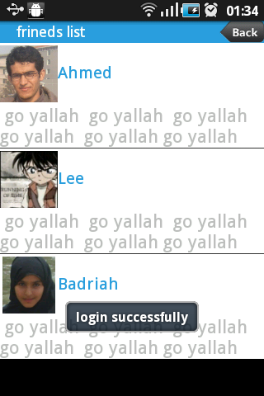
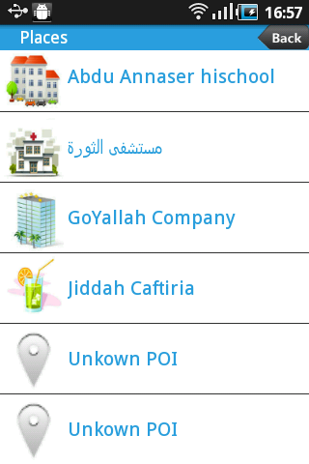
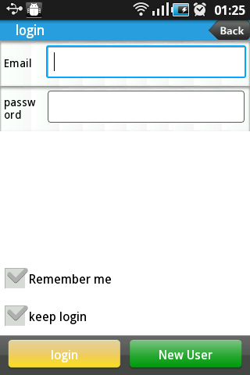
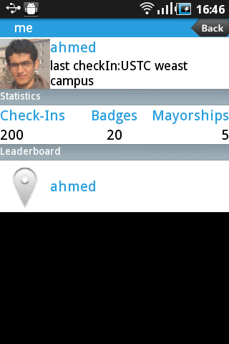
GoYallah screen shortcuts

Slide 8
Thank You 徐老师！
提前祝您 新年快乐！^-^

