Slide 1
Elevator-Assisted Data Collection for High-rise Structures
Dan Wang
Department of Computing,
The Hong Kong Polytechnic University

Slide 2
Sensor Data Delivery
Long-range, single-hop data transmission
Simple, but not efficient
Short-range, hop-by-hop data transmission
Our study: “Traffic-aware relay node deployment for data collection in wireless sensor networks”
Cannot fully balance the load and energy consumption
The intrinsic problem is the long span of the structure
Both one-hop long-range and hop-by-hop short-range data transmission suffers when the scale of the structure expands
We propose to use elevators to assist sensor data collection
The communication range will not increase when the structure expends!

Slide 3
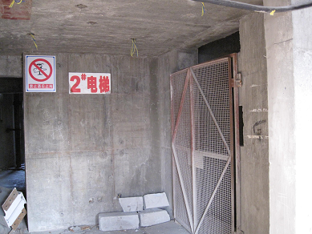
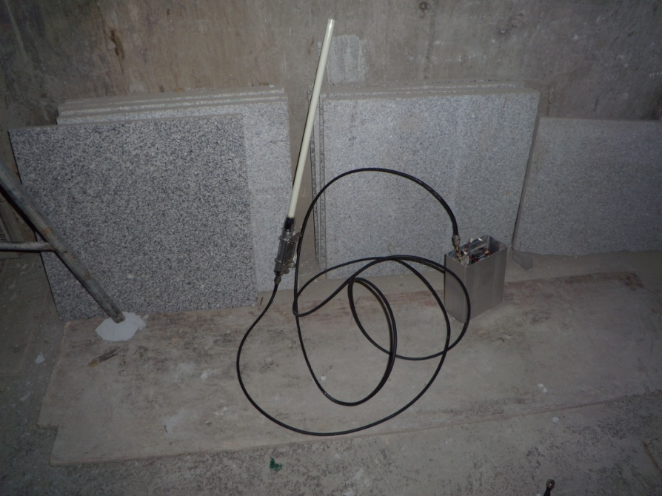
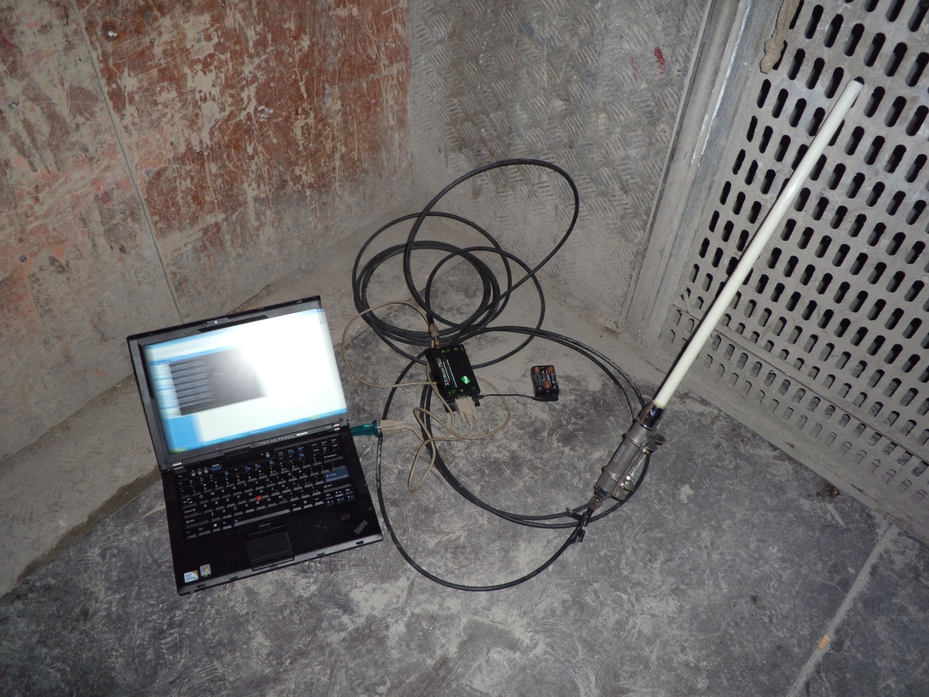
Experiment Verification
The No 2. elevator
Sensor mote
The sink (base station)
Results:
Elevator movement 1.5 m/s
Data transmission rate easily reach 55KB/s or higher
The encountering time is the most important
How to avoid insulation effect of the elevator compartment?

Slide 4
A Formal Look at the Problem
A structure with n floors
One static sensor node on each floor
Nodes on adjacent floors can communicate with each other
One sink node attached to the elevator
Sink could collect data from sensor node on the same floor
Data collection in rounds
Each round each sensor generate α bits of data
Note: each round may be a few hours
Data should be delivered no later than L rounds
Objectives
Collect data on time
Maximizing system lifetime

Slide 5
The Scope of our Study
The elevator is used for carrying passengers: we cannot control the elevator
The elevator may stop at some floors: larger amount of data can be transmitted
The elevator may not go to some floors for a long time
How to schedule the data flow?
A theoretical study from the network flow perspective
We only work on scheduling of data traffic (flows)
Assume MAC layer handles the interference
Assume mechanism for reliable data delivery

Slide 6
Treatment of the Problem
The offline scenario: assume the elevator movement is known in advance
Problem 1: Maximizing throughput (in one round)
Problem 2: Maximizing minimum residual energy (in one round)
Problem 3: The general case
The online scenario
The difficulty
A heuristic algorithm

Slide 7
Problem 1: Maximizing Throughput
A Graph
Vertices
s: a virtual source node
d: sink node
S: Sensor nodes
Edges
Edge Capacity
αi the data generated by node vi
βi the throughput from vi to d
Comment: βi can be calculated by the duration the sink interact with vi × throughput
Observation: Equal to a max-flow problem; optimal solution exists

Slide 8
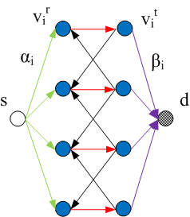
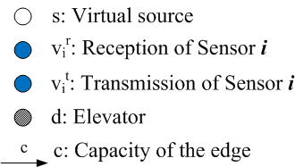
Problem 2: Maximizing Minimal Residual Energy (MMRE)
Split node vi into two virtual nodes
Link capacity
Green: Amount of data to be transmitted
Red: Energy of sensor node
Purple: Throughput to sink
Observation: Transform to a decision problem that can be solved by max-flow augmenting path algorithm; optimal solution exists

Slide 9
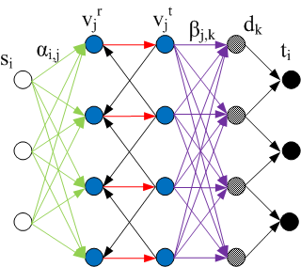
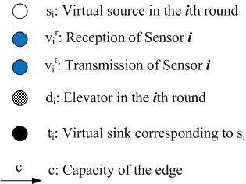
Problem 3: The General Case
Taking L into consideration
Commodity<si,ti,Σα>
Transmission schedule for the data generated in the ith round
Maximizing system lifetime
Maximize the number of commodities
Observation: A multi-commodity flow problem; optimal solution exists

Slide 10
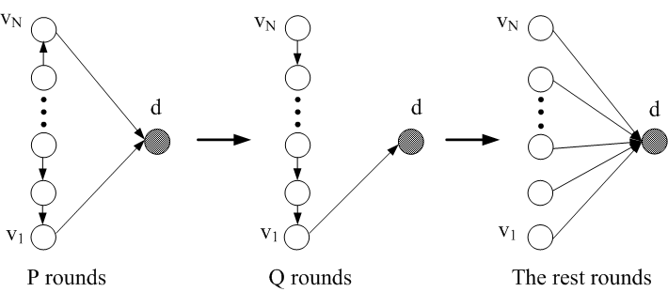
The Online Scenario
Online algorithm is difficult
Theorem: No online algorithm can have a transmission schedule that achieves a constant competitive ratio as opposed to the optimal offline algorithm
Proof (non-trivial): the intuition is online algorithm performs arbitrarily bad if a balanced elevator movement followed by a non-balanced movement followed by a balanced movement

Slide 11
Online Algorithm
Huge gap between offline algorithm and online algorithm
Offline optimal, online arbitrarily bad
Is prediction of elevator movement possible?
No need to predict exact movement
Only aggregate throughput
Algorithm Design Sketch
Assume know future period of T
Dynamic adjustment

Slide 12
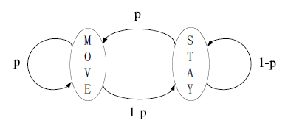
Simulations
The operation of the elevator (Markov Chain)
Move to another floor with probability p
Or stay at the same floor for T_{s} time
Elevator movement model
D&N model
DAY model
Tower model
Office model
Default values
Data rate 2Mb every 2 hours
Data deadline 4 hours
Predictable period 1 hour
p = 10%
Comparison with hop-by-hop routing

Slide 13
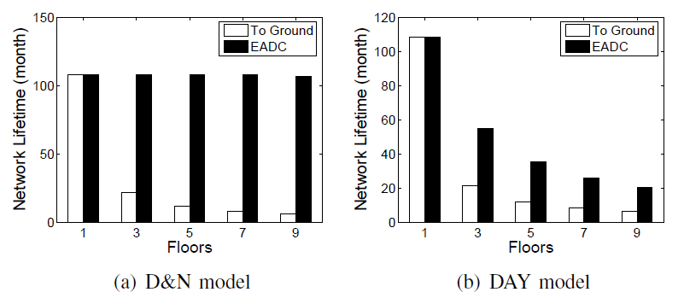
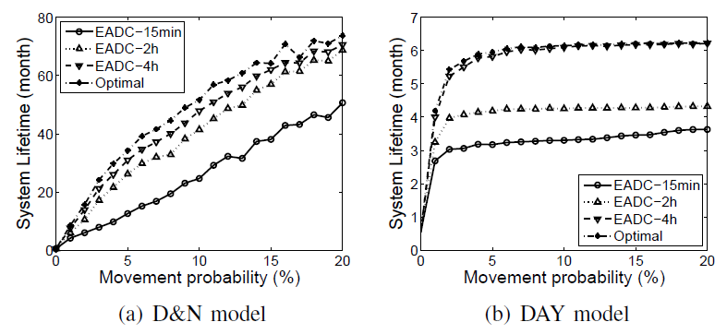
Simulation Results
Much better than hop-by-hop routing
Longer prediction period better performance

Slide 14
Thank you!

