Slide 1

Detecting and Defending Against Third-Party Tracking on the Web
Franziska Roesner, Tadayoshi Kohno, David Wetherall
April 26, 2012
NSDI

Slide 2







Third-Party Web Tracking
Advertise.com
Tracker.com
Bigger browsing profiles
= increased value for trackers
= reduced privacy for users
(Hypothetical tracking relationships only.)
April 26, 2012
Franziska Roesner

Slide 3
Tracking is Complicated
Much discussion of tracking, but limited understanding of how it actually works.
Our goals:
Understand the tracking ecosystem.
How is tracking actually done in the wild?
What kinds of browsing profiles do trackers compile?
How effective are defenses available to users?
Address gaps with new defense (ShareMeNot).
April 26, 2012
Franziska Roesner

Slide 4
Outline
How Tracking Works
Tracking Mechanisms
Tracking Taxonomy
Measurements
Defenses
April 26, 2012
Franziska Roesner

Slide 5
Mechanisms Required By Trackers
Ability to store user identity in the browser
Browser cookies
HTML5 LocalStorage and Flash cookies (LSOs)
Not considering more exotic storage mechanisms or approximate fingerprinting
Ability to communicate visited page and user identity back to tracker
Identity: Cookies attached to requests
Visited page: HTTP referrers
Both: scripts that embed information in URLs
April 26, 2012
Franziska Roesner

Slide 6
Tracking: The Simple Version
Within-Site:
Cross-Site:
First-party cookies are used to track repeat visits to a site.
Third-party cookies are used by trackers included in other sites to create profiles.
tracker.com
http://site1.com
http://site2.com
cookie: id=789
<iframe src=tracker.com/ad.html>
</iframe>
processing engine
Cookie Database
9:30am: user 789 visited site1.com
ad
cookie: id=789
tracker.com: id=789
9:31am: user 789 visited site2.com
logs
April 26, 2012
Franziska Roesner

Slide 7
Our Tracking Taxonomy
Name | Scope | User Visits Directly? | Overview
N/A | Within-Site | Yes | Site does its own on-site analytics.
Analytics | Within-Site | No | Site uses third-party analytics engine (e.g., Google Analytics).
Vanilla | Cross-Site | No | Site embeds third-party tracker that uses third-party storage (e.g., Doubleclick).
Forced | Cross-Site | Yes (forced) | Site embeds third-party tracker that forced the user to visit directly (e.g., via popup).
Referred | Cross-Site | No | Tracker relies on another cross-site tracker to leak unique identifier values.
Personal | Cross-Site | Yes | Site embeds third-party tracker that the user otherwise visits directly (e.g., Facebook).
Evolution: Embedding analytics libraries
Evolution: Third-party cookie blocking
April 26, 2012
Franziska Roesner

Slide 8
Quirks of Third-Party Cookie Blocking
Option blocks the setting of third-party cookies: all browsers
Option blocks the sending of third-party cookies: only Firefox
Result: Once a third-party cookie is somehow set, it can be used (in most browsers).
April 26, 2012
Franziska Roesner
8

Slide 9
Forced Tracking
http://site1.com
tracker.com
<iframe src=tracker.com/ad.html>
</iframe>
processing engine
High-level point:
On most browsers, if a tracker can ever set a cookie, third-party cookie blocking is rendered ineffective.
Cookie Database
ad
popup
tracker.com: id=321
cookie: id=321
http://site2.com
logs
<iframe src=tracker.com/ad.html>
</iframe>
1:30pm:
site1.com: user 321
ad
1:31pm:
site2.com: user 321
April 26, 2012
Franziska Roesner

Slide 10
Our Tracking Taxonomy
Type (Name) | Scope | User Visits Directly? | Overview
N/A | Within-Site | Yes | Site does its own on-site analytics.
Analytics | Within-Site | No | Site uses third-party analytics engine (e.g., Google Analytics).
Vanilla | Cross-Site | No | Site embeds third-party tracker that uses third-party storage (e.g., Doubleclick).
Forced | Cross-Site | Yes (forced) | Site embeds third-party tracker that forced the user to visit directly (e.g., via popup).
Referred | Cross-Site | No | Tracker relies on another cross-site tracker to leak unique identifier values.
Personal | Cross-Site | Yes | Site embeds third-party tracker that the user otherwise visits directly (e.g., Facebook).
Evolution: Embedding analytics libraries
Evolution: Third-party cookie blocking
Evolution: Complex ad networks
April 26, 2012
Franziska Roesner

Slide 11
Referred Tracking
http://site1.com
tracker.com
<iframe src=tracker.com/ad.html>
</iframe>
processing engine
High-level point:
One tracker with client-side state can enable tracking by partners without client-side state.
Cookie Database
ad
tracker.com: id=522
othertracker.com/track?id=522&referrer=site1.com
http://site2.com
othertracker.com
<iframe src=tracker.com/ad.html>
</iframe>
processing engine
logs
2:34pm:
site1.com: user 522
ad
2:35pm:
site2.com: user 522
othertracker.com/track?id=522&referrer=site2.com
April 26, 2012
Franziska Roesner

Slide 12
Our Tracking Taxonomy
Type (Name) | Scope | User Visits Directly? | Overview
N/A | Within-Site | Yes | Site does its own on-site analytics.
Analytics | Within-Site | No | Site uses third-party analytics engine (e.g., Google Analytics).
Vanilla | Cross-Site | No | Site embeds third-party tracker that uses third-party storage (e.g., Doubleclick).
Forced | Cross-Site | Yes (forced) | Site embeds third-party tracker that forced the user to visit directly (e.g., via popup).
Referred | Cross-Site | No | Tracker relies on another cross-site tracker to leak unique identifier values.
Personal | Cross-Site | Yes | Site embeds third-party tracker that the user otherwise visits directly (e.g., Facebook).
Evolution: Embedding analytics libraries
Evolution: Third-party cookie blocking
Evolution: Complex ad networks
Evolution: Social networks
April 26, 2012
Franziska Roesner

Slide 13

Personal Tracking
Just loading these buttons (not clicking on them) enables tracking.
Users visit these sites directly.
This tracking is often not anonymous (linked to accounts).
April 26, 2012
Franziska Roesner
13

Slide 14
Our Tracking Taxonomy
Type (Name) | Scope | User Visits Directly? | Overview
N/A | Within-Site | Yes | Site does its own on-site analytics.
Analytics | Within-Site | No | Site uses third-party analytics engine (e.g., Google Analytics).
Vanilla | Cross-Site | No | Site embeds third-party tracker that uses third-party storage (e.g., Doubleclick).
Forced | Cross-Site | Yes (forced) | Site embeds third-party tracker that forced the user to visit directly (e.g., via popup).
Referred | Cross-Site | No | Tracker relies on another cross-site tracker to leak unique identifier values.
Personal | Cross-Site | Yes | Site embeds third-party tracker that the user otherwise visits directly (e.g., Facebook).
Evolution: Embedding analytics libraries
Evolution: Third-party cookie blocking
Anonymous
Evolution: Complex ad networks
Evolution: Social networks
April 26, 2012
Franziska Roesner

Slide 15
Outline
How Tracking Works
Tracking mechanisms
Tracking taxonomy
Measurements
Defenses
April 26, 2012
Franziska Roesner

Slide 16
Measurement Tool: TrackingTracker
Firefox add-on
Based on taxonomy of client-side mechanisms
Crawls the web, automatically categorizing trackers
Monitors:
Third-party requests
Cookies, HTML5 LocalStorage, Flash LSOs
(considers state that changes across clean measurement runs)
Identifier leaks
April 26, 2012
Franziska Roesner

Slide 17
Measurement Study
3 data sets
Alexa Top 500
5 pages per domain: main page and up to 4 links
Alexa Non-Top 500
Sites ranked #501, #601, #701, etc.
5 pages per domain: main page and up to 4 links
AOL search logs
300 unique queries for 35 random users
April 26, 2012
Franziska Roesner

Slide 18
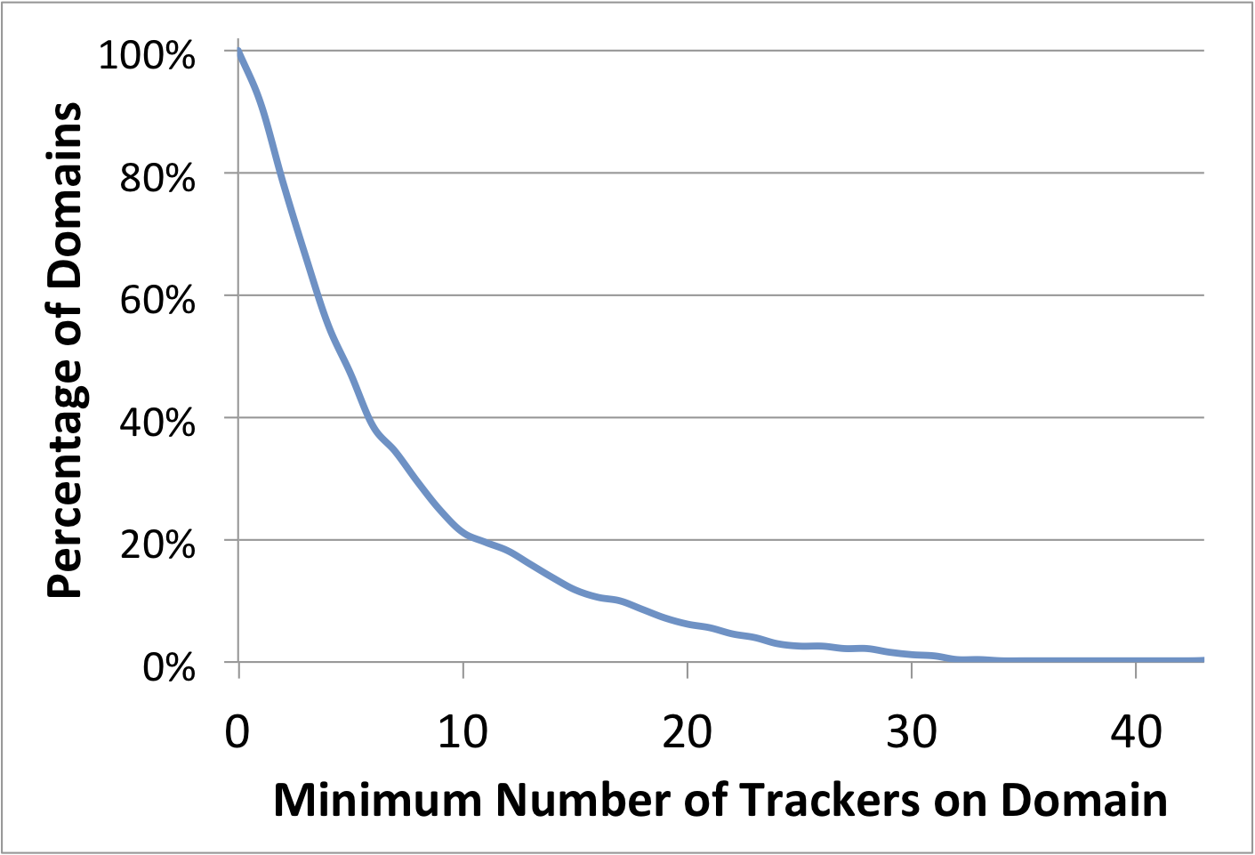
Tracking Prevalence (Top 500)
524 unique trackers on 500 domains
457 domains (91%) embed at least one tracker.
(97% of those include at least one cross-site tracker.)
50% of domains embed between 4 and 5 trackers.
One domain includes
43 trackers.
April 26, 2012
Franziska Roesner

Slide 19
April 26, 2012
Franziska Roesner

Slide 20
Doubleclick:
Avg 39% (Max 66%)
Each line represents one user.
Facebook:
Avg 23% (Max 45%)
Google:
Avg 21% (Max 61%)
April 26, 2012
Franziska Roesner

Slide 21
LocalStorage and Flash Cookies
Surprisingly little use of these mechanisms!
Of 524 trackers on Alexa Top 500:
Only 5 set unique identifiers in LocalStorage
35 set unique identifiers in Flash cookies
Respawning:
LS → Cookie: 1 case; Cookie → LS: 3 cases
Flash→ Cookie: 6 cases; Cookie → Flash: 7 cases
April 26, 2012
Franziska Roesner

Slide 22
Outline
How Tracking Works
Tracking mechanisms
Tracking taxonomy
Measurements
Defenses
April 26, 2012
Franziska Roesner

Slide 23
Defenses to Reduce Tracking
We explore several in the paper:
Third-party cookie blocking
Do Not Track header
Popup blocking
Clearing client-side state
Disabling JavaScript
Private browsing mode
April 26, 2012
Franziska Roesner
23

Slide 24
(no cookie blocking)
Referred Tracker
Forced Tracker
April 26, 2012
Franziska Roesner

Slide 25
Personal Tracking Revisited
Most popular, based on measurements:
Facebook, Google, Twitter, AddThis, YouTube, LinkedIn, Digg, Stumbleupon
Third-party cookie blocking is ineffective.
Existing browser extension solutions remove the buttons (undesirable to some users).
Can we reduce tracking but allow use?
April 26, 2012
Franziska Roesner

Slide 26

ShareMeNot
http://sharemenot.cs.washington.edu
A browser extension that protects against tracking from third-party social media buttons while still allowing them to be used.
Firefox version: removes cookies from relevant requests until user clicks button.
Similar: Priv3 Firefox add-on
Chrome version: replace buttons with local stand-in button until user click.
NEW
April 26, 2012
Franziska Roesner

Slide 27
Effectiveness of ShareMeNot (Top 500)
Tracker | Without ShareMeNot | With ShareMeNot
Facebook | 154 | 9
Google | 149 | 15
Twitter | 93 | 0
AddThis | 34 | 0
YouTube | 30 | 0
LinkedIn | 22 | 0
Digg | 8 | 0
Stumbleupon | 6 | 0
April 26, 2012
Franziska Roesner

Slide 28
Summary
Introduced taxonomy of tracking behavior for any client-side identifiers.
Analytics, Vanilla, Forced, Referred, Personal
Studied tracking in the wild with browser measurements.
Revealed rich tracking ecosystem.
Results can assist informed broader discussions.
Developed ShareMeNot, a new privacy-enhancing defense for personal tracking.
http://sharemenot.cs.washington.edu/
April 26, 2012
Franziska Roesner

