Slide 1
Team 9 Project for Natural Language Processing
Project:
Sentiment Analysis on Yelp Database
Members:
Diwash Dhungana, Dom Argento,
Sabrina Salazar, Sahardeed Ahmed

Slide 2
Topic
The main goal is to better understand overall sentiment of a given business in Yelp’s dataset.
This will be involving the understanding of a customers experience with a company
Identify specific aspects of business (e.g., price, features, performance) mentioned in reviews and analyze sentiment towards the respective establishment.

Slide 3
Problem Statement/Hypothesis
Involvement:
Yelp reviews impacting a business the business reputation
Decreasing the overall attraction for their product
How a business can increase revenue and improve their profit margins

Slide 4
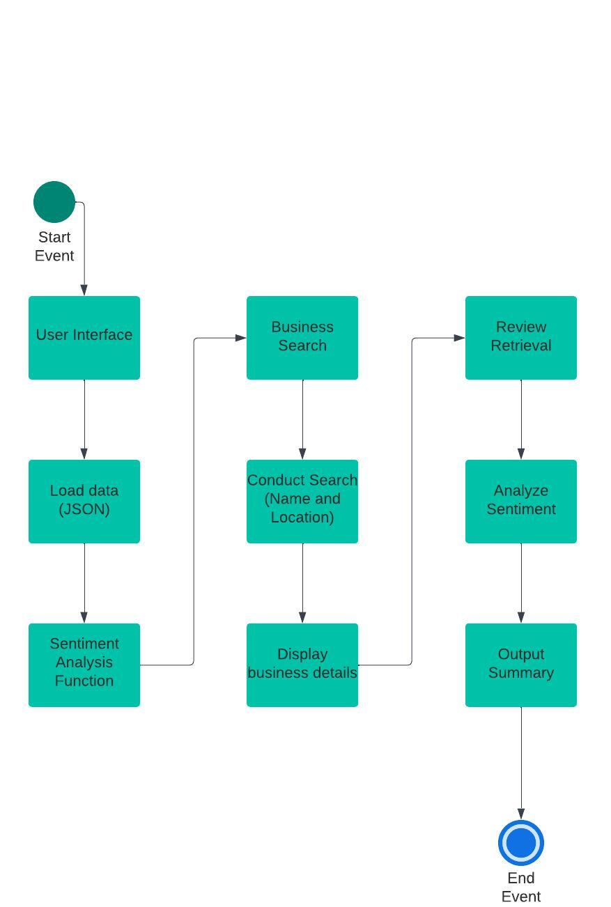
Architecture Diagram

Slide 5
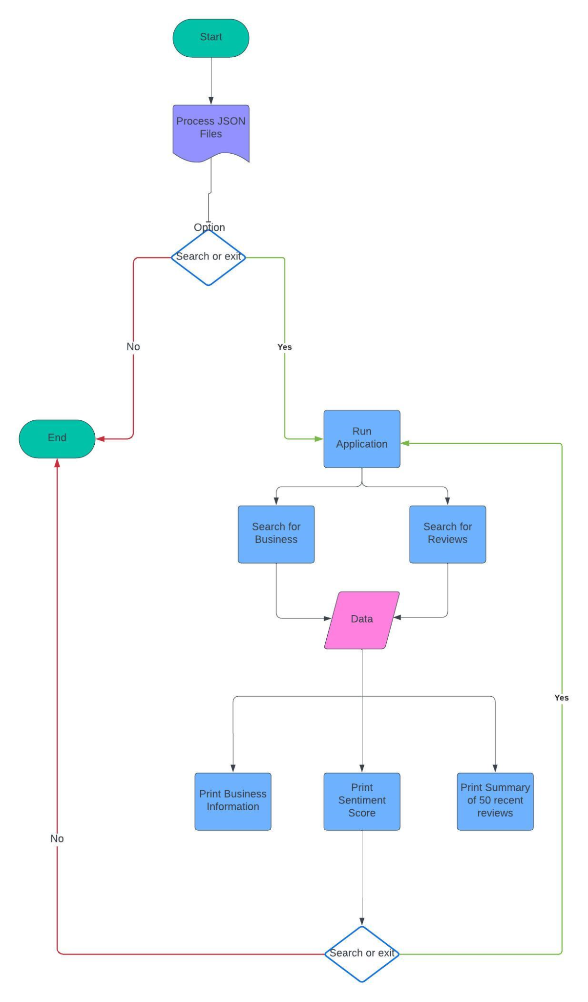
Workflow Diagram

Slide 6
DataSet
The dataset utilized was two files within Yelp’s open source dataset: https://www.yelp.com/dataset/download
The files are named:
yelp_academic_dataset_review
&
yelp_academic_dataset_business

Slide 7
Data Analysis
Our data Analysis consisted of obtaining our raw dataset, and breaking it down to see how to efficiently utilize it.
We realized we needed to analyze the data but in separate ways:
Utilize sentiment analysis to find a score for businesses based on reviews.
Utilize sentiment analysis in 50 most recent reviews to make relevant summary.
Utilize Histogram to visualize review distributions based on number rating.

Slide 8
Implementation
We utilized several techniques and libraries, primarily focused on data handling, text processing, and sentiment analysis:
JSON Parsing: json
Text File Handling: open
Regular Expressions: re
Data Structures: collections.Counter, heapq.nlargest
Natural Language Processing (NLP): nltk.sentiment.vader
List Comprehensions and Lambda Functions
Exception Handling

Slide 9
PseudoCode
Enter Application
Display main menu options
Prompt "Search for a Business" and “Exit”
Take in user choice
If user chooses “Exit”: exit application
If user chooses "Search for a Business":
Prompt user for business name & zip code
Search dataset for businesses matching the name/zip code
If no businesses found: Notify user
If businesses found: Display list of found businesses
Prompt user to select a business or cancel
If user selects a business:
Display details for the selected business
Display sentiment score and summary
Else if user cancels: Main Menu

Slide 10
Results
Assuming the user has read the READ.ME and has downloaded VADER and the required dataset from Yelp:
The user will be prompted for business and location (zip code)
User is shown matches and must choose one of listed businesses
If selection is valid, application returns all business information and an overall sentiment score (with breakdown) for business
A comprehensive summary it made out of the 50 most recent reviews and provided to user.

Slide 11
Project Management
Dominic Argento: Team Lead, data parsing, score function, summary function, powerpoint.
Sabrina Salazar: Powerpoint, rating system, pseudo code
Sahardeed Ahmed: Data visualization, pre-processing & cleaning, testing, ipynb organization

Slide 12
References
Data Analysis and NLP Model on YELP Dataset Machine Learning Python: https://youtu.be/N97OdfmiqZ0?si=7NRK9KYjGnDBDKB7
ANALYSIS OF YELP DATA SET: https://youtu.be/9r73yD1_oyo?si=Yv9HV9zH-AFr4YXi
Python Sentiment Analysis Project with NLTK and Transformers: https://youtu.be/QpzMWQvxXWk?si=_32L6eLbjlZllRFa

