Slide 1
Dominic Pescasio
My Year In Review(Tri-Tech)

Slide 2
About Me
I'm 17
I'm the middle child of 3
I like playing video games and music
I mainly play fps games

Slide 3
Successes
How to use C# scripts
How to use Blender
How to use Unity

Slide 4
Challenges
Getting used to Blender and UV editing
Trying to remember what I've learn through out the year
Time Management
Working together in groups
Organization with Trello Boards

Slide 5
Personal Satisfaction
How well I can make object in blender
More confident .
How to use GitHub
How to use Unity
Learn C# script

Slide 6
Career Plans
Finish Highschool
Get into College

Slide 7
Tri-Tech
Advantages/Disadvantages
Advantages
Disadvantages
Being able to work for a long period of time
Easy to get help
Tri-Tech schedule messes with my home school schedule

Slide 8
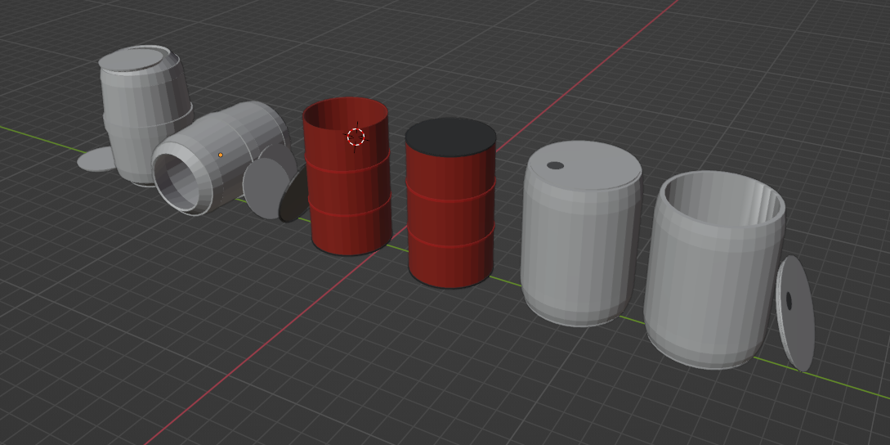
Work Examples

Slide 9
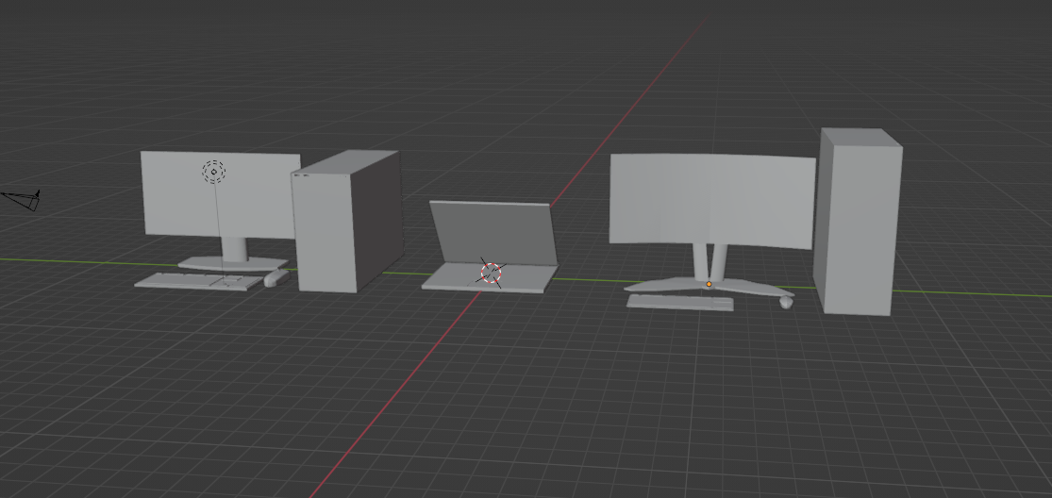
Work Examples

Slide 10

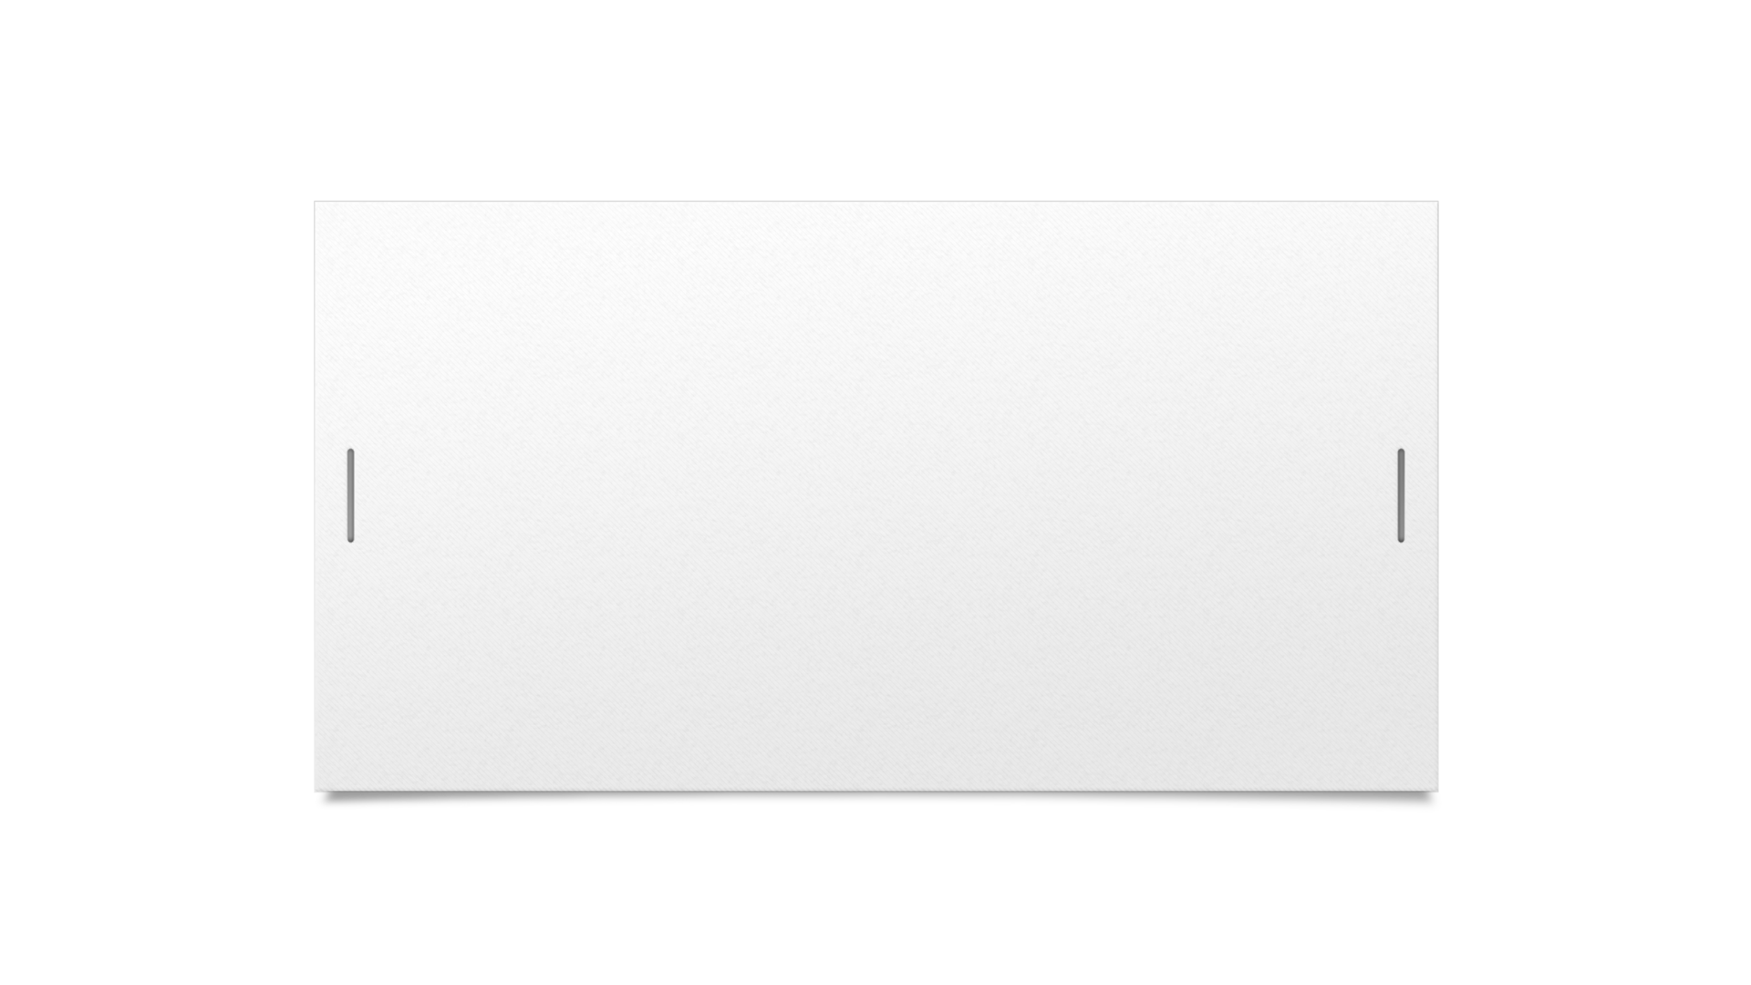

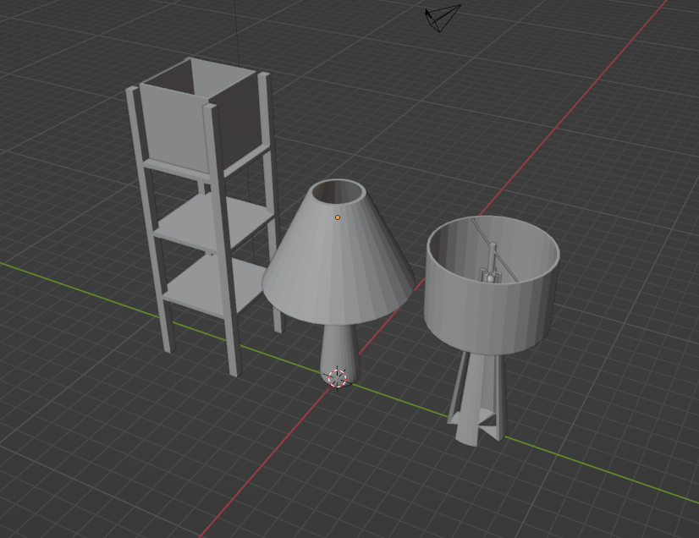


Work Examples

Slide 11
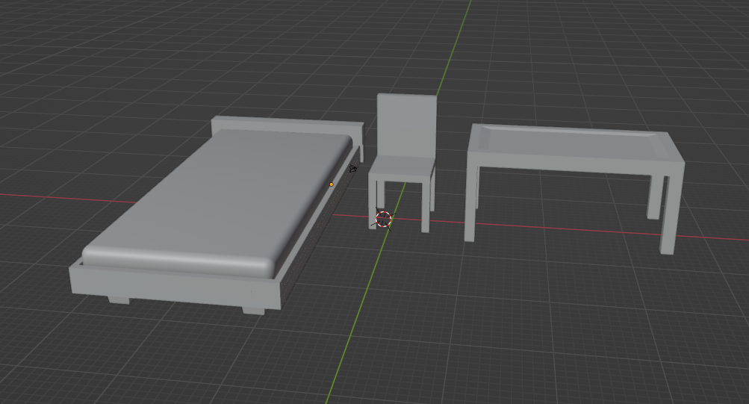
Work Examples

Slide 12
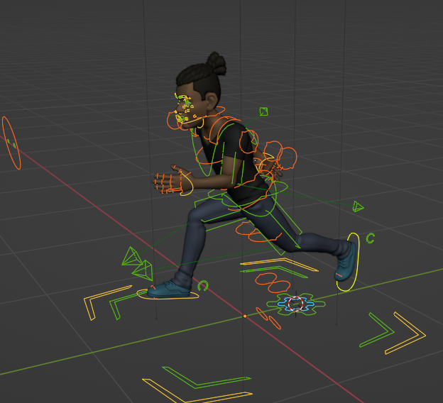
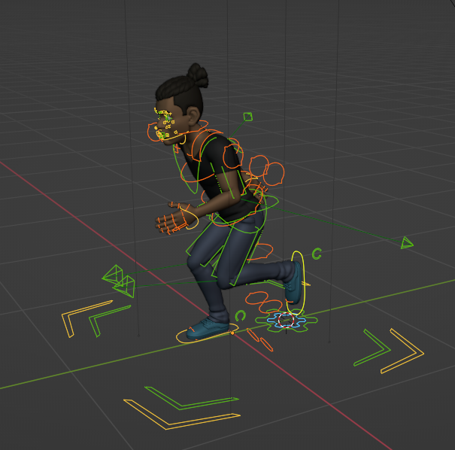
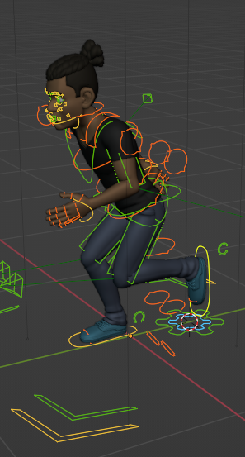
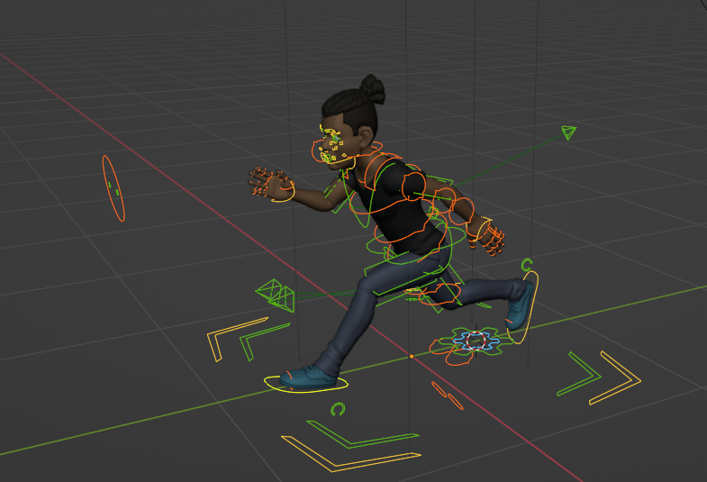
Work Examples

