Slide 1

Final Project
Kick Off !
Designed by Showeet.com
Notes:
© Copyright Showeet.com

Slide 2
Project
Planning
Notes:
© Copyright Showeet.com

Slide 3
Project Description
What’s the purpose of your app?
What problem does your app solves?
Who is your target audience?
Type of user
Geography
Age
You should be able to describe you app in a sentence or a short paragraph.
Ex:
Create the travel of your life!
Allows adventurous travelers to organize and participate in group travels all over the world, uncover amazing places and share their discoveries with the world.
Notes:
© Copyright Showeet.com

Slide 4
Defining an MVP (Minimum Viable Product)
A minimum viable product has just those core features sufficient to deploy the product, and no more
Get the product to early customers as soon as possible
Test the product before investing more
Base future development on feedback from users
For the bootcamp:
Develop the core features to showcase the app to potential employers.

Slide 5
Defining an MVP (Minimum Viable Product)
List of core features
List of additional features
Requirements (ex. Does it need to be responsive?)

Slide 6
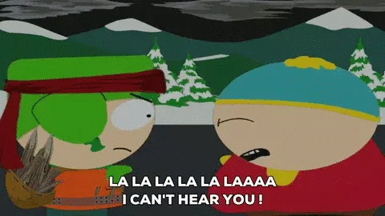
User Stories
Assuming you know what’s best and ignoring the user
Doing exactly what the user ask
Design your app by focusing on users’ needs!
Notes:
© Copyright Showeet.com

Slide 7
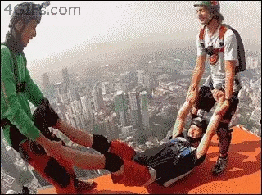
User Stories
User should be able to add an event to the group trip calendar
As a user I want to add an event to the group calendar because I want to invite my fellow travelers to do something cool together such visiting a sight worth seeing or participate in an activity.
Notes:
© Copyright Showeet.com

Slide 8
User Stories
Title:
User should be able to add an event to the group trip calendar
User Story:
As a user I want to add a event to the group calendar because I want to invite my fellow travelers to do something interesting together such visiting a sight worth seeing or participate in an activity.
User should… in the title
As a user, I want to (goals, desire) because (benefit)
Additional reading:
A framework for modern User Stories
https://medium.com/@jonatisokon/a-framework-for-user-stories-bc3dc323eca9
Notes:
© Copyright Showeet.com

Slide 9

User Stories
Who is the user?
Create a user persona
Demographics
27 years old
Single
Earns 85k a year
Goals
Build a stong portfolio
Get involved in a large project
Acquire more skills
Behaviors & Beliefs
Obsessive about code refactoring
Very details oriented
Wants to be involved in the development process
Attributes
Tech Savviness: 5
Education: 4
Ambition: 5
Experience: 3
Notes:
© Copyright Showeet.com

Slide 10
Wireframes
A Wireframe is a simplified visual representation of the user interface
Based on the user flow from the user stories
Paper, white board => more flexibility
Design with an app: easier the get back to, share, and modify
Use what is simple. Don’t spend time on complicated software.
(draw.io, mockflow, balsamiq)
Do a wireframe for each page of your app

Slide 11
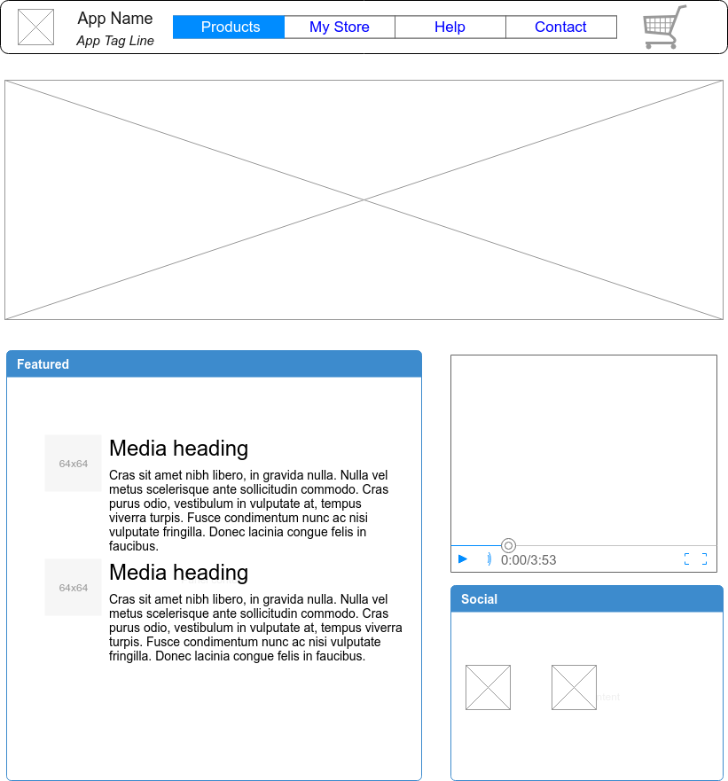
Wireframes

Slide 12
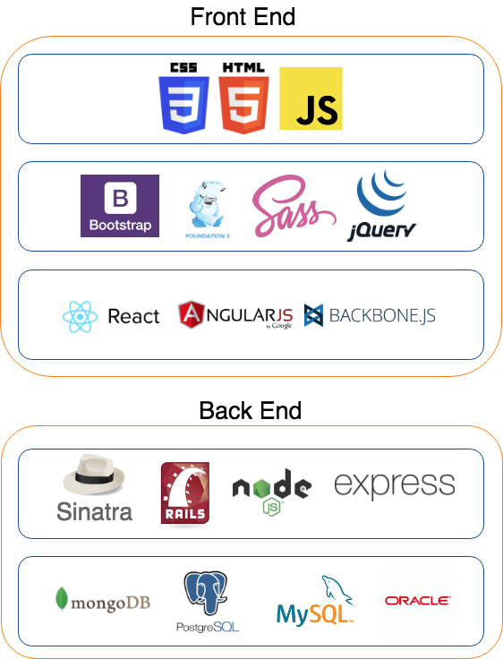
Technology Stack
Choosing Your Front-End
UI Framework
BootStrap, Foundation, Material UI, Sementic UI
Responsiveness?
Sass, JQuery?
Front-End Framework
React, Angular, VueJS, Meteor
Choosing Your Back-End
Rails, Express, Sails
Choosing Your Database
SQLite, Postgresql, Mongodb

Slide 13
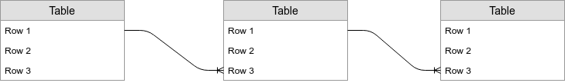
ERD
What data does your app need?
Use a software (draw.io, lucidChart, etc)

Slide 14
Project
Workflow
Project Planning Document in Compass
Notes:
© Copyright Showeet.com

Slide 15


Project Milestones
Create list of project milestones
Be specific
Have deadlines
Example:
Dayboard
Have the project setup by Thursday 11 am:
Create the initial migrations and seed file for the database based on the ERD
Create the back-end setup with express and knex
Create the front-end setup with react

Slide 16
Distribute Work
Distribute work by feature?
Preference for front-end, back-end?
Some pair coding?
Keep in mind:
Work should be equally divided
You might want to consider having everything setup before dividing the work
Help one another

Slide 17
How to Work
Agree on:
Coding Style to ensure consistency (prettier, eslint)
GIT Worflow
Never code on master!
Feature workflow
How to merge
Do not merge the day of the demo!

Slide 18
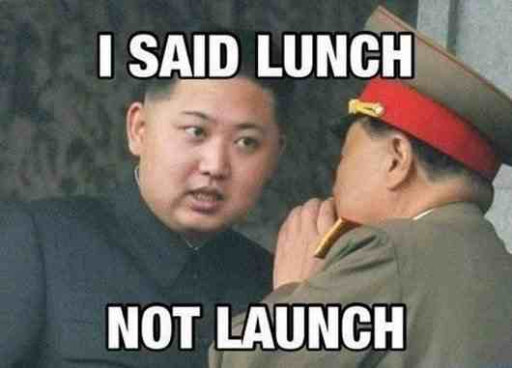
Communication
Communication skills are as important as technical skills

Slide 19
Daily Stand-Ups
In front of the stand up master, each team member will disclose:
What has been accomplished
What they will be working on
What hurdles they are facing
Improve communication and better follow-ups

Slide 20
Development
Notes:
© Copyright Showeet.com

Slide 21
Project Setup
Scaffolding
Use an existing boilerplate
Use a generator
Front-End & Back-End Scaffolding
Build static page at first?
Make CSS work
Think about migrations, seeds, validations

Slide 22
Routing
Front-end and Back-end routing
Design your routes according to REST
API on the back-end?
/api/v1/
Test your API with Curl or Postman

Slide 23
Deployment
Have a working version ready on localhost
Decide on what computer you will demo the app
Have a backup computer ready
Deploy Heroku
Make sure you have the time
Work on a separate branch

Slide 24
Things to keep in mind
If you try something new, focus on just one new thing. Think about documentation and support.
Diminish uncertainties: test your setup, the DB, migrations, seeds, AJAX calls, test external APIs, etc.
Async can be tricky!
Use helper functions
Don’t wait too long before integrating your features

Slide 25
Things to keep in mind
Login for SPAs might need to be implemented differently: JWT, oauth
Focus on the important features. Don't spend a lot of time on features that are not super important (ex. Login)
Think about the user experience. Have a good UI.
Have a good team spirit and keep it fun!

Slide 26
Questions ?

Slide 27

Let’s do this!

