Slide 1
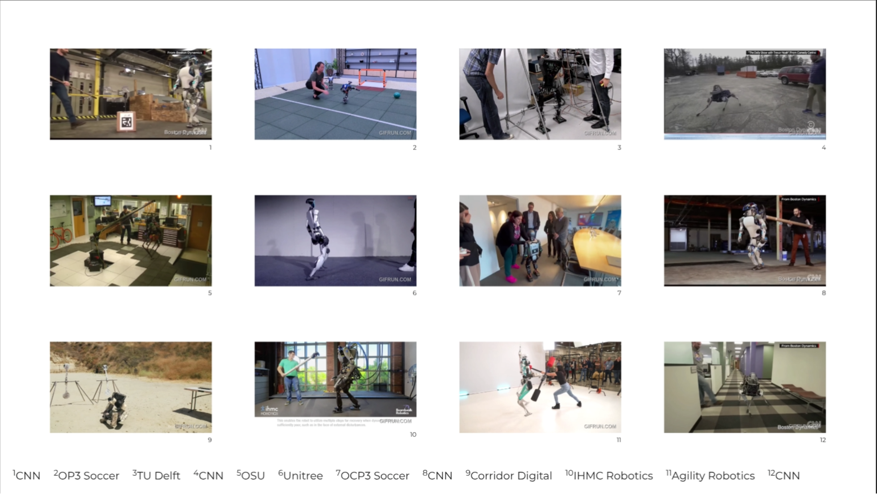
Notes:
Sources: https://www.youtube.com/watch?v=0VgxAnZKM14 CNN https://www.youtube.com/watch?v=7b53L10RaIE (OSU) Atrias https://www.youtube.com/watch?v=LfcZ_EdTtGw G1 (unitree) https://www.reddit.com/r/oddlyterrifying/comments/1j6h9q9/how_quickly_this_robot_gets_up_after_being_pushed/ reddit https://www.youtube.com/watch?v=KSvLcr5HtNc OP3 Soccer https://www.youtube.com/watch?v=y3RIHnK0_NE&t=101s Bosstown Dynamics (Corridor Digital) https://www.youtube.com/watch?v=aM-qb1yd5mU nadia (IHMC Robotics) https://www.youtube.com/watch?v=2amzGvk97GE Agility Robotics https://www.youtube.com/watch?v=w97H0eEKYvY TU Delft

Slide 2
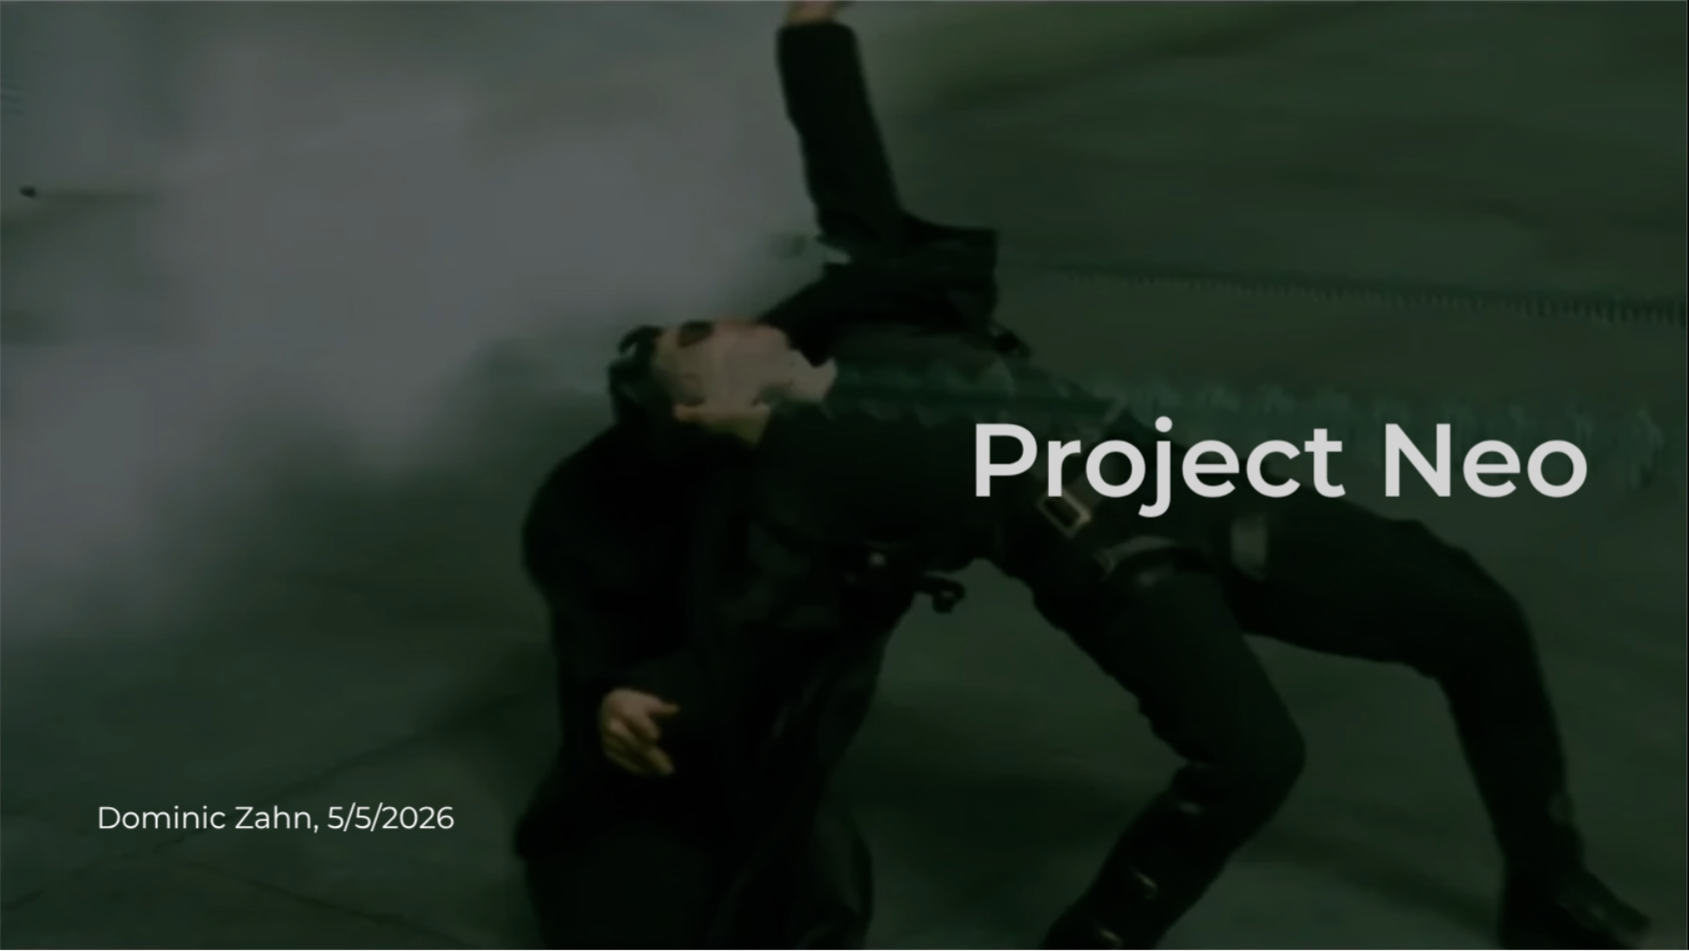
Notes:
<span style="color: white">No bullet-time for **H**e**1**nz</span>

Slide 3


Slide 4


Slide 5
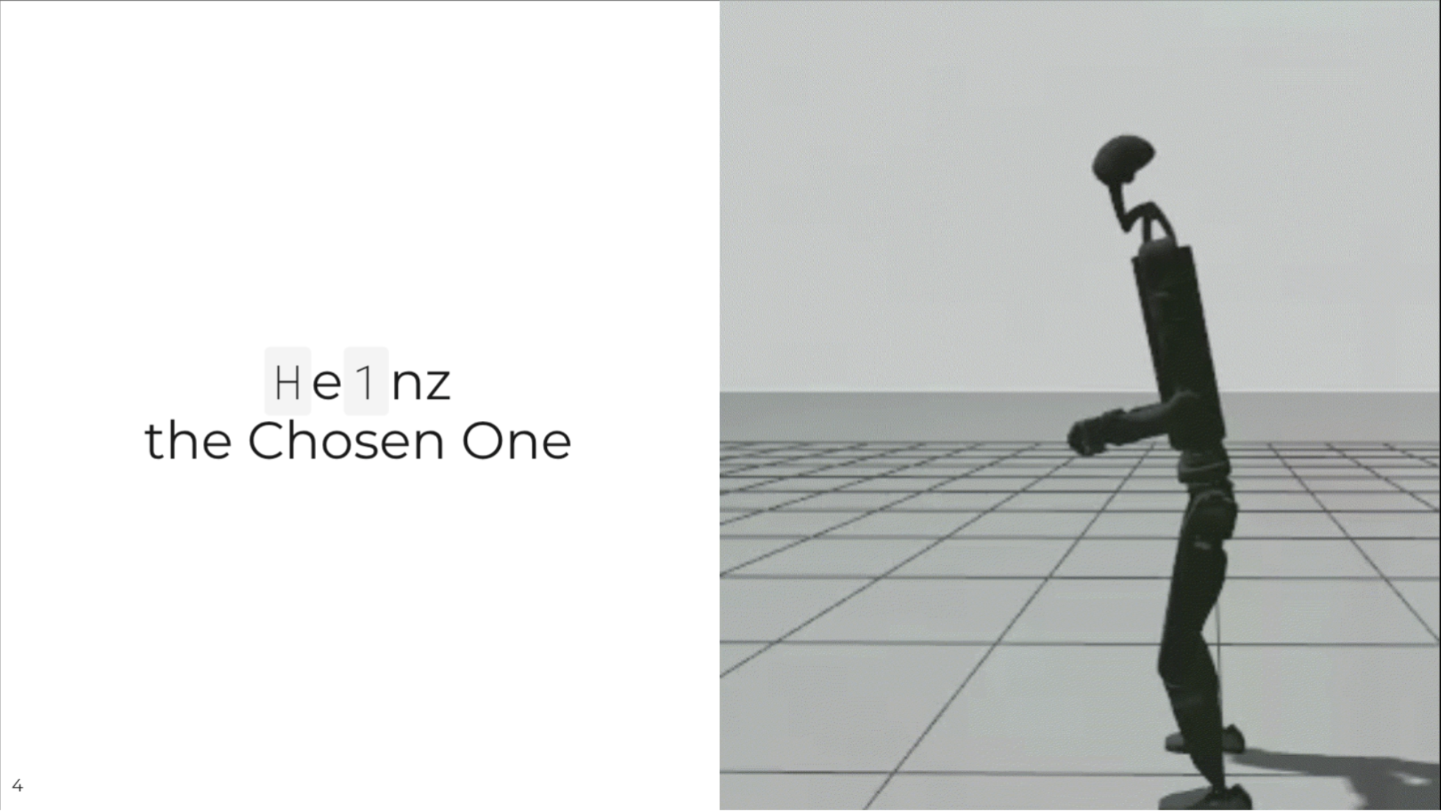
Notes:
APPENDIX

Slide 6
