Slide 1
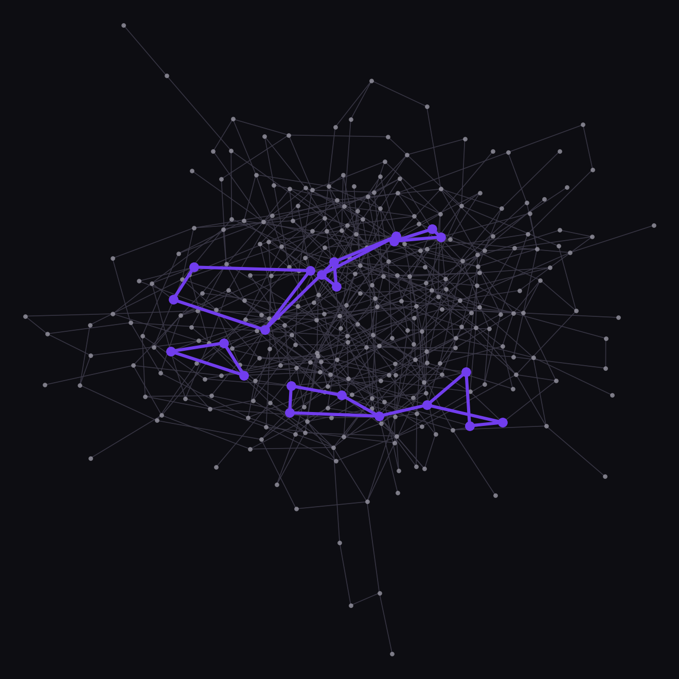

Dominican Express
A bank built inside SurrealDB
Jorge Pérez
Xabier Ariznabarreta
Javier Pérez
Advanced Databases, UFV
2,827 transfers, 22 accounts in rings
01
Notes:
JORGE. Good morning. We are Jorge, Xabier and Javier, and this is Dominican Express:
a digital bank. The deliverable of this course is the database, and in our project the
database is not just storage: the whole backend, from payments to fraud detection,
lives inside it. On the right, real data from our test bank: 2,827 transfers between
300 customers over 60 days. The violet ones are the 22 accounts the database itself
found moving money in rings.

Slide 2
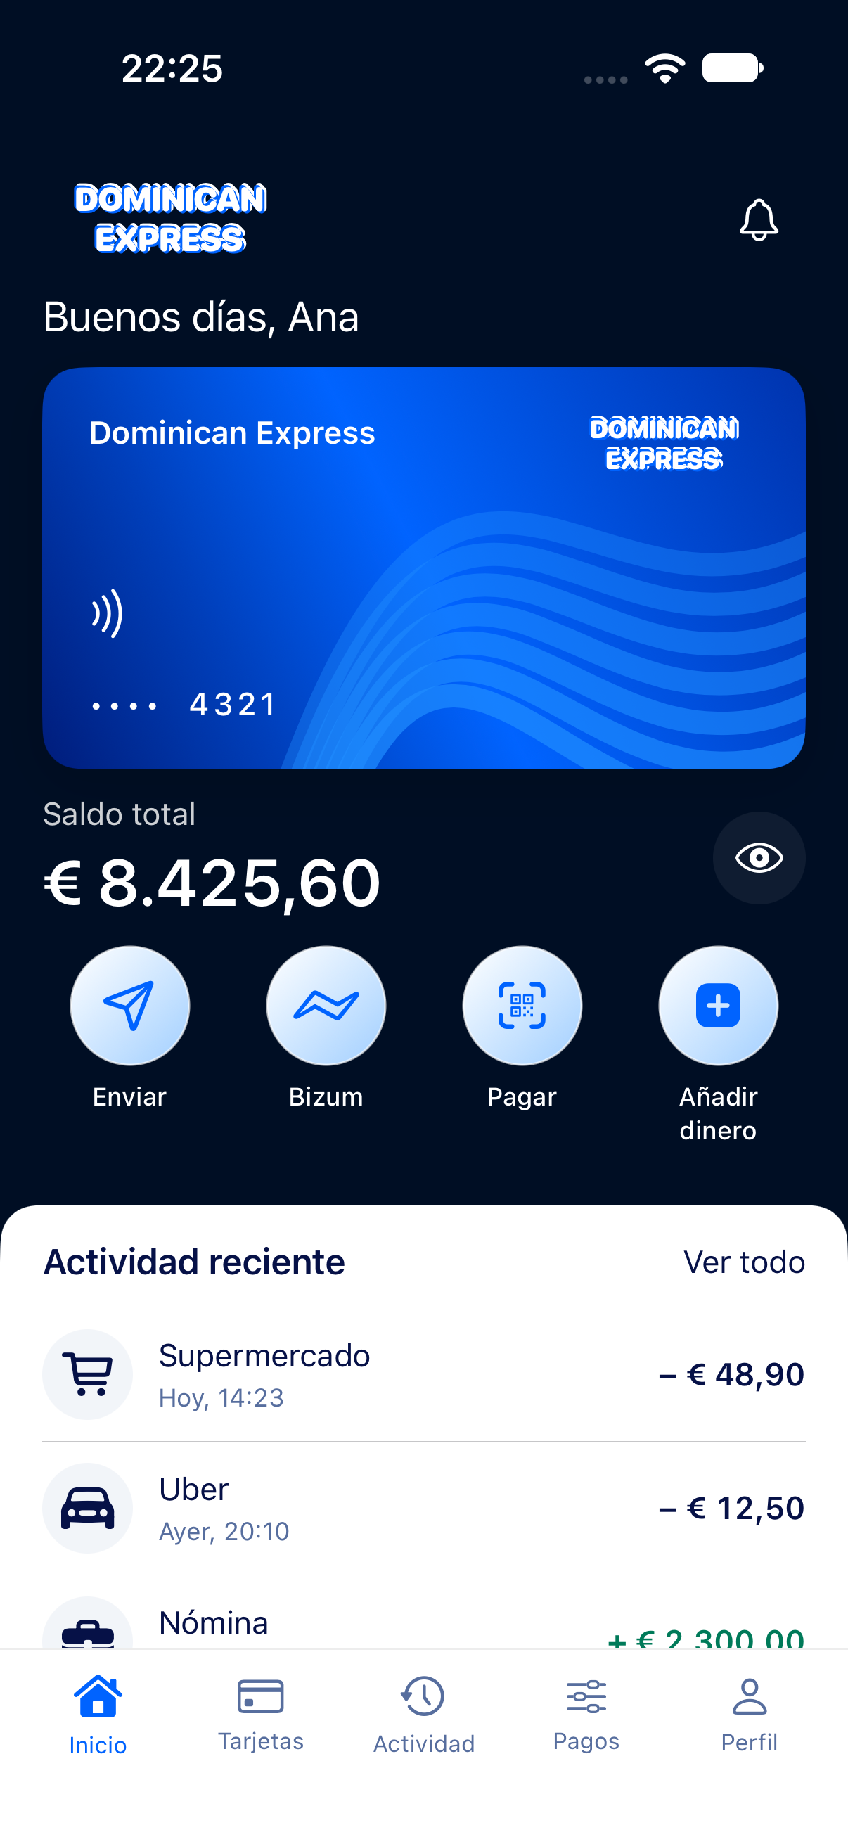
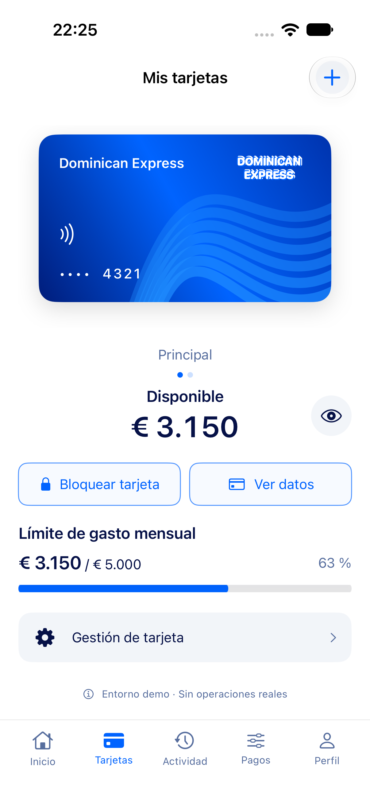
The product
iOS app in SwiftUI, talking to the database
02
Notes:
JORGE. The product is a mobile bank: accounts, transfers, Bizum between customers,
cards, shared accounts. This is our iOS app, written in SwiftUI. It started on mock data;
now it reads and pays against the real database, with no server in between. Xabier will
show you the path of every request.

Slide 3
What SurrealDB is
One engine, one language, one transaction
Documents
customer, account
Graph
owns, transfer
Key-value
storage layer
NoSQL, multi-model. Looks like SQL, has no JOINs
03
Notes:
JORGE. SurrealDB is a NoSQL, multi-model database. One engine, one query language called
SurrealQL, and one transaction cover three ways of storing data. Documents: a customer
or an account is a JSON-like record. Graph: a relation, like "this customer owns this
account", is itself a record and can carry fields. And underneath, everything is stored
as keys in an ordered key-value store. It looks like SQL, but it is not relational:
records link to each other by ID, there are no JOINs.

Slide 4
Why a bank needs it
Money never out of balance
Multi-record ACID
Fraud is a graph
Native graph
Sensitive data
Per-record, per-field permissions
Typical fits: fraud and risk, social data, access control
04
Notes:
JORGE. Why this database for a bank? A bank needs three things at once. Money that
never goes out of balance: that needs transactions over several records. Fraud is a
graph problem: rings of accounts, phones shared by strangers. And the data is sensitive,
so each customer must only see their own records, and some fields like the card number
only after a PIN. Of the engines we compared, SurrealDB is the one that gives all three
in one place.
Typical scenarios for it: fraud and risk analysis, social and recommendation data,
access-control models that are graphs. Now Xabier will show you the whole system, from
the phone to the disk.

Slide 5
The path of a request
Node A
iPhone app
HAProxy
:8100
PD
TiKV x3
Raft 2 of 3
Node B
1
/signin
2
/sql
3
/api/bizum
4
Raft
5
201
customer token
read, filtered
pay, order id
2 of 3 copies
back to the app
One address for the app. No backend in between
05
Notes:
XABIER. This is the whole system, and the path of one request through it. The iPhone app
talks to one address: HAProxy, our load balancer. Step 1, sign in: the app gets a token
that carries only that customer's permissions, never database credentials. Step 2, read:
a plain SurrealQL query; HAProxy sends it to node A or B, and the database itself filters
it, so Ana only gets her own account. Step 3, pay: a POST to an endpoint defined inside
the database, with an order id generated by the app. Step 4: the SurrealDB node turns it
into a distributed transaction; PD says which TiKV nodes hold those keys, and the write
commits when two of the three copies have it, through Raft. Step 5: 201 Created comes back
the same way. The SurrealDB nodes keep nothing, so any of them can serve any request, and
that is what makes the load balancer possible.

Slide 6
Why a load balancer
Experiment, 40 writes through HAProxy
Failed writes
SurrealDB node A killed (3 runs)
0 of 40
TiKV leader killed, health check /health
22 of 40
TiKV leader killed, health check /status
6 and 7 of 40
Check the node, not what every node shares
06
Notes:
XABIER. Why a load balancer? Because the SurrealDB nodes are stateless: without one, the
app would need the list of nodes and its own failover. With HAProxy the app has one
address, the load is spread, and a dead node is taken out before the app notices. We chose
HAProxy because it checks every node actively, once a second; free nginx only notices
when a real request fails. We measured it. Killing node A in the middle of 40 payments:
40 of 40 OK, three times, because HAProxy retries on the other node only when the
connection failed, so a payment is never sent twice. And a mistake we found: our first
health check also tested the storage. When a storage node died, both SurrealDB nodes
failed the check, HAProxy removed both, and 22 of 40 writes failed, more than with no
balancer at all. Checking only the node itself: 6 and 7, all from the storage election.

Slide 7
One record, two models
SELECT <-owns<-customer.name AS holders, <-owns.role AS roles FROM account:ana;
Ana García
owns role: titular
account:ana
document
Luis Romero
owns role: cotitular
The role lives on the edge, not in a join table
07
Notes:
XABIER. Here is the data model in one query. Ana's account is a document. Who owns it is
a graph: the edge "owns" goes from customer to account, and it carries a field, the role.
Ana is the holder, Luis the co-holder. No join table. And the same traversal,
"my customer, owns, account", is both the permission rule (you see an account if it
hangs from one of your owns edges) and the input of the fraud detectors. We use a strict
schema where money is, and free-form fields where each detector writes different
details.

Slide 8
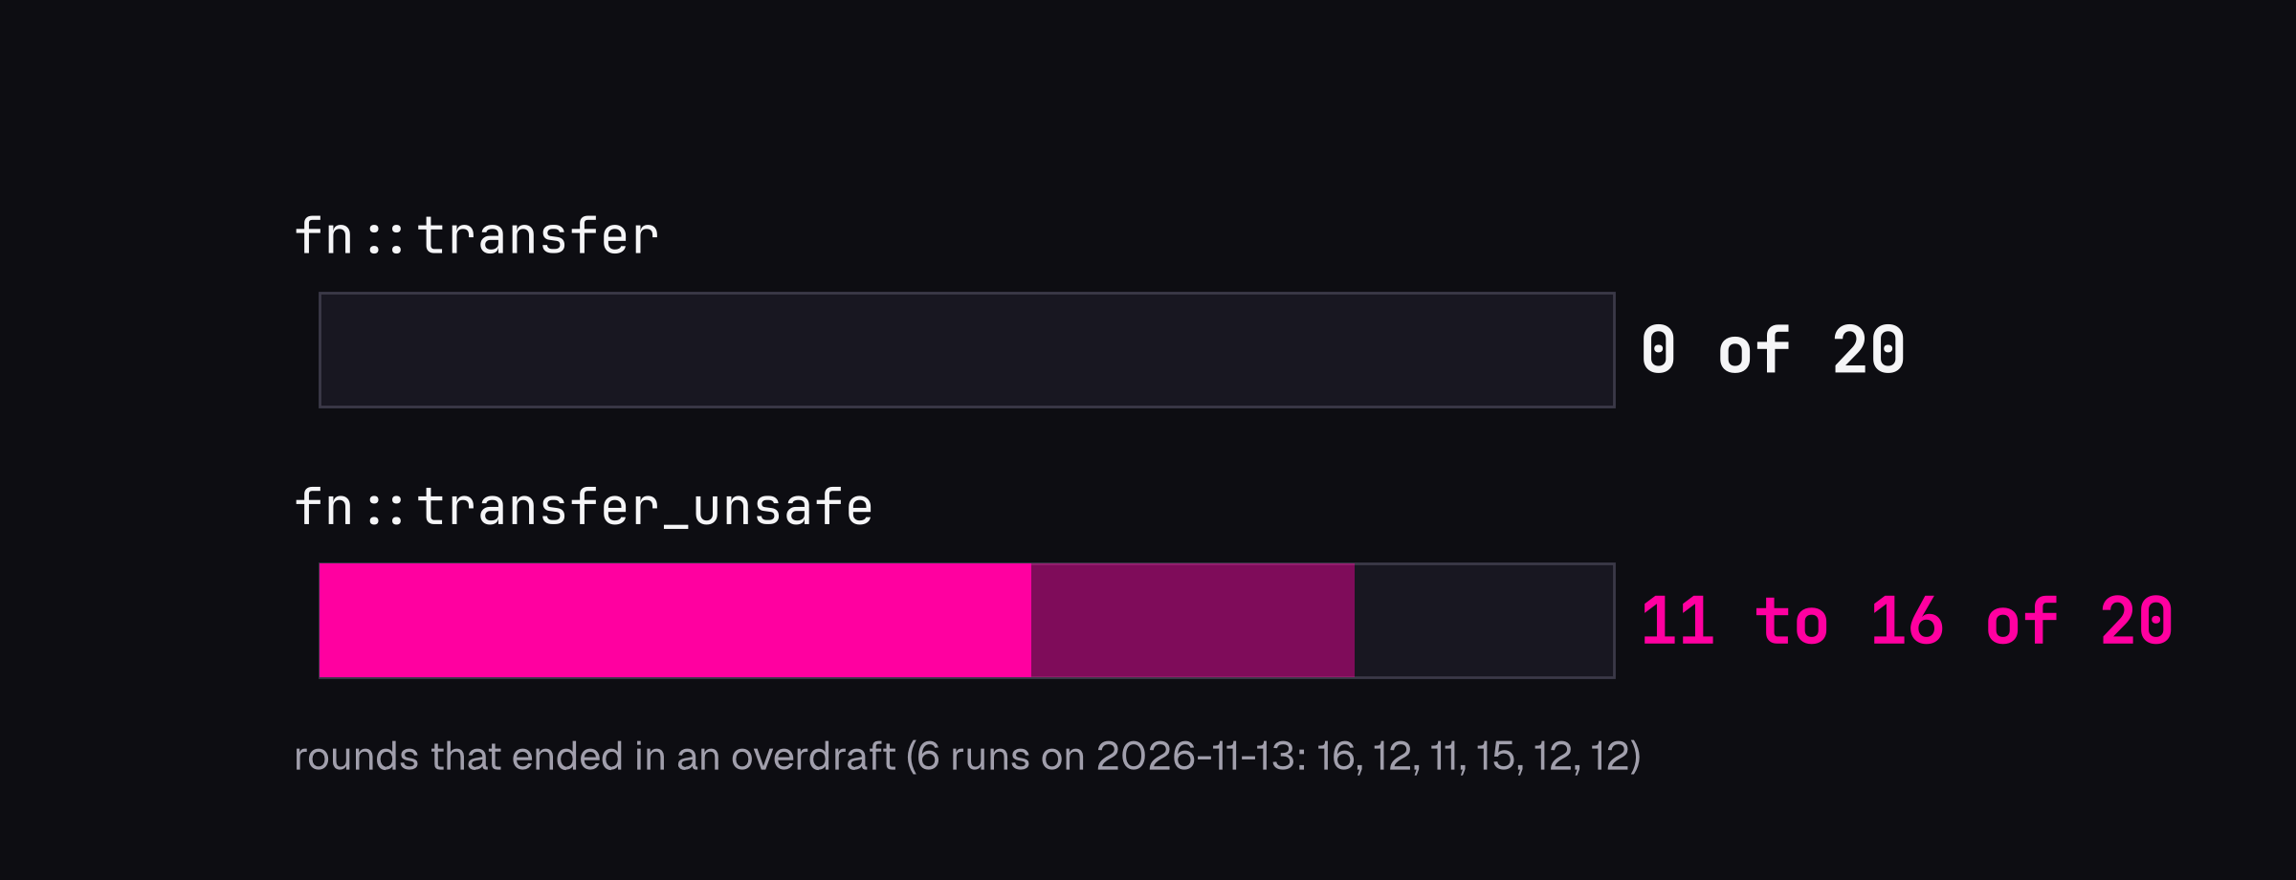
Consistency under a race
10 simultaneous full-balance transfers, 20 rounds
08
Notes:
XABIER. Consistency. Our first design was a pure ledger: the balance is the sum of the
entries. We fired ten transfers of the whole balance at the same time, twenty rounds.
The unsafe version ended in an overdraft in 11 to 16 of the 20 rounds. Why: SurrealDB
uses snapshot isolation, which only detects a conflict when two transactions write the
same record, and two transfers insert different ledger entries. The fix: every transfer
also updates the account's balance field. That write is the conflict point; one of the
two transactions is undone entirely. Result: zero overdrafts, every time. We only found
this by testing it.

Slide 9
Compute apart from storage
Node A
Node B
stateless
PD
placement
TiKV 1
TiKV 2
TiKV 3
3 copies each
leader
3 copies, Raft majority 2 of 3: CP
09
Notes:
XABIER. Architecture. SurrealDB separates compute from storage. The same binary runs on
memory, on disk, or on TiKV, a distributed key-value store. With TiKV, SurrealDB nodes
are stateless: any node serves any request. TiKV splits the data in ranges called
regions, and keeps every region on three nodes, kept in agreement by the Raft protocol.
A write commits when two of three have it. Under a network partition the minority side
refuses writes: in CAP terms it is CP, consistency first. For a bank, the right side.
We built this cluster, and in the video you will see us break it.

Slide 10
How it scales
More users
More data
Limits
add SurrealDB nodes
add TiKV nodes
PD quorum, hot regions
stateless, behind HAProxy
regions split, PD moves them
LIVE sees one node
Scale compute and storage separately
10
Notes:
XABIER. How this grows. Compute and storage scale separately. More users: add SurrealDB
nodes behind HAProxy; they keep no state, so a new node serves traffic as soon as it
passes the health check. More data: add TiKV nodes; the data is split in ranges called
regions, regions split when they grow, and PD moves them to the new node on its own.
The limits we know: PD needs a majority, so three of them in production; a region that
everyone writes to, like one very busy account, is a hot spot no number of nodes fixes;
and live queries only see their own node, so a fraud dashboard listens on every node.
On a laptop this shows the mechanism; throughput across machines we did not measure.

Slide 11
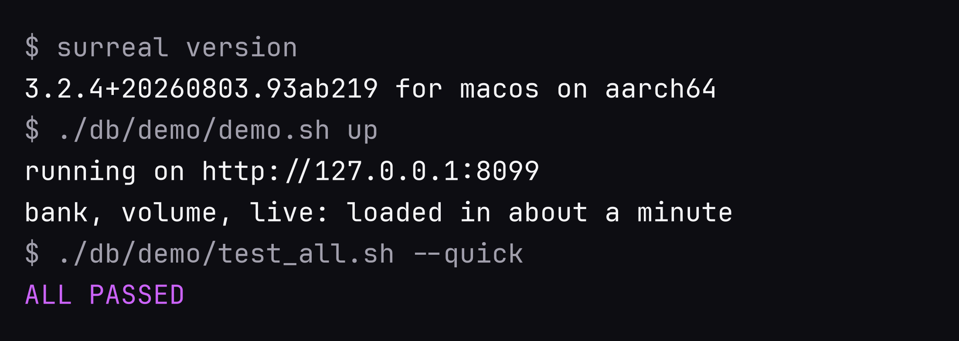
Install, access, query
HTTP, WebSocket, Surrealist, Python SDK
11
Notes:
XABIER. Installing it is one command; we pin version 3.2.4 because 3.3 changes features
we depend on. Our demo script starts the database on disk and loads three databases in
about a minute, and the six test suites run in fifteen seconds. You talk to it over HTTP
for queries and our API, over WebSocket for the SDKs and live queries, with Surrealist,
the official GUI, and from Python with the official SDK. Everything is in the public
repo, step by step, so another student can reproduce it.

Slide 12
The system under attack
1
iPhone app
pays through HAProxy
2
live alerts
a ring is frozen
3
kill node A
payments continue
4
kill a TiKV
nothing lost
5
Python SDK
insert, query, update, delete
Recorded on this laptop, nothing staged
12
Notes:
XABIER (video, about 5 minutes; narrate over it).
1. The iPhone app through HAProxy: Ana signs in, sees her real balance, pays a Bizum to
Luis; the balance drops by exactly that amount.
2. Surrealist, live alerts: a mule ring forms, six alerts arrive on their own, the ring is
frozen in proportion, Marta tries to erase the trail and cannot.
3. The cluster: HAProxy's page in view, SurrealDB node A killed during payments (every
payment still OK), then a TiKV leader killed (a few seconds of errors, nothing lost).
4. Python with the official SDK: create, read, update, delete; a retried payment charged
once.

Slide 13
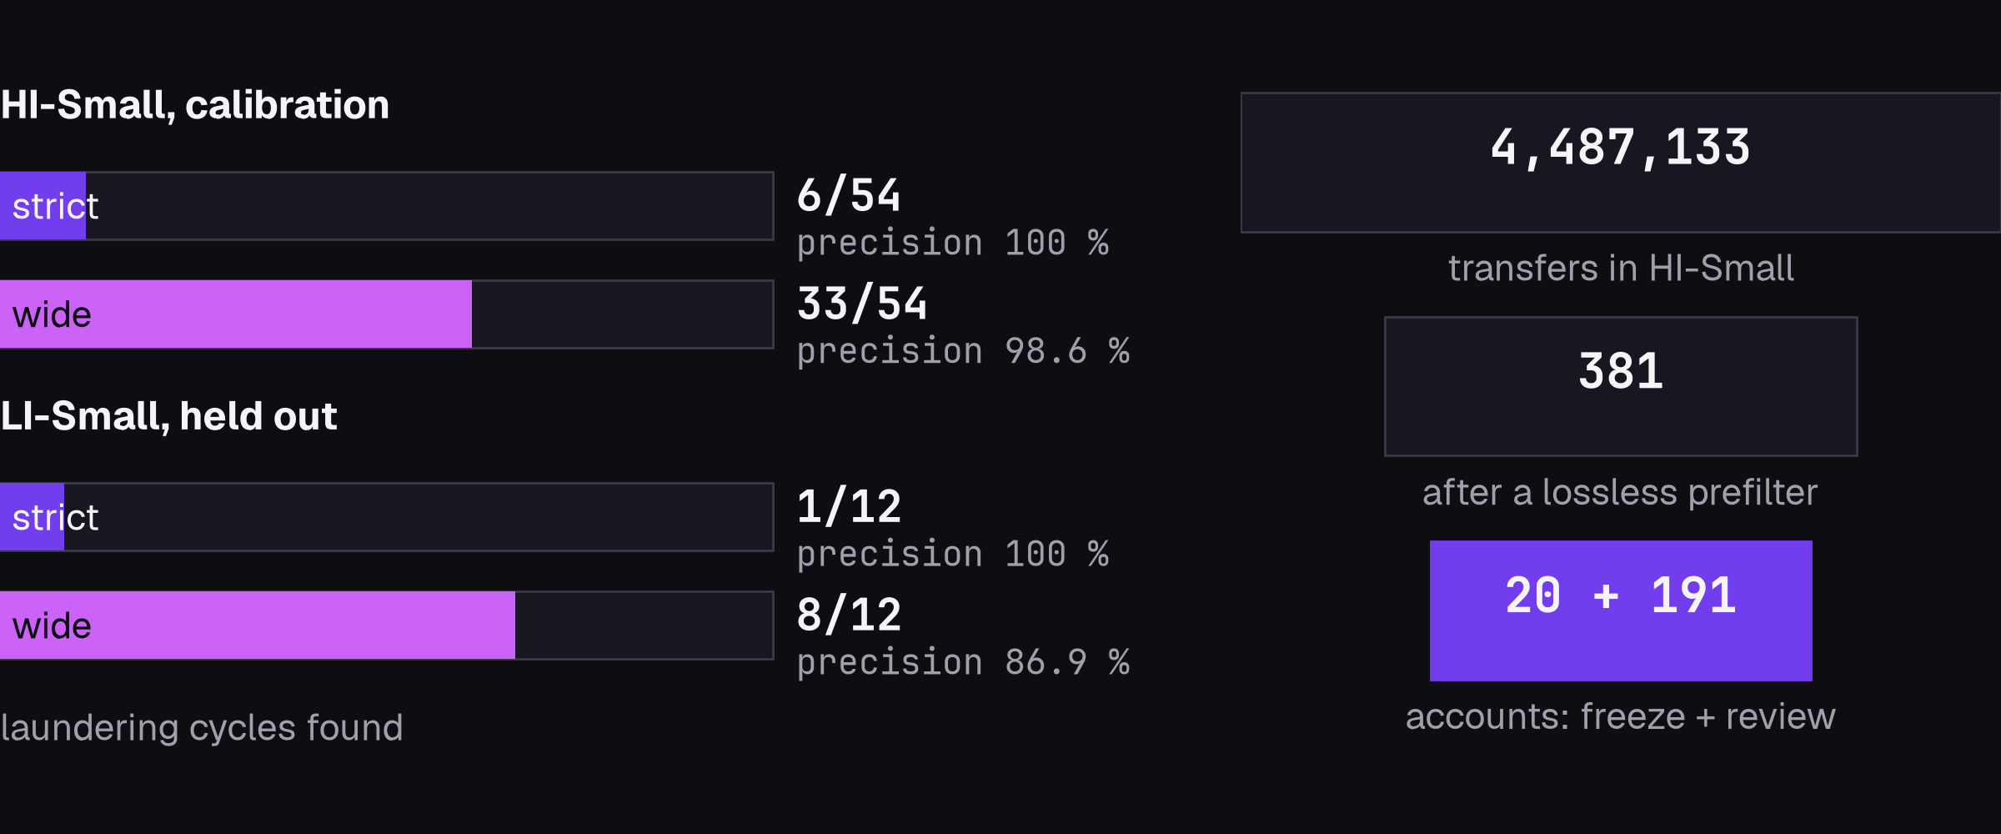
Tested on data we did not make
Calibrated on one set, validated untouched on another
13
Notes:
XABIER. The ring in the demo we planted ourselves, so it can only confirm our own design.
So we ran the detector on IBM's public anti-money-laundering dataset, where the answer
is known. First result: 6 of 54 laundering cycles. We had assumed a mule keeps a
commission, so the amount shrinks; on IBM's data it grows half the time. We fixed the
method before looking, calibrated on one set, 33 of 54, and validated on another set we
had not touched: 8 of 12. At 87 percent precision, freezing would hit one innocent in
eight, so two tiers: strict rings freeze, wide ones go to an analyst. And a cheap
filter first: 4.5 million transfers down to 381, without losing a single ring.

Slide 14
What the cluster gives, what it costs
Gives
Costs
Every write on 3 nodes
About 1.1 GB of RAM
SurrealDB node killed: 0 of 40 failed
HAProxy: a single point here
TiKV leader killed: 9 to 12 s of errors
No time travel on TiKV
0 writes lost or half applied
Live queries: one node only
5 of 6 test suites pass
One laptop: mechanics, not speed
The cluster proves failover. Time travel needs one node
14
Notes:
XABIER. What we measured. Killing a follower: nothing visible. Killing the leader of the
region being written: 9 to 12 seconds of errors, and not one write lost or half applied.
The node comes back and catches up in about ten seconds. It costs about 1.1 GB of RAM
on this laptop. And two features do not cross nodes: time travel only exists on the
single-node engine, and live queries only see changes made on their own node; across
nodes it is an Enterprise feature. So the alert demo and the time machine run on one
node, and the cluster proves the failover. Javier will now step back and judge the whole thing.

Slide 15
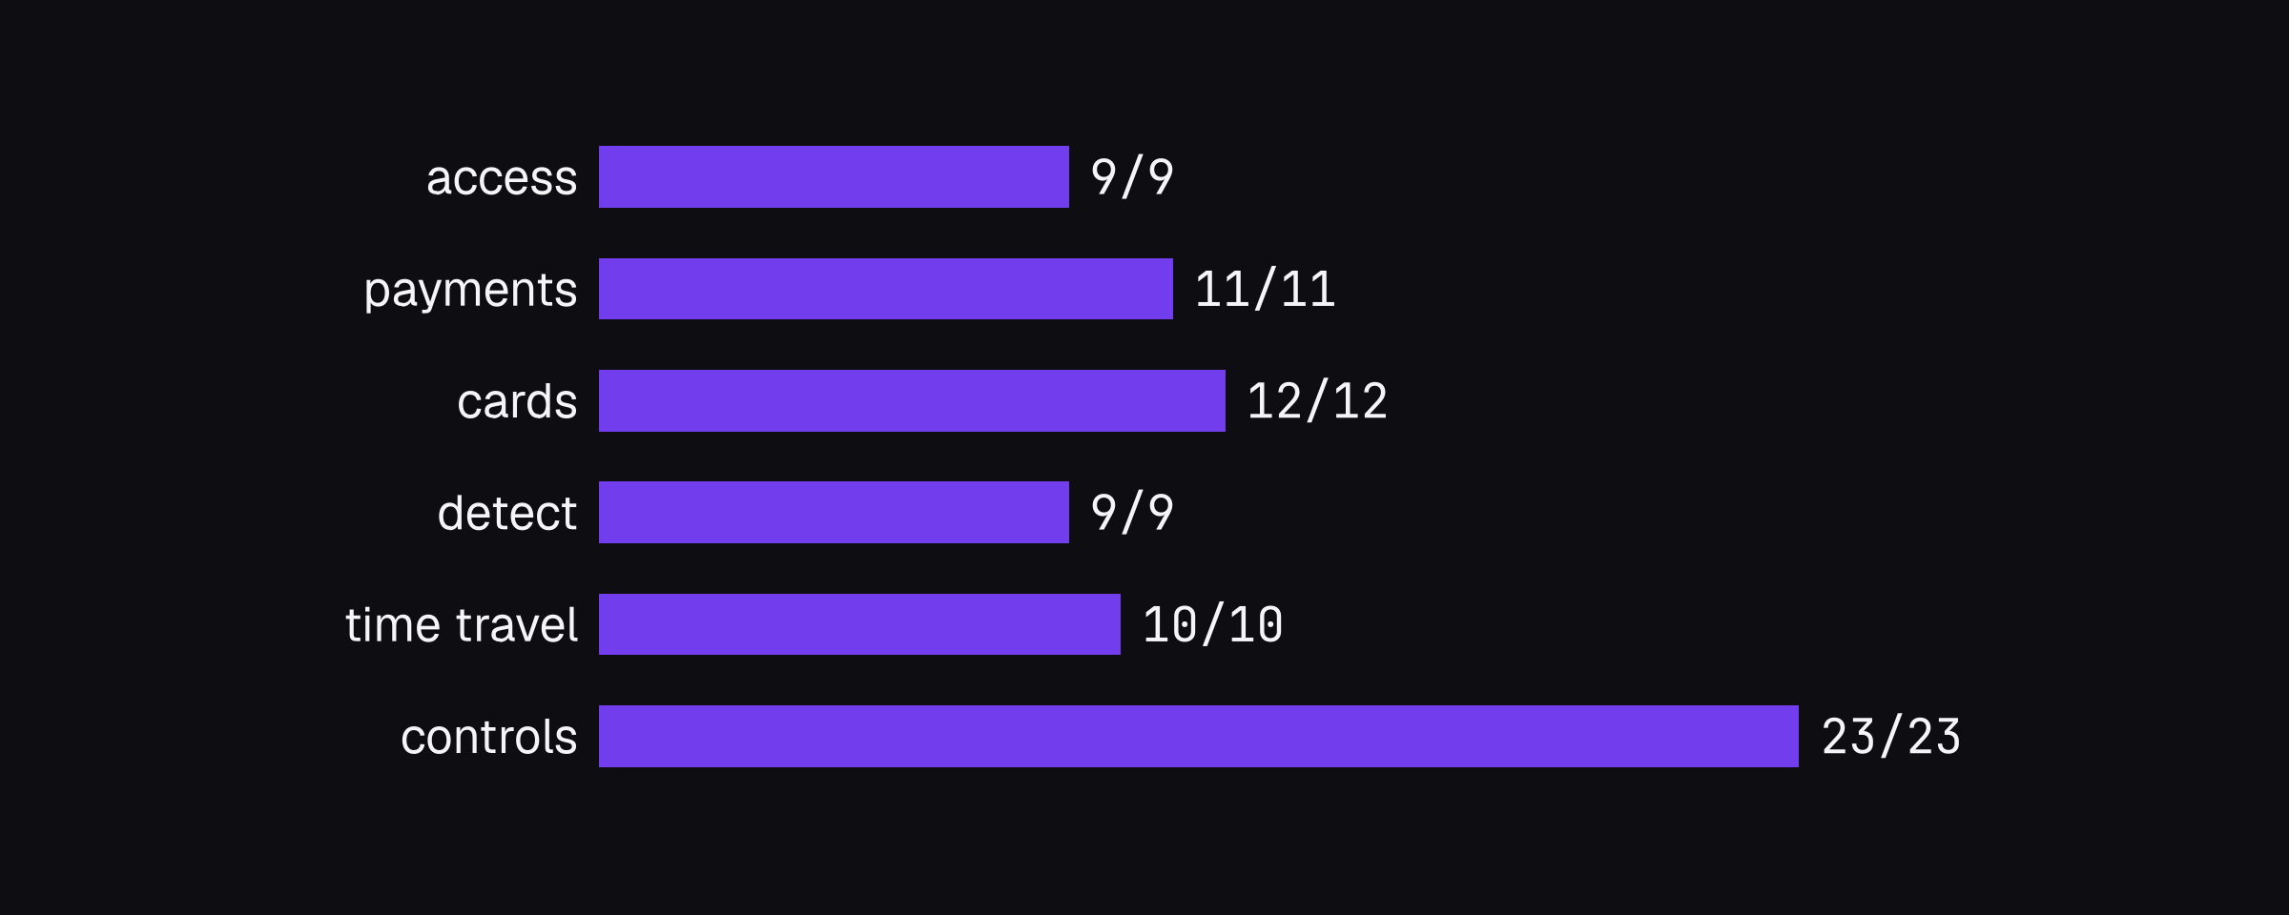
Don't trust the tool, test it
74 of 74 deliberate breaks caught
15
Notes:
JAVIER. Now a critical look. Our main method: a test you have never seen fail is not
watching anything. So every protection was broken on purpose, and its test had to
catch it: 74 of 74 caught. Testing like this found real problems in SurrealDB: a
time-travel bug that brought deleted records back, which could produce false evidence
against an innocent; live notifications lost silently when two clients listen; and a
query planner that ignored our index, 72 milliseconds against 1.2. Every one became a
design decision. SurrealDB is powerful, but young.

Slide 16
Against the alternatives
Transactions
Graph
Field permissions
Query the past
MongoDB
multi-document
100 MB limit
views only
about 5 min
Cassandra
one partition
no
column masking
no
Neo4j
yes
native
Enterprise only
no
ArangoDB
single server
native
per collection
no
PostgreSQL
yes, not NoSQL
recursive CTE
row-level
no system time
SurrealDB
multi-record
native
per field
VERSION, beta
From the documentation. Speed not measured
16
Notes:
JAVIER. How it compares, from each vendor's documentation, not measured: we do not claim
it is faster than any of them. MongoDB also has multi-document transactions; what
separates them is the graph, limited to 100 MB, and permissions per field only through
views. Cassandra keeps transactions inside one partition. Neo4j is the strongest graph,
but property permissions are Enterprise only. ArangoDB was the serious alternative,
rejected for permissions. PostgreSQL is not NoSQL, which the course requires.
SurrealDB is the only one of these with queries into the past inside the language.

Slide 17
Where SurrealDB fits
Good fit
Not yet
Documents + graph + permissions
Long proven operational record
Small team, logic in the database
Real-time across nodes, free
Prototypes and teaching
Legal evidence storage
Strengths we measured, limits we hit
17
Notes:
JAVIER. So, when would we use it? When documents, a graph and fine-grained permissions
meet, like fraud, risk or access control; for small and medium systems where a small
team benefits from having the API, authentication and real-time updates inside the
database; and for prototypes and teaching. Not yet for a system that needs a long,
proven operational record: we hit renames between versions, a bug and lost live events.
Not for real-time across nodes without the Enterprise licence. And legal evidence must
still be copied out to write-once storage.

Slide 18

Decisions, measured
Every number on these slides
is in the repository.
github.com/Dominican-Express/dominican-ios
18
Notes:
JAVIER. To finish: every number you saw is in the public repository, with the steps to
reproduce it. The code was written with AI help; what we did was decide what to build,
measure it, and break it on purpose. Thank you. Questions?

