Slide 1
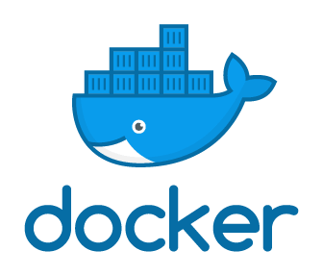
Oracle database build with docker
Dominic

Slide 2
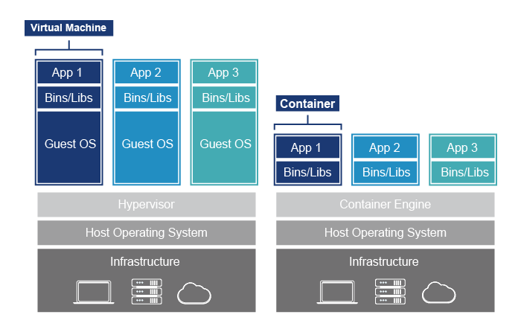
 | Virtual Machine | Container
大小 | 數十GB或更多 | 通常數百MB
速度 | 數分鐘或到小時 | 通常數秒就可生成container
安全性 | 較強 | 較弱
擴充性 | 較低 | 較高

Slide 3
IMAGES
An image is a read-only template with instructions for creating a Docker container. Often, an image is based on another image, with some additional customization.
You might create your own images or you might only use those created by others and published in a registry. To build your own image, you create a Dockerfile with a simple syntax for defining the steps needed to create the image and run it.

Slide 4
CONTAINERS
A container is a runnable instance of an image. You can create, start, stop or delete a container using the Docker API or CLI.
When a container is removed, any changes to its state that are not stored in persistent storage disappear.

Slide 5
volume
Docker volumes are very useful when we need to persist data in Docker containers or share data between containers.
Docker volumes are important because when a Docker container is destroyed, it’s entire file system is destroyed too. So if we want to keep this data, it is necessary that we use Docker volumes.

Slide 6
environment
Docker - 19.03.5
Oracle Database – 11g Release 2 (11.2.0.2) Express Edition (XE)

Slide 7
Install docker
Uninstall old versions
yum remove docker docker-client docker-client-latest docker-common docker-latest docker-latest-logrotate docker-logrotate docker-engine
Install using the repository
yum install -y yum-utils device-mapper-persistent-data lvm2
yum-config-manager --add-repo https://download.docker.com/linux/centos/docker-ce.repo
Install Docker Engine
yum install –y docker-ce docker-ce-cli containerd.io
To install a specific version
yum list docker-ce --showduplicates | sort
yum install docker-ce-<VERSION_STRING> docker-ce-cli-<VERSION_STRING> containerd.io
Start Docker
systemctl start docker

Slide 8
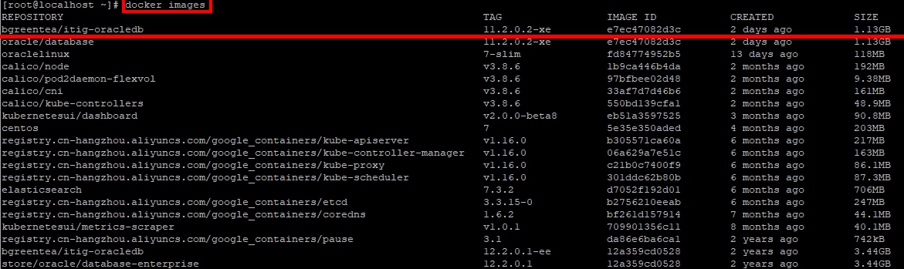
Download IMAGES
Download images
docker pull bgreentea/itig-oracledb:11.2.0.2-xe
Check image
docker images
See more version
https://hub.docker.com/repository/docker/bgreentea/itig-oracledb/tags?page=1

Slide 9
Create container
Create container
docker run -d --name <container_name> --shm-size=1g -p 1521:1521 -p 18080:8080 -e ORACLE_PWD=<your_password> -v <volume_name>:/u01/app/oracle/oradata bgreentea/itig-oracledb:11.2.0.2-xe
Parameters
--name | The name of the container
--shm-size | Amount of Linux shared memory
-p | The port mapping of the host port to the container port.<host_port>:<container_port>
-e | The Oracle Database SYS, SYSTEM and PDB_ADMIN password
-v | The data volume to use for the database. If omitted the database will not be persisted over container recreation.

Slide 10
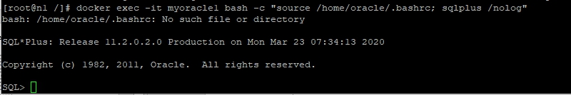
Enter Container
Check container
docker ps –a
Start up sqlplus
docker exec -it <container_name> bash -c "source /home/oracle/.bashrc; sqlplus /nolog"

Slide 11
Sqlplus command
Connect admin
connect sys as sysdba
Create user
create user <account> identified by <password>;
Give permission
GRANT CONNECT, RESOURCE, DBA TO <account> ;
Connect your account
connect <account>
Create test table
CREATE TABLE test (ID1 number, ID2 number);
Insert test data
INSERT INTO test (ID1, ID2) VALUES (1,2);
Check test data
Select * from test;

Slide 12
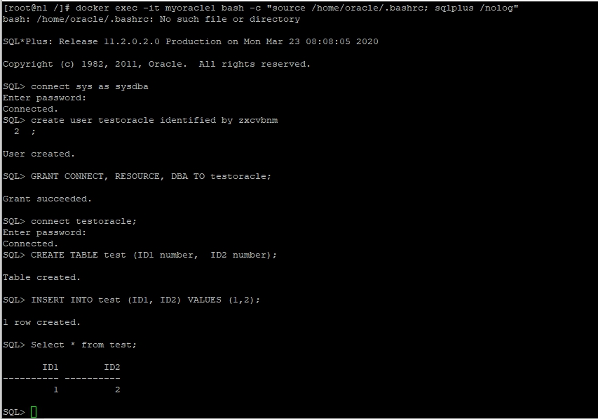
Sqlplus command

Slide 13
docker command
Stop container
docker stop <container_name> or < container_id>
Start container
docker start <container_name> or < container_id>
Remove container
docker rm <container_name> or < container_id>
Restart container
docker restart <container_name> or < container_id>
Check container
docker ps -a
Enter container
docker exec –it <container_name> or <container_id>
Check volume
docker volume ls
Check volume path
docker volume inspect <volume_name>
Check container log
docker logs <container_name> or < container_id>

Slide 14
Oracle 11g limitations
Oracle Database XE CPU Limitations
If Oracle Database XE is installed on a computer with more than one CPU (including dual-core CPUs), then it will consume, at most, processing resources equivalent to one CPU.
User Data Limitations
The maximum amount of user data in an Oracle Database XE database cannot exceed 11 gigabytes.
RAM Limitation
The maximum amount of RAM that an Oracle Database XE database uses cannot exceed 1 gigabyte, even if more is available.
More information
https://docs.oracle.com/cd/E17781_01/install.112/e18802/toc.htm#XEINL117

Slide 15
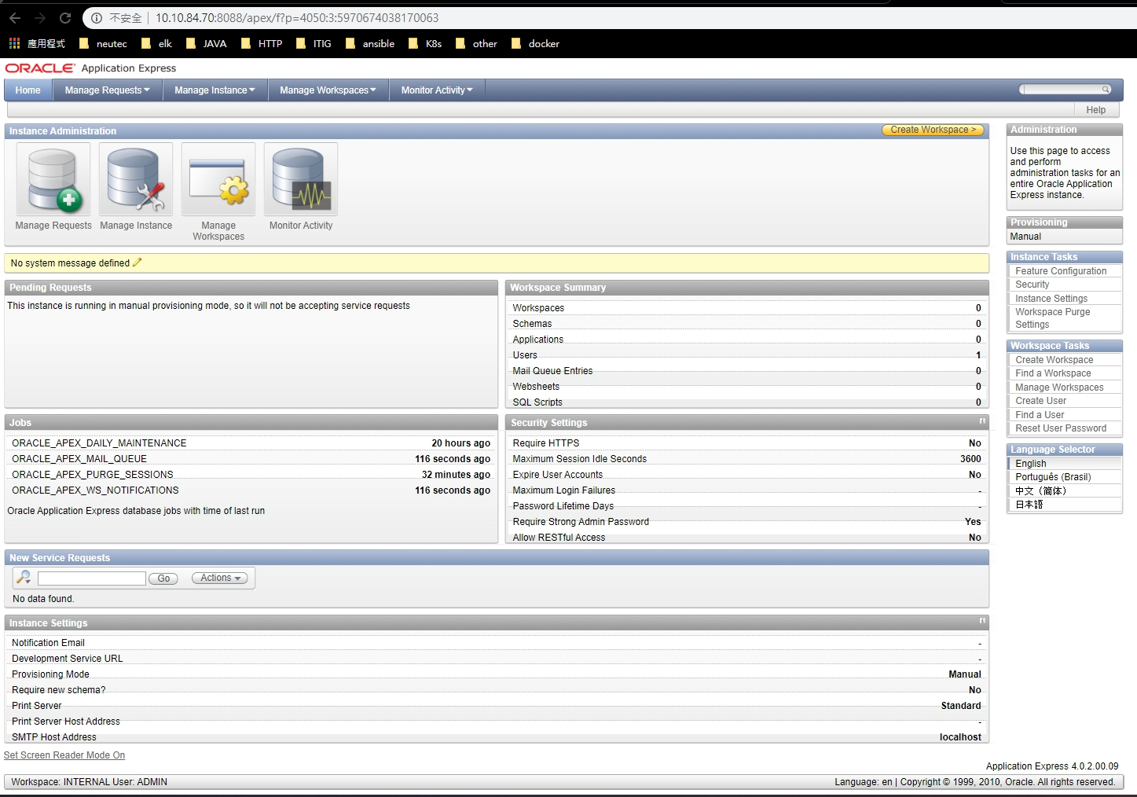
Oracle apex
Oracle APEX port is 18080 . You can use admin for login .
Oracle APEX admin URL : http://<host_ip>:<apex_port>/apex/apex_admin
Oracle APEX URL : http://<host_ip>:<apex_port>/apex

