Slide 1

Auditbeat
Patrick
Dominic

Slide 2



Architecture

Slide 3
Introduction
Auditbeat is a lightweight shipper that you can install on your servers to audit the activities of users and processes on your systems. For example, you can use Auditbeat to collect and centralize audit events from the Linux Audit Framework. You can also use Auditbeat to detect changes to critical files, like binaries and configuration files, and identify potential security policy violations.
Notes:
Auditbeat是一種輕量級的工具，可以安裝在server上，以查核系統上user , process的活動資訊。例如，您可以使用Auditbeat從Linux Audit Framework收集和集中事件。您還可以使用Auditbeat檢測對關鍵文件（如binary文件和config文件）的更改，並識別潛在的安全策略違規。

Slide 4
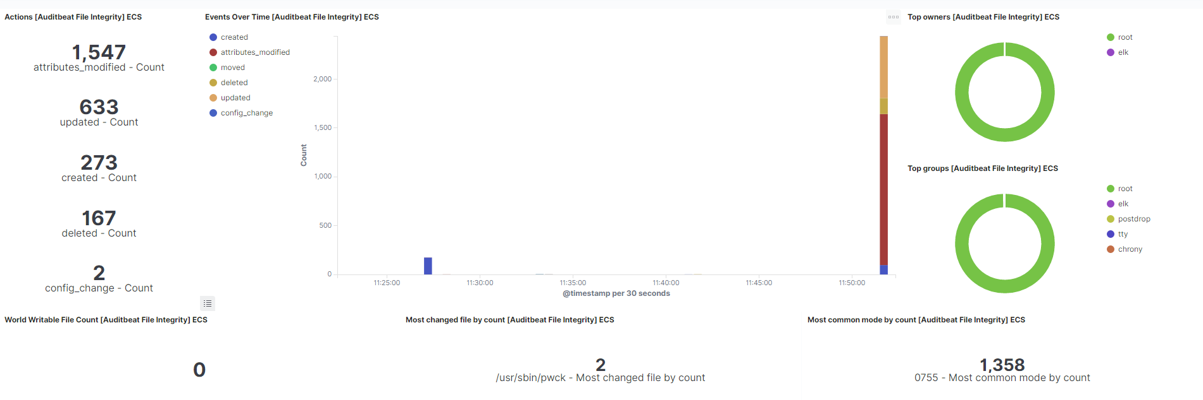
Auditbeat File Integrity Dashboard I

Slide 5
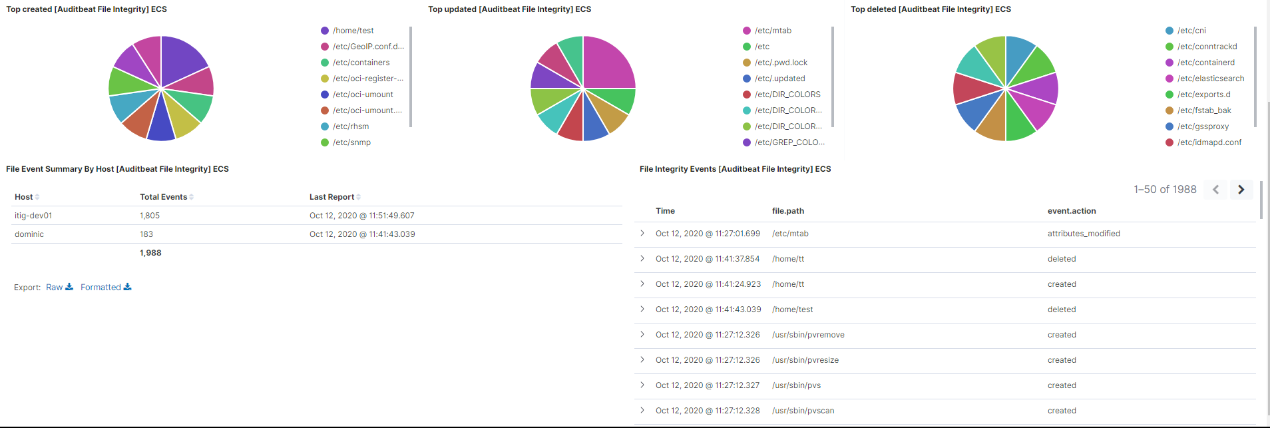
Auditbeat File Integrity Dashboard II

Slide 6
Auditbeat File Integrity Dashboard I
文件各種狀況,包含attributes_modified, created, deleted,
updated, moved, and config_change

Slide 7
Auditbeat File Integrity Dashboard I
每種event發生的時間點和次數直方圖

Slide 8
Auditbeat File Integrity Dashboard I
發生任何action中的檔案所屬的owners數圓餅圖

Slide 9
Auditbeat File Integrity Dashboard I
發生任何action中的檔案所屬的groups數圓餅圖

Slide 10
Auditbeat File Integrity Dashboard I
文件類型為symlink的總數

Slide 11
Auditbeat File Integrity Dashboard I
修改次數最多的檔案

Slide 12
Auditbeat File Integrity Dashboard I
檔案修改使用最多的檔案mode類型

Slide 13
Auditbeat File Integrity Dashboard II
監控路徑中新增檔案總數量

Slide 14
Auditbeat File Integrity Dashboard II
監控路徑中更新檔案總數量

Slide 15
Auditbeat File Integrity Dashboard II
監控路徑中移除檔案總數量

Slide 16
Auditbeat File Integrity Dashboard II
每個host總發生action以及上次更新時間

Slide 17
Auditbeat File Integrity Dashboard II
單一action詳細內容

Slide 18
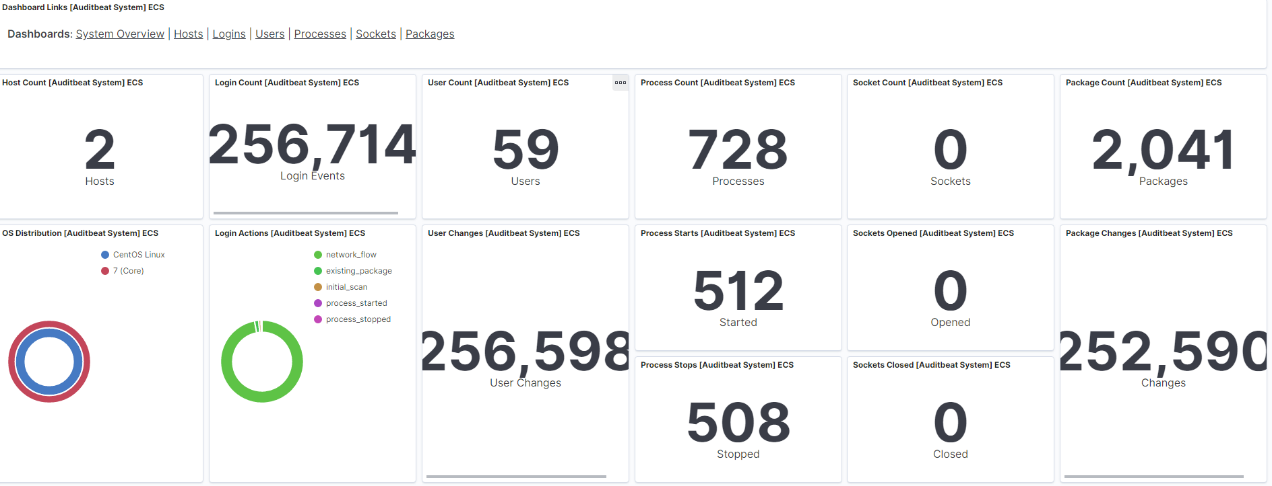
Auditbeat System Overview Dashboard I
其他類型的Dashboard link

Slide 19
Auditbeat System Overview Dashboard I
此Elasticsearch 接收到的auditbeat總數

Slide 20
Auditbeat System Overview Dashboard I
選取的時間區間內system login logout 等等相關總數

Slide 21
Auditbeat System Overview Dashboard I
透過host ID, user ID, and user name產生的uniquely ID總數

Slide 22
Auditbeat System Overview Dashboard I
a process-generated UUID, Sysmon Process GUIDs, or a hash of some uniquely identifying components of a process.建出的unique identifier

Slide 23
Auditbeat System Overview Dashboard I
It is computed as a SHA-256 hash of the host ID, socket inode, local IP, local port, remote IP, and remote port.

Slide 24
Auditbeat System Overview Dashboard I
It is computed as a SHA-256 hash of the host ID, package name, and package version.

Slide 25
Auditbeat System Overview Dashboard I
server的system os and version

Slide 26
Auditbeat System Overview Dashboard I
每個event發生的類型

Slide 27
Auditbeat System Overview Dashboard I
除default以外所以用戶所修改的動作總數

Slide 28
Auditbeat System Overview Dashboard I
Process start event總和

Slide 29
Auditbeat System Overview Dashboard I
Process stop event總和

Slide 30
Auditbeat System Overview Dashboard I
Sockets open event 總和

Slide 31
Auditbeat System Overview Dashboard I
Sockets close event 總和

Slide 32
Auditbeat System Overview Dashboard I
除default以外所以package所修改的動作總數

Slide 33
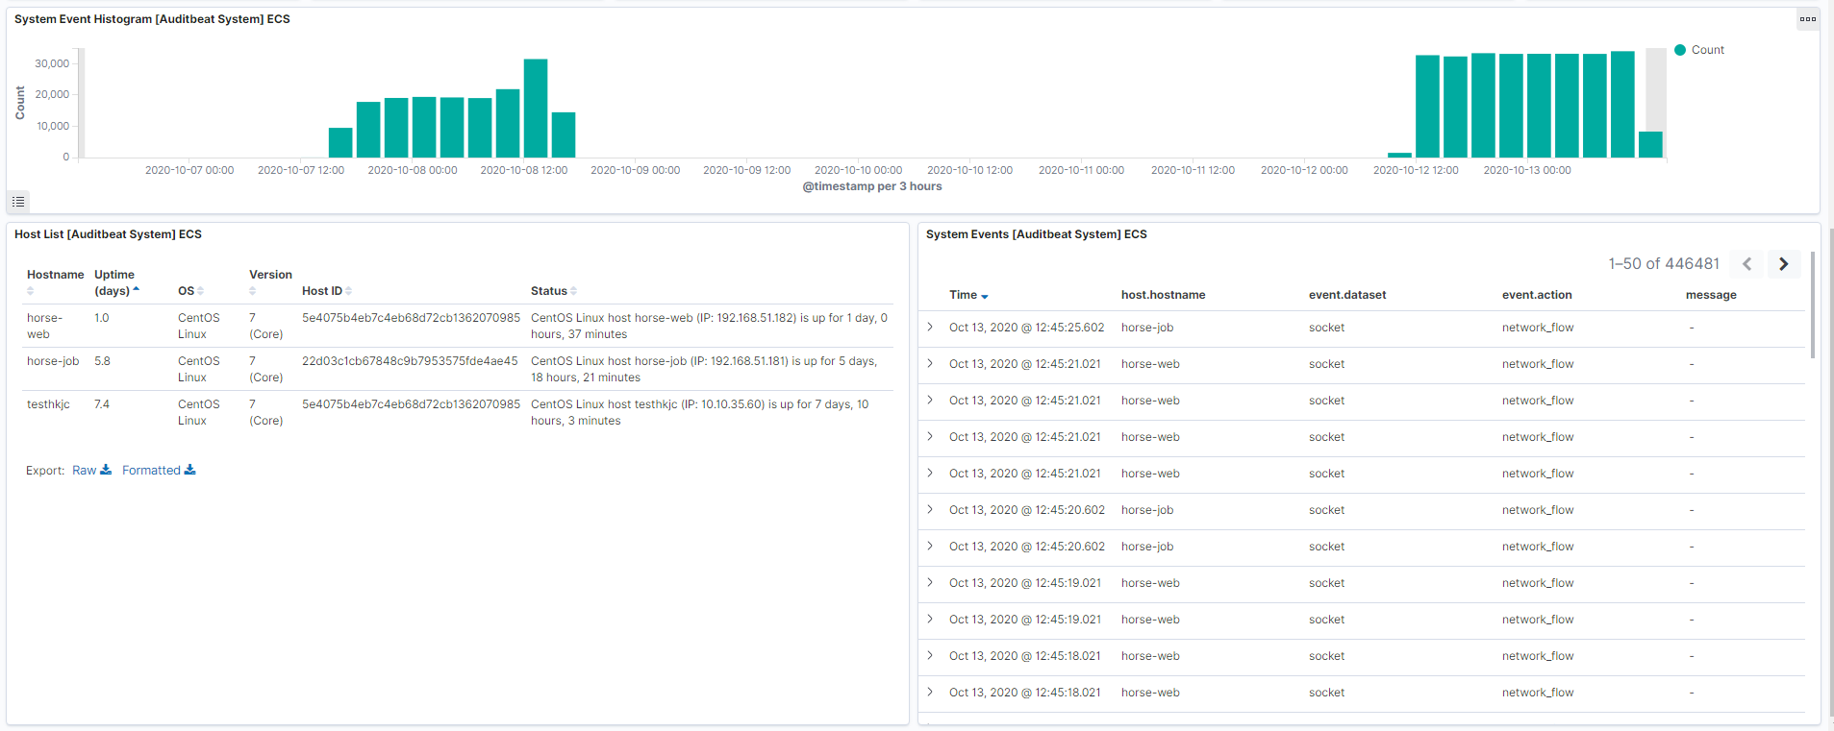
Auditbeat System Overview Dashboard II
系統相關的log直方圖

Slide 34
Auditbeat System Overview Dashboard II
server相關訊息

Slide 35
Auditbeat System Overview Dashboard II
System Events的詳細內容

Slide 36
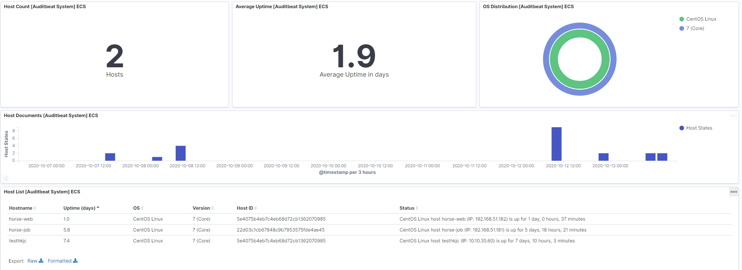
Auditbeat Host Dashboard I
此Elasticsearch 接收到的auditbeat總數

Slide 37
Auditbeat Host Dashboard I
Host event平均每日發生次數

Slide 38
Auditbeat Host Dashboard I
有action type是host的host os資料

Slide 39
Auditbeat Host Dashboard I
選取時間內host event發生次數直方圖

Slide 40
Auditbeat Host Dashboard I
所有host相關訊息包含已存在log但已停駛的auditbeat host

Slide 41
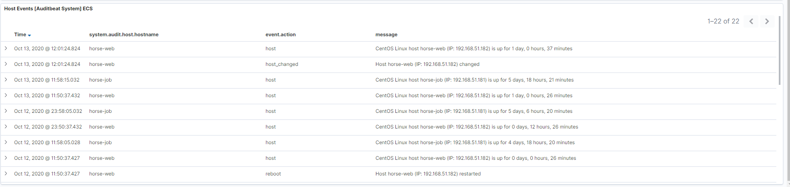
Auditbeat Host Dashboard II
event為host的detail訊息

Slide 42
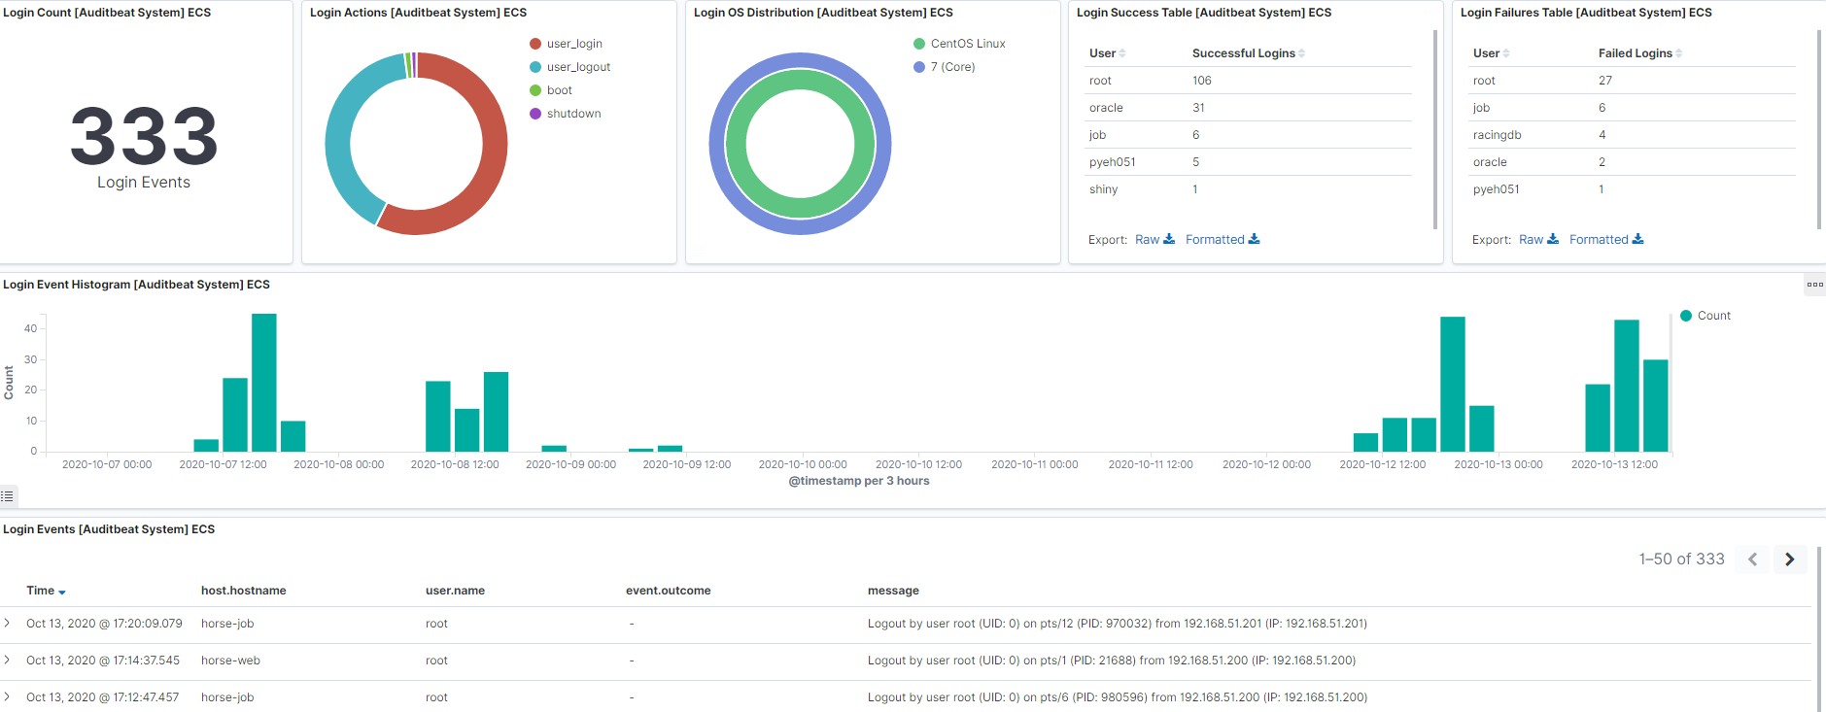
Auditbeat Login Dashboard
選取的時間區間內system login logout 等等相關總數

Slide 43
Auditbeat Login Dashboard
Login log的action類別圓餅圖

Slide 44
Auditbeat Login Dashboard
有action type是login的host os資料

Slide 45
Auditbeat Login Dashboard
Login log當中各user login success count

Slide 46
Auditbeat Login Dashboard
Login log當中各user login failures count

Slide 47
Auditbeat Login Dashboard
選取時間內login event發生次數直方圖

Slide 48
Auditbeat Login Dashboard
event為login的detail訊息

Slide 49
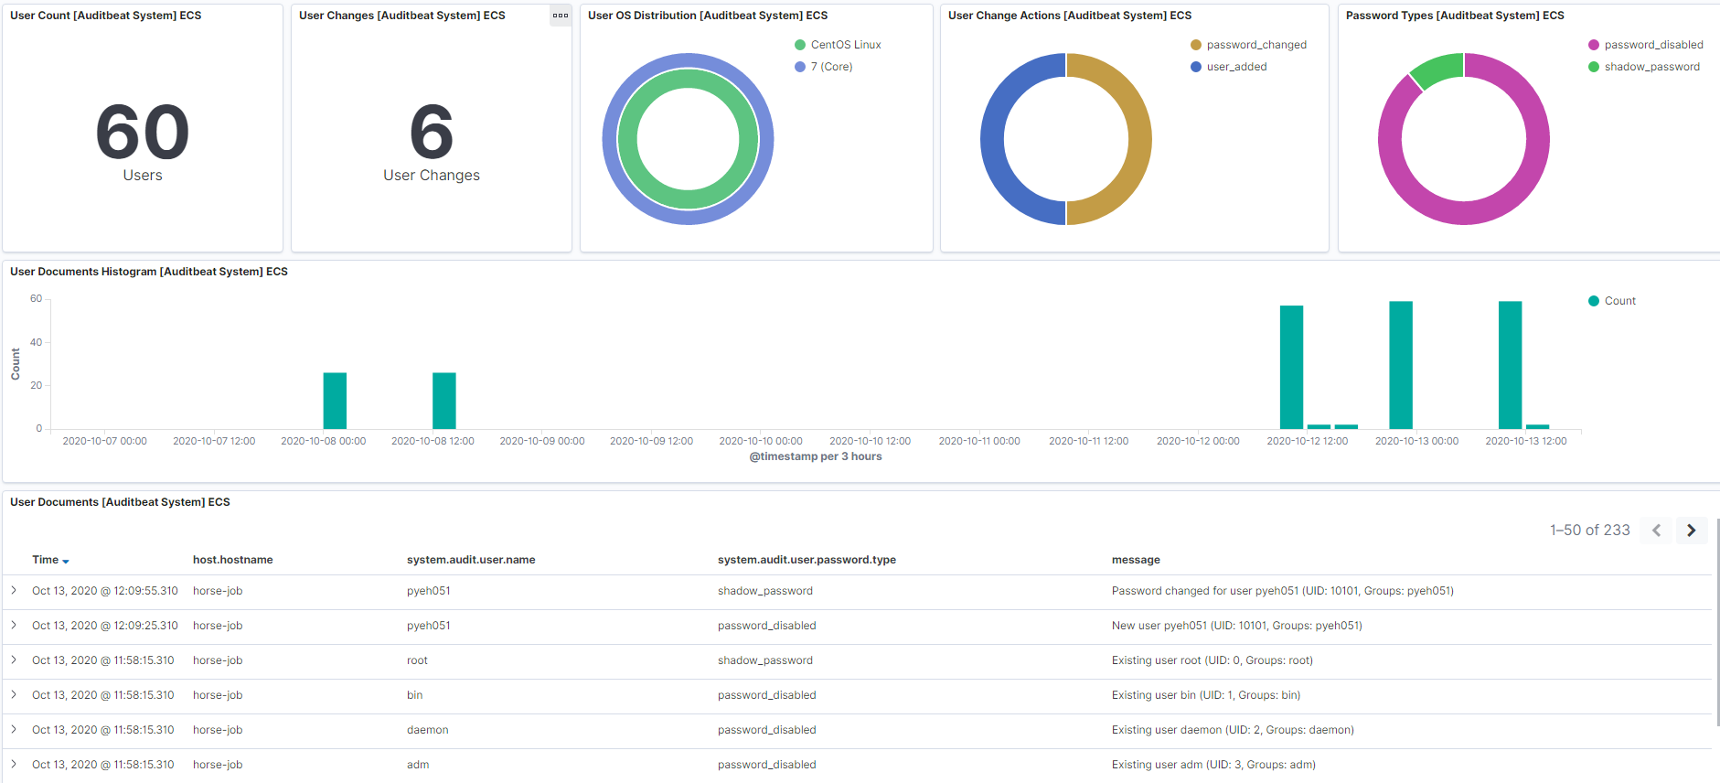
Auditbeat User Dashboard
透過host ID, user ID, and user name產生的uniquely ID總數

Slide 50
Auditbeat User Dashboard
非default user的user做出change event的總數

Slide 51
Auditbeat User Dashboard
有action type是login的host os資料

Slide 52
Auditbeat User Dashboard
非default user的user做出change event的type and count

Slide 53
Auditbeat User Dashboard
Password type and count

Slide 54
Auditbeat User Dashboard
選取時間內user event發生次數直方圖

Slide 55
Auditbeat User Dashboard
event為user的detail訊息

Slide 56
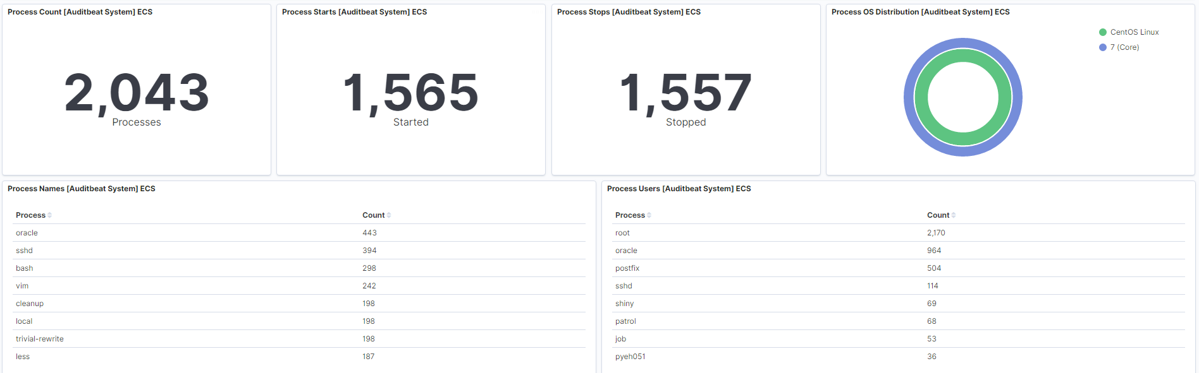
Auditbeat Process Dashboard I
a process-generated UUID, Sysmon Process GUIDs, or a hash of some uniquely identifying components of a process.建出的unique identifier

Slide 57
Auditbeat Process Dashboard I
Process start event總和

Slide 58
Auditbeat Process Dashboard I
Process stop event總和

Slide 59
Auditbeat Process Dashboard I
有action type是process的host os資料

Slide 60
Auditbeat Process Dashboard I
Process event中各process name(program name or similar.)的執行次數總和

Slide 61
Auditbeat Process Dashboard I
Process event中各user執行process的次數總和

Slide 62
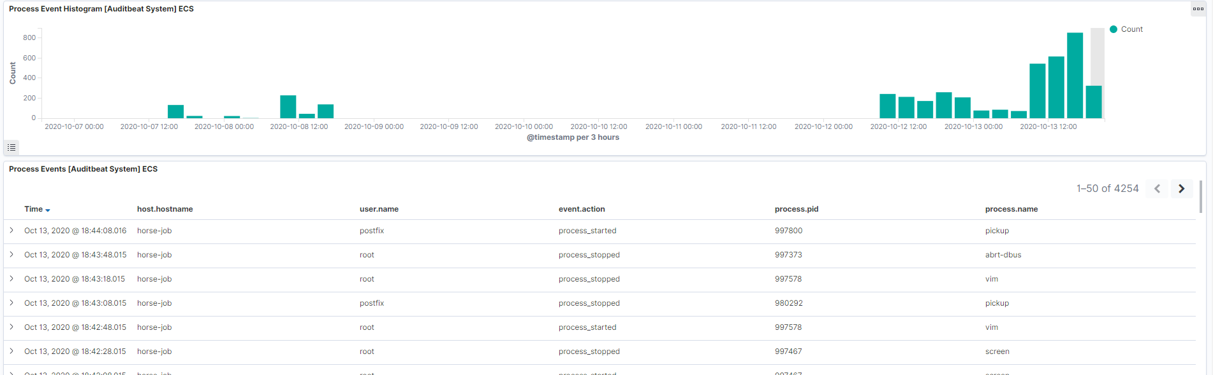
Auditbeat Process Dashboard II
選取時間內process event發生次數直方圖

Slide 63
Auditbeat Process Dashboard II
event為process的detail訊息

Slide 64
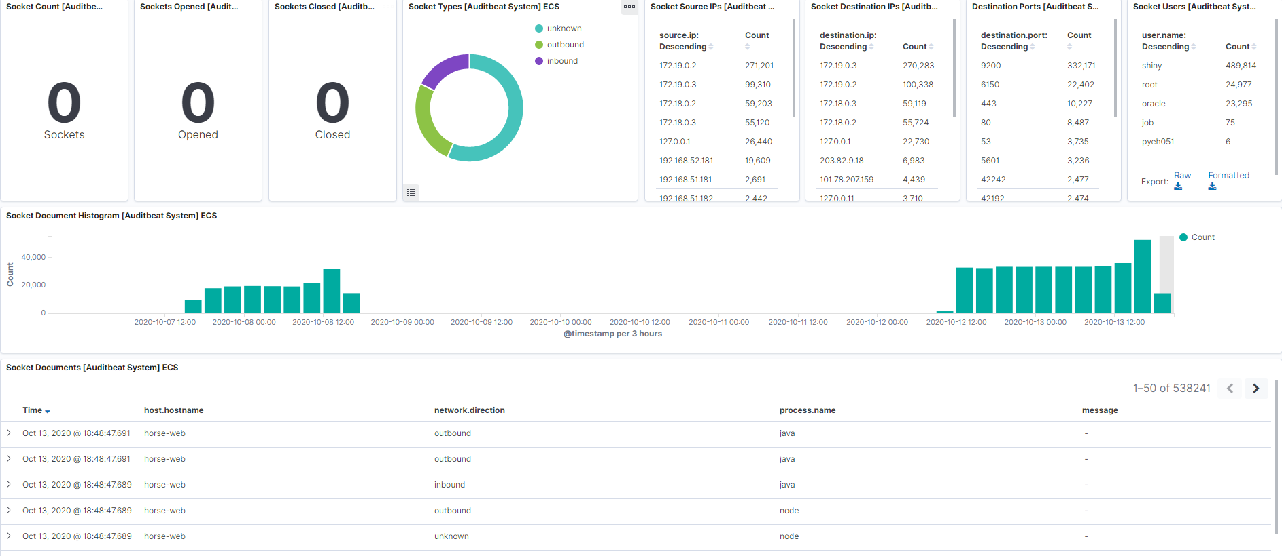
Auditbeat Socket Dashboard
透過host ID, socket inode, local IP, local port, remote IP, and remote port.建立出的ID uniquely identifying

Slide 65
Auditbeat Socket Dashboard
Socket event中socket open action的次數總和

Slide 66
Auditbeat Socket Dashboard
Socket event中socket close action的次數總和

Slide 67
Auditbeat Socket Dashboard
Direction of the network traffic圓餅圖

Slide 68
Auditbeat Socket Dashboard
SocketSource IP的ip and count

Slide 69
Auditbeat Socket Dashboard
Socket Destination IP的ip and count

Slide 70
Auditbeat Socket Dashboard
Port count

Slide 71
Auditbeat Socket Dashboard
Socket event中各user執行的次數總和

Slide 72
Auditbeat Socket Dashboard
選取時間內socket event發生次數直方圖

Slide 73
Auditbeat Socket Dashboard
event為Socket的detail訊息

Slide 74
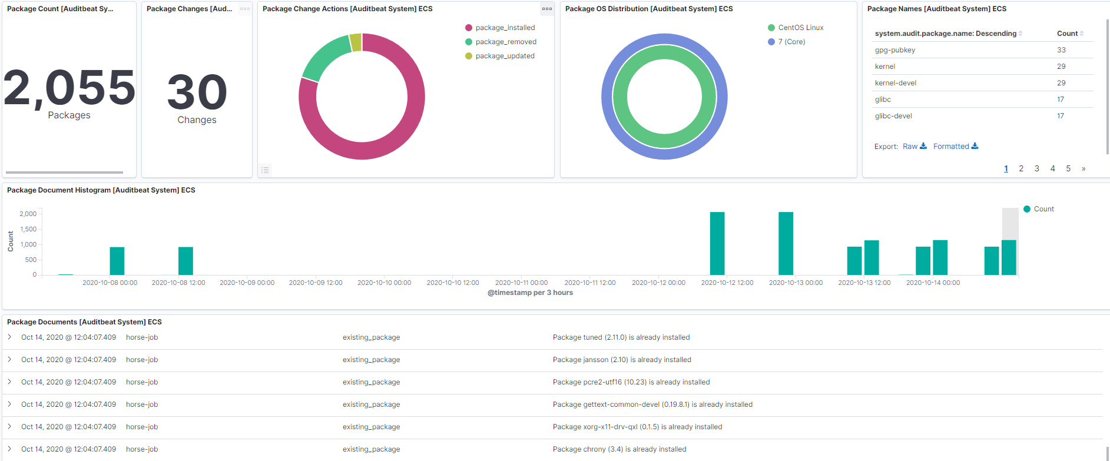
Auditbeat Package Dashboard
host ID, package name, and package version建立出的ID uniquely identifying

Slide 75
Auditbeat Package Dashboard
Deafult package以外的Action count

Slide 76
Auditbeat Package Dashboard
Deafult package以外的Action圓餅圖

Slide 77
Auditbeat Package Dashboard
有action type是login的host os資料

Slide 78
Auditbeat Package Dashboard
Package name action count

Slide 79
Auditbeat Package Dashboard
選取時間內Package event發生次數直方圖

Slide 80
Auditbeat Package Dashboard
event為package的detail訊息

Slide 81
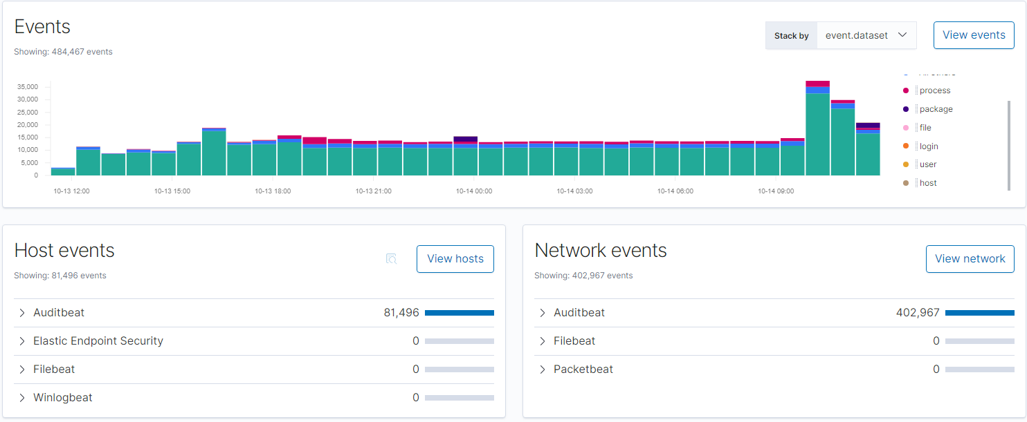
Security Overview Dashboard
Event直方圖,可以by action , dataset , module

Slide 82
Security Overview Dashboard
Host events來源count

Slide 83
Security Overview Dashboard
Network events來源count

Slide 84
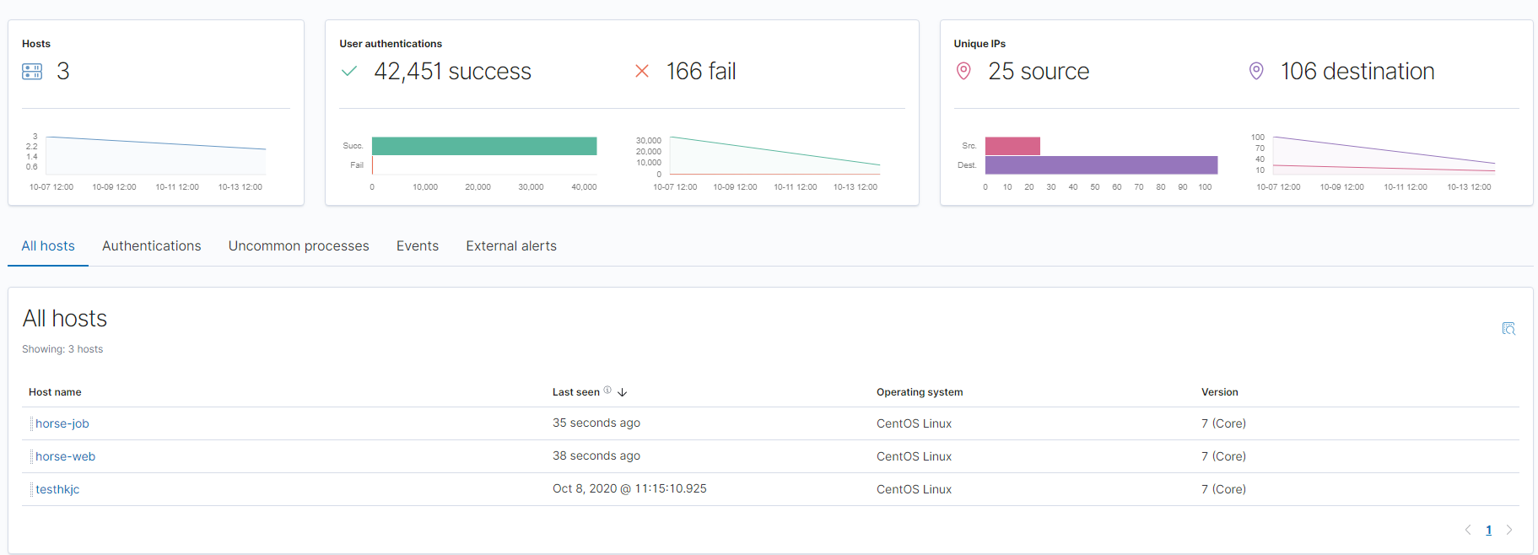
Security Host Dashboard
有安裝相關security source的host 總數

Slide 85
Security Host Dashboard
User authentications總和包含success and fail

Slide 86
Security Host Dashboard
Unique source and destination ip count

Slide 87
Security Host Dashboard
ALL host 相關訊息包含最後提交時間 system資料

Slide 88
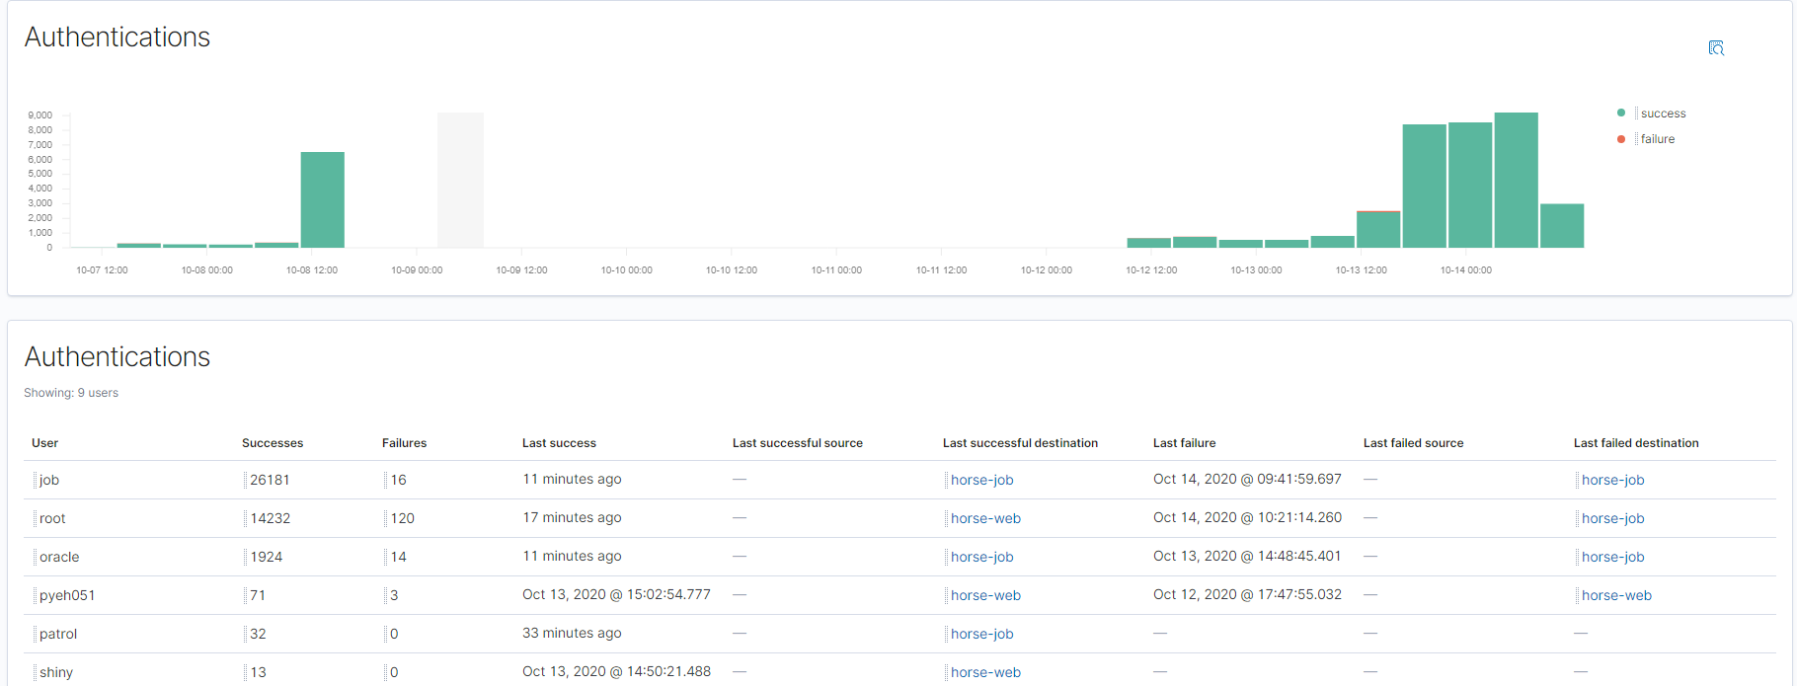
Security Host Dashboard-Authentications
Authentications success and failure直方圖
Each user authentications success and failure detail log

Slide 89
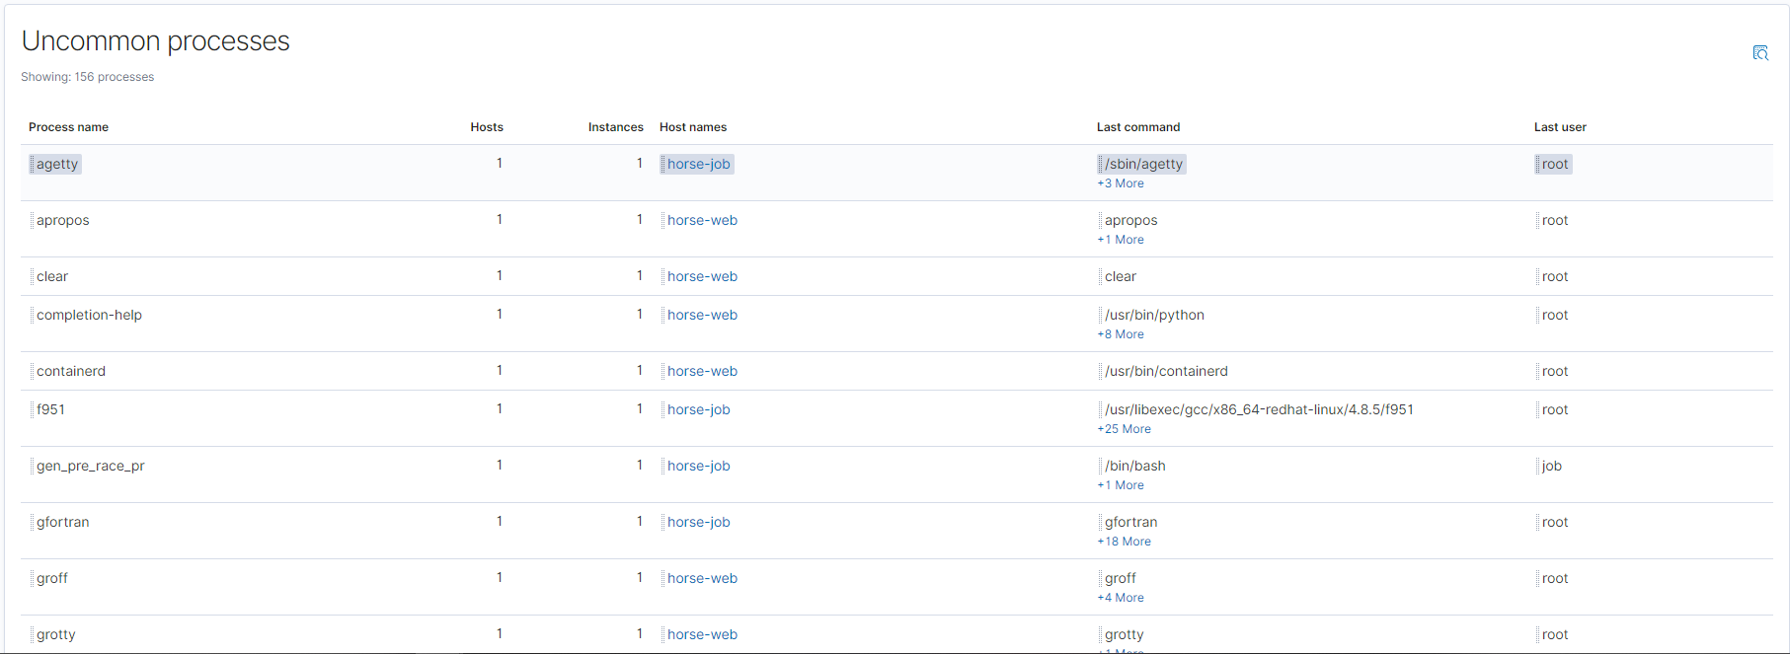
Security Host Dashboard-Uncommon processes
Each process 詳細內容

Slide 90
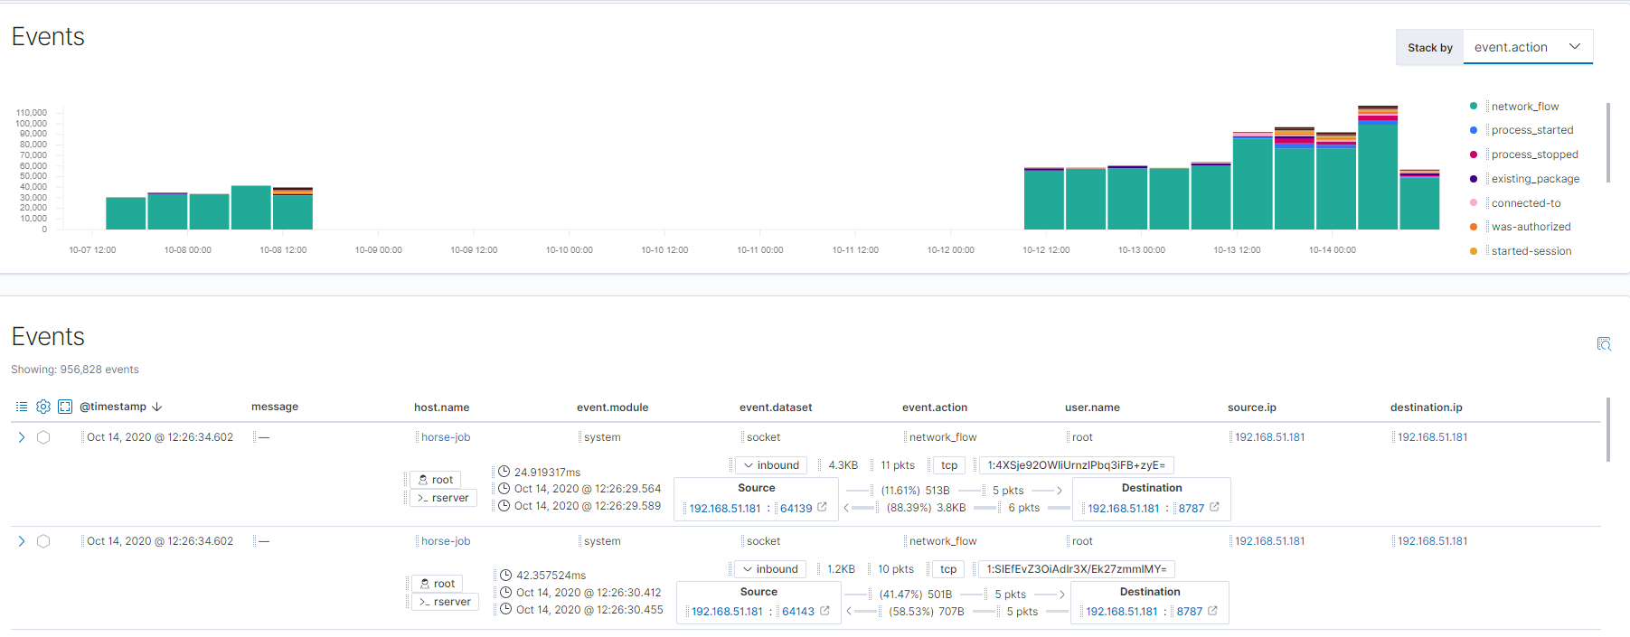
Security Host Dashboard-Events
Event直方圖,可以by action , dataset , module
Event的detail訊息包含source來源ip port封包大小 user等等訊息

Slide 91
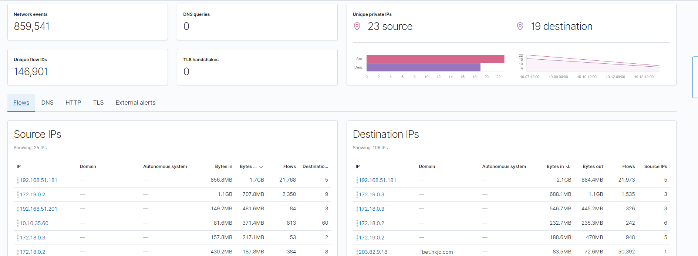
Security Network Dashboard
Network events count

Slide 92
Security Network Dashboard
Unique private IP , include source and destination

Slide 93
Security Network Dashboard
Source ip的詳細資料總計,可以點選ip看更多內容訊息

Slide 94
Security Network Dashboard
Destination ip的詳細資料總計,可以點選ip看更多內容訊息

Slide 95
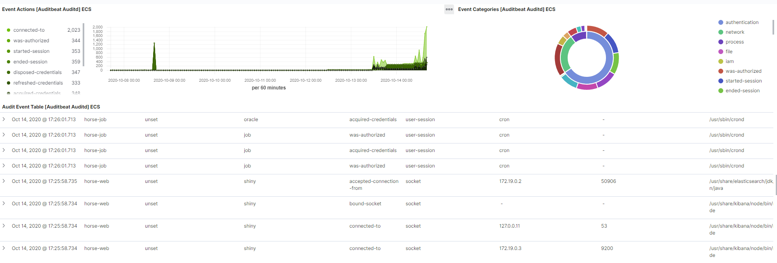
Auditbeat Auditd Overview Dashboard
Auditd event中action的count圖

Slide 96
Auditbeat Auditd Overview Dashboard
結合auditd event中category, action count的圓餅圖

Slide 97
Auditbeat Auditd Overview Dashboard
Auditd event detail log

Slide 98
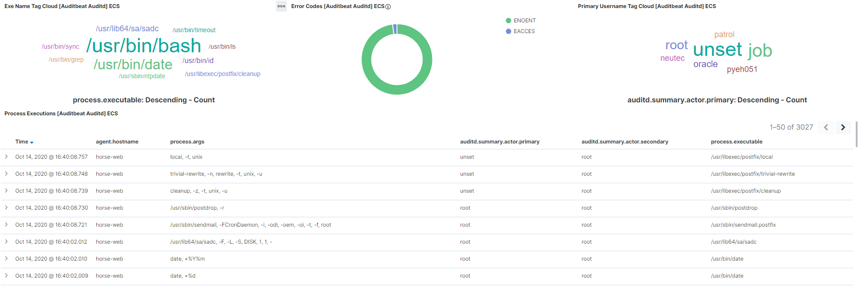
Auditbeat Auditd Executions Dashboard
Absolute path to the process executable.

Slide 99
Auditbeat Auditd Executions Dashboard
syscall exit code

Slide 100
Auditbeat Auditd Executions Dashboard
user that triggered the audit event.

Slide 101
Auditbeat Auditd Executions Dashboard
Auditd Process Executions detail log

Slide 102


