Slide 2
Spring Framework is a Java platform that provides comprehensive infrastructure support for developing Java applications. Spring handles the infrastructure so you can focus on your application.
Spring enables you to build applications from “plain old Java objects” (POJOs) and to apply enterprise services non-invasively to POJOs. This capability applies to the Java SE programming model and to full and partial Java EE.

Slide 3
Dependency Injection and Inversion of Control
Java applications -- a loose term that runs the gamut from constrained applets to n-tier server-side enterprise applications -- typically consist of objects that collaborate to form the application proper. Thus the objects in an application have dependencies on each other.
Although the Java platform provides a wealth of application development functionality, it lacks the means to organize the basic building blocks into a coherent whole, leaving that task to architects and developers. True, you can use design patterns such as Factory, Abstract Factory, Builder, Decorator, and Service Locator to compose the various classes and object instances that make up an application. However, these patterns are simply that: best practices given a name, with a description of what the pattern does, where to apply it, the problems it addresses, and so forth. Patterns are formalized best practices that you must implement yourself in your application.
The Spring Framework Inversion of Control (IoC) component addresses this concern by providing a formalized means of composing disparate components into a fully working application ready for use. The Spring Framework codifies formalized design patterns as first-class objects that you can integrate into your own application(s). Numerous organizations and institutions use the Spring Framework in this manner to engineer robust, maintainable applications.

Slide 4
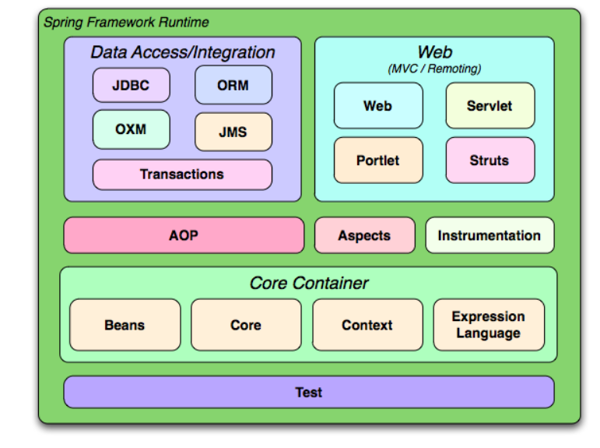
MODULES

Slide 5
The Spring Framework consists of features organized into about 20 modules. These modules are grouped into Core Container, Data Access/Integration, Web, AOP (Aspect Oriented Programming), Instrumentation, and Test, as shown in the following diagram.
Core Container
The Core Container consists of the Core, Beans, Context, and Expression Language modules.
The Core and Beans modules provide the fundamental parts of the framework, including the IoC and Dependency Injection features. The BeanFactory is a sophisticated implementation of the factory pattern. It removes the need for programmatic singletons and allows you to decouple the configuration and specification of dependencies from your actual program logic.
The Context module builds on the solid base provided by the Core and Beans modules: it is a means to access objects in a framework-style manner that is similar to a JNDI registry. The Context module inherits its features from the Beans module and adds support for internationalization (using, for example, resource bundles), event-propagation, resource-loading, and the transparent creation of contexts by, for example, a servlet container. The Context module also supports Java EE features such as EJB, JMX ,and basic remoting. The ApplicationContext interface is the focal point of the Context module.

Slide 6
The Expression Language module provides a powerful expression language for querying and manipulating an object graph at runtime. It is an extension of the unified expression language (unified EL) as specified in the JSP 2.1 specification. The language supports setting and getting property values, property assignment, method invocation, accessing the context of arrays, collections and indexers, logical and arithmetic operators, named variables, and retrieval of objects by name from Spring's IoC container. It also supports list projection and selection as well as common list aggregations.
Data Access/Integration
The Data Access/Integration layer consists of the JDBC, ORM, OXM, JMS and Transaction modules.
The JDBC module provides a JDBC-abstraction layer that removes the need to do tedious JDBC coding and parsing of database-vendor specific error codes.
The ORM module provides integration layers for popular object-relational mapping APIs, including JPA, JDO, Hibernate, and iBatis. Using the ORM package you can use all of these O/R-mapping frameworks in combination with all of the other features Spring offers, such as the simple declarative transaction management feature mentioned previously.
The OXM module provides an abstraction layer that supports Object/XML mapping implementations for JAXB, Castor, XMLBeans, JiBX and XStream.
The Java Messaging Service (JMS) module contains features for producing and consuming messages.
The Transaction module supports programmatic and declarative transaction management for classes that implement special interfaces and for all your POJOs (plain old Java objects).

Slide 7
Web
The Web layer consists of the Web, Web-Servlet, Web-Struts, and Web-Portlet modules.
Spring's Web module provides basic web-oriented integration features such as multipart file-upload functionality and the initialization of the IoC container using servlet listeners and a web-oriented application context. It also contains the web-related parts of Spring's remoting support.
The Web-Servlet module contains Spring's model-view-controller (MVC) implementation for web applications. Spring's MVC framework provides a clean separation between domain model code and web forms, and integrates with all the other features of the Spring Framework.
The Web-Struts module contains the support classes for integrating a classic Struts web tier within a Spring application. Note that this support is now deprecated as of Spring 3.0. Consider migrating your application to Struts 2.0 and its Spring integration or to a Spring MVC solution.
The Web-Portlet module provides the MVC implementation to be used in a portlet environment and mirrors the functionality of Web-Servlet module.

Slide 8
AOP and Instrumentation
Spring's AOP module provides an AOP Alliance-compliant aspect-oriented programming implementation allowing you to define, for example, method-interceptors and pointcuts to cleanly decouple code that implements functionality that should be separated. Using source-level metadata functionality, you can also incorporate behavioral information into your code, in a manner similar to that of .NET attributes.
The separate Aspects module provides integration with AspectJ.
The Instrumentation module provides class instrumentation support and classloader implementations to be used in certain application servers.

Slide 9
Test
The Test module supports the testing of Spring components with JUnit or TestNG. It provides consistent loading of Spring ApplicationContexts and caching of those contexts. It also provides mock objects that you can use to test your code in isolation.
The building blocks described previously make Spring a logical choice in many scenarios, from applets to full-fledged enterprise applications that use Spring's transaction management functionality and web framework integration.

Slide 10
The IoC container
It is a process whereby objects define their dependencies, that is, the other objects they work with, only through constructor arguments, arguments to a factory method, or properties that are set on the object instance after it is constructed or returned from a factory method. The container then injects those dependencies when it creates the bean. This process is fundamentally the inverse, hence the name Inversion of Control (IoC), of the bean itself controlling the instantiation or location of its dependencies by using direct construction of classes, or a mechanism such as the Service Locator pattern.
The org.springframework.beans and org.springframework.context packages are the basis for Spring Framework's IoC container. The BeanFactory interface provides an advanced configuration mechanism capable of managing any type of object. ApplicationContext is a sub-interface of BeanFactory. It adds easier integration with Spring's AOP features; message resource handling (for use in internationalization), event publication; and application-layer specific contexts such as the WebApplicationContext for use in web applications.
In Spring, the objects that form the backbone of your application and that are managed by the Spring IoC container are called beans. A bean is an object that is instantiated, assembled, and otherwise managed by a Spring IoC container. Otherwise, a bean is simply one of many objects in your application. Beans, and the dependencies among them, are reflected in the configuration metadata used by a container.

