Slide 1

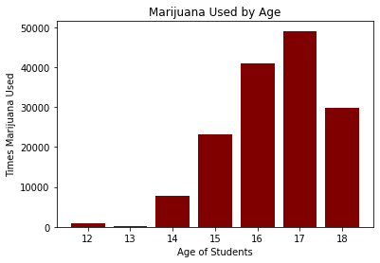
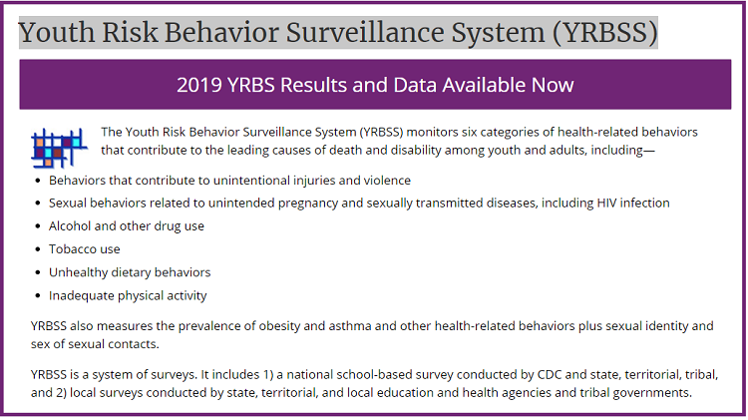
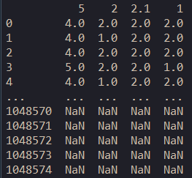
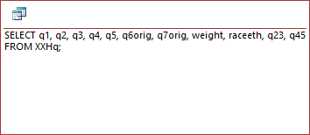
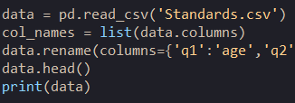
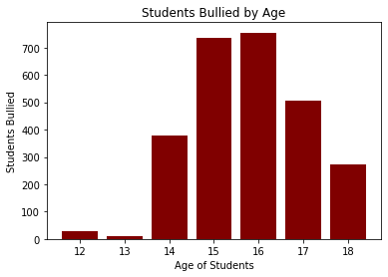
CSCI / ISAT B104
Fall 2021
Authors: Alex Wyman & Dominick Crowell
University of South Carolina Beaufort, Department of Computer Science
Background
Research Question and Hypothesis
Results (continued)
YRBS Background
Description of the Project
For this project, we must retrieve data of students getting bullied in school and using marijuana and determine whether there is a correlation between the two by creating Python graphics to compare the two.
2019 Data Set
Our data ranges from ages 12-18 and there are 6,640 male and 6,885 female respondents. The are 60 12-year-olds, 27 13-year-olds, 1,699 14-year-olds, 3,473 15-year-olds, 3,627 16-year-olds, 3,102 17-year-olds, and 1.616 18-year-olds who have responded to this survey.
We were attempting to determine: Is there is a correlation between kids being bullied and kids using marijuana? The hypothesis below guided our work.
Hypothesis: There is correlation between kids getting bullied in school and kids using marijuana.
Data Retrieval & Winnowing
To acquire our data, we used the links provided to us on your Blackboard project page, downloading the access file to use in MS Access. Once in access, we used a video made to inform people on how to make a SQL Query in Access. That is how we retrieved and winnowed my data to what we needed.
Raw Data SQL Statement
Discussion & Implications
Although the graphs showing bullied students and marijuana-using students aren’t the same, that follow a similar pattern by being low for ages 12-13, rising until 16-17, and then decreasing to 18 years old.
According to the data, it seems instances of bullying and marijuana use increase drastically at the start of high school and decrease toward the end.
Conclusion
Our hypothesis that there would be a correlation between being bullied and marijuana-use is somewhat correct as both graphs spike during high school years and begin to decrease toward the end of high school.
Python Code
 | Observed | Expected | Residual
1 | 28 17 | 9.02959 35.9704 | 18.97041 -18.9704
2 | 9 10 | 3.8125 15.1875 | 5.1875 -5.1875
3 | 380 1290 | 335.098 1334.9 | 44.902 -44.9
4 | 736 2678 | 685.045 2728.95 | 50.955 -50.95
5 | 755 2817 | 716.749 2855.25 | 38.251 -38.25
6 | 506 2558 | 614.815 2449.18 | -108.815 108.82
7 | 271 1326 | 320.45 1276.55 | -49.45 49.45
Test | Df | Chi-square | P-value
Pearson | 6 | 107.153 | 8.03961e-21
Results
Reference List
Log-likelihood | 6 | 94.686 | 3.21375e-18
Becker, E. (2017, 05 25). Processing data from a file. Retrieved 11 14, 2021, from Data Carpentry: https://datacarpentry.org/python-socialsci/05-processing-data-from-file/index.html
CDC. (2019). 2019 YRBS National, State, and District Combined Datasets User’s Guide. CDC. Retrieved 11 14, 2021, from https://www.cdc.gov/healthyyouth/data/yrbs/pdf/2019/2019_YRBS_SADC_Documentation.pdf
Monk, M. (2016, 3 6). SQL with Microsoft Access 2016 Lesson 4 - Select query. Retrieved 11 14, 2021, from https://www.youtube.com/watch?v=IFr4jvt_ZZc
We conducted a Chi Squared test of independence to determine the independence of age to drug use. The test showed that the two were independent as seen by the significant difference in the Chi-Square column.

