Slide 1

WEEK 3 · LESSON 11
Voice agents with ElevenLabs
Build an AI that you can talk to, and find where it gets slow or goes off topic.
Agentic AI Builder
Notes:
Welcome back. This is Lesson 11. It takes about 40 minutes. Build an AI that you can talk to, and find where it gets slow or goes off topic. Remind students they can reread the notes on the course site afterwards.

Slide 2
THE BIG IDEA
A voice agent is the same AI you already know, with ears and a mouth added. It listens, thinks, then speaks. What makes it feel good or bad is speed and turn-taking.
Notes:
Say this slowly in your own words, then ask: what is the one word that sticks out for you?

Slide 3

By the end you can…
Explain the difference between ElevenLabs' creative platform and its agents platform.
Create a conversational voice agent with a clear prompt and a chosen voice.
Test the agent live and identify where it is slow or goes off topic.
Notes:
Read the goals aloud. Come back to them in the recap and ask who can now do each one.

Slide 4
What is ElevenLabs?
Creative platform
Agents platform
Makes audio. You give it text and it reads it aloud in a chosen voice…
Runs a live conversation. It listens, thinks with a language model, and talks back, like a receptionist.
Notes:
ElevenLabs is a company, founded in 2022, that is a leader in generating realistic audio. It has two parts that are easy to mix up: Pricing: there is a generous free tier, and paid plans are monthly. Check the pricing page for current limits before you plan a big test.

Slide 5
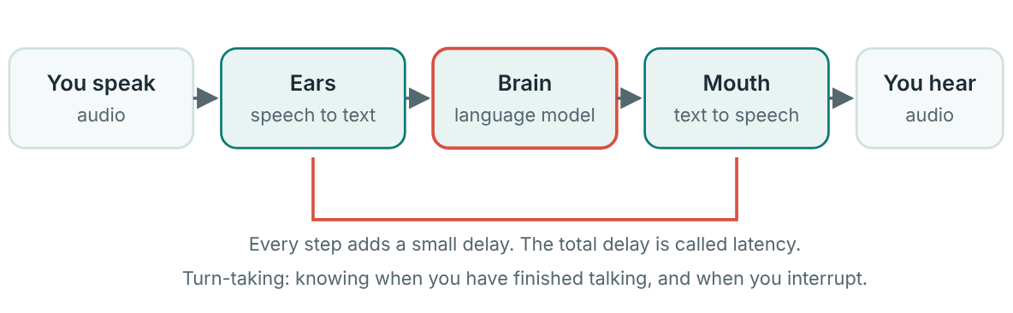
How a voice agent works: ears, brain, mouth
One turn of a voice conversation.
Notes:
Two things decide whether it feels natural: Latency. The pause between you finishing and the agent starting to answer. Long pauses feel awkward, like a bad phone line. Turn-taking. Knowing when you are done speaking and when you want to interrupt.

Slide 6
How a voice agent works: ears, brain, mouth
Latency. The pause between you finishing and the agent starting to answer. Long pauses feel awkward, like a bad phone line.
Turn-taking. Knowing when you are done speaking and when you want to interrupt.

Slide 7
Think of it like this
A receptionist
A good receptionist answers quickly, speaks in short sentences, does not read out a whole catalogue, and stays on the subject. That is exactly what we want from a voice agent.

Slide 8
Writing a prompt for voice
Ask for short sentences and a maximum length.
Ask for one question at a time.
No bullet points, emoji, or formatting symbols. They sound strange when read aloud.
Tell it what to do when it does not know.
Give it a first message, the greeting it says when a call begins.
Notes:
A prompt for voice differs from a prompt for chat. Spoken answers must be short and direct, because long ones sound unnatural and take longer to say. Ask for short sentences and a maximum length. Ask for one question at a time. No bullet points, emoji, or formatting symbols. They sound strange when read aloud. Tell it what to do when it does not know. Give it a first message, the greeting it says when a call begins.

Slide 9
Example system prompt
EXAMPLE SYSTEM PROMPT
You are the phone assistant for Hillside Bakery in Nyeri.
Your job is to answer questions about opening hours, the menu and how to order.
Speak in short, friendly sentences. Keep every answer under three sentences.
Ask only one question at a time.
Never read out long lists. Give the two most useful items and offer to say more.
If you do not know something, say "I'm not sure, but I can take a message."
Only talk about the bakery. If asked about anything else, politely say you can only help with the bakery.

Slide 10
Example first message
EXAMPLE FIRST MESSAGE
Hello, thanks for calling Hillside Bakery. How can I help you today?

Slide 11
Build your first voice agent
1
Create an account on the ElevenLabs website and open the Agents area.
2
Choose Create an agent and give it a name.
3
Paste your first message and your system prompt.
4
Pick a voice that suits the job. Listen to a few. Warm and clear usually beats dramatic.
5
Choose the language, and the language model if the settings offer a choice. Faster models usually mean lower latency.
Notes:
Create an account on the ElevenLabs website and open the Agents area. Choose Create an agent and give it a name. Paste your first message and your system prompt. Pick a voice that suits the job. Listen to a few. Warm and clear usually beats dramatic. Choose the language, and the language model if the settings offer a choice. Faster models usually mean lower latency. Use the test button to talk to it in your browser. Allow the microphone when your browser asks.

Slide 12
Your exercise
Build a voice agent that answers three scripted questions about a topic you choose (a bakery, a bicycle shop, a school, a salon). Time each response and note any answer that drifts off topic.
STEPS
Write three questions in advance, for example: “What time do you open on Saturday?” “Do you make…
Ask each one aloud.
Note whether the answer was on topic, correct for the information you gave it, and short enough.
Fix one problem in the prompt and ask the same questions again.
Notes:
Give students time to work. Walk around, and look at what they have rather than waiting for questions.

Slide 13
Quick check
1. What is the difference between ElevenLabs' creative platform and its agents platform?
2. Which three jobs does a voice agent do on every turn?
3. Which style of reply suits a voice agent best?
4. What is latency?
5. Your agent drifts off topic in a test. What is the best next step?
Notes:
Ask each question aloud before showing options. Answers: 1. The creative platform generates audio. The agents platform runs a live conversation. One is like hiring a voice-over artist. The other is like hiring a receptionist. 2. Listen (speech to text), think (language model), speak (text to speech). Ears, brain, mouth. 3. Short, direct sentences. Short answers sound natural and arrive faster. 4. The delay between you finishing speaking and the agent starting to answer. Every step in the pipeline adds a little delay, and the total is what you feel. 5. Add a clear rule to the prompt, then ask the same questions again. Fix one thing, then re-test with the same questions.

Slide 14
Words to know
ElevenLabs
Creative platform
A company that makes realistic AI audio.
ElevenLabs' tools for generating audio, such as reading text aloud in a chosen voice.
Agents platform
Speech to text
ElevenLabs' tools for running a live voice conversation with an AI.
Turning spoken audio into written words. The agent's ears.
Text to speech
Latency
Turning written words into spoken audio. The agent's mouth.
The delay between you finishing speaking and the agent starting to answer.
Notes:
Point at each word as you say it. Ask students to explain two of them to the person beside them.

Slide 15
Recap
A voice agent adds ears (speech to text) and a mouth (text to speech) to the language model brain.
Latency and turn-taking decide whether it feels natural. Short, direct prompts usually sound better.
Test with fixed questions, time each answer, and fix one problem at a time.
Notes:
Ask students to say each point back to you in their own words.

Slide 16
NEXT TIME
Lesson 12, Integrating ElevenLabs and n8n: two ways to join them, and how a webhook lets a voice agent trigger a workflow.
Notes:
Tell students what to prepare, for example an account to create or something to install, so the next lesson starts smoothly.

