Slide 1

WEEK 3 · LESSON 12
Joining ElevenLabs and n8n: two patterns
Choose who runs the show, and use a webhook as the bridge.
Agentic AI Builder
Notes:
Welcome back. This is Lesson 12. It takes about 45 minutes. Choose who runs the show, and use a webhook as the bridge. Remind students they can reread the notes on the course site afterwards.

Slide 2
THE BIG IDEA
There are two ways to join a voice agent to n8n. In Pattern A, n8n runs everything and borrows ElevenLabs for speech. In Pattern B, ElevenLabs runs the conversation and calls an n8n workflow when it needs something done.
Notes:
Say this slowly in your own words, then ask: what is the one word that sticks out for you?

Slide 3

By the end you can…
Compare the two integration patterns and choose one for a project.
Call ElevenLabs for text-to-speech and speech-to-text from an n8n workflow.
Give a voice agent a tool that triggers an n8n workflow.
Notes:
Read the goals aloud. Come back to them in the recap and ask who can now do each one.

Slide 4
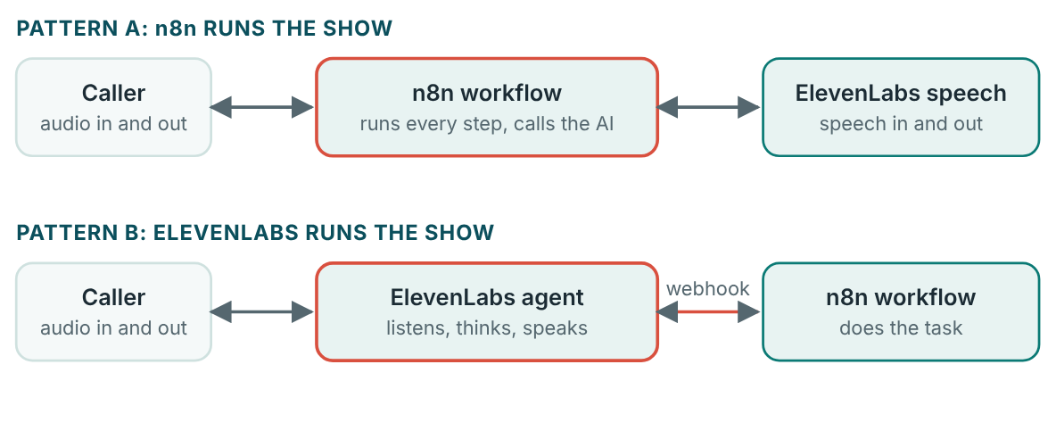
The two patterns
Who is in charge: the box in the middle that is outlined in red.

Slide 5
The two patterns
 | Pattern A: n8n orchestrates | Pattern B: ElevenLabs orchestrates
How it works | The whole workflow runs in n8n. | The voice agent runs in ElevenLabs.
Strengths | Simple. Everything is in one place. Easy to swap one service for… | Lower latency. Access to advanced voice features.
Moving parts | Fewer | More: two systems to keep in step
Best when | You process audio or text in batches… | You need a natural live conversation that sometimes triggers actions

Slide 6
Think of it like this
Who answers the phone
Pattern A: you answer the phone yourself and ask a translator to help each time. Pattern B: a receptionist answers the phone and walks over to you only when something needs doing.

Slide 7
The bridge: a webhook
1
In n8n: add a Webhook node.
2
Do the work. For a callback booking, add a node that writes a row to a Google Sheet with the name, phone number and time.
3
Reply. Add a Respond to Webhook node that returns a short answer such as {"result": "Callback booked for 3 pm"}.
4
In ElevenLabs: open the agent's tools and add a webhook tool (some versions call it a server tool).
5
Tell the agent when to use it, in its system prompt.
Notes:
In Pattern B, the voice agent needs a way to ask n8n to do something. That bridge is the webhook from Lesson 9: an address that wakes up a workflow. The agent's “tool” is simply a call to that address. In n8n: add a Webhook node. Set the method to POST and choose a path. Set it to respond using a Respond to Webhook node, so the answer goes back to the agent. Do the work. For a callback booking, add a node that writes a row to a Google Sheet with the name, phone number and time. Reply. Add a Respond to Webhook node that returns a short answer such as {"result": "Callback booked for 3 pm"}. In ElevenLabs: open the agent's tools and add a webhook tool (some versions call it a server tool). Paste the n8n address, choose POST, and describe the tool in plain words: “Use this to book a callback. It needs the caller's name, phone number and preferred time.” Tell the agent when to use it, in its system prompt.

Slide 8

Test address or production address?
The test URL in n8n only works while you are actively listening for a test event. A live agent needs the production URL, and the workflow must be active. This is the most common reason a tool “works in n8n but not from the agent”.

Slide 9
Lock the door
A webhook is public to anyone who has the address. If the tool settings let you add a secret header, add one, and make the n8n Webhook node require it, so only your agent can trigger the workflow.

Slide 10
Pattern A in practice
Text to speech: a POST request that sends the reply text and chooses a voice. It returns audio.
Speech to text: a POST request that sends an audio file. It returns the written words.
Notes:
In Pattern A, n8n calls ElevenLabs the same way it calls any API, using the HTTP Request node. The key goes in a header, as in Lesson 1. Text to speech: a POST request that sends the reply text and chooses a voice. It returns audio. Speech to text: a POST request that sends an audio file. It returns the written words. The exact address, header names and fields are in the ElevenLabs API documentation, and they change from time to time. Always copy from the current docs. Store the key in an n8n credential, never inside the workflow text.

Slide 11
Your exercise
Build the same task both ways, such as booking a callback. Then compare.
STEPS
Task: a caller gives a name, a phone number and a time.
Pattern B build: an ElevenLabs agent with a webhook tool that calls an n8n workflow.
Pattern A build: an n8n workflow that takes the request as text, writes the row…
Compare the two using the table below.
Notes:
Give students time to work. Walk around, and look at what they have rather than waiting for questions.

Slide 12
Quick check
1. In Pattern A, who runs the whole workflow?
2. What are the main strengths of Pattern B?
3. What is the bridge between a voice agent and an n8n workflow in Pattern B?
4. Which pattern is simplest and keeps everything in one place?
5. A webhook tool works when you test in n8n but fails from the live agent. What is the likely cause?
Notes:
Ask each question aloud before showing options. Answers: 1. n8n, which calls ElevenLabs when it needs speech. Pattern A is n8n orchestration. 2. Lower latency and access to advanced voice features. Pattern B lets ElevenLabs run the conversation natively. The price is two systems to keep in step. 3. A webhook. The agent's tool calls the webhook address, which starts the workflow. 4. Pattern A. Pattern A has fewer moving parts and makes it easy to swap one service for another. 5. The agent uses the test URL, or the workflow is not active. A live agent needs the production URL, and the workflow must be active.

Slide 13
Words to know
Pattern A
Pattern B
n8n orchestration: the whole workflow runs in n8n, which calls ElevenLabs for speech.
ElevenLabs orchestration: the voice agent runs the conversation and calls an n8n workflow…
Orchestration
Webhook tool
Deciding which part runs, and in what order. Who is in charge.
A tool for a voice agent that calls a webhook address to trigger a workflow.
Production URL
Test URL
The webhook address that works while the workflow is active. Use it for live agents.
The webhook address that only works while you are listening for a test event in n8n.
Notes:
Point at each word as you say it. Ask students to explain two of them to the person beside them.

Slide 14
Recap
Pattern A: n8n runs everything and borrows ElevenLabs for speech. Simple, one place, easy to swap services.
Pattern B: ElevenLabs runs the conversation and calls n8n as a tool. Lower latency, advanced voice features, more parts.
A webhook is the bridge. Use the production URL for live agents, and lock the door with a secret header where you can.
Notes:
Ask students to say each point back to you in their own words.

Slide 15
NEXT TIME
Lesson 13, RAG and agentic RAG: how to let an AI answer from your own documents instead of guessing.
Notes:
Tell students what to prepare, for example an account to create or something to install, so the next lesson starts smoothly.

