Slide 1

WEEK 3 · LESSON 13
RAG and agentic RAG
How an AI answers from your own documents instead of guessing.
Agentic AI Builder
Notes:
Welcome back. This is Lesson 13. It takes about 45 minutes. How an AI answers from your own documents instead of guessing. Remind students they can reread the notes on the course site afterwards.

Slide 2
THE BIG IDEA
RAG stands for Retrieval-Augmented Generation. In plain words: before the AI answers, it looks up the right pages in your documents, then answers using only those pages.
Notes:
Say this slowly in your own words, then ask: what is the one word that sticks out for you?

Slide 3

By the end you can…
Explain embeddings, chunking and similarity search in simple terms.
Describe the two phases of RAG: ingestion and answering.
Explain how agentic RAG differs from standard RAG.
Notes:
Read the goals aloud. Come back to them in the recap and ask who can now do each one.

Slide 4
Think of it like this
An open-book exam
A closed-book exam tests memory. An open-book exam lets the student find the right page, then answer from it. RAG turns your AI into an open-book student, and the book is your documents.
Notes:
A language model only knows what it learned in training. It has never seen your price list, your policies or your product sheets. If you ask, it may guess, and a confident guess is the worst kind of wrong answer.

Slide 5
Think of it like this
A map
Imagine a map where every sentence is a pin. “How do I return shoes?” and “What is your refund policy?” land close together. “Best pizza in town” lands far away. The numbers are the pin's coordinates.
Notes:
A computer cannot compare meaning directly. So we turn each piece of text into a long list of numbers called an embedding. Texts with similar meaning get similar numbers. To find relevant text, we turn the question into a pin too, and fetch the nearest pins. This is called similarity search. Try it: Real embeddings have hundreds or thousands of numbers, not two, but the idea is the same: close together means similar meaning.

Slide 6
Chunking: cutting documents into pieces
Too big: a chunk covers many topics, so the match is vague.
Too small: a chunk loses its context, such as a price with no product name.
Good starting point: a few sentences or one short section, often with a small overlap between neighbours.
Notes:
You do not search whole documents. You cut them into chunks, short passages, and give each one an embedding. Too big: a chunk covers many topics, so the match is vague. Too small: a chunk loses its context, such as a price with no product name. Good starting point: a few sentences or one short section, often with a small overlap between neighbours.

Slide 7
Think of it like this
Index cards
Instead of handing someone a whole textbook, you write each idea on its own index card. Finding the right card is quick. But a card that just says “KES 450” is useless.

Slide 8
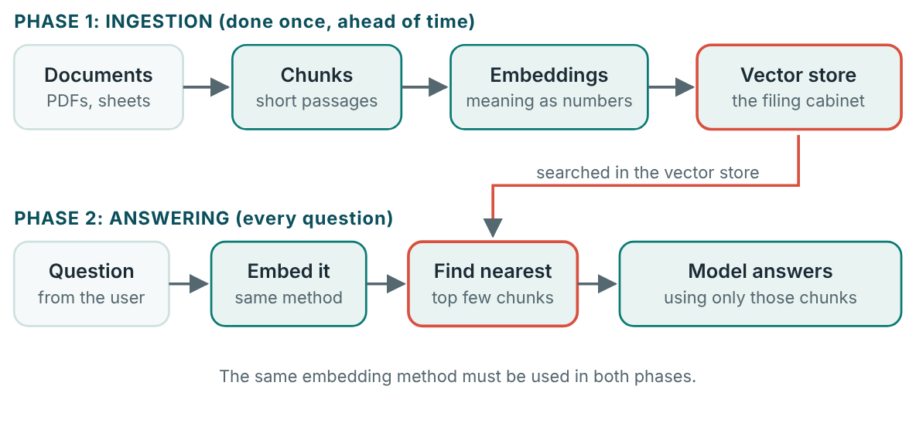
The two phases
Ingestion fills the filing cabinet. Answering looks things up in it.

Slide 9

One rule that catches everyone
The question and the documents must be embedded with the same model. Mix them and the map no longer lines up, so the search returns nonsense.

Slide 10
Standard RAG and agentic RAG
 | Standard RAG | Agentic RAG
Who decides to search? | The system. It always searches once, then answers. | The agent. It chooses whether to search, what to search for…
Number of searches | Exactly one | Zero, one or several
Good for | Simple, predictable questions | Vague or multi-part questions, small talk, comparing two items
Cost and speed | Faster and cheaper | Slower and costlier, more flexible
Notes:
Example: a customer asks, “Compare the Basic and Pro blender, and tell me which is quieter.” An agentic system searches for Basic, then searches for Pro, then compares. A one-shot system may only retrieve one of them.

Slide 11
Think of it like this
Two librarians
The first librarian always walks to one shelf and brings back whatever is there. The second thinks first: “Do I need a book? Which shelf? Is this enough, or should I check another?” That second librarian is agentic RAG. In n8n, the search is simply a tool you give the agent, as in Lesson 4.

Slide 12
Grounding rules for the prompt
GROUNDING RULES FOR THE PROMPT
Answer only using the information returned by the search tool.
If the search results do not contain the answer, say "I don't have that information" and offer to take a message.
Never use outside knowledge for prices, specifications or policies.
When you give a price or a specification, say which product it belongs to.
Notes:
Without such rules the model happily fills gaps from its own memory, which is exactly what you were trying to stop.

Slide 13

Try it live
Open this lesson's page on the course site and play with the interactive demo.
Change the inputs, watch what happens, and say out loud what you think will change before you click.
Notes:
Open the lesson page on the course site and use the interactive demo together. Let students suggest the inputs.

Slide 14
Your exercise
On paper or in a document, plan a RAG system for a small business before building anything. Lesson 14 builds the real thing.
DONE WHEN…
I can explain an embedding using the map comparison
I can name the two phases and what happens in each
I can explain standard versus agentic RAG in one sentence
Notes:
Give students time to work. Walk around, and look at what they have rather than waiting for questions.

Slide 15
Quick check
1. What does RAG add to a language model?
2. What is an embedding?
3. Why do we cut documents into chunks?
4. What must stay the same between ingestion and answering?
5. What makes RAG agentic?
Notes:
Ask each question aloud before showing options. Answers: 1. It looks up relevant text from your documents before answering. Retrieval-Augmented Generation means retrieve first, then generate the answer. 2. A list of numbers that represents the meaning of a piece of text. Similar meanings give similar numbers. 3. So the search can find short, specific passages. Chunks are like index cards: quick to find and focused on one idea. 4. The embedding model. A different embedding model means a different map, so the search no longer works. 5. The agent decides whether, what and how many times to search. In agentic RAG the search is a tool the agent chooses to use.

Slide 16
Words to know
RAG
Embedding
Retrieval-Augmented Generation. Look up relevant text first, then answer from it.
A list of numbers that stands for the meaning of a piece of text.
Chunk
Similarity search
A short passage cut from a larger document, searched and retrieved on its own.
Finding the stored chunks whose embeddings are closest to the question's.
Vector store
Ingestion
A database that holds embeddings and can search them by closeness.
The one-off preparation phase: cut documents into chunks, embed them, store them.
Notes:
Point at each word as you say it. Ask students to explain two of them to the person beside them.

Slide 17
Recap
RAG lets the AI answer from your documents: look up the right chunks first, then answer using only them.
Embeddings turn meaning into numbers. Similarity search finds the nearest chunks. Use the same embedding model in both phases.
Ingestion happens ahead of time. Answering happens on every question. Agentic RAG lets the agent decide when to search.
Notes:
Ask students to say each point back to you in their own words.

Slide 18
NEXT TIME
Lesson 14, Supabase vectors and data ingest: build the real filing cabinet and load your product data into it.
Notes:
Tell students what to prepare, for example an account to create or something to install, so the next lesson starts smoothly.

