Slide 1

WEEK 3 · LESSON 14
Supabase vectors and data ingest
Build the filing cabinet, load your data into it, and check that the search finds the right things.
Agentic AI Builder
Notes:
Welcome back. This is Lesson 14. It takes about 55 minutes. Build the filing cabinet, load your data into it, and check that the search finds the right things. Remind students they can reread the notes on the course site afterwards.

Slide 2
THE BIG IDEA
Supabase gives you a database that can store embeddings and search them by closeness. An n8n workflow reads your data, embeds it and files it there. Then you test the search before you trust it.
Notes:
Say this slowly in your own words, then ask: what is the one word that sticks out for you?

Slide 3

By the end you can…
Create a vector table in Supabase.
Build an n8n ingestion workflow that loads product data with metadata.
Check retrieval quality with a quick test.
Notes:
Read the goals aloud. Come back to them in the recap and ask who can now do each one.

Slide 4
Think of it like this
A filing cabinet with a smart assistant
A normal database is a cabinet where you find a file by its exact label. A vector database is a cabinet where you can say “bring me whatever is about returning shoes” and it brings the nearest matches.
Notes:
Supabase is an online database service built on PostgreSQL. It has a free tier. An add-on called pgvector lets it store embeddings and find the closest ones.

Slide 5
Step 1: create the table
1
Create a free Supabase account and a new project. Save the database password somewhere safe.
2
Open the SQL Editor.
3
Paste the code below and run it.
Notes:
Create a free Supabase account and a new project. Save the database password somewhere safe. Open the SQL Editor. Paste the code below and run it.

Slide 6

The number 1536 must match your embedding model
This is the length of each embedding. It must be identical to the length your embedding model produces. A common OpenAI embedding model produces 1536. If you pick another model, check its length in its documentation and change the number in both places. A mismatch is the most common error in this lesson.

Slide 7
The service key is a master key
The service role key can read and write everything and skips the safety rules. Put it only inside an n8n credential. Never paste it into a web page, a chat, a screenshot or a public GitHub repository. If it leaks, rotate it in Supabase straight away.
Notes:
In Supabase, open the project settings and find the project URL and the API keys. n8n's Supabase credential asks for the URL and a key.

Slide 8
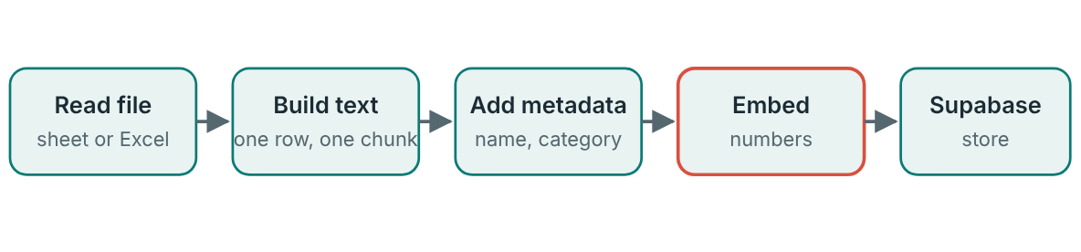
Step 3: the ingestion workflow
Run once to load, and again when the data changes.
Notes:
Read your data. Use a Google Sheets node, or the node that reads a spreadsheet file, to get one item per product. Make each row one readable chunk. Use an Edit Fields node to build a sentence that includes the product name, so context is never lost: {{ $json.Name }} ({{ $json.Category }}). {{ $json.Description }} Price: {{ $json.Price }}. Add the Supabase Vector Store node with the operation to add documents. Pick your table and connect an embeddings model node and a document loader. Add metadata in the loader: the product name, category and any ID. Metadata lets you filter later and show where an answer came from. Run it once and open the table in Supabase. You should see one row per product, with text, metadata and a long embedding.

Slide 9
Step 3: the ingestion workflow
1
Read your data. Use a Google Sheets node, or the node that reads a spreadsheet file, to get one item per product.
2
Make each row one readable chunk.
3
Add the Supabase Vector Store node with the operation to add documents.
4
Add metadata in the loader: the product name, category and any ID.
5
Run it once and open the table in Supabase. You should see one row per product, with text, metadata and a long embedding.

Slide 10
Step 4: test the retrieval
1
Pick 10 products at random from your file.
2
For each one, write a natural question about it, for example “How much is the quiet blender?”
3
Ask each question through a search-only workflow (a vector store node set to retrieve, with no agent yet).
4
Check whether the right product appears in the top 3 results.
Notes:
Never trust a search you have not tested. A quick method: Pick 10 products at random from your file. For each one, write a natural question about it, for example “How much is the quiet blender?” Ask each question through a search-only workflow (a vector store node set to retrieve, with no agent yet). Check whether the right product appears in the top 3 results. Eight or more out of ten in the top three is a healthy start. If you get fewer, change the chunk text (add the name, category and key words) and re-load before changing anything else.

Slide 11
Step 4: test the retrieval (worksheet)
#
Product
My question
In top 3? (yes / no)

Slide 12
Your exercise
DONE WHEN…
The documents table exists in Supabase
Every product is a row with text, metadata and an embedding
I loaded the data only once and there are no duplicates
I ran the 10-product test and recorded the results
My service key lives only in an n8n credential
Notes:
Give students time to work. Walk around, and look at what they have rather than waiting for questions.

Slide 13
Quick check
1. What does pgvector add to a PostgreSQL database?
2. Why must the vector size (such as 1536) match your embedding model?
3. Why add metadata to each chunk?
4. What is the safest place for the Supabase service key?
5. How do you check whether the search is good?
Notes:
Ask each question aloud before showing options. Answers: 1. The ability to store embeddings and search by closeness. pgvector is the add-on that makes a normal database into a vector store. 2. A table and an embedding model with different lengths cannot work together. A dimension mismatch is the most common error. 3. To filter results and show where an answer came from. Metadata such as the product name and category makes results traceable and filterable. 4. Inside an n8n credential. The service key is a master key. Keep it out of anything shared. 5. Ask questions about 10 random products and see if each appears in the top 3. Test retrieval separately before adding an agent on top.

Slide 14
Words to know
Supabase
PostgreSQL
An online database service built on PostgreSQL, with a free tier.
A widely used database. Supabase is built on it.
pgvector
Metadata
An add-on that lets PostgreSQL store and search embeddings.
Extra labels attached to a chunk, such as product name and category.
Dimensions
Service key
The length of an embedding, for example 1536 numbers.
A master key for your Supabase project. Never share it.
Notes:
Point at each word as you say it. Ask students to explain two of them to the person beside them.

Slide 15
Recap
Supabase with pgvector is the vector store: one row per chunk, holding text, metadata and an embedding.
The ingestion workflow reads data, builds a readable chunk for each row, adds metadata, embeds it and stores it. Load once.
Test retrieval with 10 random products before adding an agent. Match the vector size to your embedding model and guard your service key.
Notes:
Ask students to say each point back to you in their own words.

Slide 16
NEXT TIME
Lesson 15, the Week 3 project: a Product Expert voice agent that answers from your product data and declines what it should not answer.
Notes:
Tell students what to prepare, for example an account to create or something to install, so the next lesson starts smoothly.

