Slide 1

WEEK 3 · LESSON 15
Project: the Product Expert voice agent
Put Week 3 together: a voice agent that answers questions from your product data and declines the rest.
PROJECT
Agentic AI Builder
Notes:
Welcome back. This is Lesson 15. It takes about 90 minutes. Put Week 3 together: a voice agent that answers questions from your product data and declines the rest. Remind students they can reread the notes on the course site afterwards.

Slide 2
THE BIG IDEA
You will build a voice agent that knows your products. Ask it about a price and it answers correctly. Ask it about something outside the catalogue and it politely says no. Then you prove it works with a test.
Notes:
Say this slowly in your own words, then ask: what is the one word that sticks out for you?

Slide 3
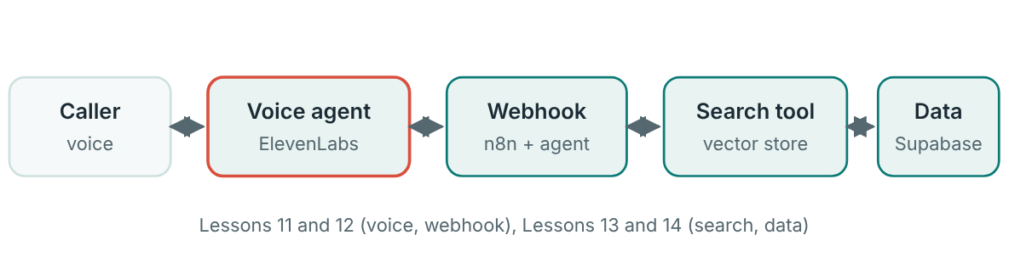
What you are combining
Pattern B from Lesson 12, with agentic RAG behind the webhook.

Slide 4
Your starting files
Products.xlsx: the product list to load into Supabase.
voice.html: a ready-made web page that hosts the voice agent so you can talk to it in a browser.
Notes:
Products.xlsx: the product list to load into Supabase. voice.html: a ready-made web page that hosts the voice agent so you can talk to it in a browser. Use the files your teacher shares. If you do not have them yet, ask before you start.

Slide 5
Build it in order
1
Load the data (Lesson 14).
2
Build the answering workflow.
3
Write the grounding prompt.
4
Create the voice agent (Lesson 11). Short answers, one question at a time, a clear first message.
5
Connect them (Lesson 12). Add a webhook tool that sends the caller's question to your production URL. Add a secret header.
Notes:
Load the data (Lesson 14). Create the table, load every product once with metadata, and run the 10-product retrieval test. Do not move on until at least eight of ten pass. Build the answering workflow. A Webhook node, an AI Agent with a chat model, and the vector store as a tool. Return the answer with Respond to Webhook. Write the grounding prompt. Answer only from the search results. Say “I don't have that information” when it is not there. Decline anything outside your products. Create the voice agent (Lesson 11). Short answers, one question at a time, a clear first message. Connect them (Lesson 12). Add a webhook tool that sends the caller's question to your production URL. Add a secret header. Open voice.html and talk to your agent. Test, fix, and test again using the table below.

Slide 6
Starter prompt for the n8n agent
STARTER PROMPT FOR THE N8N AGENT
You are a product expert for our store.
Use the search tool to find product information. Search before every answer about a product.
Answer only with facts returned by the search tool. Always mention the product name with any price or specification.
If the tool does not return the answer, say "I don't have that information."
If the question is not about our products, say you can only help with our products.
For questions comparing two products, search for each one separately.
Keep every answer to two short sentences.

Slide 7
The test (worksheet)
#
Type
Question
Correct answer
Agent said
Notes:
Write 20 questions before you start fixing anything: 17 about your products and 3 that are out of scope (for example, “What is the weather like?”, “Tell me a joke”, “Which phone should I buy?” if you sell kitchen items). Mix easy and tricky: price, features, comparisons, a product that does not exist, a misspelled name. For each question, write the correct answer from your file first. Then ask the agent and mark it. The table above shows the first rows. Copy the pattern in your own notebook or sheet for all 20 questions.

Slide 8
When a question fails: find the layer
Symptom | Layer | Try this
Search returned the wrong product | Data and chunks | Put name, category and key words in each chunk. Re-load once.
Right product retrieved, wrong answer given | n8n agent prompt | Tighten the grounding rules. Ask it to quote the retrieved text.
Answers things it should decline | Both prompts | Add explicit refusal rules and examples of what is out of scope.
Slow or rambling | Voice agent | Shorter prompt, two-sentence limit, faster model.
The tool is never called | Voice agent tool | Improve the tool description and say when to use it.

Slide 9

Before you share anything
Open your exported workflow and search it for any key, password or secret header. Remove them. Credentials should live in n8n only.

Slide 10
How it will be judged
Area | Strong work looks like
Correctness | At least 85% of in-scope answers right…
Staying in scope | All out-of-scope questions politely declined, with no invented answers
Voice quality | Short, natural replies and a reasonable pause before answering
Testing | 20 written questions, honest results…
Safety | No secrets in files, a secured webhook

Slide 11
Quick check
1. What are the two pass conditions for the project?
2. A question fails because the wrong product was retrieved. Which layer do you fix first?
3. A confident answer gives the wrong price. How is it marked?
4. The tool works in n8n but never fires from the voice agent. What do you check?
5. What must you remove from a workflow before sharing it?
Notes:
Ask each question aloud before showing options. Answers: 1. At least 85% of in-scope questions correct and all 3 out-of-scope questions declined. Correctness and staying in scope are both required. 2. The data and chunks. If retrieval is wrong, no prompt can rescue the answer. 3. As a fail. A confident wrong answer is the worst kind of error. 4. That it uses the production URL and the workflow is active. Test URLs only work while n8n is listening. 5. Any keys, passwords or secret headers. Secrets belong in credentials, not in files you hand in.

Slide 12
Words to know
In scope
Out of scope
A question the agent should be able to answer from its data.
A question the agent should politely decline.
Test set
Grounding prompt
A fixed list of questions with known right answers, used to measure quality.
Instructions telling the agent to answer only from retrieved information.
Regression
A fix that breaks something that used to work. Re-run the whole test after every change.
Notes:
Point at each word as you say it. Ask students to explain two of them to the person beside them.

Slide 13

Recap
The Product Expert combines Week 3: a voice agent calls a webhook, an n8n agent searches Supabase, and the answer comes back.
Write the 20-question test first. Target at least 85% in scope and 3 of 3 declined out of scope.
When something fails, find the layer: data, n8n prompt, voice agent or webhook. Fix one thing, then re-run the whole test.
Notes:
Ask students to say each point back to you in their own words.

Slide 14
NEXT TIME
Lesson 16, self-hosted n8n and local models: run your own n8n and a model on your own computer.
Notes:
Tell students what to prepare, for example an account to create or something to install, so the next lesson starts smoothly.

