Slide 1

WEEK 4 · LESSON 17
Advanced integrations
Send data with POST, split work into sub-workflows, and handle errors without panic.
Agentic AI Builder
Notes:
Welcome back. This is Lesson 17. It takes about 50 minutes. Send data with POST, split work into sub-workflows, and handle errors without panic. Remind students they can reread the notes on the course site afterwards.

Slide 2
THE BIG IDEA
Real workflows must survive real life: services go down, replies come back wrong, and a workflow grows too big to read. This lesson gives you three habits: call APIs properly, split big workflows into small ones, and plan for failure.
Notes:
Say this slowly in your own words, then ask: what is the one word that sticks out for you?

Slide 3

By the end you can…
Pick the right authentication and send a POST request with JSON from n8n.
Split a large workflow into reusable sub-workflows.
Add retries and an error branch so failures are handled, not hidden.
Notes:
Read the goals aloud. Come back to them in the recap and ask who can now do each one.

Slide 4
Recap: choosing authentication
Pattern | When to use it
API key | The service gives you a key. Simplest. Store it in an n8n credential.
Pre-configured OAuth2 | n8n has a built-in login for the service (Google Sheets, Gmail).
Custom OAuth2 | The service offers only OAuth2 and n8n has no ready login.
Notes:
Always try the easiest that the service supports.

Slide 5
The HTTP Request node
1
Set the method (GET to fetch, POST to send).
2
Paste the URL from the service's documentation.
3
Choose authentication and pick a saved credential. Do not type keys into the node.
4
For POST, switch on Send Body, choose JSON, and fill in the fields the documentation asks for.
Notes:
If n8n has no ready-made node for a service, the HTTP Request node can call any web API. You already did this by hand in Lesson 1. Set the method (GET to fetch, POST to send). Paste the URL from the service's documentation. Choose authentication and pick a saved credential. Do not type keys into the node. For POST, switch on Send Body, choose JSON, and fill in the fields the documentation asks for. The double curly braces are expressions from Lesson 9. They fill in the real values for each item.

Slide 6
Think of it like this
A recipe card
A big cookbook says “make the sauce (page 12)” instead of repeating the sauce steps in every recipe. A sub-workflow is page 12.
Notes:
A workflow with fifty boxes is hard to read and harder to fix. Move a repeated or self-contained job into its own workflow, then call it from the main one with the Execute Workflow node. Create a new workflow and start it with the Execute Workflow Trigger node. Build the job after it. In the main workflow add Execute Workflow and choose the sub-workflow. Pass the data it needs as inputs, and read what it returns. Benefits: one fix updates every place that uses it, you can test the piece on its own, and agents can use sub-workflows as tools (Lesson 19).

Slide 7
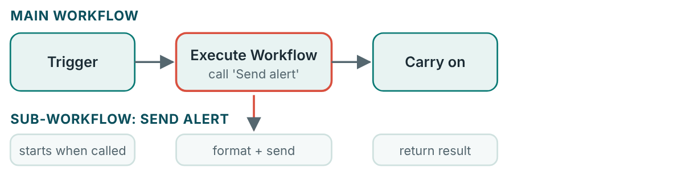
Sub-workflows: small pieces you can reuse
The main workflow stays short. The details live in one place.

Slide 8
Sub-workflows: small pieces you can reuse
1
Create a new workflow and start it with the Execute Workflow Trigger node. Build the job after it.
2
In the main workflow add Execute Workflow and choose the sub-workflow.
3
Pass the data it needs as inputs, and read what it returns.

Slide 9
Planning for failure
1. Retry on fail
2. Continue on error
3. Error workflow
In a node's settings, switch on Retry On Fail, and set how many tries and how long to wait.
Setting for a node: On Error, choose to continue using the error output.
A separate workflow that starts whenever any workflow fails, and alerts you. Use the Error Trigger node.
Notes:
Things go wrong: a service is down, a limit is reached, a field is missing. Three tools help.

Slide 10
Think of it like this
A delivery
If nobody answers the door, the courier tries again later (retry). If it still fails, they leave a note and carry on with other parcels (error branch). The depot manager gets a report of every failed delivery (error workflow).

Slide 11

Do not retry blindly
Retrying is safe for reading data. It can be dangerous for actions like sending money or emails, because a retry may do the action twice. Think about what repeating the step would do.

Slide 12
Test your error handling on purpose
URL | What it does
https://httpbin.org/status/500 | Always fails with a server error (500)
https://httpbin.org/status/429 | Says “too many requests” (429)
https://httpbin.org/status/200 | Succeeds (200)
Notes:
A free testing site, httpbin.org, will answer with whatever status code you ask for: Point an HTTP Request node at the 500 address, switch on retries and an error branch, and watch what happens. Then point it at the 200 address and check that the normal path still works.

Slide 13
Your exercise
Build a workflow that sends data to an API with POST, uses a sub-workflow for one step, and handles a failure by logging it and carrying on.
STEPS
HTTP Request node: POST a small JSON body to https://httpbin.org/post (a safe test address that…
Move the step that formats the message into a sub-workflow, and call it.
Add a second HTTP Request to https://httpbin.org/status/500 with retries on and an error branch.
On the error branch, write a row to a sheet, or set a field such as failed…
Notes:
Give students time to work. Walk around, and look at what they have rather than waiting for questions.

Slide 14
Quick check
1. Which node can call almost any web API?
2. Why use a sub-workflow?
3. Which setting makes a node try again after a failure?
4. What is risky about retrying a step that sends an email?
5. What does the Error Trigger node start?
Notes:
Ask each question aloud before showing options. Answers: 1. HTTP Request. When there is no ready-made node, HTTP Request does the job. 2. To keep workflows short, reuse a job in many places and test it on its own. It is the recipe-card idea: write it once, refer to it. 3. Retry On Fail. Retries help with short outages. 4. It may send the email twice. Retries are safe for reading and risky for actions that cannot be repeated. 5. A separate workflow that runs when another workflow fails. It is the depot manager who gets a report of every failure.

Slide 15
Words to know
HTTP Request node
Request body
An n8n node that calls any web API.
The data sent along with a POST request, usually JSON.
Status code
Sub-workflow
A number in the reply that says how it went: 200 worked, 4xx your mistake, 5xx their…
A workflow called by another workflow, like a reusable recipe card.
Execute Workflow
Retry On Fail
The n8n node that runs another workflow.
A node setting that tries the step again after an error.
Notes:
Point at each word as you say it. Ask students to explain two of them to the person beside them.

Slide 16
Recap
Use the easiest authentication the service offers, and keep keys in credentials.
Split big workflows into sub-workflows you can reuse and test separately.
Plan for failure: retries for short outages, error branches to carry on, and an error workflow to alert you.
Notes:
Ask students to say each point back to you in their own words.

Slide 17
NEXT TIME
Lesson 18, MCP: a standard plug that lets agents use outside tools without custom wiring.
Notes:
Tell students what to prepare, for example an account to create or something to install, so the next lesson starts smoothly.

