Slide 1

WEEK 4 · LESSON 18
MCP: a standard plug for tools
How agents connect to outside tools through one common standard, and how to do it safely.
Agentic AI Builder
Notes:
Welcome back. This is Lesson 18. It takes about 50 minutes. How agents connect to outside tools through one common standard, and how to do it safely. Remind students they can reread the notes on the course site afterwards.

Slide 2
THE BIG IDEA
MCP (Model Context Protocol) is a standard plug. Any AI app that speaks MCP can use any tool that speaks MCP, without custom wiring for each pair.
Notes:
Say this slowly in your own words, then ask: what is the one word that sticks out for you?

Slide 3

By the end you can…
Explain MCP and the roles of host, client and server.
Choose between the ways MCP connects.
Connect an MCP server to an n8n agent, or expose your own workflows as an MCP server.
Judge whether an MCP server is safe to trust.
Notes:
Read the goals aloud. Come back to them in the recap and ask who can now do each one.

Slide 4
Think of it like this
The phone charger
Before USB-C, every phone had its own charger. You needed a drawer full of them. With one standard plug, any charger fits any phone. MCP is that standard plug for AI tools: write a tool once, and any compatible agent can use it.

Slide 5
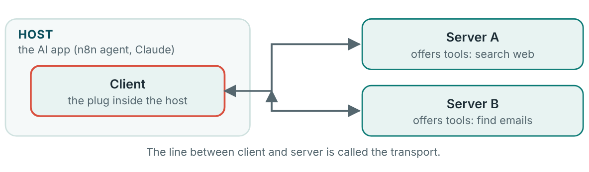
Three roles
Host, client and server.
Notes:
Host: the AI application the person uses, such as an n8n agent or a chat app. Client: the part inside the host that speaks MCP and keeps one connection to each server. Server: a program that offers tools (and sometimes data) in the standard format. “Server” just means “the side that offers things”. It may run on your own computer.

Slide 6
Three roles
Host: the AI application the person uses, such as an n8n agent or a chat app.
Client: the part inside the host that speaks MCP and keeps one connection to each server.
Server: a program that offers tools (and sometimes data) in the standard format.

Slide 7
How they connect: transports
Transport | What it is | Use it for
stdio | The host starts the server as a program on the same computer… | Local tools on your own machine. Not available to cloud-only apps
Streamable HTTP | The server lives at a web address and talks over normal web requests | Remote servers. The current recommended way over the web
SSE | An older web method | Still seen in the wild, but deprecated.

Slide 8
MCP in n8n: three routes
1. Use an MCP server as a tool
2. Offer your workflows as tools
3. Control n8n itself
Add the MCP Client Tool node to your AI Agent.
Start a workflow with the MCP Server Trigger node and attach tools to it.
n8n can also expose your instance to MCP clients so they can find and run chosen workflows.
Notes:
Open an AI Agent workflow from earlier. Under Tool, add the MCP Client Tool node. Set the endpoint (the server's web address) and the transport the server supports. Choose authentication if the server needs it. Use a credential, not text typed into the node. Choose which of the server's tools the agent may use. Start with only what you need. Ask the agent a question that needs the tool and open the execution to confirm it called it.

Slide 9
MCP in n8n: three routes
1
Open an AI Agent workflow from earlier.
2
Under Tool, add the MCP Client Tool node.
3
Set the endpoint (the server's web address) and the transport the server supports.
4
Choose authentication if the server needs it. Use a credential, not text typed into the node.
5
Choose which of the server's tools the agent may use. Start with only what you need.

Slide 10

An MCP server is code you are inviting in
A server can read what you send it, and what it sends back goes straight into your agent's thinking. A careless or malicious server can leak data or slip hidden instructions into its replies.
Notes:
Lesson 19 explains the worst combination of risks, called the lethal trifecta.

Slide 11
Your exercise
Connect an MCP server to an n8n agent and ask it a question that needs the tool. Then, if time allows, expose one workflow of your own as an MCP server.
STEPS
Pick a safe, well-known server your teacher suggests. A read-only one is best.
Add it to the agent with the MCP Client Tool node and allow one or two tools.
Ask a question that needs it.
Ask a question that does not need it. Did the agent correctly leave it alone?
Notes:
Give students time to work. Walk around, and look at what they have rather than waiting for questions.

Slide 12
Quick check
1. What does MCP stand for?
2. Which comparison fits MCP best?
3. In MCP, what is the host?
4. Which transport is the current recommended way over the web?
5. Why should you limit which tools an agent can use?
Notes:
Ask each question aloud before showing options. Answers: 1. Model Context Protocol. It is a standard way for AI apps to talk to tools. 2. A standard plug that lets any charger fit any phone. Write a tool once, and any compatible agent can use it. 3. The AI application the person uses, such as an n8n agent. The host contains a client. The server offers the tools. 4. Streamable HTTP. SSE is deprecated. stdio is for local programs. 5. A server's tools can read or change things, so give only what is needed. Least privilege reduces what can go wrong.

Slide 13
Words to know
MCP
Host
Model Context Protocol. A standard way for AI apps to use outside tools.
The AI application that wants to use tools.
MCP client
MCP server
The part inside the host that speaks MCP and connects to servers.
A program that offers tools in the MCP standard.
Transport
stdio
The way client and server talk: stdio, Streamable HTTP or SSE.
Local transport: the host starts the server on the same computer.
Notes:
Point at each word as you say it. Ask students to explain two of them to the person beside them.

Slide 14
Recap
MCP is the standard plug: hosts contain clients, clients connect to servers, and servers offer tools.
Transports: stdio for local programs, Streamable HTTP for remote servers, SSE is older and deprecated.
In n8n you can use servers (MCP Client Tool), offer workflows as a server (MCP Server Trigger), or expose your instance.
Notes:
Ask students to say each point back to you in their own words.

Slide 15
NEXT TIME
Lesson 19, context engineering and sub-agents: how to give an agent exactly what it needs, split big jobs between agents, and avoid the lethal trifecta.
Notes:
Tell students what to prepare, for example an account to create or something to install, so the next lesson starts smoothly.

