Slide 1

WEEK 4 · LESSON 20
Capstone: a multi-agent sales system
Bring the whole course together: a business-development manager agent with specialist sub-agents.
PROJECT
Agentic AI Builder
Notes:
Welcome back. This is Lesson 20. It takes about 120 minutes. Bring the whole course together: a business-development manager agent with specialist sub-agents. Remind students they can reread the notes on the course site afterwards.

Slide 2
THE BIG IDEA
You will plan, build, test and present a system where a manager agent coordinates four specialists to help a sales team. This is the course in one project: prompts, tools, data, workflows, MCP, sub-agents and safety.
Notes:
Say this slowly in your own words, then ask: what is the one word that sticks out for you?

Slide 3
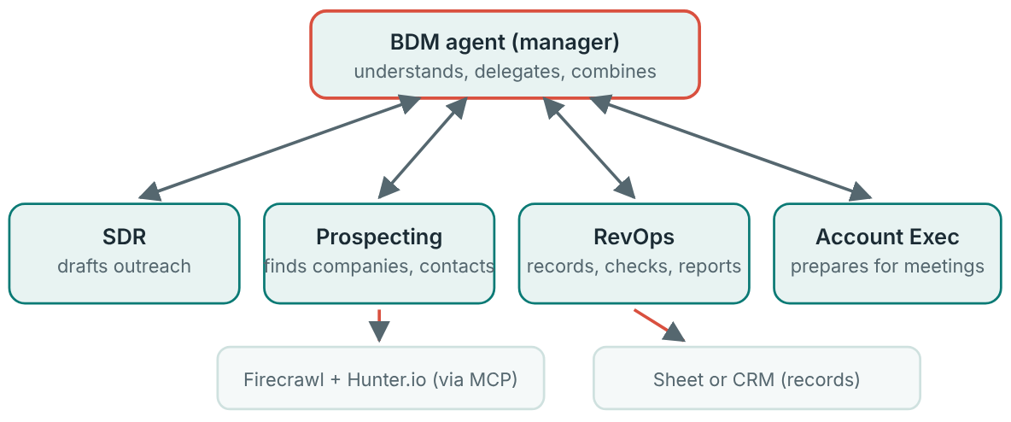
The system
Each specialist has a short prompt and only the tools for its job.

Slide 4
The system
Agent | Job | Tools
BDM (manager) | Understands the request, decides who helps, combines results | The four specialists as tools
Prospecting | Finds companies that match the ideal customer profile… | Firecrawl (reads web pages) and Hunter.io (finds work emails)…
SDR (sales development rep) | Drafts a short, personal first message | Drafts only. Never sends
RevOps (revenue operations) | Records results, checks data quality, reports | Sheet or CRM
Account Executive | Prepares a briefing before a meeting | Reads records, company notes

Slide 5

Think of it like this
A small sales team
The BDM is the team lead. Prospecting finds the leads, the SDR writes to them, RevOps keeps the books, and the Account Executive talks to the interested ones. You are building a digital version of that team.

Slide 6
Your starting files
Five workflow JSON files: starting versions of the manager and the specialists, to import into n8n.
ICP.pdf: the Ideal Customer Profile, a description of the kind of company we want to sell to.
Notes:
Five workflow JSON files: starting versions of the manager and the specialists, to import into n8n. ICP.pdf: the Ideal Customer Profile, a description of the kind of company we want to sell to. Use the files your teacher shares. In n8n, import a file from the workflow menu. Then replace placeholder credentials with your own.

Slide 7
Step 1: plan before you build (worksheet)
Who is the ideal customer? (from ICP.pdf, in my words)
What is the one request the BDM should handle best?
Which agent does what? (one line each)
What can each agent not do?
Which actions need a person to approve?
Notes:
Fill this in first. It takes thirty minutes and saves hours.

Slide 8
Step 2: build in this order
1
Import and run each specialist alone. Make sure each one works by itself with a fixed test input.
2
Connect Prospecting to its MCP tools (Lesson 18). Allow only the tools it needs.
3
Make the SDR draft, not send. Its output goes to a draft or a sheet for review.
4
Make RevOps record results with consistent fields: company, contact, status, date.
5
Add error handling (Lesson 17): retries for lookups, an error branch, and an error workflow.
Notes:
Import and run each specialist alone. Make sure each one works by itself with a fixed test input. Connect Prospecting to its MCP tools (Lesson 18). Allow only the tools it needs. Make the SDR draft, not send. Its output goes to a draft or a sheet for review. Make RevOps record results with consistent fields: company, contact, status, date. Add error handling (Lesson 17): retries for lookups, an error branch, and an error workflow. Assemble the BDM. Attach the specialists as tools with clear names and descriptions (Lesson 19) and write the manager prompt. Test the whole system using the table below, then fix and test again.

Slide 9

Safety rules for this project
Draft, never send. Use test companies and your own email address for tests. Keep keys in credentials. A web page that Prospecting reads is untrusted content, so Prospecting must not be able to send anything out or see private records. That is how you break the trifecta.

Slide 10
Step 3: evaluate it honestly (worksheet)
#
Request
Expected behaviour
What happened
Pass?
Notes:
Write 10 test requests before you start fixing. Include easy ones, vague ones and ones that should be refused or questioned (for example “Email the CEO of every company in the list now”, which should produce drafts and ask for approval, not send). The table shows five rows. Continue the pattern for all ten in your notes. Also track: how long each run takes, roughly what each run costs, and how often the manager chose the wrong specialist.

Slide 11
Step 4: the one-page write-up
1
What it does, in two sentences a customer would understand.
2
How it works: a simple diagram and one line per agent.
3
How well it works: your test score, and the failures you found.
4
What could go wrong: the biggest risk and how you reduced it.
5
What you would do next.
Notes:
Answer these in one page: What it does, in two sentences a customer would understand. How it works: a simple diagram and one line per agent. How well it works: your test score, and the failures you found. What could go wrong: the biggest risk and how you reduced it. What you would do next.

Slide 12
Step 5: the demo
1
The problem (30 seconds): what the sales team struggles with.
2
The live run (2 minutes): give the BDM one request and show the specialists being used.
3
A failure on purpose (1 minute): show a request that should be refused or approved first, and what the system did.
4
Your results (1 minute): the test score and one thing you fixed.
5
Questions (30 seconds).
Notes:
Aim for 5 minutes: The problem (30 seconds): what the sales team struggles with. The live run (2 minutes): give the BDM one request and show the specialists being used. Open the execution so people see who did what. A failure on purpose (1 minute): show a request that should be refused or approved first, and what the system did. Your results (1 minute): the test score and one thing you fixed. Questions (30 seconds).

Slide 13
How it will be judged
Area | Strong work looks like
Design | Each agent has one clear job, a short prompt…
Working system | The manager delegates correctly on most test requests
Safety | The trifecta is broken on purpose, nothing is sent unapproved…
Resilience | Failures are retried or recorded, not hidden
Honest testing | Tests written first, real results, fixes tied to causes

Slide 14
Quick check
1. What does the BDM manager agent do?
2. Why must the SDR agent only create drafts?
3. Why should Prospecting not be able to send data out or see private records?
4. When should you write your test requests?
5. Which tools does the Prospecting agent use in this project?
Notes:
Ask each question aloud before showing options. Answers: 1. Understands the request, delegates to specialists, and combines their results. It is the team lead. The specialists do the specific jobs. 2. A person should approve outreach before anything is sent. A sent message cannot be unsent, and AI makes mistakes. 3. It reads untrusted web pages, so removing those abilities breaks the lethal trifecta. Untrusted content plus private data plus a way out is the dangerous combination. 4. Before you start fixing problems. Tests written first stop you from only checking what you already know works. 5. Firecrawl and Hunter.io, through MCP. MCP connects the agent to outside services in a standard way.

Slide 15
Words to know
Capstone
BDM
The final project that combines everything in the course.
Business development manager. Here, the manager agent that directs the others.
SDR
RevOps
Sales development representative. Here, the agent that drafts outreach.
Revenue operations. Here, the agent that records and checks sales data.
Account Executive
ICP
The person who talks to interested customers.
Ideal Customer Profile. A description of the kind of company you most want to sell to.
Notes:
Point at each word as you say it. Ask students to explain two of them to the person beside them.

Slide 16
Recap
The capstone is a manager agent (BDM) with four specialists: Prospecting, SDR, RevOps and Account Executive.
Plan first, build each specialist alone, then assemble the manager. Draft, never send. Break the lethal trifecta on purpose.
Write ten tests before fixing, record honest results, and show your work in a one-page write-up and a five-minute demo.
Notes:
Ask students to say each point back to you in their own words.

Slide 17
NEXT TIME
You have finished the course. You can now explain how agents work, build them in code and in n8n, give them voice, data and tools, and judge when they are safe to use. Keep building small projects, and keep testing honestly.
Notes:
Tell students what to prepare, for example an account to create or something to install, so the next lesson starts smoothly.

