Slide 1

WEEK 1 · LESSON 4
Memory, context and tools: from chatbot to agent
Why a chat only seems to remember, and how an AI uses tools to act.
Agentic AI Builder
Notes:
Welcome back. This is Lesson 4. It takes about 50 minutes. Why a chat only seems to remember, and how an AI uses tools to act. Remind students they can reread the notes on the course site afterwards.

Slide 2
THE BIG IDEA
The AI does not remember your chat. The app re-sends the whole conversation every time. And an AI cannot do things by itself: it asks, and your app acts. Put those two ideas in a loop and you have an agent.
Notes:
Say this slowly in your own words, then ask: what is the one word that sticks out for you?

Slide 3

By the end you can…
Explain why a chat seems to have memory, and why the model does not.
Decide what to keep, summarise or drop when a conversation gets long.
Describe the agent loop and how a tool call works.
Notes:
Read the goals aloud. Come back to them in the recap and ask who can now do each one.

Slide 4
The illusion of memory
1
You type a new message.
2
The app adds it to the whole conversation so far.
3
The app sends everything to the AI.
4
The AI reads it from the very top, then writes the next reply.
Notes:
When you chat with an AI, it feels like it remembers what you said ten messages ago. It does not. Here is what really happens on every turn: You type a new message. The app adds it to the whole conversation so far. The app sends everything to the AI. The AI reads it from the very top, then writes the next reply. The proof: if the app stops sending message 1, the AI has never heard of it.

Slide 5
Think of it like this
The notebook
Imagine a helper who forgets everything the moment you walk away. To get around that, every time you speak to them you hand over a notebook and say “read this from page one, then answer.” The notebook is the memory. The helper has none.

Slide 6
Think of it like this
The desk
The context window is the size of the desk. Only what fits on the desk can be read. Pile on too much and either something falls off, or the helper gets distracted by the mess.
Notes:
Last lesson you met the context window, the maximum number of tokens in one call. Everything in the conversation counts against it: your instructions, every earlier message, tool results, and the reply being written. Two problems follow. If you go over the limit, the call fails or the oldest text is cut. And even below the limit, a desk piled with irrelevant papers can make answers less focused. More is not always better.

Slide 7
Three ways to handle a long conversation
Strategy | What it does | Everyday comparison | Weakness
Trim | Keep only the last few messages | Throw away the oldest pages | Early facts vanish
Summarise | Replace old messages with a short summary | Write a one-page recap of the meeting | Needs an extra AI call, and details can be lost
Store and retrieve | Save facts outside the prompt, fetch the relevant ones when needed | A filing cabinet with an index | Needs search logic (you build this in Week 3)
Notes:
The question to ask for every piece of information: keep it, summarise it, or drop it?

Slide 8
Think of it like this
Phone a friend
You are in a quiz show and do not know the answer, so you phone a friend. The AI cannot make the call itself. It says “please phone the calculator and ask for 1234 times 5678.” Your app makes the call and reads back the result.
Notes:
On its own an AI can only produce text. It cannot check a calendar, calculate reliably, look at a website or send an email. A tool fixes that. A tool is a small function in your app that you describe to the AI: its name, what it does, and what information it needs. The AI never runs a tool. It writes a structured request: call this tool with these inputs. Your app runs the tool and sends the result back. Then the AI writes the final answer using that result.

Slide 9
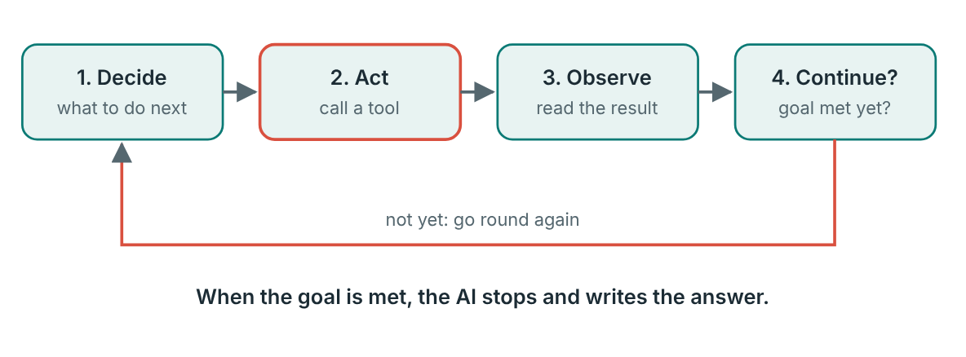
The agent loop
The agent loop. Tools are the core idea behind agents.
Notes:
Put it together. An agent repeats four steps until the goal is met: Later in the course you will meet MCP (Lesson 18), a standard way to share tools between applications. It builds directly on this idea.

Slide 10

Always set a limit
Good apps cap how many times the loop can run, say five rounds. Otherwise a confused AI could keep going forever, and you would pay for every round.

Slide 11
Common mistakes
Thinking the AI learns from the chat. It does not change between calls.
Trimming by message count while a few very long messages still overflow the desk.
Cutting the system prompt when trimming. Always add it fresh.
Believing the AI runs the tool itself.
Forgetting a limit on how many loop rounds are allowed.
Notes:
Thinking the AI learns from the chat. It does not change between calls. Trimming by message count while a few very long messages still overflow the desk. Cutting the system prompt when trimming. Always add it fresh. Believing the AI runs the tool itself. Forgetting a limit on how many loop rounds are allowed.

Slide 12

Try it live
Open this lesson's page on the course site and play with the interactive demo.
Change the inputs, watch what happens, and say out loud what you think will change before you click.
Notes:
Open the lesson page on the course site and use the interactive demo together. Let students suggest the inputs.

Slide 13
Your exercise
The goal is to see with your own eyes that the AI only knows what is re-sent. Choose either version.
STEPS
The app writes each message on its own card: “Hi, my name is Wanjiru…
Add five more cards, for example: a Python question, a library name, what an API does, a study tip…
Round 1, full history.
Round 2, trimmed history. The app hands over only the last four cards. Ask the same final question.
Swap roles and repeat with different facts.
Notes:
Give students time to work. Walk around, and look at what they have rather than waiting for questions.

Slide 14
Quick check
1. Why does a chat seem to remember what you said earlier?
2. If the app stops sending message 1, what does the AI know about it?
3. A long conversation no longer fits the context window. Which is NOT a standard strategy?
4. Who actually runs a tool in an agent?
5. Which sequence is the agent loop?
Notes:
Ask each question aloud before showing options. Answers: 1. The app re-sends the whole conversation every turn. The AI is stateless. The app supplies the memory by re-sending the history. 2. Nothing. The AI only sees what is in the current call. 3. Ask the AI to remember it harder. Trimming, summarising and storing-and-retrieving are the three strategies. Memory is not something the AI can try harder at. 4. Your app. The model asks for a tool in a structured request. The app runs it and returns the result. 5. Decide, act with a tool, observe the result, continue until the goal is met. That four-step loop is the heart of every agent.

Slide 15
Words to know
Stateless
Conversation history
Keeping nothing between calls. An AI model is stateless; the app supplies the memory.
The list of earlier messages that the app re-sends on each turn.
Context window
Summarise
The fixed token limit for one call.
Replace old messages with a short recap to save space.
Tool
Tool call
A function in your app that the AI can ask for, such as a calculator or a search.
A structured request from the AI saying which tool to run and with what inputs.
Notes:
Point at each word as you say it. Ask students to explain two of them to the person beside them.

Slide 16
Recap
A chat only seems to remember. The app re-sends the whole conversation each time.
The context window is a desk. Decide what to keep, summarise or drop.
A tool call is a structured request: the model asks, your app acts, and the result goes back.
An agent runs that cycle in a loop until the goal is met, with a safety limit.
Notes:
Ask students to say each point back to you in their own words.

Slide 17
NEXT TIME
Lesson 5, the Week 1 project: build a small assistant that remembers facts, uses two tools only when needed, and passes a 20-prompt test.
Notes:
Tell students what to prepare, for example an account to create or something to install, so the next lesson starts smoothly.

