Slide 1

WEEK 2 · LESSON 6
Your first n8n AI agent
Meet n8n, build a chat agent with no code, and run it live.
Agentic AI Builder
Notes:
Welcome back. This is Lesson 6. It takes about 40 minutes. Meet n8n, build a chat agent with no code, and run it live. Remind students they can reread the notes on the course site afterwards.

Slide 2
THE BIG IDEA
n8n lets you build automations by connecting boxes on a canvas instead of writing code. Each box does one job. This week you turn what you learned about AI into working workflows.
Notes:
Say this slowly in your own words, then ask: what is the one word that sticks out for you?

Slide 3

By the end you can…
Find your way around n8n cloud and name its parts…
Build and run a chat agent that has an AI model connected.
Run a workflow by hand for testing, then switch it on for real use.
Notes:
Read the goals aloud. Come back to them in the recap and ask who can now do each one.

Slide 4
Think of it like this
A factory assembly line
A workflow is like an assembly line. Each station (node) does one job. Conveyor belts (connections) carry the item to the next station. Each time the line runs, that is one execution.
Notes:
A trigger node answers the question “what starts this?” (a chat message, a schedule, an incoming web request). Action nodes answer “what should happen next?”

Slide 5
The five words you need
Word | Plain meaning | On the assembly line
Node | One step. It is either a trigger that starts the workflow… | One station
Connection | The line between two nodes. It passes data along. | The conveyor belt
Workflow | A set of connected nodes that does a whole job. | The entire line
Execution | One run of a workflow, saved so you can look back at it. | One batch going down the line
Template | A ready-made workflow you can copy and adapt. | A recipe card

Slide 6
Getting set up
1
Create an account on n8n.io and start the free trial of n8n cloud. After the trial it is a monthly subscription.
2
Click Create workflow. You will see an empty canvas. Give the workflow a name such as “My first agent”.
3
Get an AI key.
Notes:
Create an account on n8n.io and start the free trial of n8n cloud. After the trial it is a monthly subscription. Click Create workflow. You will see an empty canvas. Give the workflow a name such as “My first agent”. Get an AI key. OpenAI needs a minimum balance. OpenRouter is a free-tier alternative, and it uses the same key idea you met in Lesson 1.

Slide 7

Keep your key private
In n8n you paste keys into a credential, a safe box that n8n stores for you. Never paste a key into a prompt, a spreadsheet or a message.

Slide 8
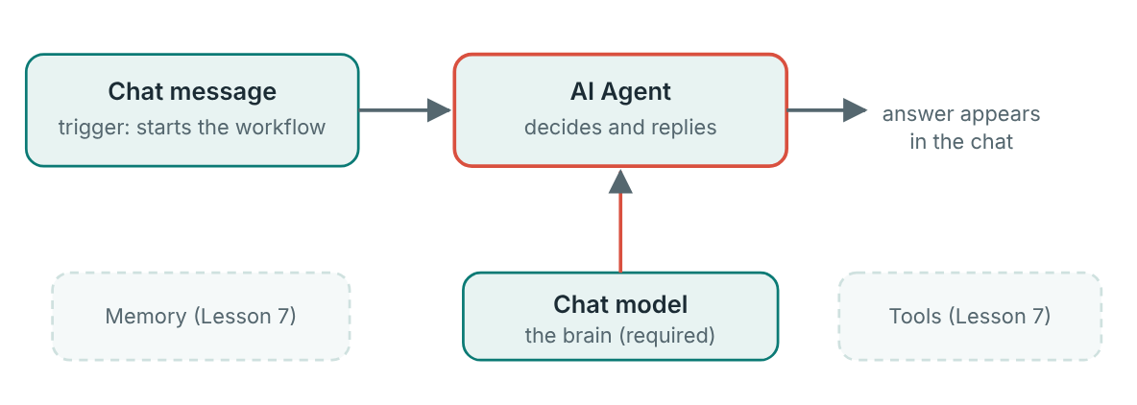
Build the agent
The first agent: one trigger, one agent, one model. Memory and tools come next lesson.
Notes:
This is the whole workflow. Three boxes: Click the + on the canvas and add a chat trigger, often named On chat message. Add an AI Agent node and connect it to the trigger. On the AI Agent node, find the Chat Model slot at the bottom and click its +. Choose an OpenAI or OpenRouter chat model. Create a credential with your key when asked, then pick a model name. Open the AI Agent's options and add a System Message. This is the system prompt from Lesson 3. Here is a system message to try. You will replace the text in the middle each time.

Slide 9
Build the agent
1
Click the + on the canvas and add a chat trigger, often named On chat message.
2
Add an AI Agent node and connect it to the trigger.
3
On the AI Agent node, find the Chat Model slot at the bottom and click its +. Choose an OpenAI or OpenRouter chat model.
4
Create a credential with your key when asked, then pick a model name.
5
Open the AI Agent's options and add a System Message. This is the system prompt from Lesson 3.

Slide 10
System message
SYSTEM MESSAGE
You are a helpful assistant.
Answer questions using ONLY the text below.
If the answer is not in the text, say: "I can't find that in the text."
Keep answers to two sentences.
TEXT:
(paste a short article, a menu, or a set of opening hours here)

Slide 11
Test it
1
Click Open chat (or the chat button on the canvas) and ask a question about your text.
2
Ask something that is not in the text. A good agent should say it cannot find it.
3
Click Executions and open the latest run. Click each node to see what went in and what came out.
Notes:
Click Open chat (or the chat button on the canvas) and ask a question about your text. Ask something that is not in the text. A good agent should say it cannot find it. Click Executions and open the latest run. Click each node to see what went in and what came out. Reading an execution is the most useful habit in n8n. When something goes wrong, the answer is nearly always visible there.

Slide 12
Manual runs and live runs
Manual execution
Active execution
For testing. You press the button and watch it work on the canvas.
For real use. After you turn the workflow on, it runs by itself whenever its trigger fires.
Notes:
The button is called Active in some versions and Publish in newer ones. It does the same job. Always test by hand before switching on.

Slide 13
What does it cost?
n8n cloud: a free trial, then a monthly subscription.
OpenAI: needs a minimum balance in your account before the key works.
OpenRouter: has free models with limits, which suits learning.
Notes:
n8n cloud: a free trial, then a monthly subscription. OpenAI: needs a minimum balance in your account before the key works. OpenRouter: has free models with limits, which suits learning.

Slide 14
Your exercise
Build a chat agent that answers questions about a short text you paste into its prompt. Run it, then open the execution view and read each step.
DONE WHEN…
Workflow has a chat trigger, an AI Agent and a chat model
System message includes my text and the “only use this text” rule
Three in-text questions answered correctly
One out-of-text question was politely declined
I opened the execution and can name what each node received and returned
Notes:
Give students time to work. Walk around, and look at what they have rather than waiting for questions.

Slide 15
Quick check
1. What is a node in n8n?
2. What does a connection do?
3. What is the difference between a manual and an active execution?
4. Where do you look to see what each node received and returned in a past run?
5. Which provider is a free-tier alternative when OpenAI needs a minimum balance?
Notes:
Ask each question aloud before showing options. Answers: 1. One step in a workflow, either a trigger or an action. Nodes are the boxes. Connected together, they make a workflow. 2. Passes data from one node to the next. Connections are the conveyor belts between stations. 3. Manual is for testing, active runs for real when the trigger fires. Always test manually first, then switch the workflow on. 4. The execution view. Executions save every run, node by node. 5. OpenRouter. OpenRouter offers some free models, with limits, using the same key idea.

Slide 16
Words to know
n8n
Node
A tool for building automations by connecting boxes (nodes) on a canvas.
One step in a workflow. Either a trigger or an action.
Trigger
Action
A node that starts a workflow, such as a chat message or a schedule.
A node that does something after the trigger, such as call an AI or send an email.
Connection
Workflow
The line between two nodes that passes data along.
A set of connected nodes that does a whole job.
Notes:
Point at each word as you say it. Ask students to explain two of them to the person beside them.

Slide 17
Recap
n8n builds automations from connected boxes: nodes joined by connections make a workflow.
A chat agent needs three things: a trigger, an AI Agent node and a chat model.
Test by hand, read the execution, and only then switch the workflow on.
Notes:
Ask students to say each point back to you in their own words.

Slide 18
NEXT TIME
Lesson 7, Agentic AI in n8n: give your agent tools and memory, and learn why treating the AI like a person leads to weak designs.
Notes:
Tell students what to prepare, for example an account to create or something to install, so the next lesson starts smoothly.

