Slide 1

WEEK 2 · LESSON 8
Connecting to Google Docs and Gmail
Choose the right way to log in, then build an agent that reads a document and drafts an email.
Agentic AI Builder
Notes:
Welcome back. This is Lesson 8. It takes about 45 minutes. Choose the right way to log in, then build an agent that reads a document and drafts an email. Remind students they can reread the notes on the course site afterwards.

Slide 2
THE BIG IDEA
To use your own documents and email, n8n needs permission to get in. There are three ways to give that permission, from easy to hard. Pick the easiest one that works, and keep a human in the loop.
Notes:
Say this slowly in your own words, then ask: what is the one word that sticks out for you?

Slide 3

By the end you can…
Choose the right authentication pattern for an integration.
Connect Google Drive or Docs and Gmail to an agent.
Build an agent that reads a document and drafts an email reply.
Notes:
Read the goals aloud. Come back to them in the recap and ask who can now do each one.

Slide 4
Three ways to log in
Level | Pattern | What it is | Everyday comparison
Easy | API key | A simple password-style key you copy from the service… | A house key. Whoever holds it can enter
Medium | Pre-configured OAuth2 login | You click “Sign in with Google”. | A hotel keycard issued at reception.
Hard | Full OAuth2 for a custom integration | You register your own app with the service… | Applying to the council for your own keycard system
Notes:
Authentication just means proving who you are and what you are allowed to do. Think of getting into a building. OAuth2 is the “Sign in with Google” style of login. You never hand n8n your password. You approve a limited permission instead, and you can take it back at any time.

Slide 5
Stay safe while you experiment
Use a test document and, if you can, a spare or test email account.
Make the workflow create a draft. Do not send anything until you have read it.
Give the smallest permissions that do the job.
When you finish the course, remove the n8n access in your Google account settings.
Notes:
Use a test document and, if you can, a spare or test email account. Make the workflow create a draft. Do not send anything until you have read it. Give the smallest permissions that do the job. When you finish the course, remove the n8n access in your Google account settings.

Slide 6

Why drafts matter
An AI can make a mistake and write something wrong, rude or private. A draft sits in your folder waiting for you. A sent email cannot be unsent.

Slide 7
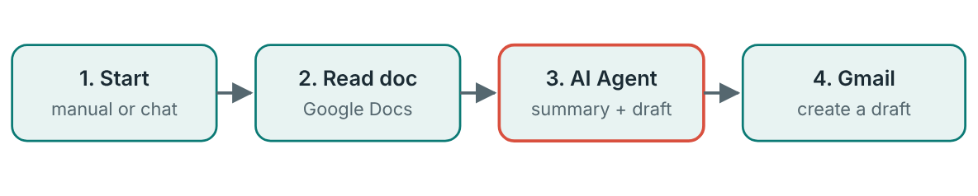
Build it: read a document, draft an email
Four nodes. Nothing is sent, only saved as a draft.
Notes:
Prepare a test document in Google Docs: a short note, a meeting summary or a customer message. A page or less is perfect. Add a start node. A manual trigger is easiest while testing. Add the Google Docs node with the operation to get a document. Click Sign in with Google to connect, then give the document's link or ID. (You can use the Google Drive node to download a file instead.) Add an AI Agent with a chat model. In its prompt, pass in the document text. In n8n you do this with an expression, which is a small piece of code in double curly braces that pulls in data from an earlier node. You learn expressions properly in Lesson 9. Add the Gmail node, choose the draft resource and the create operation. Set a subject, and set the message to the agent's output. Run it by hand. Open Gmail and read the draft before doing anything else.

Slide 8
Build it: read a document, draft an email
1
Prepare a test document in Google Docs: a short note, a meeting summary or a customer message. A page or less is perfect.
2
Add a start node. A manual trigger is easiest while testing.
3
Add the Google Docs node with the operation to get a document.
4
Add an AI Agent with a chat model.
5
Add the Gmail node, choose the draft resource and the create operation.

Slide 9
Prompt for the agent
PROMPT FOR THE AGENT
You write short, polite email replies.
Read the document below. Then write:
1. A summary in three sentences.
2. A draft email to the sender, in plain friendly language.
Use only facts from the document. If something is unclear, say so in the email instead of guessing.
DOCUMENT:
(the document text goes here, inserted by n8n)

Slide 10
Your exercise
Read a document from Drive, summarise it with the model, and save the summary as a draft email. Send nothing until you have checked the draft.
DONE WHEN…
I connected Google with the “Sign in with Google” login, not by pasting a password
The workflow reads my test document
A draft appears in Gmail
I read the draft and compared it with the document for mistakes
I can explain easy, medium and hard authentication in my own words
Notes:
Give students time to work. Walk around, and look at what they have rather than waiting for questions.

Slide 11
Quick check
1. Which authentication pattern is a simple password-style key?
2. In n8n cloud, how do Google Sheets and Gmail usually connect?
3. Why should the workflow create a draft instead of sending the email?
4. Which pattern needs the most patience?
5. Must you use Google for these integrations?
Notes:
Ask each question aloud before showing options. Answers: 1. An API key. An API key is the easy pattern: copy it from the service and keep it secret. 2. Pre-configured OAuth2 login: n8n has already done the setup. That is the medium pattern. You click sign in and approve the permission. 3. So a person can check it before anything goes out. AI can make mistakes. A draft keeps a human in control. 4. Full OAuth2 for a custom integration. You set up the registration and login yourself. 5. No. Integrations are optional and you can choose different services. The patterns apply to any service. Most have free tiers.

Slide 12
Words to know
Authentication
API key
Proving who you are and what you are allowed to do.
A simple password-style credential copied from a service. Keep it secret.
OAuth2
Pre-configured OAuth2
The 'Sign in with Google' style of login.
OAuth2 where n8n has already done the hard setup. You just click sign in.
Integration
Draft
A connection between n8n and another service, such as Gmail or Google Drive.
An email saved but not sent.
Notes:
Point at each word as you say it. Ask students to explain two of them to the person beside them.

Slide 13
Recap
Three ways to log in: API key (easy), pre-configured OAuth2 (medium), full OAuth2 (hard). Pick the easiest that works.
Use test documents and create drafts. Read everything before anything is sent.
A document-to-draft workflow is four nodes: start, read, AI agent, Gmail draft.
Notes:
Ask students to say each point back to you in their own words.

Slide 14
NEXT TIME
Lesson 9, Data and integrations: read and write JSON inside n8n, use expressions to pull values from earlier nodes, and receive data through a webhook.
Notes:
Tell students what to prepare, for example an account to create or something to install, so the next lesson starts smoothly.

