Slide 1

Pandemic Simulator
Ortbauer, Sixt, Lorenz

Slide 2
What was the idea
We wanted to recreate a pandemic with our own virus and own conditions
After changing the values, we wanted to see different results

Slide 3
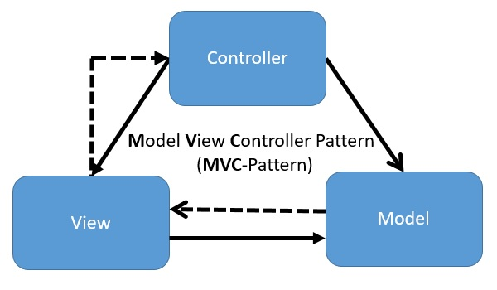
aRCHITECTURE
We don’t have a big architectural background
Its like the MVC pattern we learned in Java
A model which generates the data for the view
The view which Displays all the data in form of a graph and textural output (JavaFX)
A controller which handles the view

Slide 4
How we started
After the project proposal we started to do some research on the different models of how to simulate a virus
This took a while and after we found the right model for us, we started to think about effort estimation
At the start we had no idea of how long the individual tasks would take
Simon will give you a quick overview about the model we used

Slide 5
Let's take a look at the project!

Slide 6

Thanks for listening – any questions?

