Slide 1
Funkcijski pristup razvoju web korisničkih sučelja
Dominik ivošević
Mentor: Vlado sruk

Slide 2


Slide 3


Slide 4






Slide 5


Slide 6
Angular 2
Web components
Shadow DOM
Custom Elements
TypeScript
ReactiveX

Slide 7
Purescript angular 2
Minimalni prihvatljivi proizvod:
Sučelje stranih funkcija
Bootstrapping
Navigacija
Prepoznavanje komponenata
Pristup i manipulacija dosega preko pogleda i unutar koda
Pozivanje pripadnih funkcija preko pogleda i unutar koda
Ubacivanje servisa u komponente

Slide 8
Primjer omatanja funkcije iz angular Api-ja
foreign import bootstrap :: DecoratedNgClass -> Array Provider -> EffNg Unit
// module Angular.Browser
var browser = require('angular2/platform/browser');
exports.bootstrap = function (a) {
return function (b) {
browser.bootstrap(a, b);
}
}

Slide 9
privezivanje
module Main where
import Prelude (Unit)
-- Definiranje datoteka providera
import Angular.Common (formProviders)
import Angular.Http (httpProviders)
import Angular.Router (routerProviders)
import Angular.Browser (bootstrap)
import Utilities.Angular (EffNg)
import App.Root (root)
-- Privezivanje korijenske komponente i pruzanje omogucivaca
main :: forall a. a -> EffNg Unit
main _ = bootstrap root [
formProviders,
httpProviders,
routerProviders
]

Slide 10
navigacija
rootRoutes :: Array Route
rootRoutes = [
{ path: "/", name: "Index", component: index, useAsDefault: true },
{ path: "/overview", name: "Overview", component: overview, useAsDefault: false }
]
root :: DecoratedNgClass
root = decorateNgClass (toNgClass rootProto) [
createComponent rootComponent,
createRouteConfig rootRoutes
] []

Slide 11
Omogućavanje manipulacije dosega klasa s angular i purescript strane
foreign import data Provider :: *
foreign import data Directive :: *
foreign import data Decorator :: *
foreign import data Injectee :: *
foreign import data NgClass :: *
foreign import data DecoratedNgClass :: *
foreign import data ANGULAR :: !
type EffNg a = Eff (angular :: ANGULAR) a
foreign import data MemberFunction :: *
foreign import toMemberFunction :: forall a. a -> MemberFunction
foreign import toDirective :: forall a. a -> Directive
type NgClassProto a b = {
name :: String,
classScope :: a,
memberFunctions :: b
}
foreign import toNgClass :: forall a b. (NgClassProto a b) -> NgClass
foreign import decorateNgClass :: NgClass -> Array Decorator -> Array Injectee -> DecoratedNgClass

Slide 12
exports.toNgClass = function (ngClassProtoObj) {
console.log(ngClassProtoObj);
var name = ngClassProtoObj.name;
var classScope = ngClassProtoObj.classScope;
var memberFunctions = ngClassProtoObj.memberFunctions;
var functAsString = "" +
"(function " + name + "() {" +
"var self = this;" +
"for (var i in classScope) {" +
" this[i] = classScope[i];" +
"}" +
"classScope['realScope'] = self;" +
"if (memberFunctions.psConstructor) memberFunctions.psConstructor(this);" +
"})";
var classFun = eval(functAsString);
classFun.__proto__ = classFun.__proto__ || {};
for (var i in memberFunctions) {
classFun.__proto__[i] = memberFunctions[i];
}
return classFun;
};

Slide 13
exports.decorateNgClass = function (ngClass) {
return function(decorators) {
return function (constructorInjectors) {
decorators.push(Reflect.metadata('design:paramtypes', constructorInjectors || []));
var decoratedNgClass = Reflect.decorate(decorators, ngClass);
return decoratedNgClass;
}
}};

Slide 14
Omogućavanje uporabe pripadnih funkcija klasa s angular i purescript strane
"classScope['realScope'] = self;" +
foreign import scopeUpdater :: forall a. a -> a -> EffNg a
foreign import scopeUpdaterNew :: forall a. a -> (a -> a) -> a
foreign import scopeExtractor :: forall a b. a -> (a -> b) -> b

Slide 15
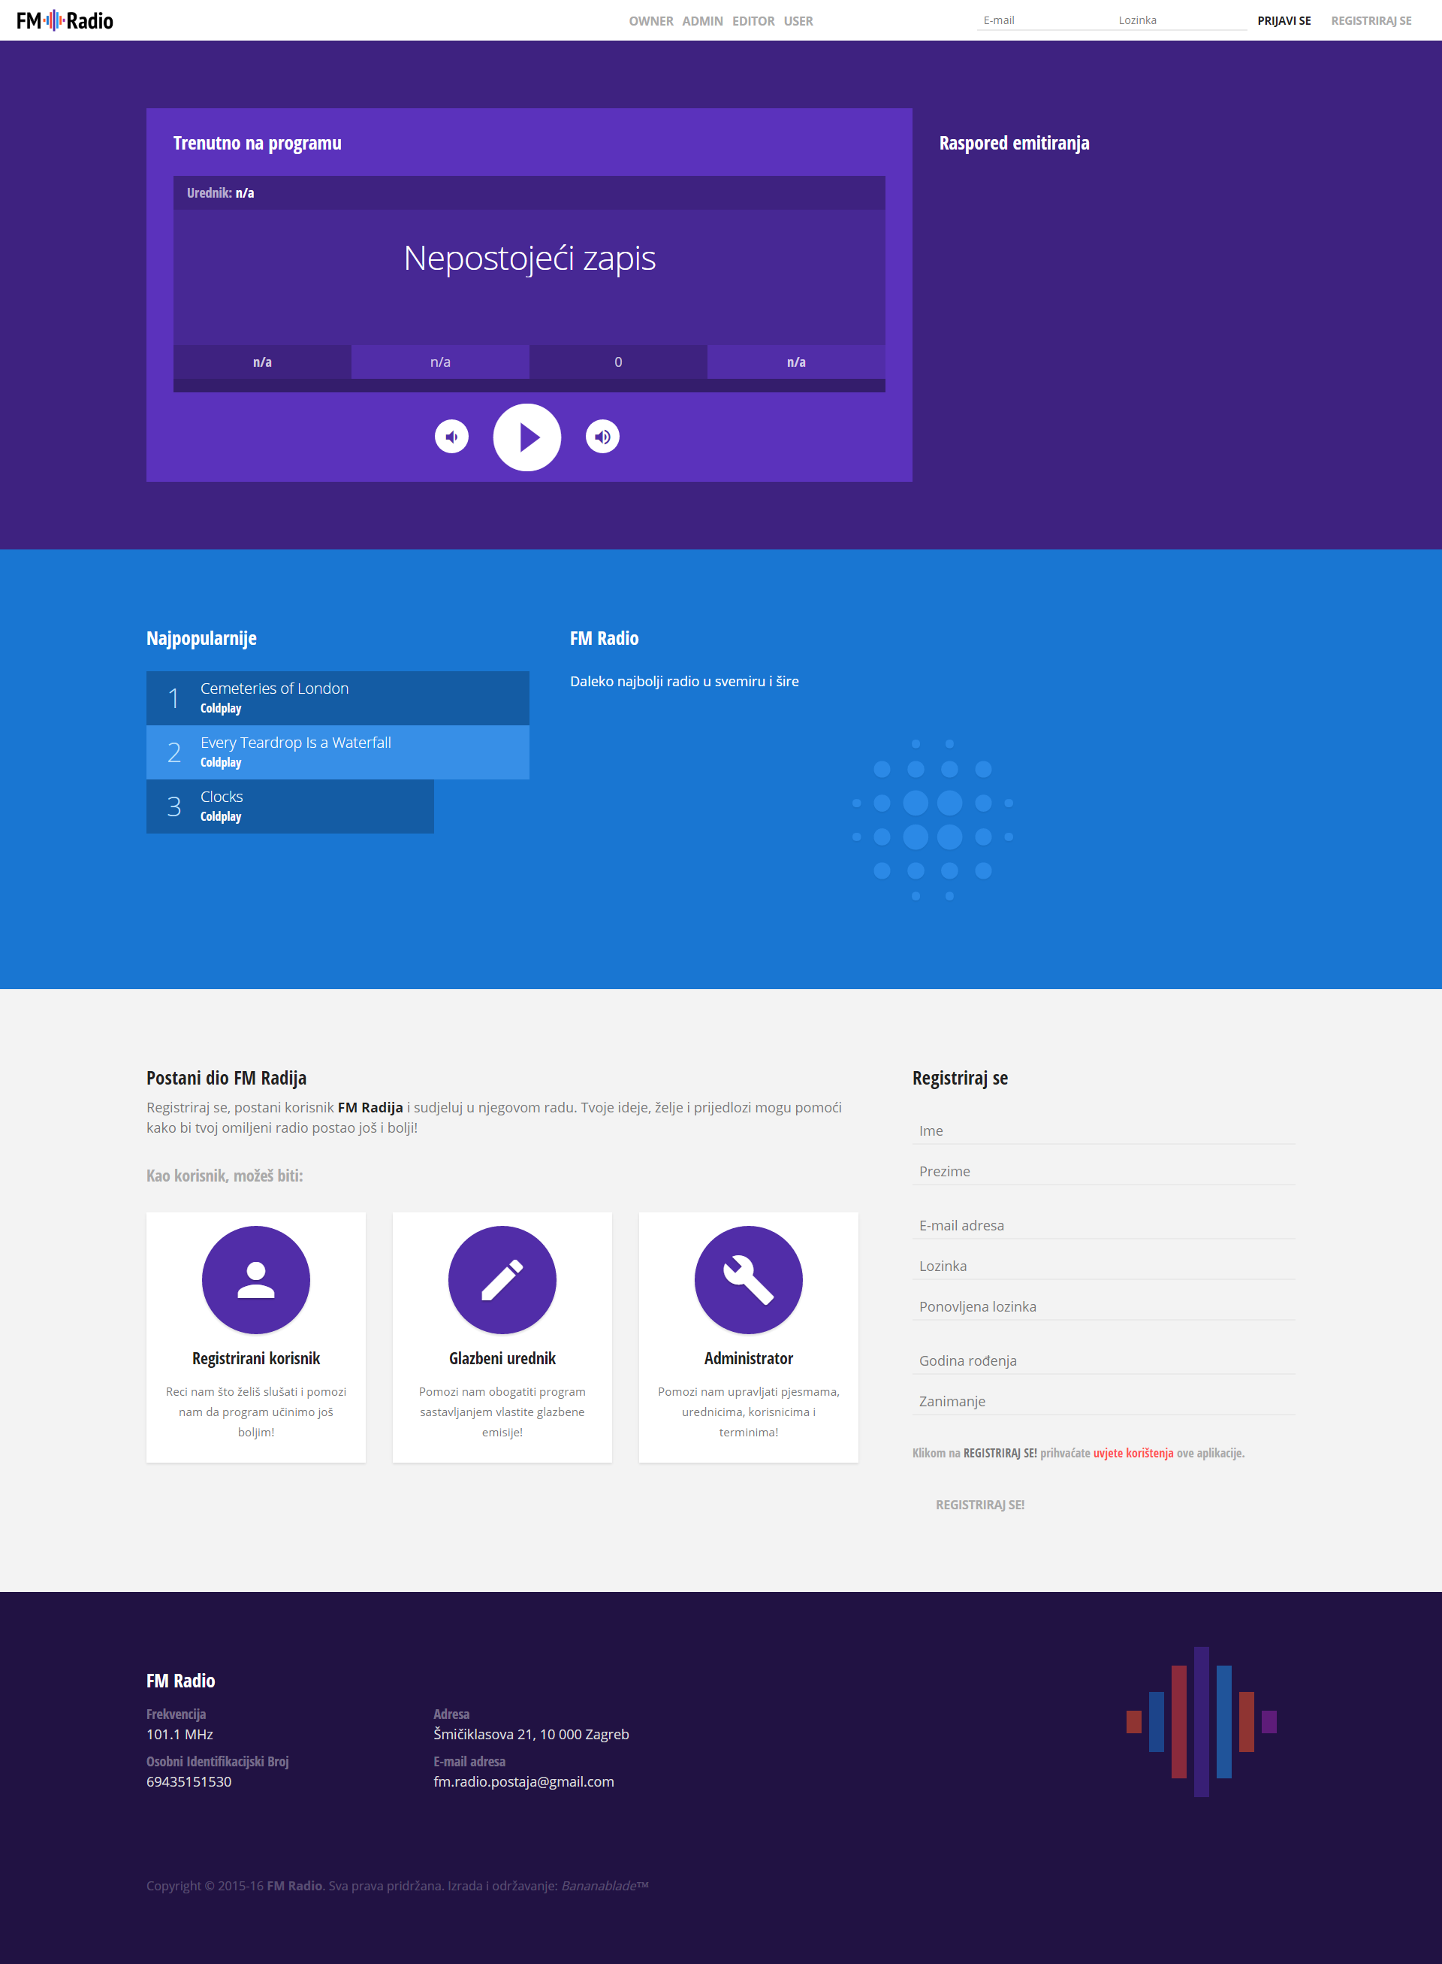

Slide 16

Hvala na slušanju ☺

