Slide 1
Navigating Uncertainty in New Keynesian Models:
Stochastic Volatility, Learning, and Optimal Policy Responses
Dominik Hecker
Kiel University
hecker@economics.uni-kiel.de
June 2025

Slide 2
Motivation: Uncertainty on the Rise
Uncertainty has increased due to geopolitical, technological, and environmental risks
Uncertainty affects economic decision-making: consumption, investment, expectation formation
Few macroeconomic models incorporate uncertainty
If they do, they assume full information about the stochastic volatility process

Slide 3
This paper
Contributes to the understanding of how information frictions shape monetary policy under uncertainty
Motivated by inattention, publication lags, data revisions
Builds on a standard NK model with stochastic volatility
Introduces a gap between perceived and actual uncertainty
Agents learn about volatility
Derives optimal monetary policy under full (actual volatility) and partial information (perceived volatility)
Main findings:
Perceived uncertainty lags actual uncertainty in the data.
Partial information leads to overreactive monetary policy.
Average Inflation Targeting (AIT) helps stabilize policy even under information frictions.
Notes:
Contributes to the understanding of uncertainty about uncertainty.
Shocks cannot be identified in real-time, how should shock volatility if dynamic?
Inattention, Information Frictions, Publication Lags, Data Revisions
This paper investigates how information frictions influence policy design.
Off-the-shelf model with stochastic volatility
Introduce gap between objective and subjective uncertainty (connected via learning)
Derive the optimal monetary policy response
Central findings:
Empirical evidence suggests a measurable lag between objective and subjective uncertainty. Subjective uncertainty systematically lags behind realized volatility.
When policymakers have partial information about stochastic volatility, monetary policy becomes overactive, reacting too strongly to perceived shocks.
Under average inflation targeting (AIT), the optimal policy under partial information converges to the full-information benchmark, thereby mitigating inefficiencies due to uncertainty misperceptions.

Slide 4
UNCERTAINTY FROM AN EMPIRICAL PERSPECTIVE

Slide 5
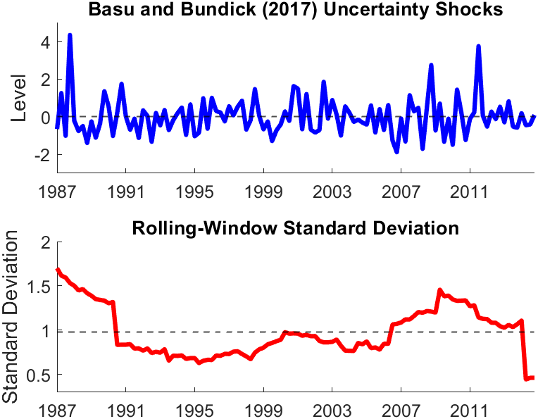
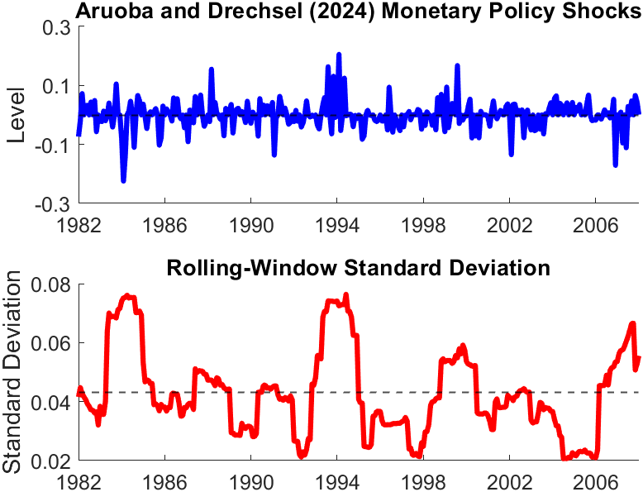
Uncertainty matters!

Slide 6
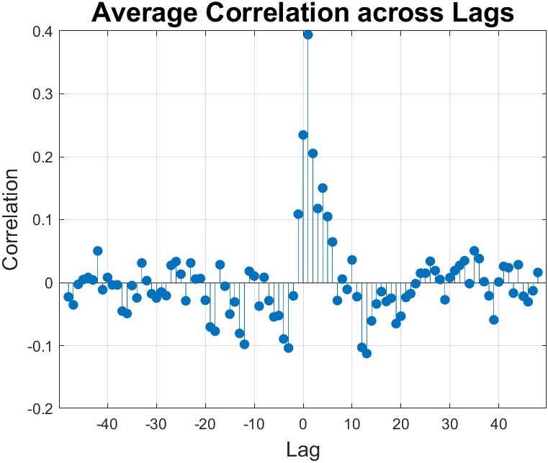
Gap between Actual and Perceived Uncertainty
Actual uncertainty: Macro, real, and financial uncertainty by Jurado et al. (2015, AER)
Perceived uncertainty: Uncertain future, Michigan Survey
Largest correlation at positive lags
PLM lags behind ALM

Slide 7
A NEW KEYNESIAN MODEL WITH A GAP
BETWEEN ACTUAL AND PERCEIVED UNCERTAINTY

Slide 8
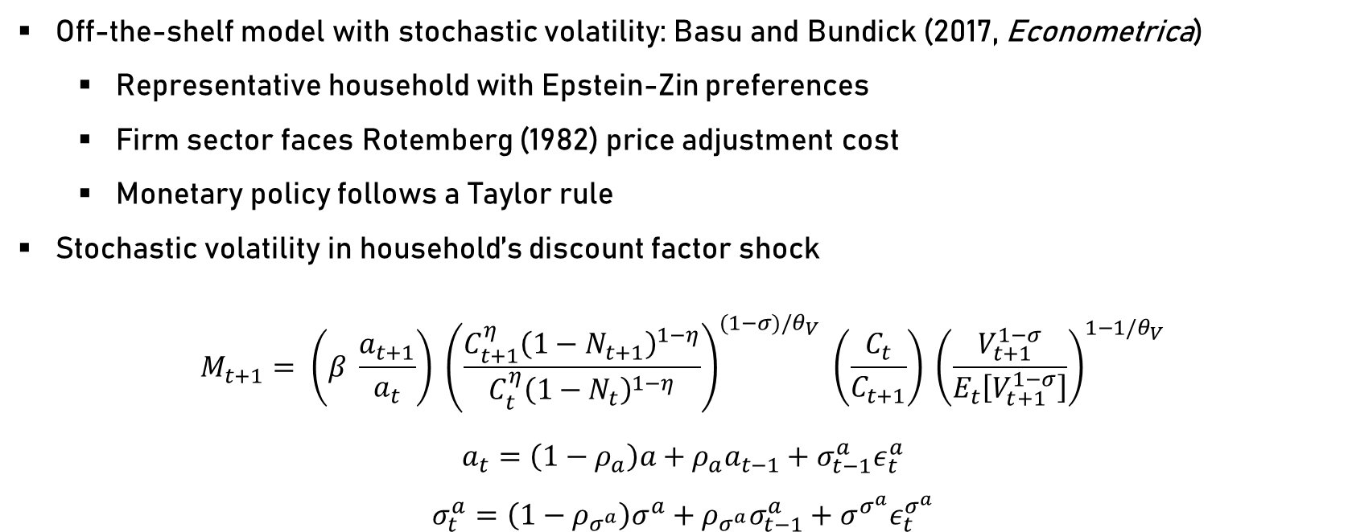
Model framework
Off-the-shelf model with stochastic volatility: Basu and Bundick (2017, Econometrica)
Representative household with Epstein-Zin preferences
Firm sector faces Rotemberg (1982) price adjustment cost
Monetary policy follows a Taylor rule
Stochastic volatility in household’s discount factor shock
$$M_{t+1}= \left(β \frac{a_{t+1}}{a_{t}}\right) {\left(\frac{C_{t+1}^{η}{\left(1−N_{t+1}\right)}^{1−η}}{C_{t}^{η}{\left(1−N_{t}\right)}^{1−η}}\right)}^{(1−σ)/θ_{V}} \left(\frac{C_{t}}{C_{t+1}}\right) {\left(\frac{V_{t+1}^{1−σ}}{E_{t}\left[V_{t+1}^{1−σ}\right]}\right)}^{1−1/θ_{V}}$$
$$a_{t}=\left(1−ρ_{a}\right)a+ρ_{a}a_{t−1}+σ_{t−1}^{a}ε_{t}^{a}$$
$$σ_{t}^{a}=\left(1−ρ_{σ^{a}}\right)σ^{a}+ρ_{σ^{a}}σ_{t−1}^{a}+σ^{σ^{a}}ε_{t}^{σ^{a}}$$

Slide 9
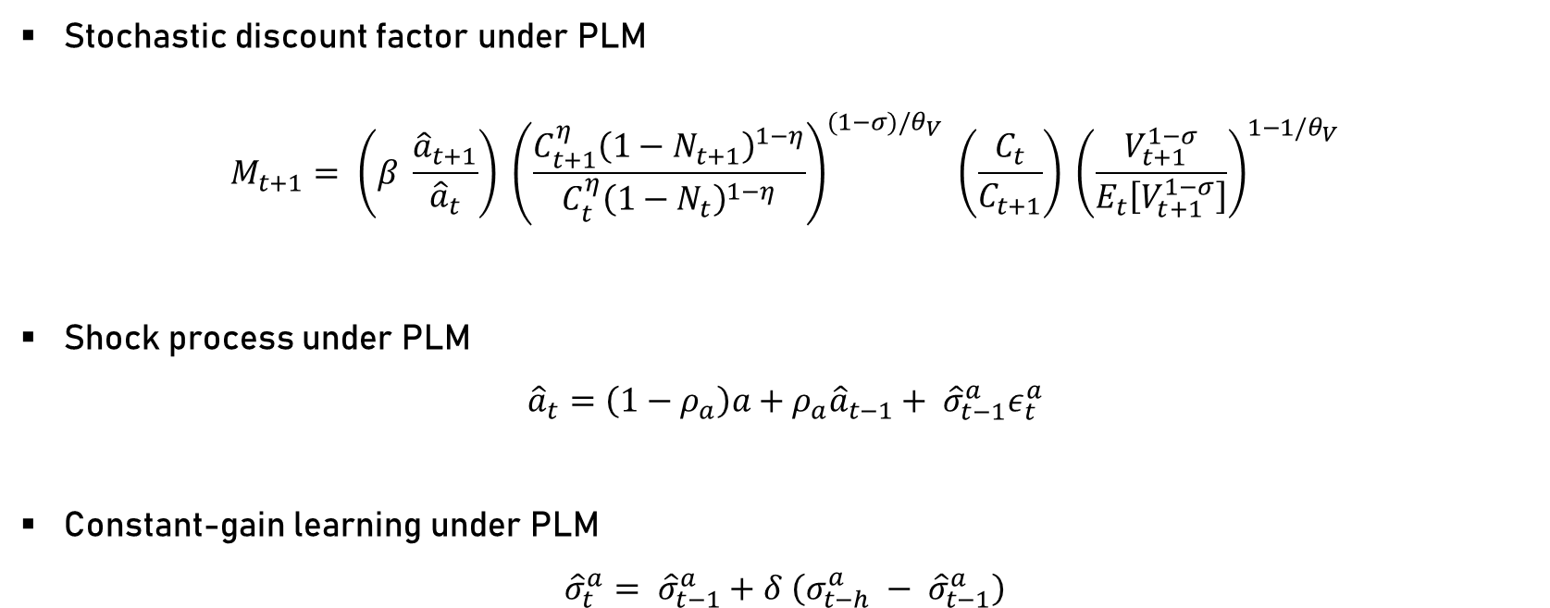
Gap between Actual and Perceived Uncertainty
Stochastic discount factor under PLM
$$M_{t+1}= \left(β \frac{{\hat{a}}_{t+1}}{{\hat{a}}_{t}}\right) {\left(\frac{C_{t+1}^{η}{\left(1−N_{t+1}\right)}^{1−η}}{C_{t}^{η}{\left(1−N_{t}\right)}^{1−η}}\right)}^{(1−σ)/θ_{V}} \left(\frac{C_{t}}{C_{t+1}}\right) {\left(\frac{V_{t+1}^{1−σ}}{E_{t}\left[V_{t+1}^{1−σ}\right]}\right)}^{1−1/θ_{V}}$$
Shock process under PLM
$${\hat{a}}_{t}=\left(1−ρ_{a}\right)a+ρ_{a}{\hat{a}}_{t−1}+ {\hat{σ}}_{t−1}^{a}ε_{t}^{a}$$
Constant-gain learning under PLM
$${\hat{σ}}_{t}^{a}= {\hat{σ}}_{t−1}^{a}+δ \left(σ_{t−h}^{a} − {\hat{σ}}_{t−1}^{a}\right)$$

Slide 10
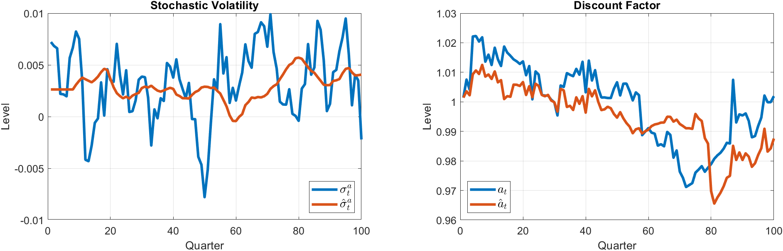
Model dynamics

Slide 11
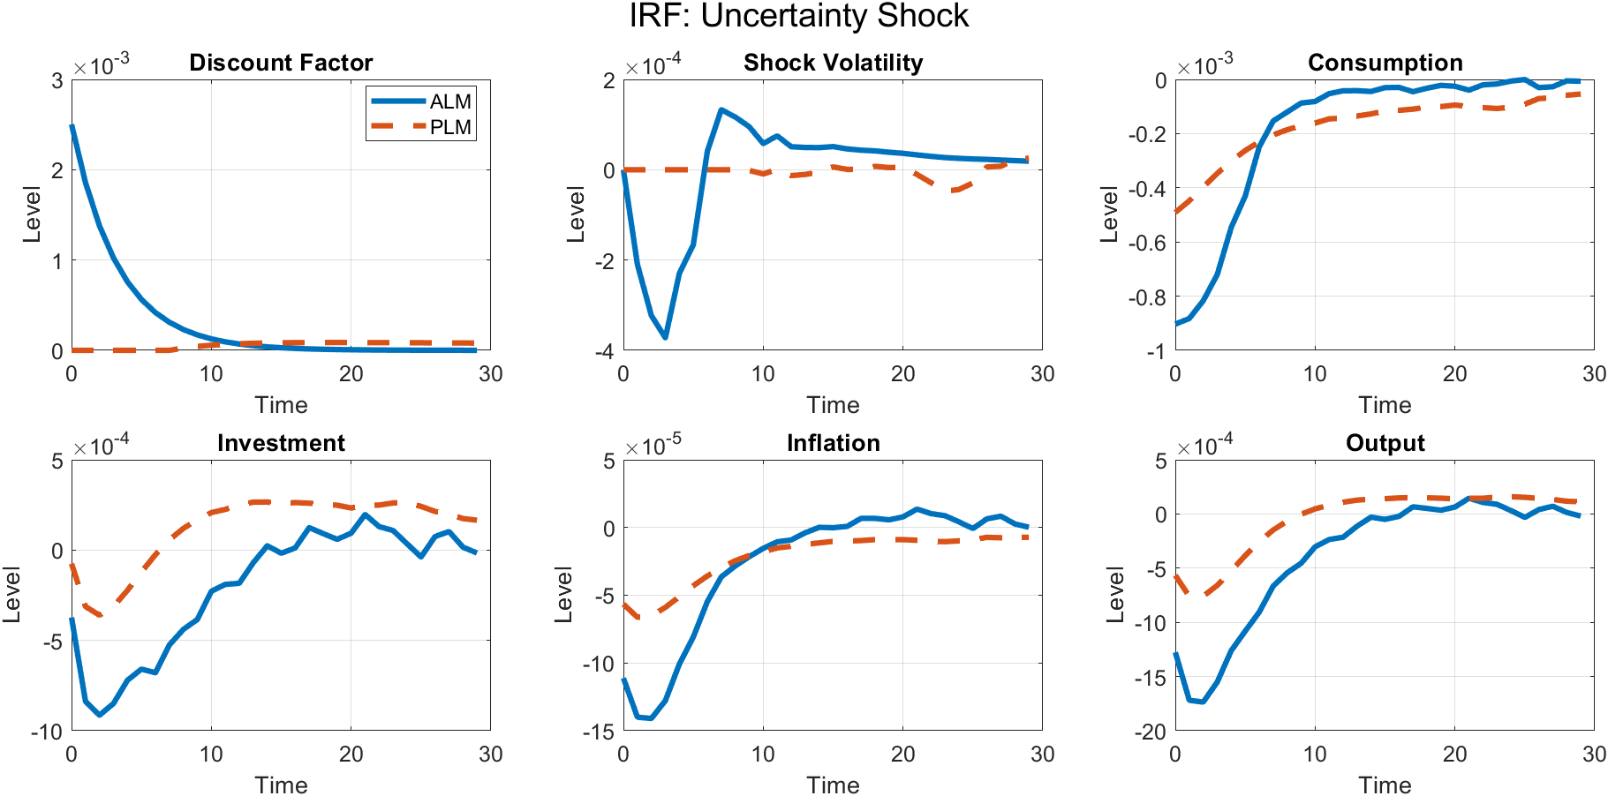
Relevance for Monetary Policy?

Slide 12
MONETARY POLICY DESIGN

Slide 13
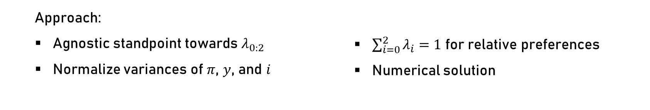
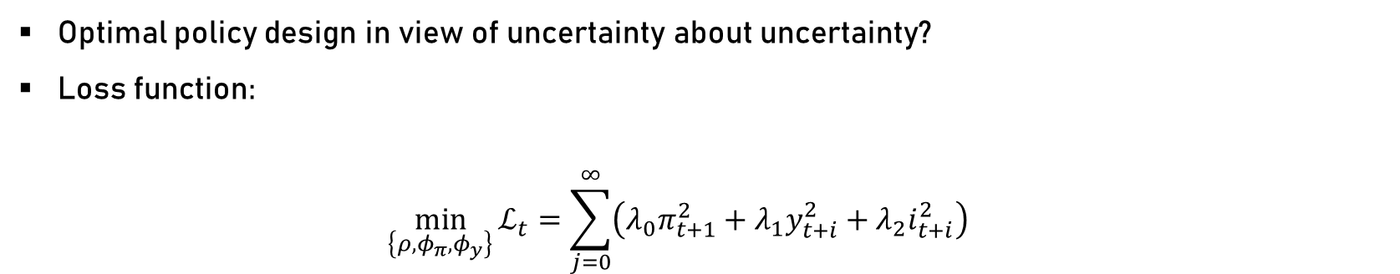
Monetary policy
Optimal policy design in view of uncertainty about uncertainty?
Loss function$:$
$$\min_{\left\{ρ,φ_{π},φ_{y}\right\}}{ℒ_{t}}=\sum_{j=0}^{∞}{\left(λ_{0}π_{t+1}^{2}+λ_{1}y_{t+i}^{2}+λ_{2}i_{t+i}^{2}\right)}$$
Approach:
Agnostic standpoint towards $λ_{0:2}$
Normalize variances of $π$, $y$, and $i$
$\sum_{i=0}^{2}{λ_{i}}=1$ for relative preferences
Numerical solution

Slide 14
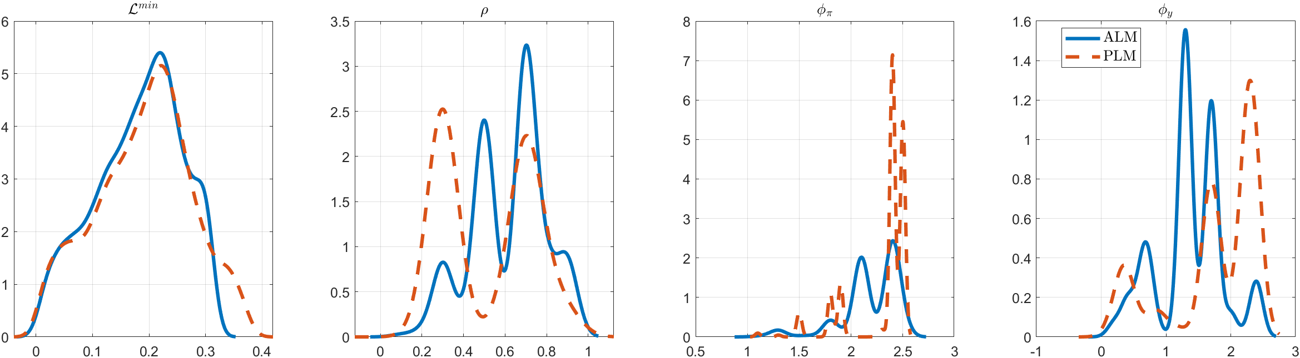




Optimal policy design
$$ℒ^{min}$$
$$ρ$$
$$φ_{π}$$
$$φ_{y}$$

Slide 15
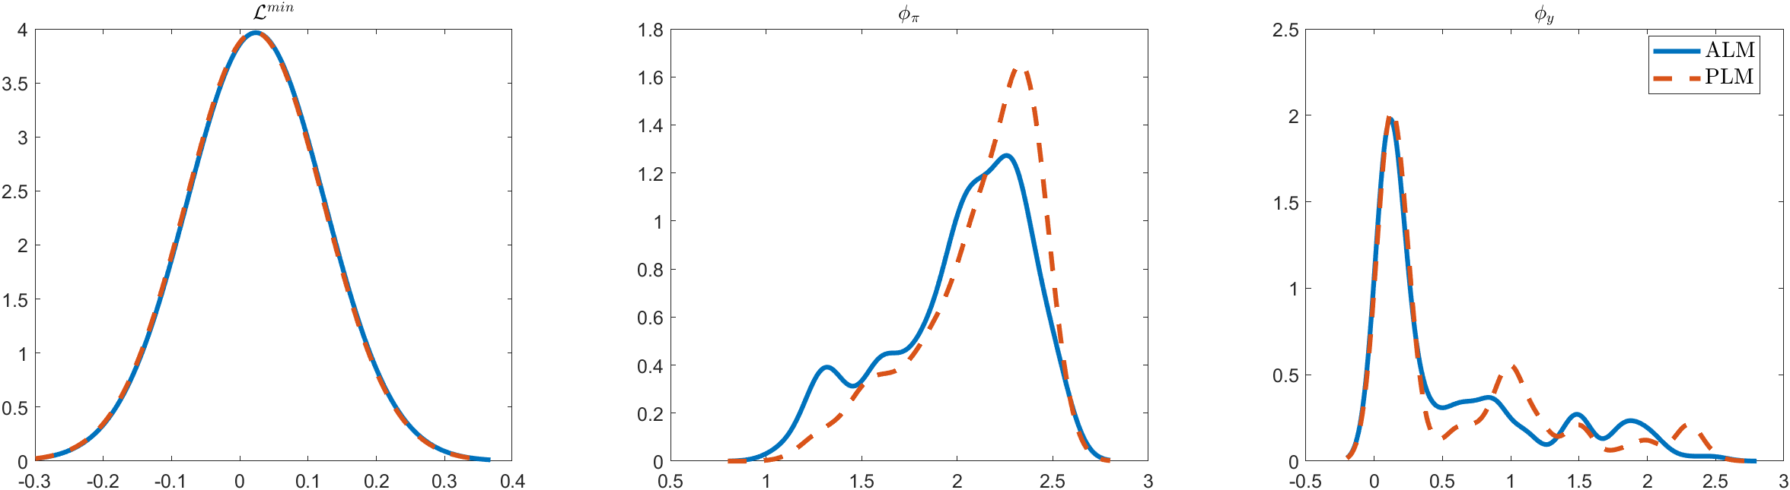
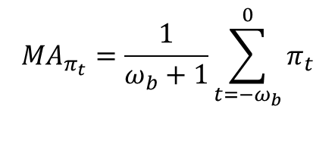




Alternative monetary policy?
Can Average Inflation Targeting (AIT) cope with uncertainty about uncertainty better than Inflation Targeting?
$$i_{t}=φ_{π}MA_{π_{t}}+φ_{y}y_{t}$$
$$MA_{π_{t}}=\frac{1}{ω_{b}+1}\sum_{t=−ω_{b}}^{0}{π_{t}}$$
$$ℒ^{min}$$
$$φ_{π}$$
$$φ_{y}$$

Slide 16
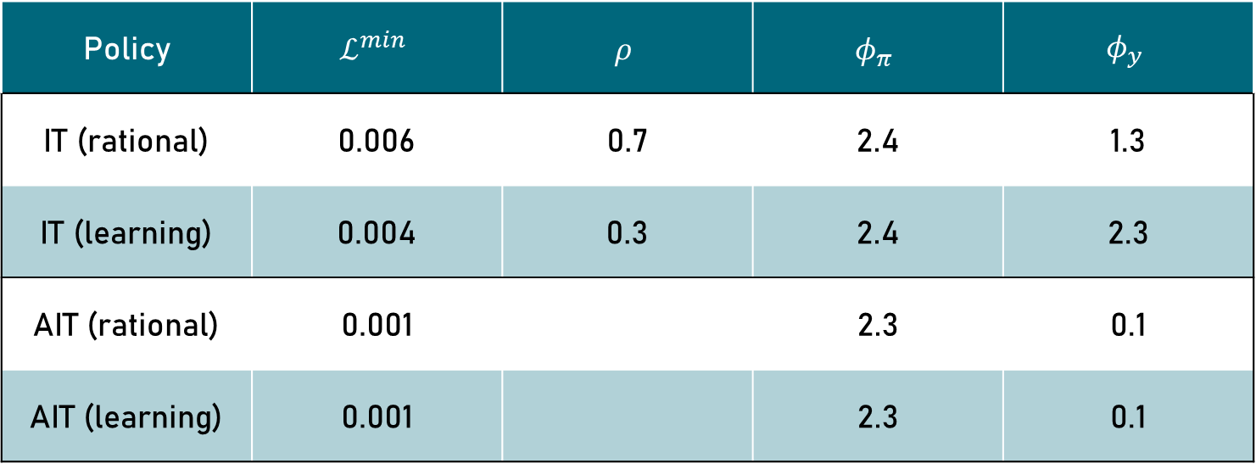
IT vs AIT
Policy | $$ℒ^{min}$$ | $$ρ$$ | $$φ_{π}$$ | $$φ_{y}$$
IT (rational) | 0.006 | 0.7 | 2.4 | 1.3
IT (learning) | 0.004 | 0.3 | 2.4 | 2.3
AIT (rational) | 0.001 |  | 2.3 | 0.1
AIT (learning) | 0.001 |  | 2.3 | 0.1

Slide 17
CONCLUDING REMARKS

Slide 18
First attempt to
… understand uncertainty about uncertainty in the New Keynesian framework
… quantify the resulting implications for monetary policy
Findings
Perceived uncertainty lags actual volatility empirically.
Partial information leads to policy overreaction.
AIT performs robustly under learning.
Implications
Learning is essential for modeling expectations realistically.
Information frictions can destabilize policy outcomes.
AIT effectively dampens biases induced by misperceived uncertainty.

Slide 19
Thank you for attending the session.
hecker@economics.uni-kiel.de

