Slide 1

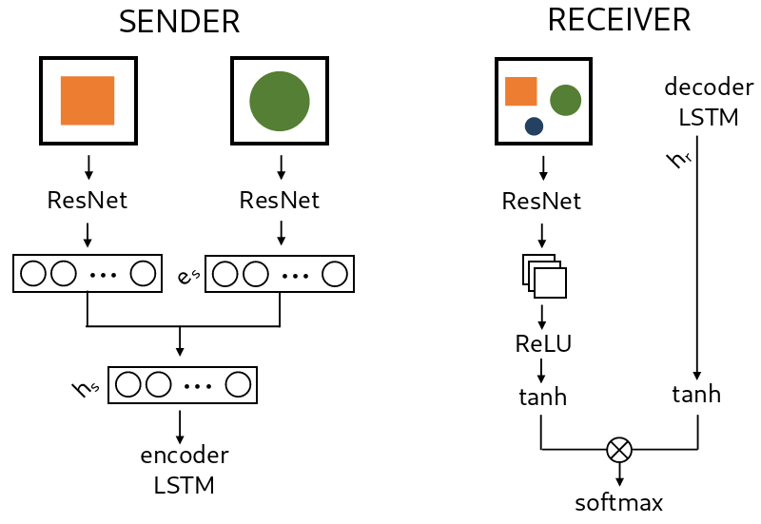
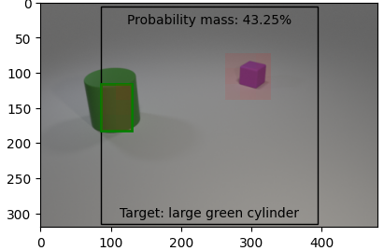
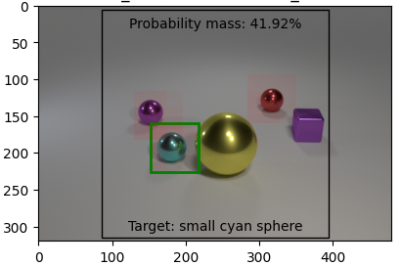
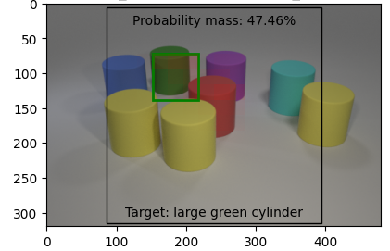
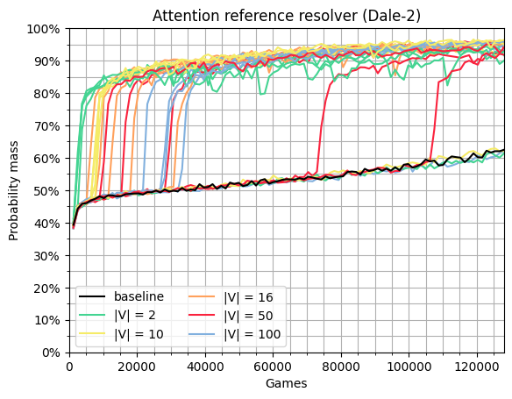
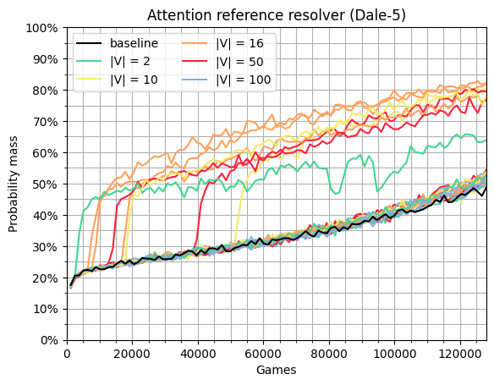
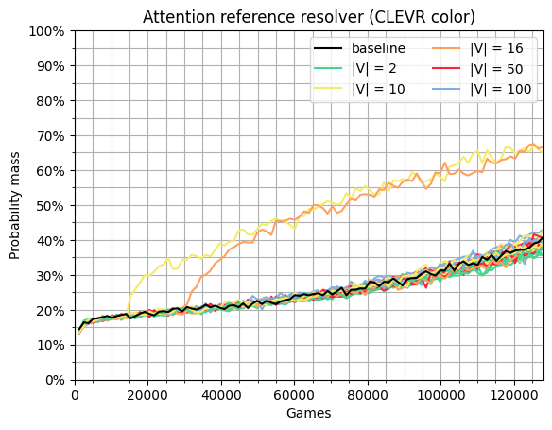

Learning to Refer: How Scene Complexity Affects
Emergent Communication in Neural Agents
Dominik Künkele¹ and Simon Dobnik^{1,2}
¹Department of Philosophy, Linguistics and Theory of Science
²Centre for Linguistic Theory and Studies in Probability (CLASP)
University of Gothenburg, Sweden
contact@dominik-kuenkele.de simon.dobnik@gu.se
Aims
Setup
Findings
A picture is worth a thousand words...
Study emergence of discrete linguistic symbols and languages from continuous sensory input in interactive communication
Study constraints on symbol grounding in interacting neural agents
Investigate the effects of structured biases of scene complexity, discriminating features present, and message space on emergent languages
Medium vocabularies (|V| ∈ {10, 16}) and message lengths (n ∈ {2, 4}) perform best
Emergent vocabularies align with the structured contextual biases introduced
Scene complexity (number of distractors, number of features) strongly impacts communication success
Shape attributes easiest to learn, size attributes most challenging
Future: Compare emergent vocabularies and languages with (different) natural languages
Receiver attends to region in visual scene based on the sender‘s message
Experiments
Dale-2
Dale-5
CLEVR Color
Sender in Supervised Generation (GRE)
Strict string accuracy | 99% | 69% | 93%
F1 score | 98,57% | 89,53% | 95,17%
Shape Prec / Rec | 99,75% / 99,74% | 98,30% / 98,3% | 100% / 100%
Color Prec / Rec | 98,09% / 98,53% | 92,44% / 92,95% | 92,76% / 92,76%
Size Prec / Rec | 98,73% / 95,9% | 69,43% / 64,13% | N/A
<pad> Prec / Rec | 99,64% / 99,77% | 82,22% / 84,59% | 100% / 100%
Sender and Receiver in Emergent Interaction
16th International Conference on Computational Semantics (IWCS 2025)
Supported by the Swedish Research Council Project Grant (VR 2023-01552) Beyond Pixels and Words

