Slide 1
Learning to refer: How Scene complexity Affects emergent communication in Neural Agent
Dominik Künkele & Simon Dobnik
University of Gothenburg 08-09-2025

Slide 2
limits of the agents’ architectures, the environment, and input representations

Slide 3
Alignment with Referring Expressions in natural Languages

Slide 4
I CREATION OF DATASETS
II VALIDATION OF DATASETS
III LANGUAGE GAMES

Slide 5
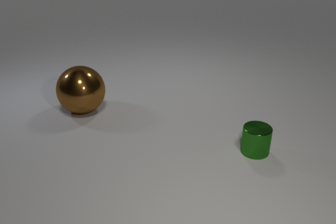
DALE 2
small green cylinder

Slide 6
DALE 2
small green cylinder

Slide 7
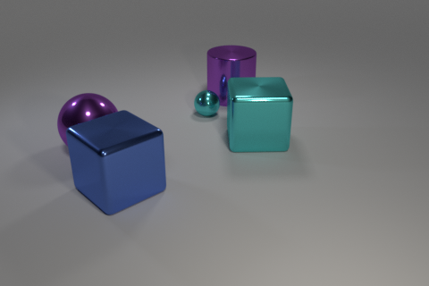
DALE 5
large blue cube

Slide 8
DALE 5
large blue cube

Slide 9
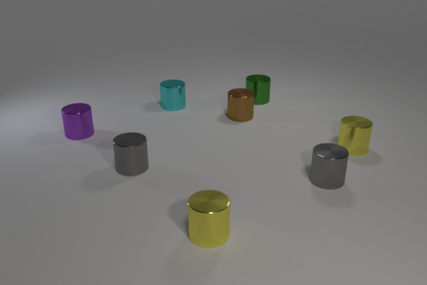
CLEVR COLOR
small purple cylinder

Slide 10
CLEVR COLOR
small purple cylinder

Slide 11
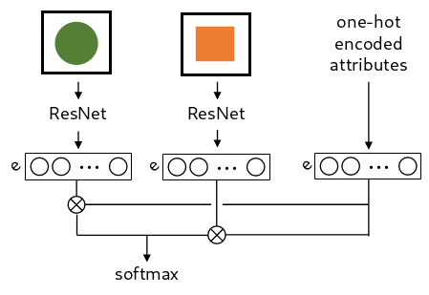
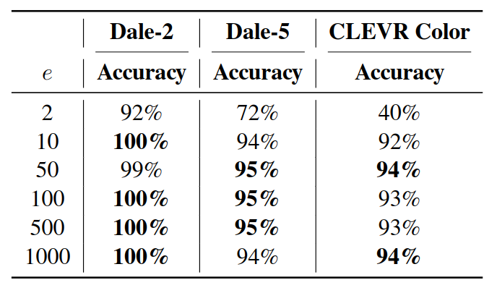
OBJECT IDENTIFICATION

Slide 12
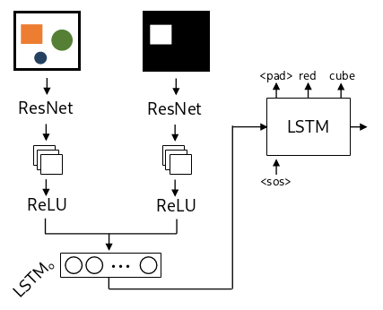
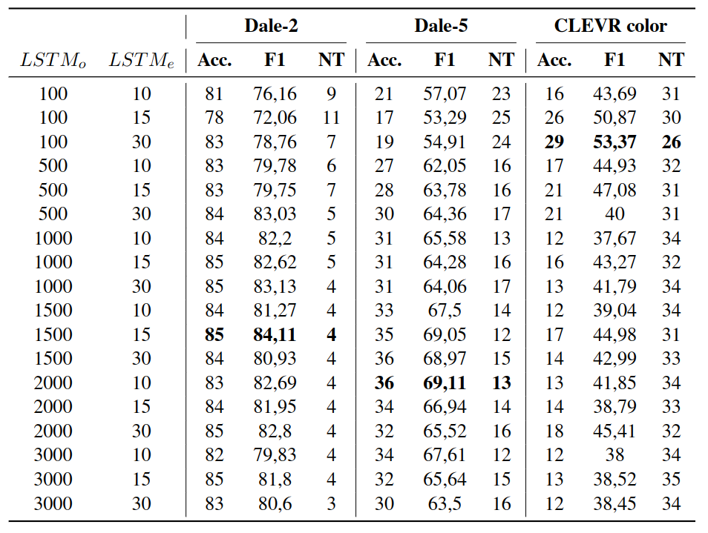
REFERRING EXPRESSION GENERATION

Slide 13
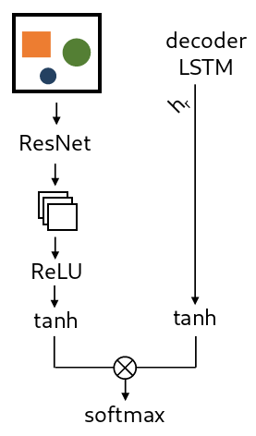
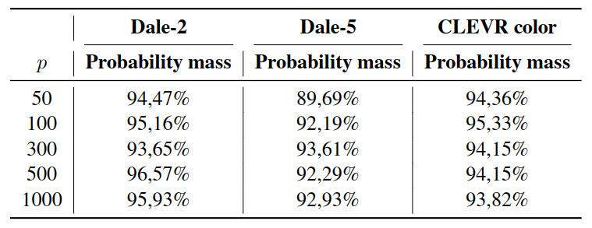
REFERENCE RESOLUTION

Slide 14
LANGUAGE GAMES
Game
INPUT
Random messages
Sender Wrapper
Receiver Wrapper
Sender Agent
Receiver Agent
m₀ m₁ <eos>
h₀
RNN
m
RNN
h_{n}
m₀ m₁ <eos>
back-propagation
GROUND TRUTH
LOSS FUNCTION

Slide 15
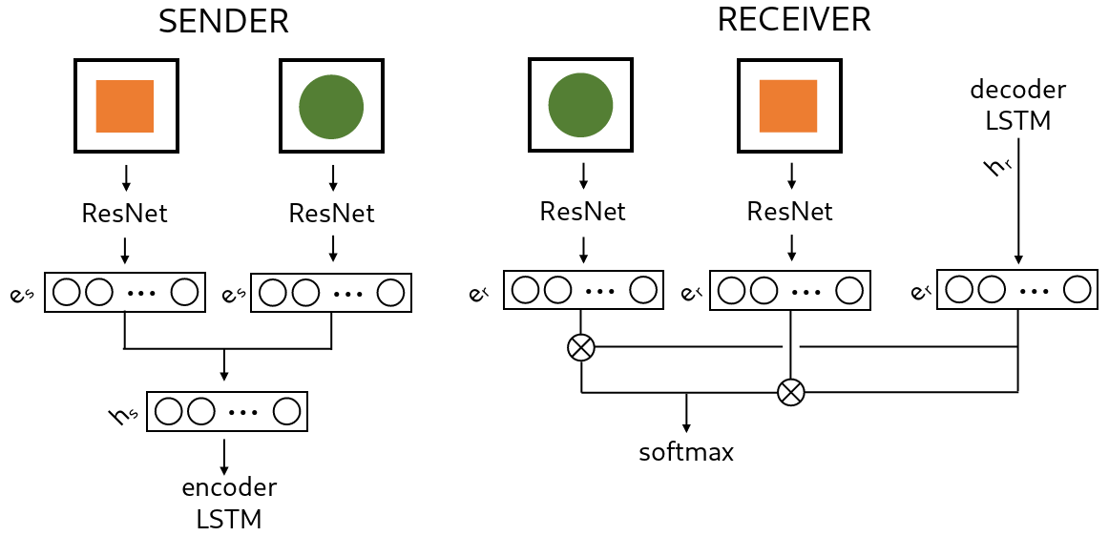
OBJECT IDENTIFICATION

Slide 16
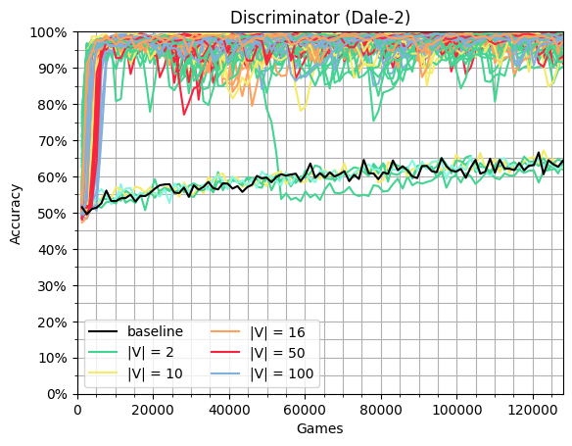
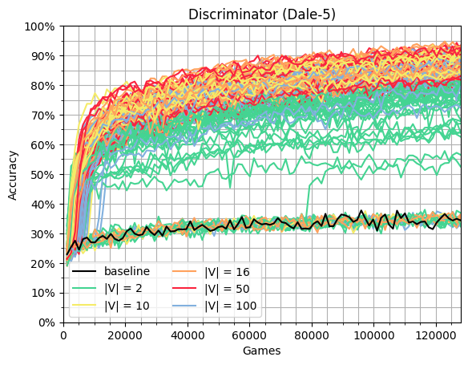
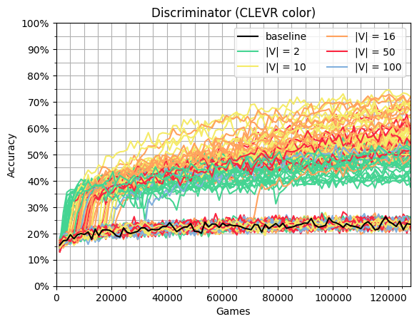
OBJECT IDENTIFICATION

Slide 17
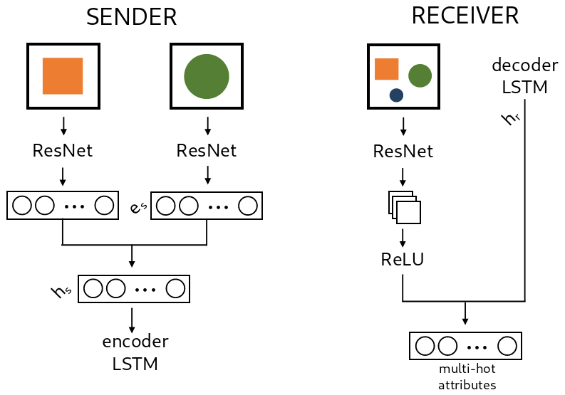
REFERRING EXPRESSION GENERATION

Slide 18
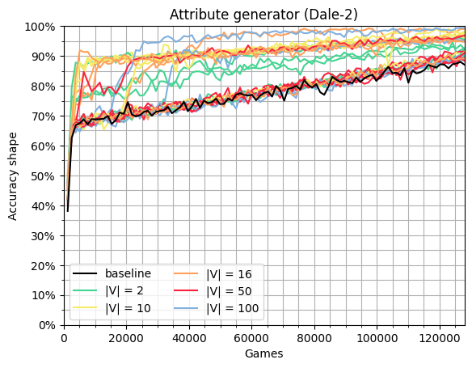
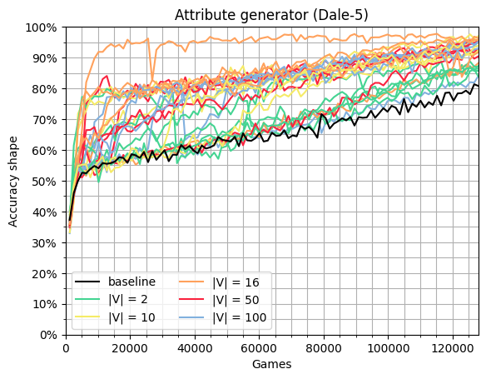
REFERRING EXPRESSION GENERATION

Slide 19
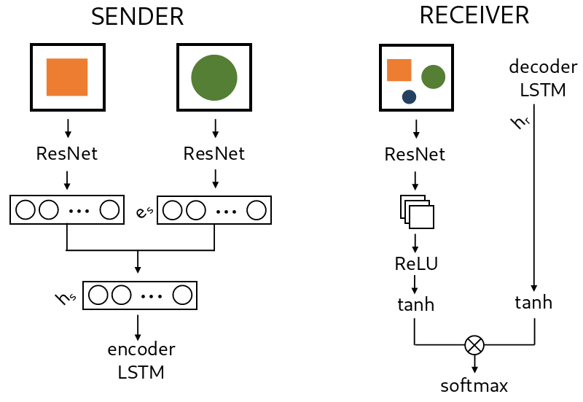
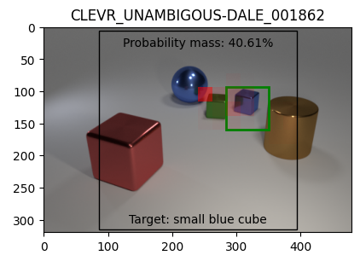
ATTENDING IN LANGUAGE GAMES

Slide 20
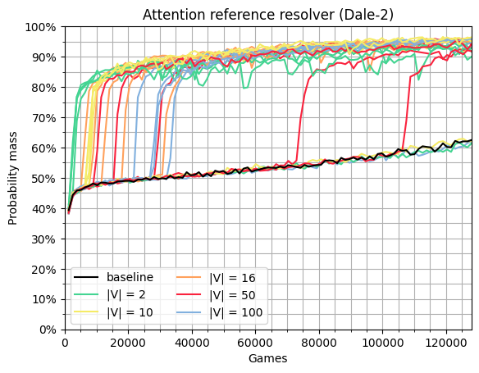
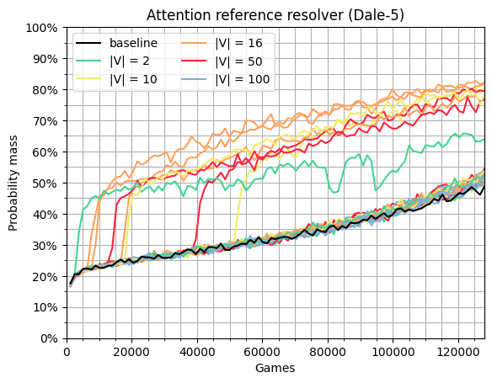
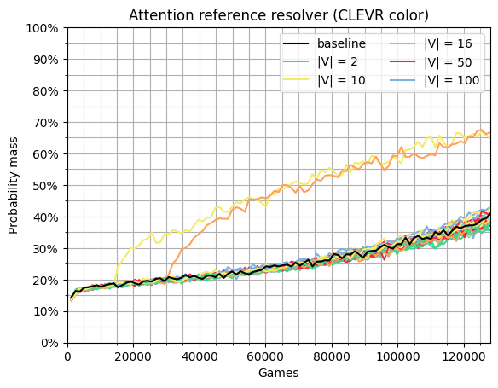
REFERENCE RESOLUTION

Slide 21
„Incremental Algorithm“
cyan sphere
small sphere
small (object)
small cyan (object)
spherical cyan (object)
small cyan sphere

