Slide 1

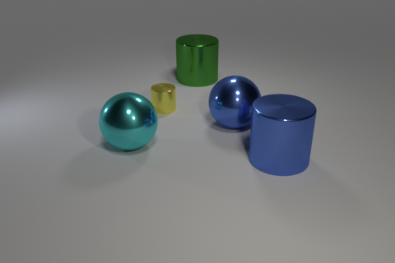
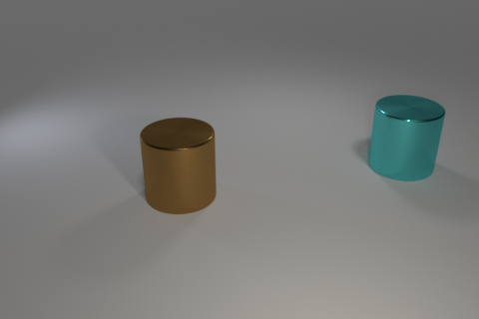
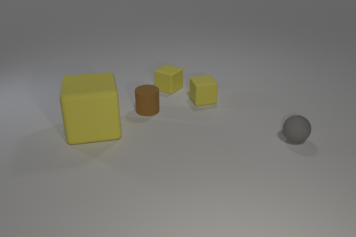
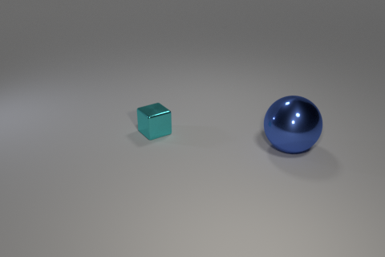
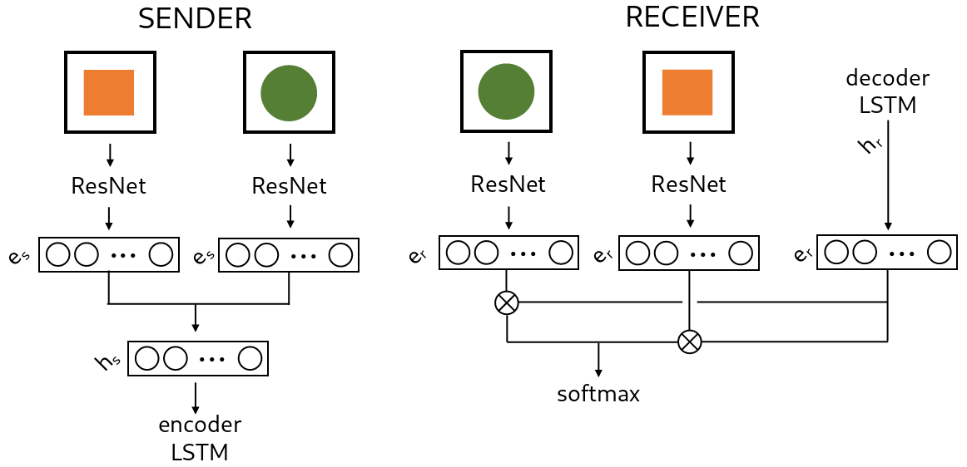
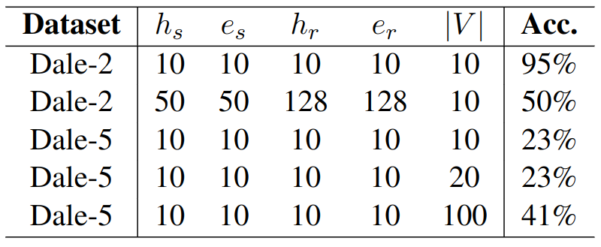
Referring as a collaborative process:
learning to ground language through language games
Dominik Künkele and Simon Dobnik
University of Gothenburg, Sweden
dominik.kuenkele@outlook.com and simon.dobnik@gu.se
Motivation
3-d dataset in which relations of objects are highly controllable
Referential grounding in language games
Dale-5
Dale-2
Datasets ‘Dale-5’ and ‘Dale-2‘
Two datasets based on CLEVR (Johnson et al. (2017))
Target object uniquely identifiable using one to three attributes (size, shape, colour)
Unique description based on GRE-algorithm by Dale and Reiter (1995) with importance order:
shape > colour > size
Around each object a fixed-size bounding box is extracted
the yellow cylinder
the turquoise cylinder
the large yellow cube
the sphere
Language Games
Sender receives target object always first, receiver in random order
Message is a sequence of symbols of vocabulary V
Sender and receiver are updated based on the receiver’s prediction
NLL-Loss is calculated after each symbol of the message and then summed up
Results
|V| smaller than number of attributes enough for ‘Dale-2’
|V| smaller than number of possible objects indicates description of discriminative features
More symbols necessary when more distractors present

