Slide 1

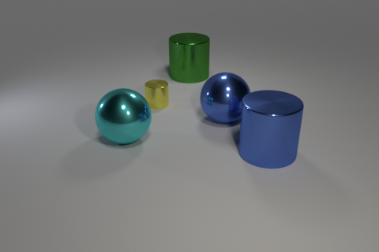
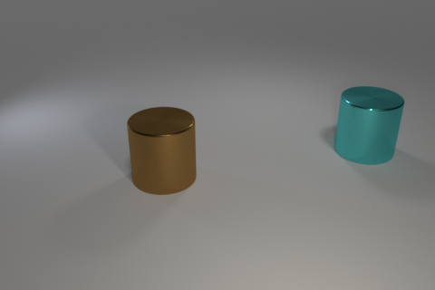
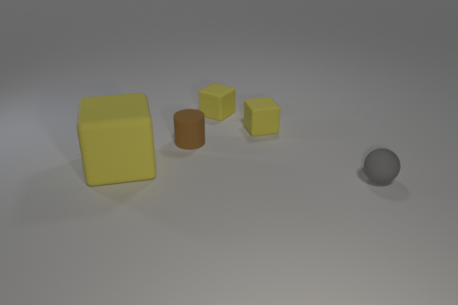
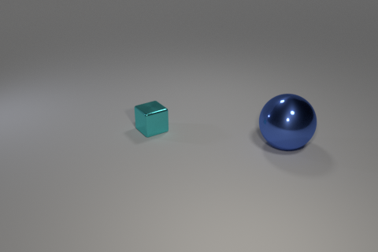
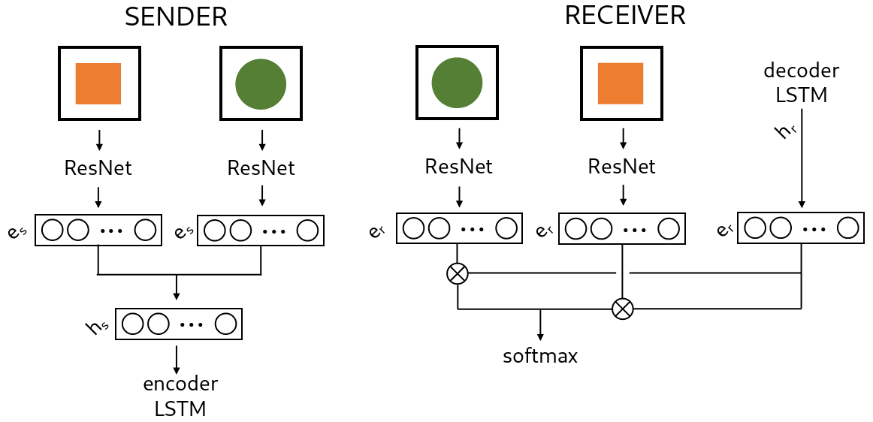
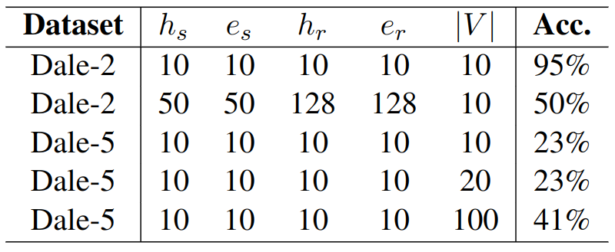
Referring as a collaborative process:
learning to ground language through language games
Dominik Künkele and Simon Dobnik
University of Gothenburg, Sweden
dominik.kuenkele@outlook.com and simon.dobnik@gu.se
AIMS
Referential grounding in language games
3-d scenes of objects with different attributes and in different spatial configurations
Dale-5
Dale-2
Datasets ‘Dale-5’ and ‘Dale-2‘
Two new datasets based on CLEVR (Johnson et al. (2017)
Target object uniquely identifiable by 1-3 attributes (size, shape, colour)
Objects in scenes are generated as anticipated by the GRE algorithm (Dale and Reiter, 1995) with ranking shape > colour > size
Extract visual features of objects as bounding boxes of fixed size
Agents negotiate on a language to refer to target objects
the yellow cylinder
the turquoise cylinder
the large yellow cube
the sphere
Language Games
Objects presented to sender and receiver in random order, except for the sender’s target
Message is a sequence of symbols of vocabulary V
Both sender and receiver are updated based on the receiver’s success to identify the target
Loss: incremental sum of losses over sequences of symbols
Results
|V| smaller than the set of attributes (3 + 8 + 2 = 13) enough for ‘Dale-2’
|V| smaller than the possible set of unique objects (3 * 8 * 2 = 48) indicates learning of discriminative descriptions
More symbols are required with more distractors

