Slide 1
SpATIAL rELATIONS in emerged language
Dominik Künkele
LT2402 – University of Gothenburg
18-04-2023

Slide 2
Background
Emerged Language
- Flexibility
- Efficiency

Slide 3
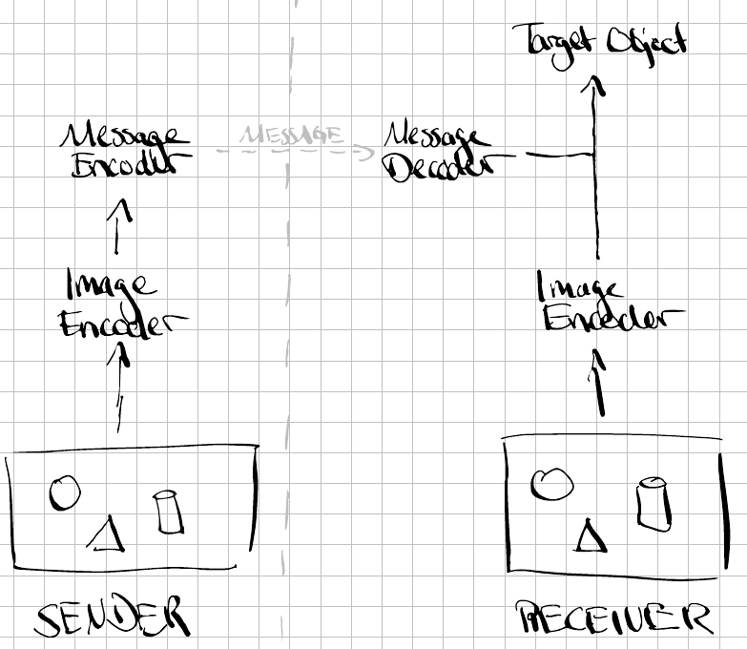
Language Game

Slide 4
Dataset
Goals
- 3D dataset
- simple objects (defined attributes)
- controlled relations (position, attributes)

Slide 5
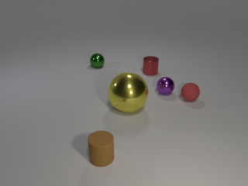
Dataset
CLEVR dataset
- scene with 3D objects
- color, shape, size
- random relations

Slide 6
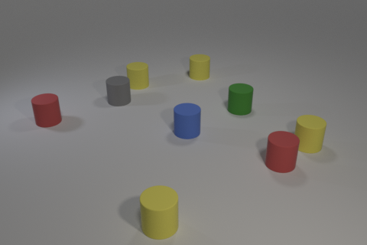
Dataset
Adapted CLEVR dataset
- target object, target group, non-target group
- color, shape, size
- contolled relations
E.g.:
- all objects share size and shape
- target object has unique color

Slide 7
MODEL
pretrained Resnet (without 2 last layers)
Encoded attributes

