Slide 1
SYSTEM DESIGN
M-Lab: Team Daimler
17. Nov. 2016
Speaker: Dominik Röhrig, Ibrahim Dahmash

Slide 2
Outline
Speaker: Dominik Röhrig
Existing System
Problem
System Design
Design Goals
System Architecture
Control Flow
Architectural Style
Subsystem Decomposition
Hardware-/Software-Mapping
Sequence Diagram
Use-Case-Diagram

Slide 3
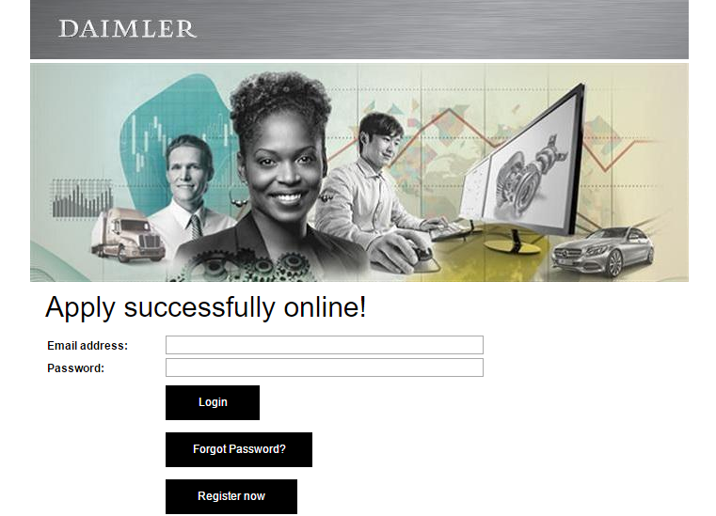
Existing System
Speaker: Dominik Röhrig
Usual application process
Application website of Daimler

Slide 4
Problem
Speaker: Dominik Röhrig
How can we get the attention of the user?
→ User friendliness
How can we gather information about the personality/ soft skills of the applicant?
→ not only graduation and hard skills
We want to find those candidates, who perform best in real job situations
Mobile-App: ease of use, unusual innovative techniques, different feeling of application

Slide 5
System Design Design Goals
Speaker: Dominik Röhrig
High priorities
Understandability
User-Friendliness
Reliability
Privacy
Reusability / Reuse of components
Low priorities
Maintainability
Portability
Adaptability
High Performance
Flexibility

Slide 6
System Design Design Goals- Current Focus
Speaker: Dominik Röhrig
Understandability/ Ease of Use:
→ Assistant, which is always explaining what to do
Well-Defined User-Interface:
→ Creative and attractive interface
Reusability:
→ Assistant, which always appears again to help

Slide 7
System Architecture
Speaker: Dominik Röhrig
Each feature is a independent sub module
Control flow through the application
→Concurrency: step by step
→Modularization: each feature is a own process (expandable)

Slide 8
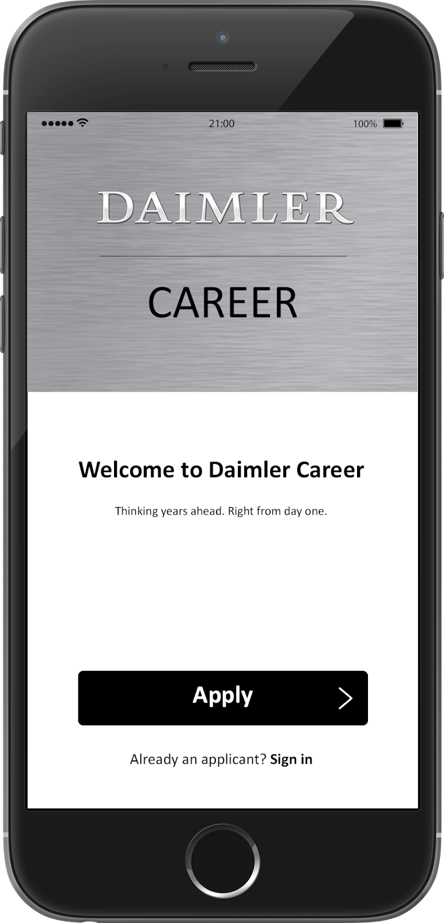
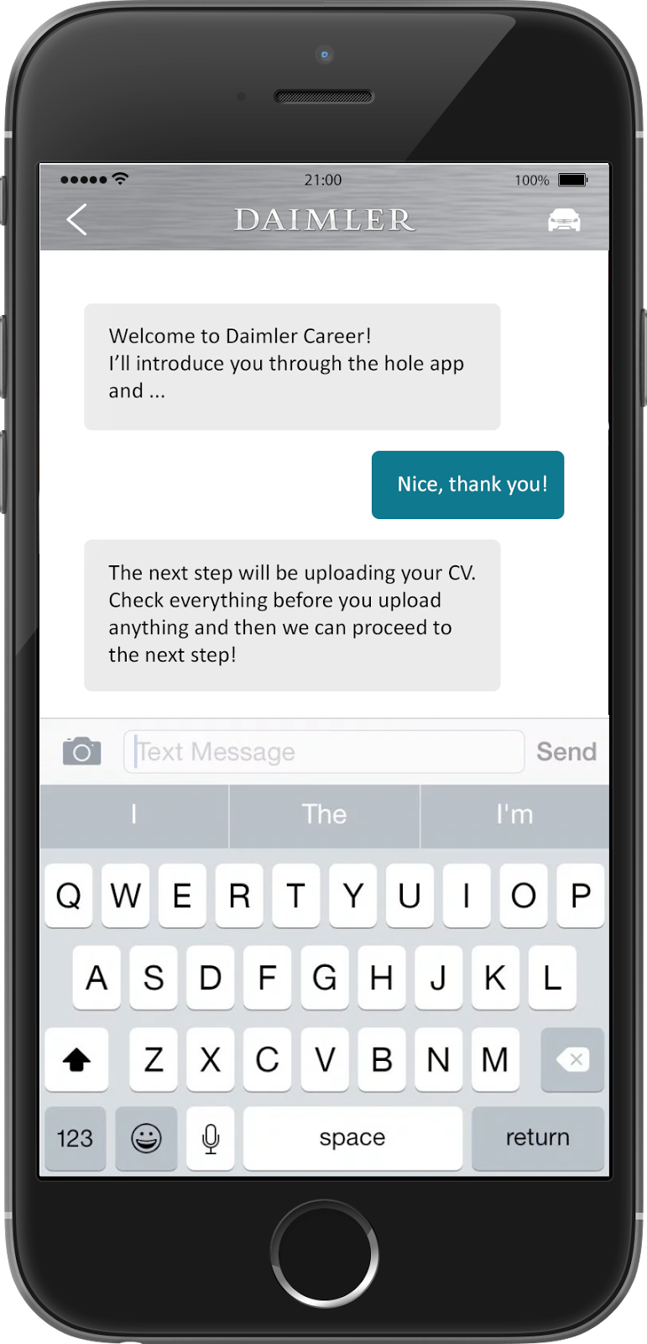
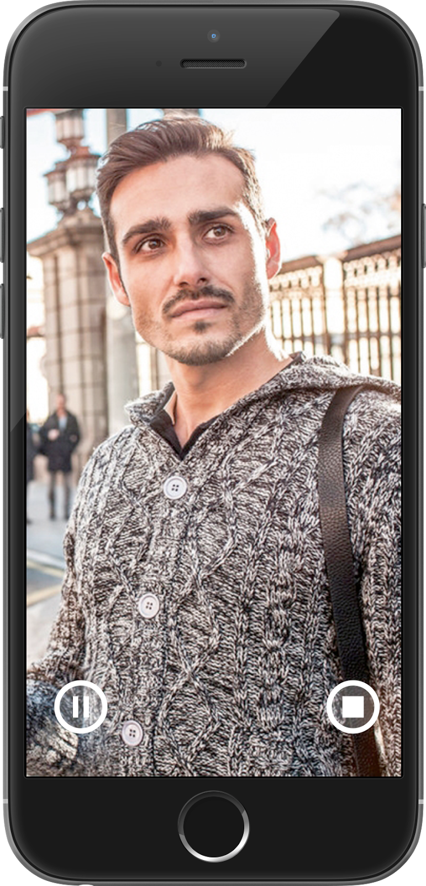
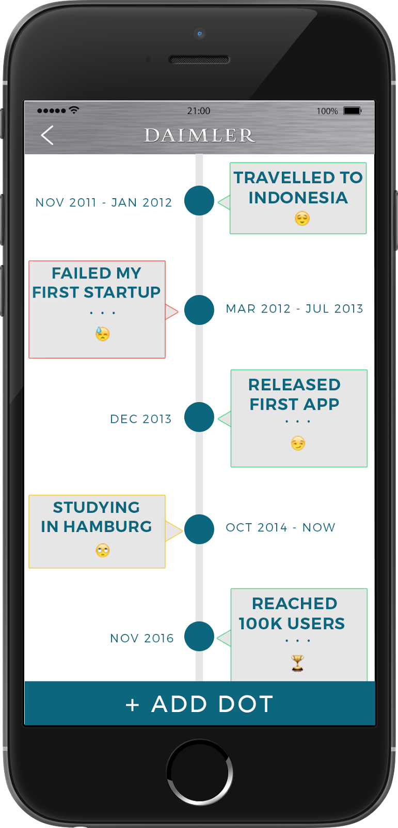
Software Control Flow
Speaker: Dominik Röhrig
Login
Main Menu
LogIn_Button
pressed
Password =true
Chat Bot
Password =false
Video_Button
pressed
TimLine_Button pressed
Video Introduction completed = false
Finish_Button
pressed
Timeline completed = false
completed = true
Video Introduction
Timeline
Final View
completed = false
Video Introduction completed = true
completed = false
Timeline completed = true
completed = true

Slide 9
System Architecture Server-/Client- Architecture
Speaker: Dominik Röhrig
MVC-Pattern
Interface
Model
Backend
View
LinkedIn
Controller
Frontend
API
Thin Client
Xing
API

Slide 10
Subsystem Decomposition Layers vs Partitions
Speaker: Ibrahim Damash
Layer relationships:
→Layer A “depends on” Layer B (compile time property)
→Layer A “calls” Layer B (runtime property)
Partition relationship:
→A can call services in B, B can call services in A
Good Design:
→High Coherence
→Low Coupling (Principle of information hiding)

Slide 11
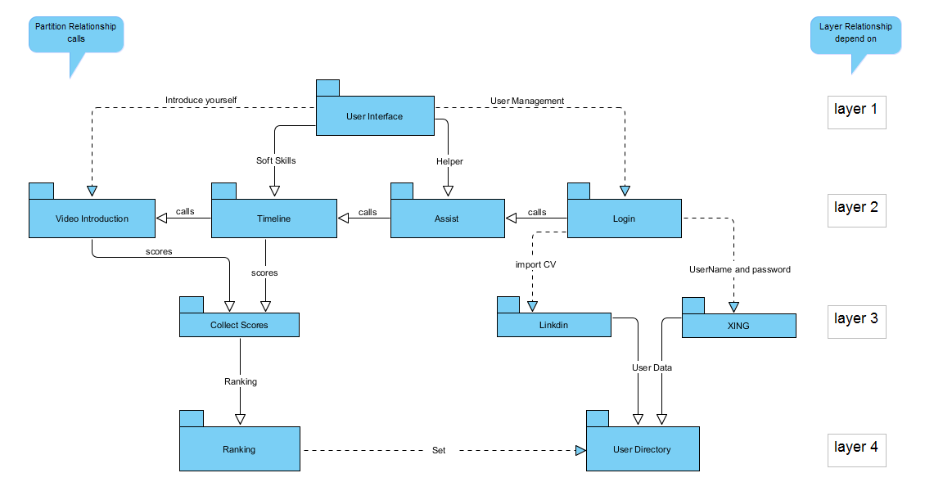
Subsystem Decomposition Layers vs Partitions
Speaker: Ibrahim Damash

Slide 12
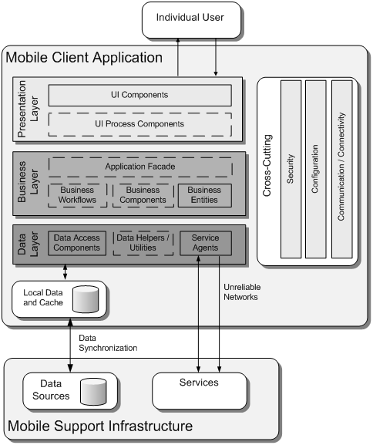
Hardware/Software Mapping
Speaker: Ibrahim Damash
This is the common Client
Mobile app architecture
Presentation Layer (View)
Business Layer (Controller)
Data Access layer (Model)
Backend infrastructure
Common client mobile application architecture [1]

Slide 13
Hardware/Software Mapping
Speaker: Ibrahim Damash
How shall we realize the subsystems: With hardware or with software?
How do we map the object model onto the chosen hardware and/or software?
Mapping the Objects:
Processor, Memory, Input/output
Mapping the Associations:
Network connections

Slide 14
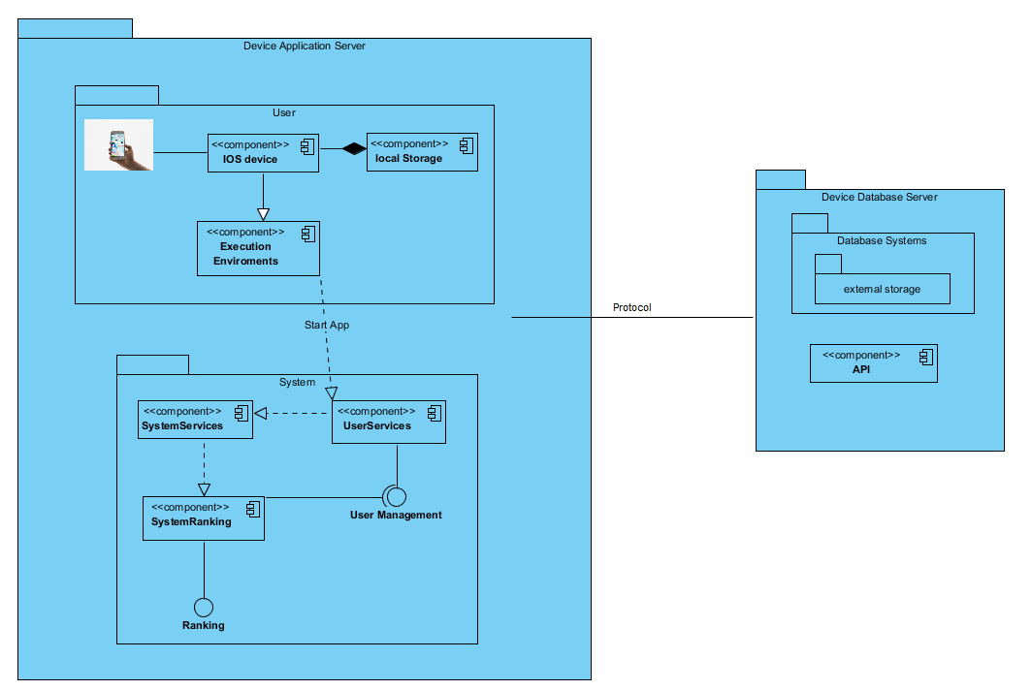
Hardware/Software Mapping
Speaker: Ibrahim Damash

Slide 15
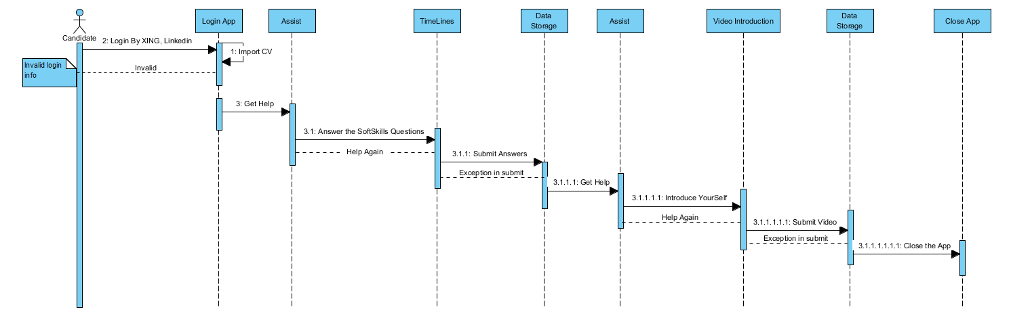
Sequence-Diagram
Speaker: Ibrahim Damash

Slide 16
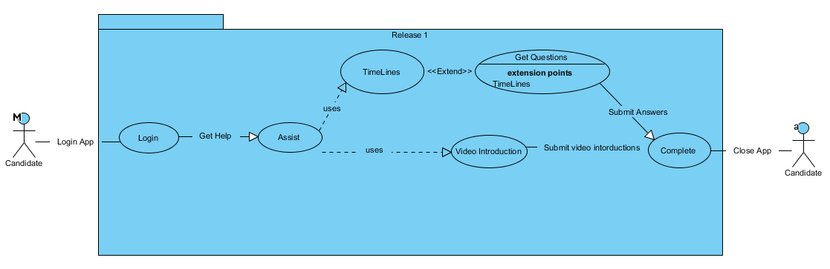
Use-Cases-Diagram
Speaker: Ibrahim Damash

Slide 17
References
Speaker: Ibrahim Damash
1- The patterns & practices Microsoft Application Architecture Guide, 2nd Edition.

Slide 18
Thank you for your attention! ☺

