Slide 1

Unsupervised Machine Learning: K-means Clustering and PCA on Country Data
Factors of Child mortality
(refers to the probability of dying between birth and exactly five years of age expressed per 1,000 live births)

Slide 2


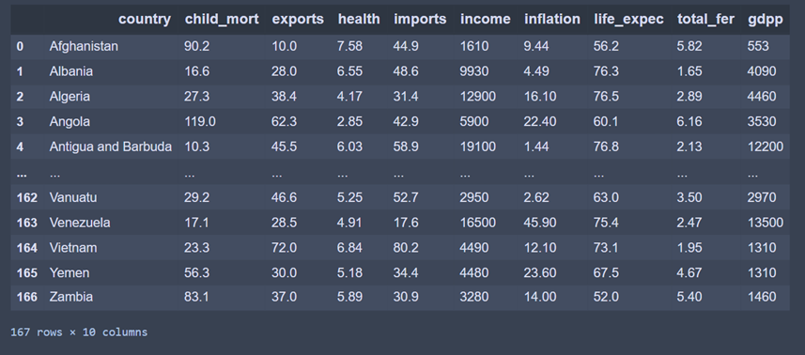
Meet the ‘Country-data.csv’

Slide 3
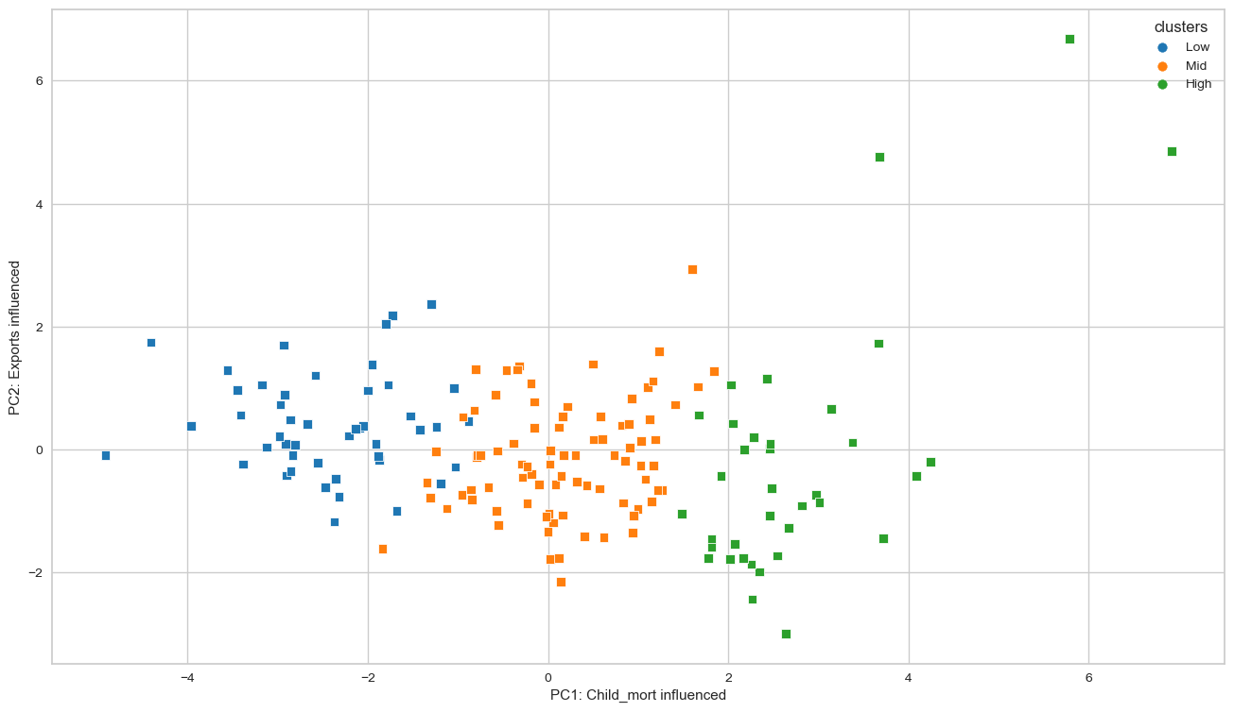
Principal component analysis – visual PC1:PC2
Cluster Interpreter
Low: Less prosperous countries
Mid: In-between
High: Prosperous countries

Slide 4
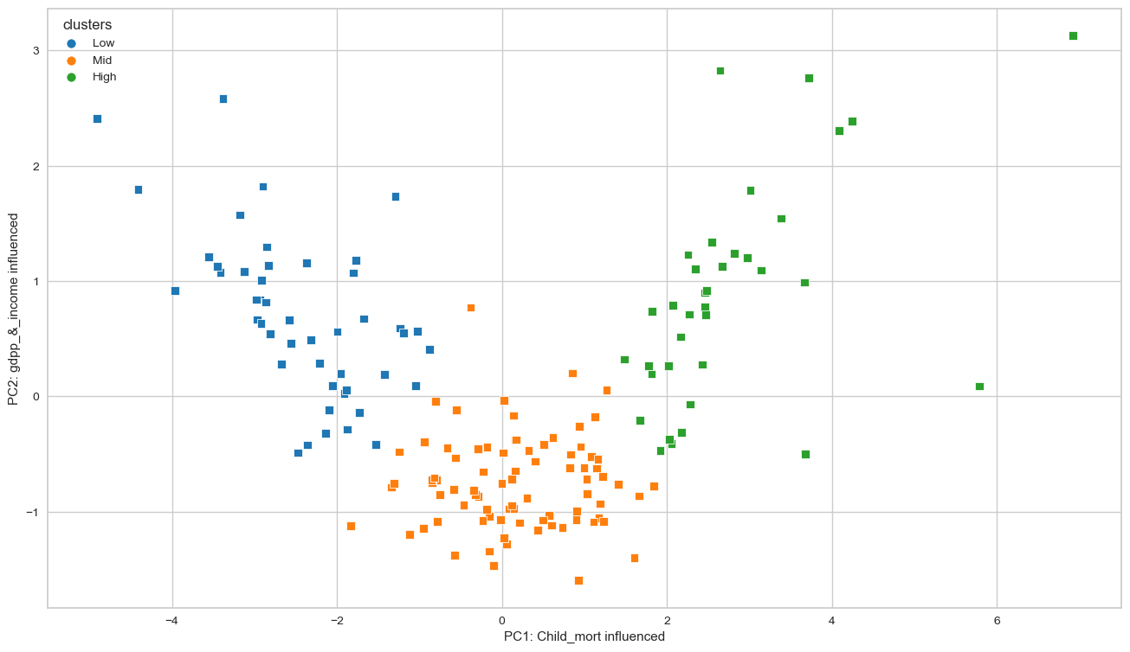
Principal component analysis – visual PC1:PC4
Cluster Interpreter
Low: Less prosperous countries
Mid: In-between
High: Prosperous countries

Slide 5
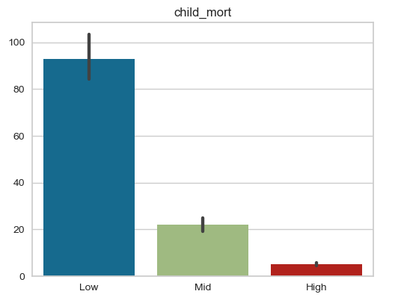

Low: Less prosperous countries
Mid: In-between
High: Prosperous countries

Slide 6
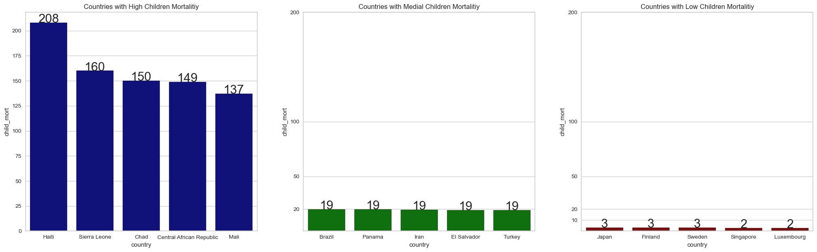
The extremes of each cluster…

Slide 7
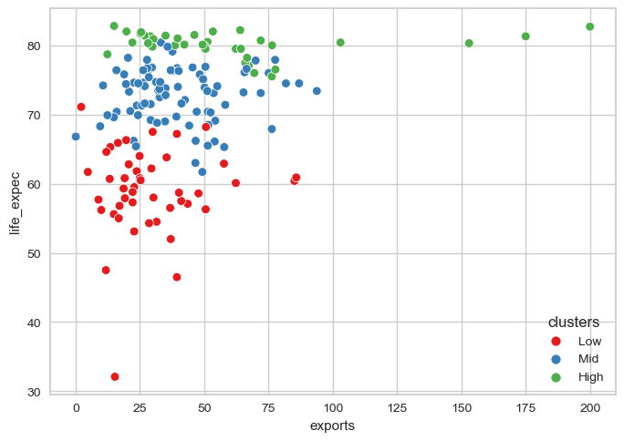
Life expectancy vs. exports

Slide 8
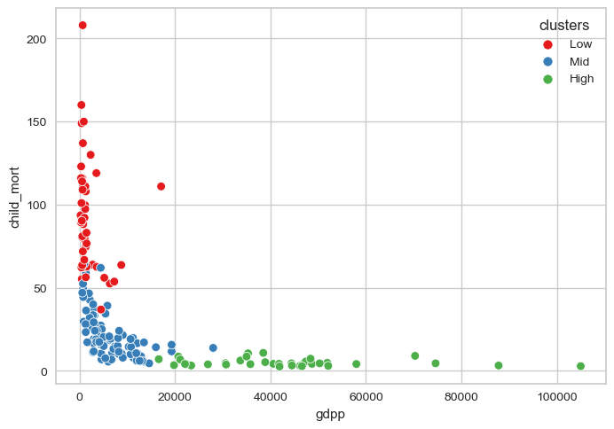
Child mortality vs. Gdp(perc)

Slide 9

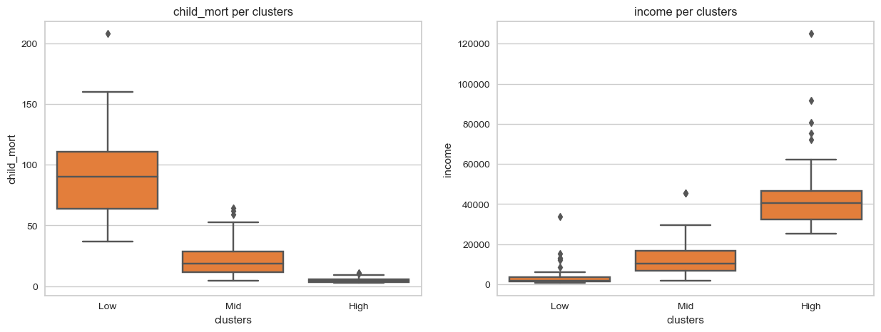

Child mortality
Income

Slide 10
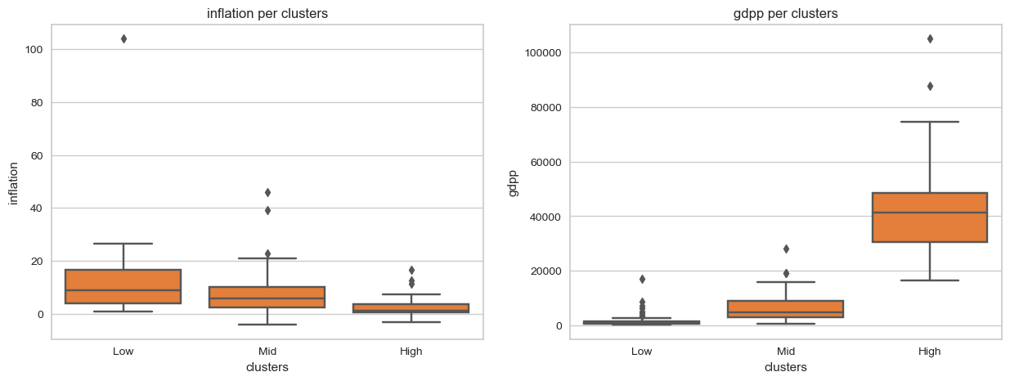
Inflation
Gdp(perc)

Slide 11


Thanks for your attention! Questions?

