Slide 1




Consultant Dashboard
Imagine you are a Consultant preparing a market research for a mobile app company.
One of your daily tasks is to meet the Product Manager and evaluate their App idea.
My Consultant Dashboard gives you a practical way
to walk app creators through the market data behind their ideas,
helping you ground the conversation in clear, data-driven insights.
BY DOMINIKA DRĄŻYK
NOVEMBER, 2025

Slide 2

Introduction
Imagine you are a Market Research Consultant hired
by a mobile app company. One of your tasks is to assist
the Product Manager in evaluating their app ideas.
App creators need fast, objective insight into how their concept fits the current mobile-app landscape.
This Consultant Dashboard provides exactly that.
It helps the Consultant to:
present the most competitive app categories;
showcase the specific category targeted by the creators;
compare their goals against market medians.
With these inputs, the Product Manager can ground their decisions in data rather than assumptions
and quickly understand where their app stands relative to the market.

Slide 3
Data source
Google Play Store Apps dataset via Kaggle
Authored by L. Gupta (2019) [ link ]
{ googleplaystore.csv }
{ googleplaystore_user_reviews.csv }
Imagine you are a Market Research Consultant hired
by a mobile app company. One of your tasks is to assist
the Product Manager on the evaluation of their app ideas.
Ap creators need fast, objective insight into how their concept fits the current mobile-app landscape.
This Consultant Dashboard provides exactly that.
It helps the Consultant to:
present the most competitive app categories;
showcase the specific category targeted by the creators;
compare their goals against market medians.
With these inputs, the Product Manager can ground their decisions in data rather than assumptions
and quickly understand where their app stands relative to the market.
Approach
O1: Dataset preprocessing
O1.1 Loading both datasets
O1.2 Quality check and transforming variables
O1.3 Merging both datasets into one dataframe
O1.4 Missing data review and saving results
Python {pandas, matplotlib, seaborn}
Git & GitHub for version control

Slide 4
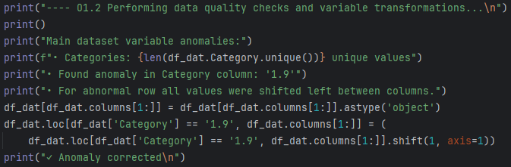

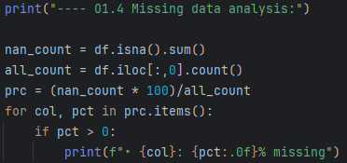
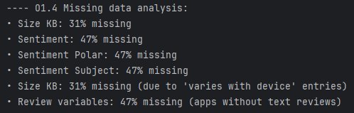
Examples of data preprocessing solutions
Quality checks: I inspected dataset columns and their content to catch potential anomalies in data types. Here I found data entry and corrected them to avoid losing otherwise correct entries.
Transforming variables: I transformed the ’Last Updated’ column into a correct date-time format and displayed the percentage of entries that could potentially be lost due to conversion.
Missing data review: I calculated and evaluated missing data per column. Knowing the structure and characteristics of both datasets, I was able to diagnose the cause of data entry gaps.

Slide 5
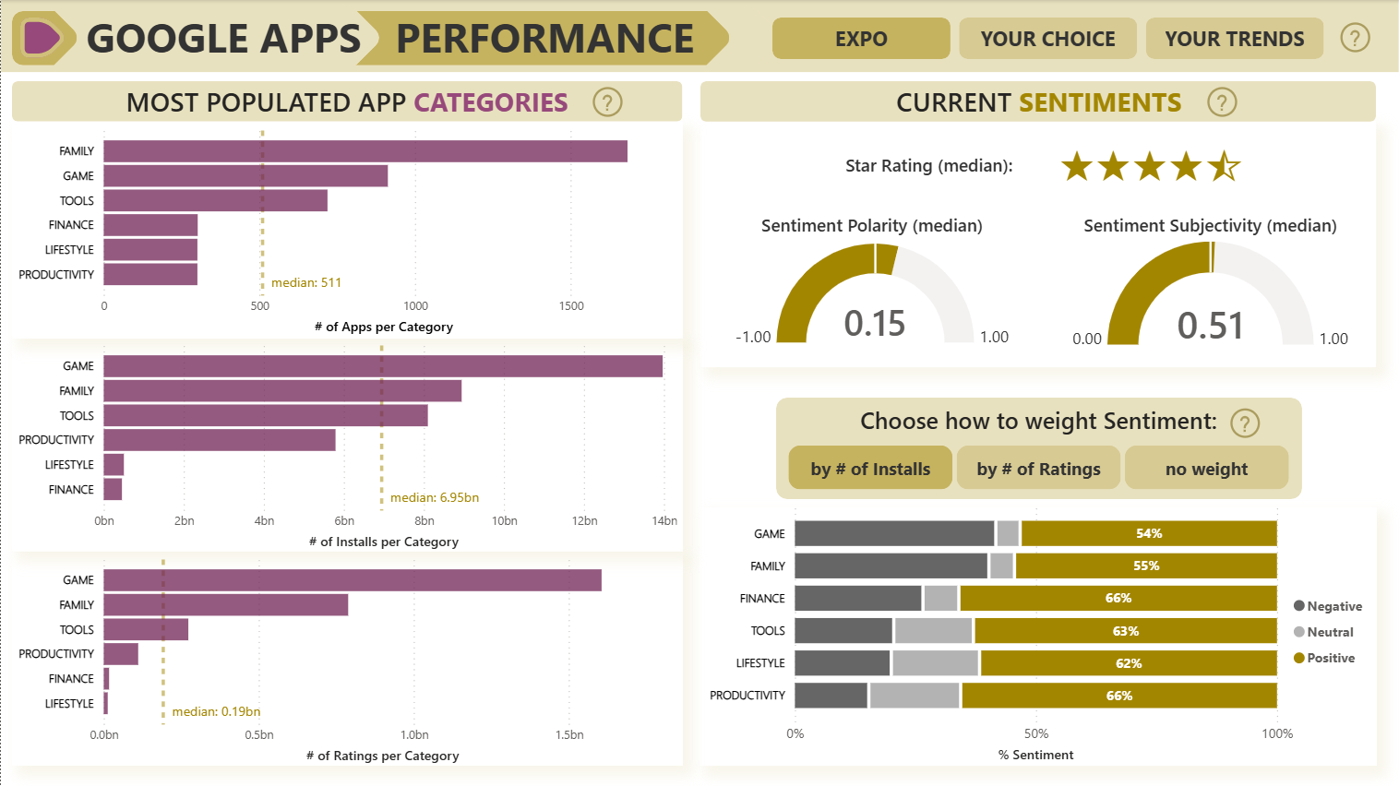


Creating the Dashboard
Top panel can be used to navigate between three pages of the Dashboard:
EXPO,
YOUR CHOICE,
YOUR TRENDS.
Questionmark tooltip informs users
how to move between pages.

Slide 6
Creating the Dashboard
EXPO page gives a high-level market overview of the most app-packed Categories.
Barplots show the number of Apps,
the number of app Installs and the number
of star Ratings in each Category.

Slide 7
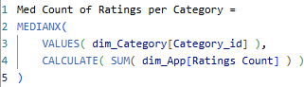




Creating the Dashboard
EXPO page gives a high-level market overview of the most app-packed Categories.
Barplots show the number of Apps, App Installs and Star Ratings in each Category.
All plots display the corresponding median values across Categories.
Medians are calculated using DAX.

Slide 8
Creating the Dashboard
Median Star Rating of displayed Categories is shown on the right.
Besides, some Apps receive text Reviews from users. Gauge plots show the median Polarity and Subjectivity of those Reviews.

Slide 9
Creating the Dashboard
Finally, the bar plot show the percentage
of Negative, Neutral and Positive Sentiments in text Reviews per Category.
Users can inspect how Apps in most popular Categories are judged.

Slide 10
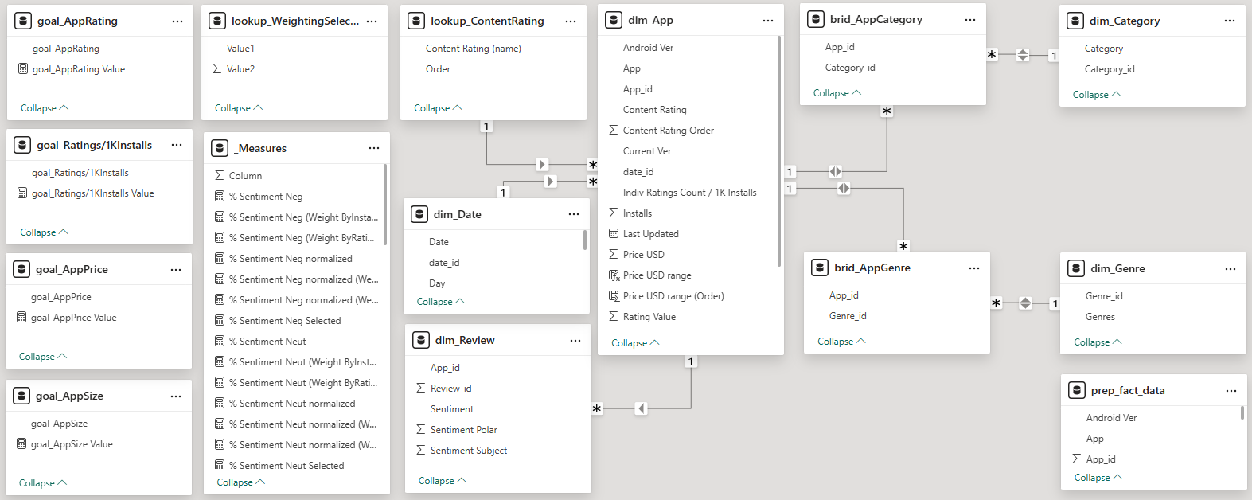
Creating the Dashboard
Those percentages are normalized and can be:
weighted by the number of Installs*;
weighted by the number of Star Ratings;
unweighted.
Custom DAX measures and tables were created to maintain this solution.
* Apps with high Installs count heavily influence the average.

Slide 11
Creating the Dashboard
Those percentages are normalized and can be:
weighted by the number of Installs*;
weighted by the number of Star Ratings;
unweighted.
Users can choose calculation method using buttons. Questionmark tooltip explains how.
Custom DAX measures and tables were created to maintain this solution.
* Apps with high Installs count heavily influence the average.

Slide 12
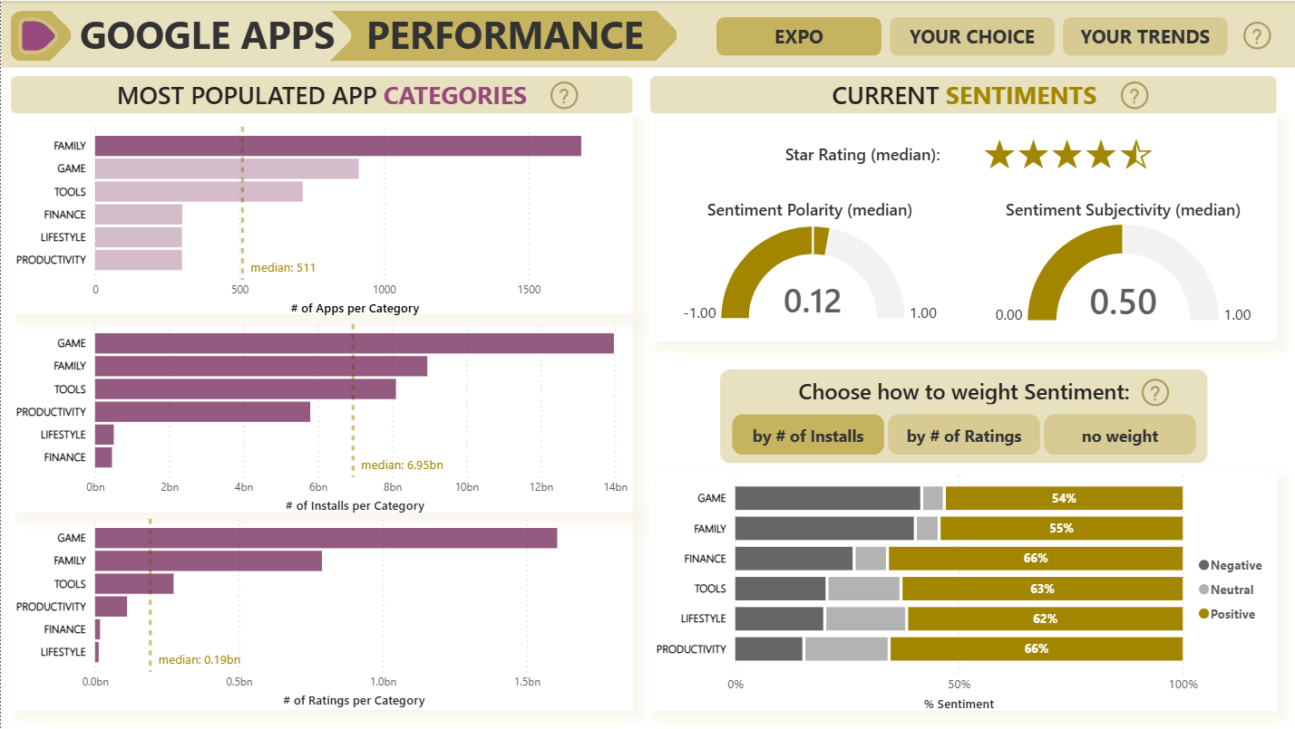

Creating the Dashboard
Furthermore, clicking one Category on any barplot filters the Star Rating, Sentiment Polarity and Sentiment Subjectivity medians to show only data related to this Category.

Slide 13
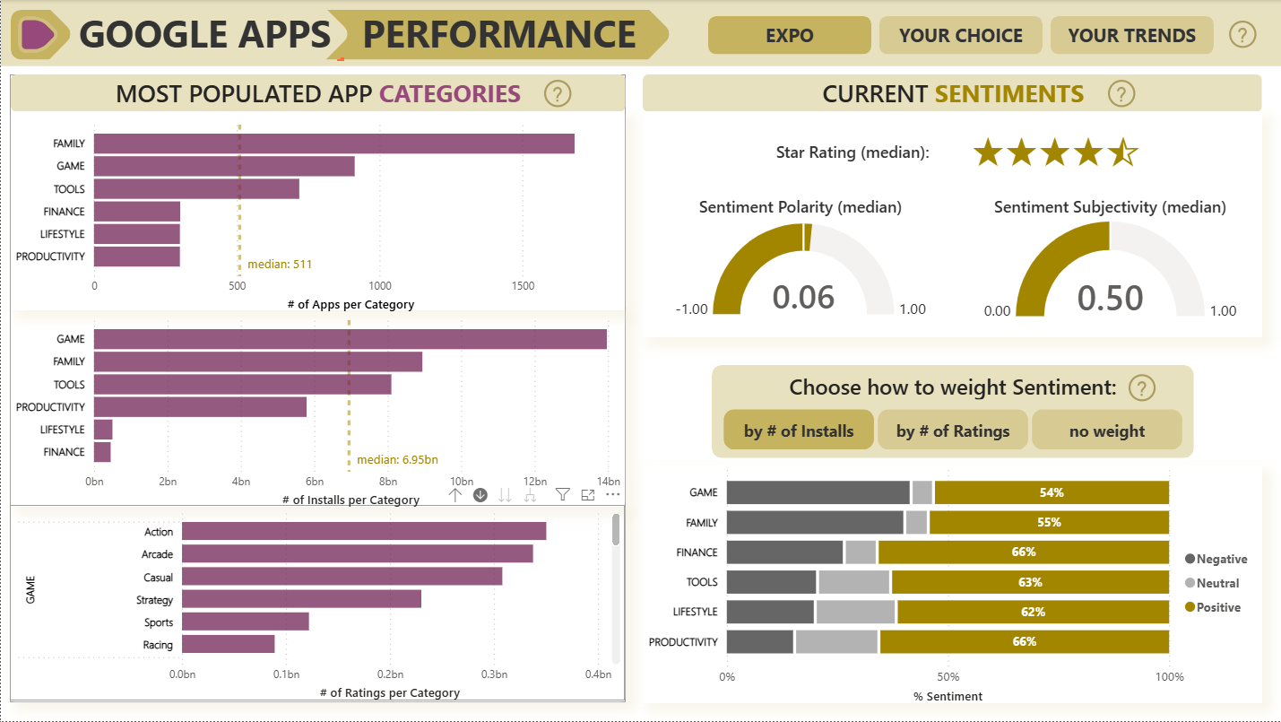


Creating the Dashboard
Finally, users can activate a drill-down option on any barplot and click
any Category to see the results
for each Genre.

Slide 14
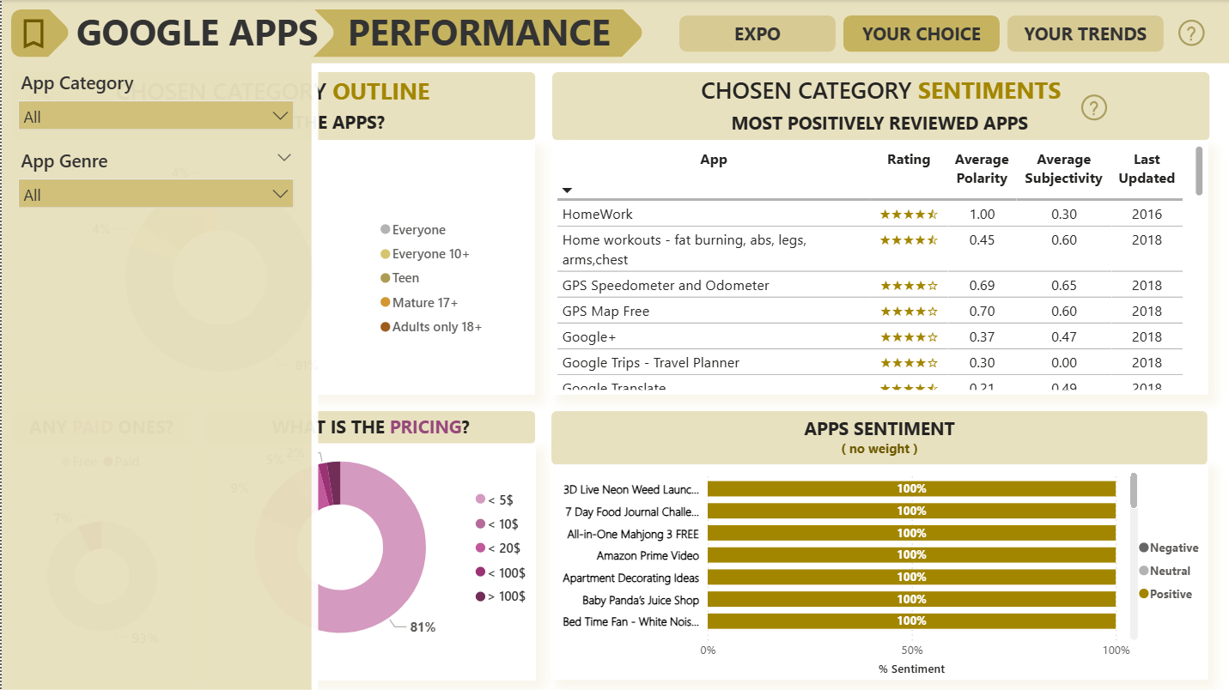
Creating the Dashboard
YOUR CHOICE page frames the competitive landscape the proposed app would enter.
Users should start by clicking the Bookmark symbol to open Filters Panel.

Slide 15
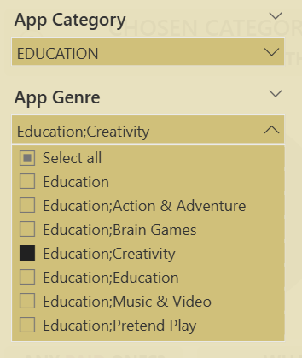

Creating the Dashboard
In Filters Panel users can choose App Category
that is of interest to the Product Manager.
Some Categories have several Genres (category sub-types) that can be selected to narrow down
the focus of the analysis.
Example:
Filter Panel can be closed by clicking
the Bookmark symbol again.

Slide 16
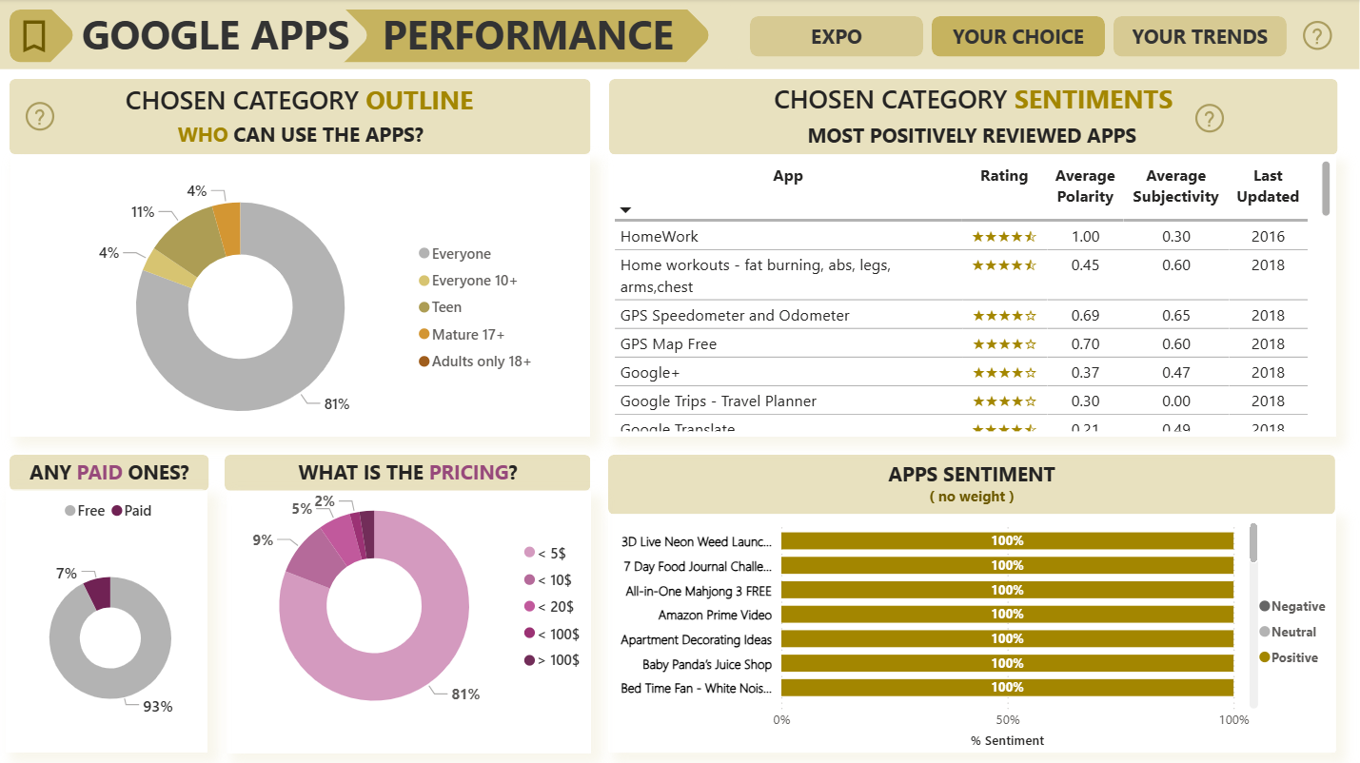
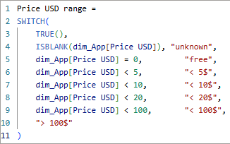


Creating the Dashboard
Pie charts describe the characteristics of Apps
in chosen Category: Content Rating and App Price. To facilitate data presentation pricing ranges
were created post hoc using DAX.

Slide 17
Creating the Dashboard
Next, the table shows most positively reviewed Apps (filtered by decreasing % of Positive Sentiment) in chosen Category.
Users can see App names, their Star Rating and Sentiment metadata.

Slide 18
Creating the Dashboard
Sentiment percentages are shown
on the barplot below.
Both visuals help establish
the most competitive rivals
on the market and pricing options.

Slide 19
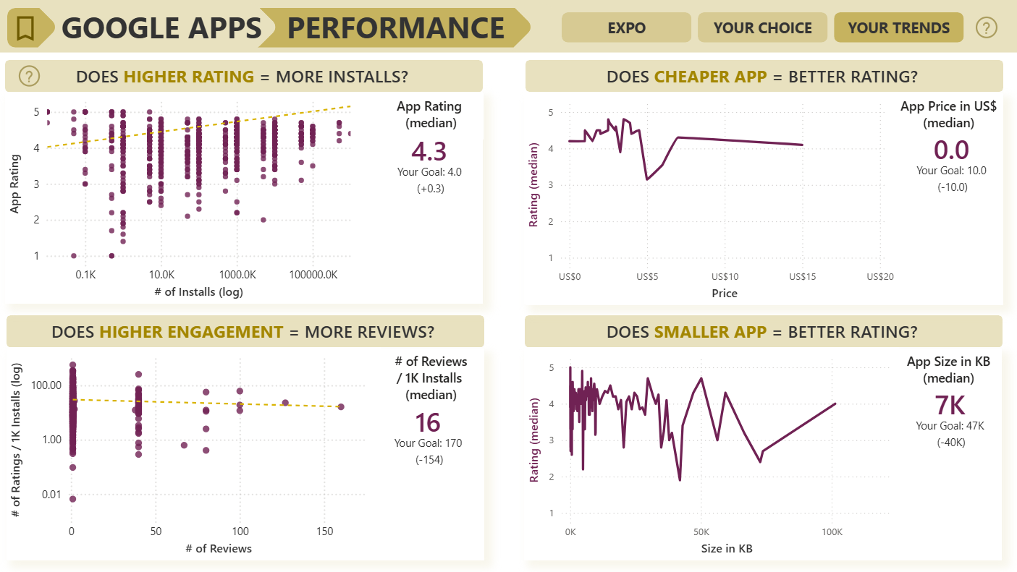
Creating the Dashboard
YOUR TRENDS page compares Product Manager’s goals with real-world benchmarks. It highlights whether the typical App rating, price, size, and engagement levels within chosen Category align with what the app creator hopes to achieve.
Users should start by clicking the Bookmark symbol to open Filters Panel.

Slide 20
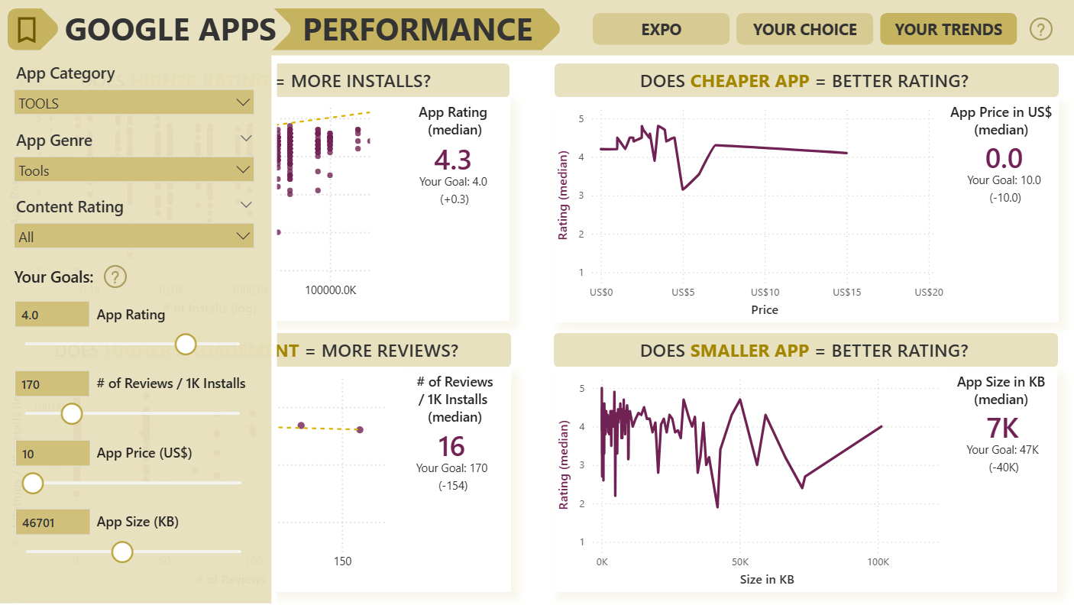

Creating the Dashboard
In Filters Panel users can choose App Category, Genre and target group (Content Rating).
Furthermore, several numerical KPIs (Goals)
can be set to inform comparisons. For example, Product Managers may already have an idea
of the target App Rating the product should achieve.

Slide 21


Creating the Dashboard
The page includes four plots showing
the relationships between benchmark performance measures.
For example, we can observe moderate trend (dashed line) of the number of App Installs increasing together with App Rating.
A number to the right is median App Rating
for all Apps within previously chosen group (Category, Genre, Content Rating).
Importantly, this value is then compared
to goal App Rating, to show how far does the target result stand from the real-world median.

Slide 22
Creating the Dashboard
Three remaining plots illustrate
how does App Price, Size, and the number
of Reviews correspond to their Star Rating
and user engagement.

Slide 23
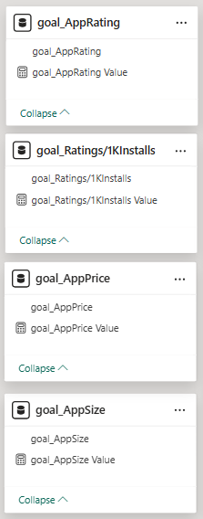
Creating the Dashboard
Custom DAX measures and tables were created to maintain this solution.
Three remaining plots illustrate
how does App Price, Size, and the number
of Reviews correspond to their Star Rating
and user engagement.

Slide 24
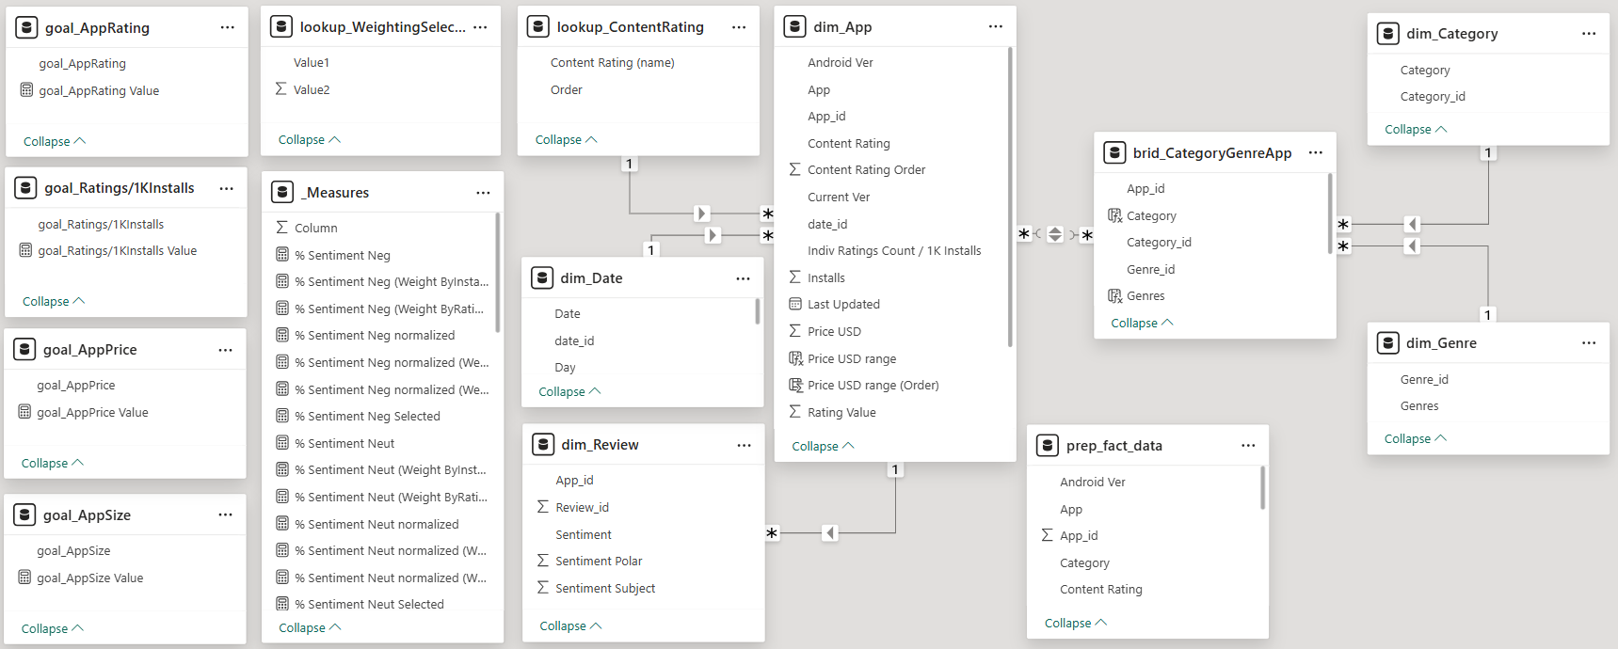
Final Dashboard Model
Legend:
DAX _Measures ensuring correct calculations across filters.
Additional ( lookup_ and goal_ ) tables added to maintaing visuals and store input values.
Dimentional ( dim_ ) tables storing the source data and IDs.
Bridging ( brid_ ) table maintaining proper hierarchy of App–Genre–Category.
Original source data table ( fact_ ).

Slide 25


Final results
prep_fact_data.csv
the main dataset merged from both Kaggle data sources
{googleplaystore.csv, googleplaystore_user_reviews.csv}
and preprocessed using Python codes.
preprocessing_code.py
    the Python code that can be re-used in future
    in case of a database update.
Consultant_Dashboard.pbix
    the PowerBI dashboard based on the preprocessed dataset
    {prep_fact_data.csv}

Slide 26


Limitations of data coverage
prep_fact_data.csv
the main dataset merged from both Kaggle data sources
{googleplaystore.csv, googleplaystore_user_reviews.csv}
and preprocessed using Python codes.
preprocessing_code.py
    the Python code that can be re-used in future
    in case of a database update.
Consultant_Dashboard.pbix
    the PowerBI dashboard based on the preprocessed dataset
    {prep_fact_data.csv}
The Last Updated field does not extend beyond 2018, indicating
that the source dataset is no longer current and may not fully reflect today’s app-store landscape.
Several Genres contain only a small number of Apps, which limits the reliability of some category-level comparisons or trend-based interpretation.
This dashboard was created as a portfolio project
to demonstrate analytical and data-modelling skills,
as well as the Power BI proficiency. While the dataset has clear limitations, it serves adequately for those purposes.

Slide 27
Key skills
Data modelling
Designing a star-schema model (fact table + dimension tables).
Creating one-to-many and one-to-one relationships.
Resolving ambiguity with bridging tables (App–Genre–Category).
Creating calculated columns (for categorical ranges and ordering).
Building aggregation measures (counts, medians, ratios).
Data visualization
Designing charts with drill-down hierarchies (Category → Genre).
Configuring scatterplots with logarithmic scaling for a clean data presentation.
Creating user inputs and KPI cards with goal-vs-median logic.
Creating multi-page thematic layouts with page navigation and filter panels.
Storytelling
Translating a consultant-focused narrative into a functional dashboard.
Highlighting high-impact apps visually.
Organizing visuals into purposeful pages aligned with a consulting scenario.
Preparing a PowerPoint to communicate methodology.

