Slide 1




Efficiency and Diversity of R&D in Knowledge-Intensive Services (2005–2023)
How efficiently selected European countries convert R&D spending into researcher human capital within the knowledge-intensive services sector?
Does increasing female participation in researcher roles correlates with chosen metrics of development?
BY DOMINIKA DRĄŻYK OCTOBER, 2025

Slide 2
Introduction
The knowledge‑intensive services sector ('G‑N’ by NACE) has become a major engine of innovation in Europe.
About companies embracing gender diversity within the R&D:
(...) more innovative, better at solving complex problems (Phillips, 2014);
(...) tend to achieve higher productivity and innovation performance (Hoogendoorn et al., 2019);
(...) consistently outperform rivals (Carucci, 2024).
〽️ PRACTICAL BUSINESS QUESTION:
Does investing in a more gender-diverse R&D workforce help or hinder the efficient use of R&D budgets in G-N sector?

Slide 3

Data sources:
The knowledge‑intensive services sector ('G‑N’ by NACE) has become a major engine of innovation in Europe.
About companies embracing gender diversity within the R&D:
(...) more innovative, better at solving complex problems (Phillips, 2014);
(...) tend to achieve higher productivity and innovation performance (Hoogendoorn et al., 2019);
(...) consistently outperform rivals (Carucci, 2024).
〽️ PRACTICAL BUSINESS QUESTION:
Does investing in a more gender-diverse R&D workforce help or hinder the efficient use of R&D budgets in G-N sector?
Business enterprise R&D expenditure in high-tech sectors by NACE Rev. 2 {htec_sti_exp2}
Business enterprise R&D personnel in high-tech sectors by NACE Rev. 2 {htec_sti_pers2}
R&D personnel and researchers in business enterprise sector by NACE Rev. 2 activity and sex {rd_p_bempoccr2}
publicly available
regularly updated
structured, but require pre-processing

Slide 4
Approach
O1: Automated web-scraping of datasets and metadata
O2: Cleaning and reshaping datasets
O3: Merging datasets
Python {BeautifulSoup, selenium, pandas, pyjstat}
Jupyter Notebook as environment
Git & GitHub for version control

Slide 5
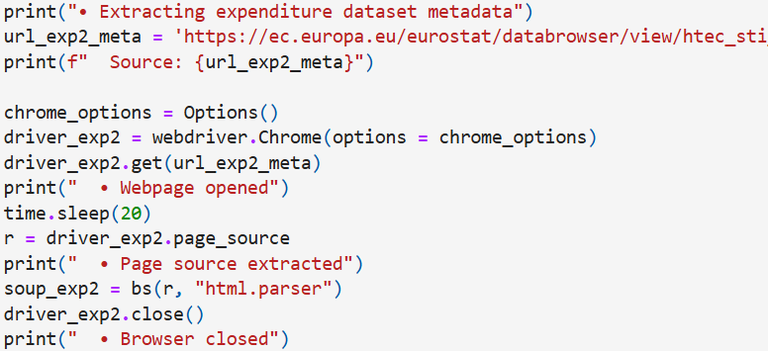
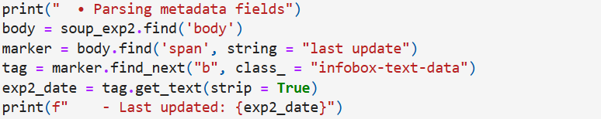
Example – web scraping
O1: Automated web-scraping of datasets and metadata
O2: Cleaning and reshaping datasets
O1: Merging datasets
SOLUTION I use selenium library to automatically open and scrap a website. Then I use BeautifulSoup library to access its HTML code and extract metadata of the source.

Slide 6
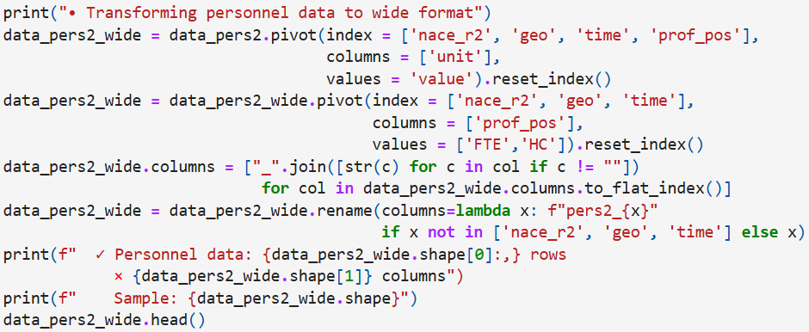
Example – reshaping dataset
O1: Automated web-scraping of datasets and metadata
O2: Cleaning and reshaping datasets
O1: Merging datasets
SOLUTION I use pandas library to pivot tables into preferred wide format, rename newly created columns and display the characteristics of the transformed DataFrame.

Slide 7


Intermediate results
eu_efta_countries.csv
a list of EU and EFTA countries for filtering data;
scraper_data.csv
the main dataset merged from the extrenal data sources {htec_sti_exp2, htec_sti_pers2, rd_p_bempoccr2};
scraper_metadata.csv
the metadata from external data sources including dataset IDs, source, title and the date of their last update;
scraper_code.ipynb / scraper_code.py
the Python codes that can be re-used in the future in case of an Eurostat database update.

Slide 8
Further Approach
I have generated three new data sources and an reusable code:
eu_efta_countries.csv
a list of EU and EFTA countries for filtering the main dataset;
scraper_data.csv
the main dataset merged from the three extrenal data sources {htec_sti_exp2, htec_sti_pers2, rd_p_bempoccr2};
scraper_metadata.csv
the metadata about three external data sources including dataset IDs, source, title and the date of their last update;
scraper_code.ipynb / scraper_code.py
the Python codes that can be used in the future to re-scrap the data in case of an Eurostat database update.
O1: Dataset preprocessing
O1.1 Loading datasets and metadata
O1.2 Filterng and renaming dataset variables
O1.3 Missing data review and country selection
O2: Analysing chosen efficency metrics
O2.1 Calculating Annual Spending Efficiency across countries
O2.2 Calculating Annual Labor Intensity across countries
O3: Analysing participation of female researchers
O3.1 Calculating Share of Female Researchers in all Researchers
O3.2 Spending Efficiency vs. Female Researchers Share
O3.3 Calculating Growth Rates of chosen metrics
Python {pandas, NumPy, scipy, matplotlib, seaborn}
Jupyter Notebook as environment
Git & GitHub for version control

Slide 9
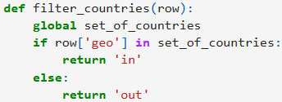
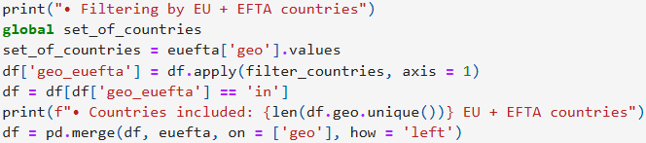
Example – filtering dataset
Further Approach
O1: Dataset preprocessing
O1.1 Loading datasets and metadata
O1.2 Filterng and renaming dataset variables
O1.3 Missing data review and country selection
O2: Analysing chosen efficency metrics
O2.1 Calculating Annual Spending Efficiency across countries
O2.2 Calculating Annual Labor Intensity across countries
O3: Analysing participation of female researchers
O3.1 Calculating Share of Female Researchers in all Researchers
O3.2 Spending Efficiency vs. Female Researchers Share
O3.3 Calculating Growth Rates of chosen metrics
SOLUTION As the analysis focuses only on EU and EFTA countries, I wrote a simple function that effectively allows me to filter the main dataset by a list of EU and EFTA countries, previously scrapped from the Eurostat website.

Slide 10
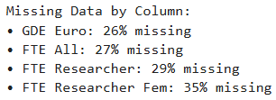
Missing data review
Further Approach
Key variables related to knowledge-intensive services sector
GDE Euro: R&D expenditure (millions €)
FTE All: number of full-time positions
FTE Researcher: number of full-time researcher positions
FTE Researcher Fem: number of full-time researcher positions held by women
O1: Dataset preprocessing
O1.1 Loading datasets and metadata
O1.2 Filterng and renaming dataset variables
O1.3 Missing data review and country selection
O2: Analysing chosen efficency metrics
O2.1 Calculating Annual Spending Efficiency across countries
O2.2 Calculating Annual Labor Intensity across countries
O3: Analysing participation of female researchers
O3.1 Calculating Share of Female Researchers in all Researchers
O3.2 Spending Efficiency vs. Female Researchers Share
O3.3 Calculating Growth Rates of chosen metrics
INSIGHT The number of female researcher full-time equivalents variable (FTE Researcher Fem) includes significant proportion of missing data (~35%) compared to the rest of chosen metrics.

Slide 11
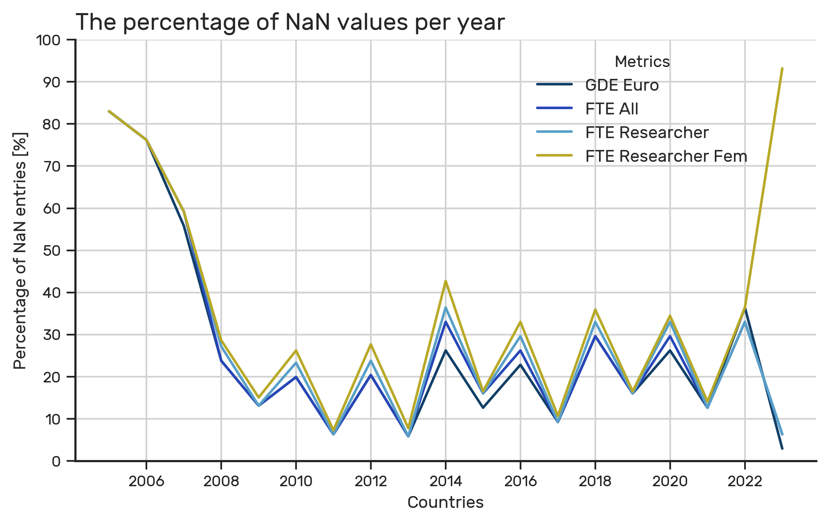
Missing data review
Further Approach
O1: Dataset preprocessing
O1.1 Loading datasets and metadata
O1.2 Filterng and renaming dataset variables
O1.3 Missing data review and country selection
O2: Analysing chosen efficency metrics
O2.1 Calculating Annual Spending Efficiency across countries
O2.2 Calculating Annual Labor Intensity across countries
O3: Analysing participation of female researchers
O3.1 Calculating Share of Female Researchers in all Researchers
O3.2 Spending Efficiency vs. Female Researchers Share
O3.3 Calculating Growth Rates of chosen metrics
INSIGHT Data entry issues:
pre-2008 period with missing data across all metrics;
post-2022 period with gaps in FTE Researcher Fem.
These patterns inform the selection of the 2009-2021
analysis period for optimal data coverage.

Slide 12
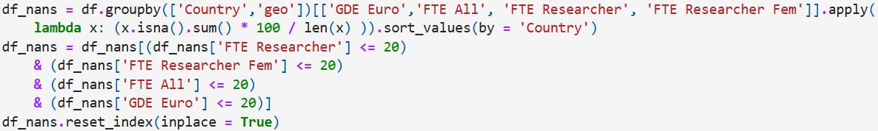
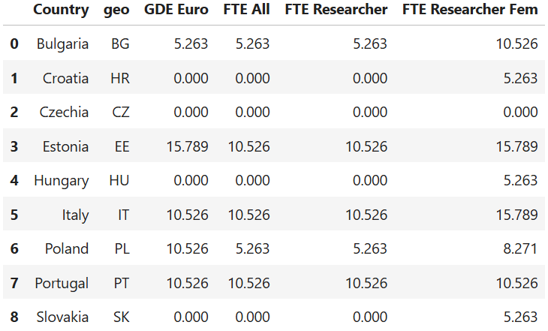
Missing data review
Further Approach
O1: Dataset preprocessing
O1.1 Loading datasets and metadata
O1.2 Filterng and renaming dataset variables
O1.3 Missing data review and country selection
O2: Analysing chosen efficency metrics
O2.1 Calculating Annual Spending Efficiency across countries
O2.2 Calculating Annual Labor Intensity across countries
O3: Analysing participation of female researchers
O3.1 Calculating Share of Female Researchers in all Researchers
O3.2 Spending Efficiency vs. Female Researchers Share
O3.3 Calculating Growth Rates of chosen metrics
INSIGHT I used pandas library to filter countries that demonstrate
data completeness rates of at least 80%
across all analytical metrics.
Only those nine countries listed above fulfill that requirement and those will be chosen for further analysis.

Slide 13
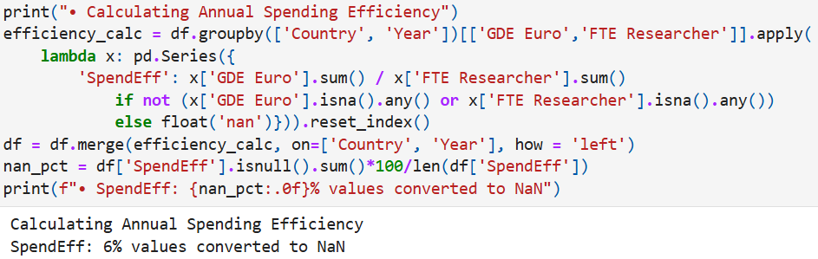
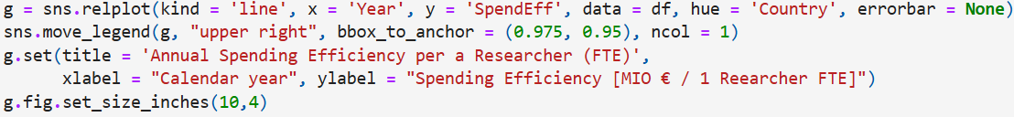
Example - metrics calculation
Further Approach
O1: Dataset preprocessing
O1.1 Loading datasets and metadata
O1.2 Filterng and renaming dataset variables
O1.3 Missing data review and country selection
O2: Analysing chosen efficency metrics
O2.1 Calculating Annual Spending Efficiency across countries
O2.2 Calculating Annual Labor Intensity across countries
O3: Analysing participation of female researchers
O3.1 Calculating Share of Female Researchers in all Researchers
O3.2 Spending Efficiency vs. Female Researchers Share
O3.3 Calculating Growth Rates of chosen metrics
SOLUTION I used pandas library to calculate annual spending efficiency, defined as R&D expenditure per researcher full-time equivalent.
Then I visualised the calculated metrics across years and chosen set of countries using matplotlib and seaborn libraries.

Slide 14
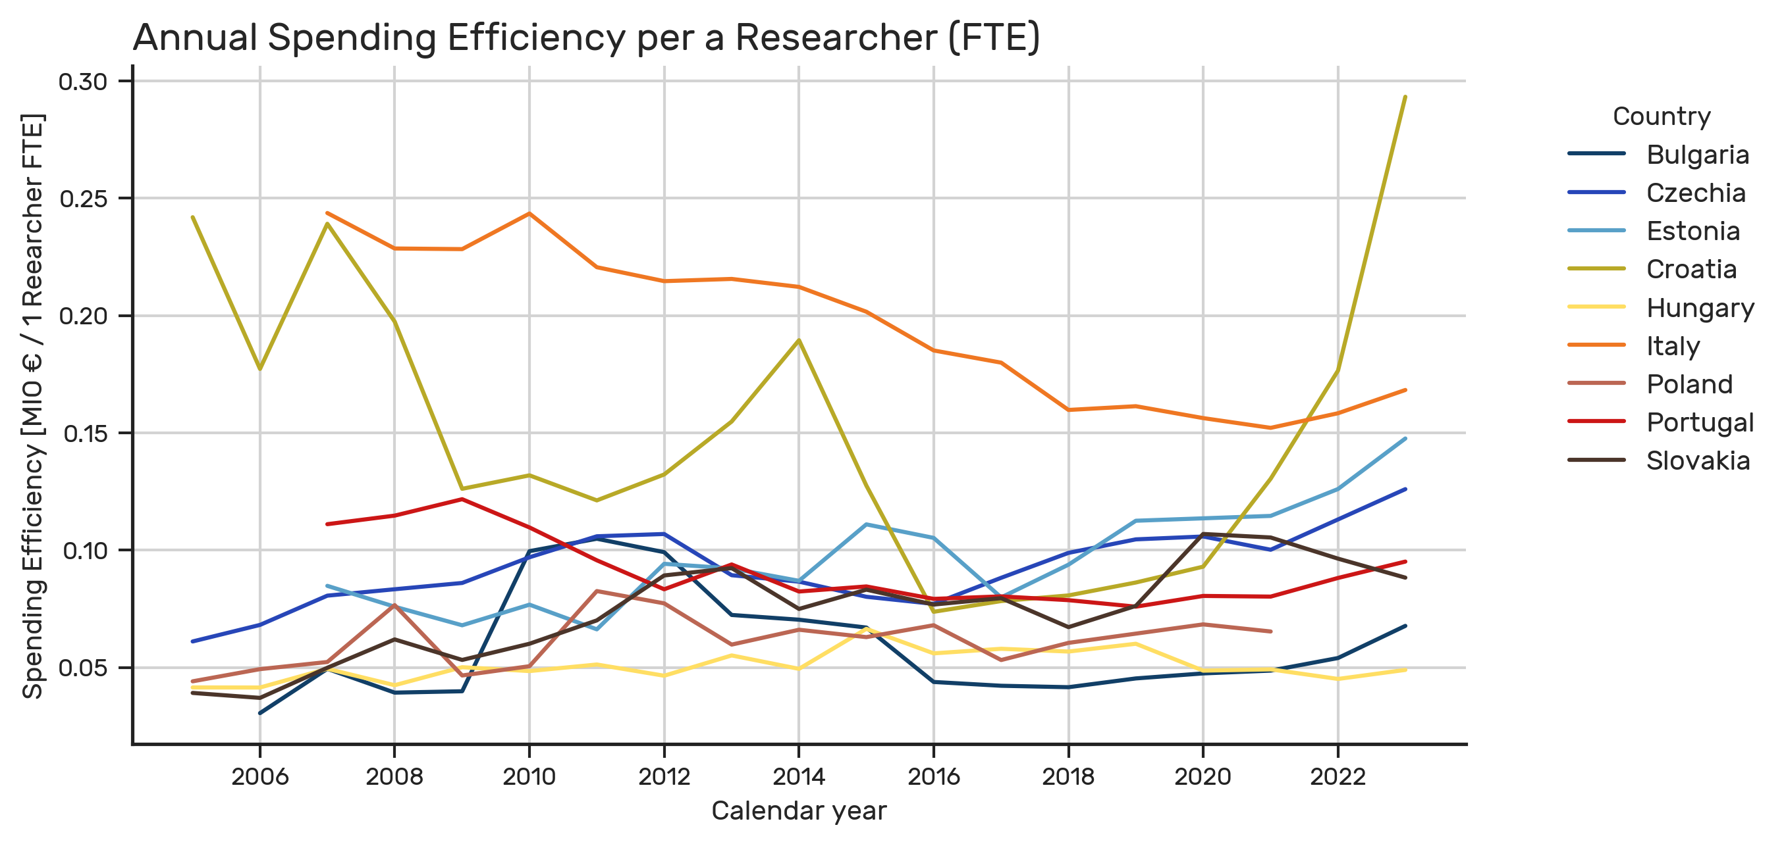
Visualization
Further Approach
O1: Dataset preprocessing
O1.1 Loading datasets and metadata
O1.2 Filterng and renaming dataset variables
O1.3 Missing data review and country selection
O2: Analysing chosen efficency metrics
O2.1 Calculating Annual Spending Efficiency across countries
O2.2 Calculating Annual Labor Intensity across countries
O3: Analysing participation of female researchers
O3.1 Calculating Share of Female Researchers in all Researchers
O3.2 Spending Efficiency vs. Female Researchers Share
O3.3 Calculating Growth Rates of chosen metrics
INSIGHT A rising curve present for most countries, except Portugal and Italy, showing a decrease. This could be due to austerity periods following the 2008 crisis (Wearden, 2011). A decrease could indicate labor scaling, budget cuts, or both.
Croatia presented a volatile trend (probably due its late EU accession). Poland presents a generally low but stable spending efficiency.

Slide 15
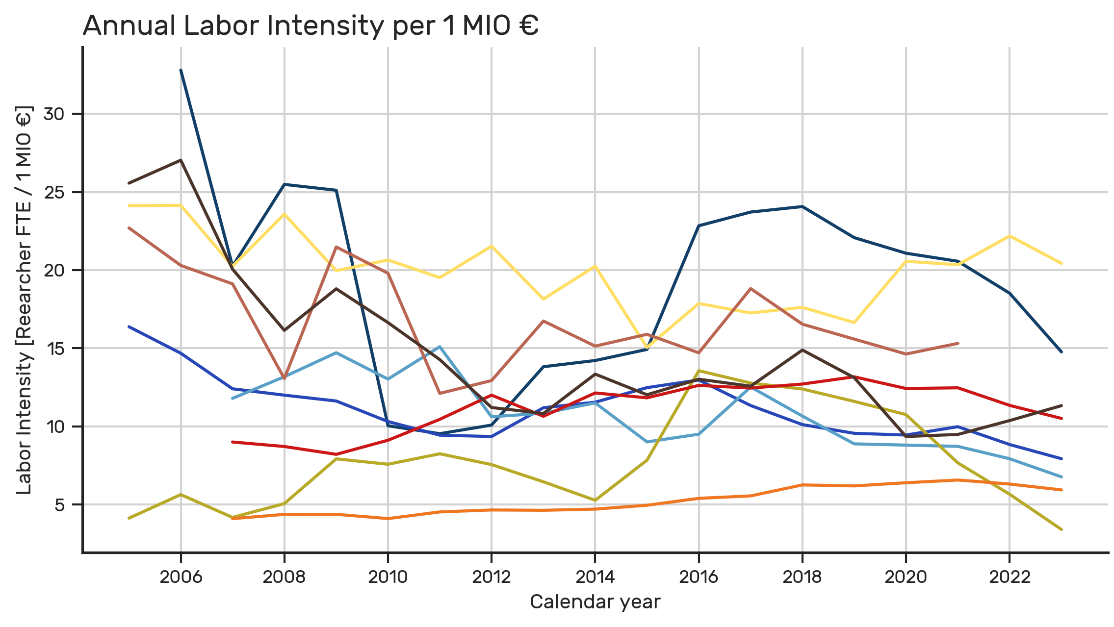
Visualization
Further Approach
O1: Dataset preprocessing
O1.1 Loading datasets and metadata
O1.2 Filterng and renaming dataset variables
O1.3 Missing data review and country selection
O2: Analysing chosen efficency metrics
O2.1 Calculating Annual Spending Efficiency across countries
O2.2 Calculating Annual Labor Intensity across countries
O3: Analysing participation of female researchers
O3.1 Calculating Share of Female Researchers in all Researchers
O3.2 Spending Efficiency vs. Female Researchers Share
O3.3 Calculating Growth Rates of chosen metrics
INSIGHT Labor Intensity: researcher FTEs per unit of expenditure.
A rise was observed only for Italy and Portugal, which could partially explain their decrease in spending efficiency. All remaining countries increased spending faster than the number of researcher FTEs.
Poland presented a generally high labor intensity, with a volatile pattern between 2007 and 2011, that could be caused by its late EU accession.

Slide 16
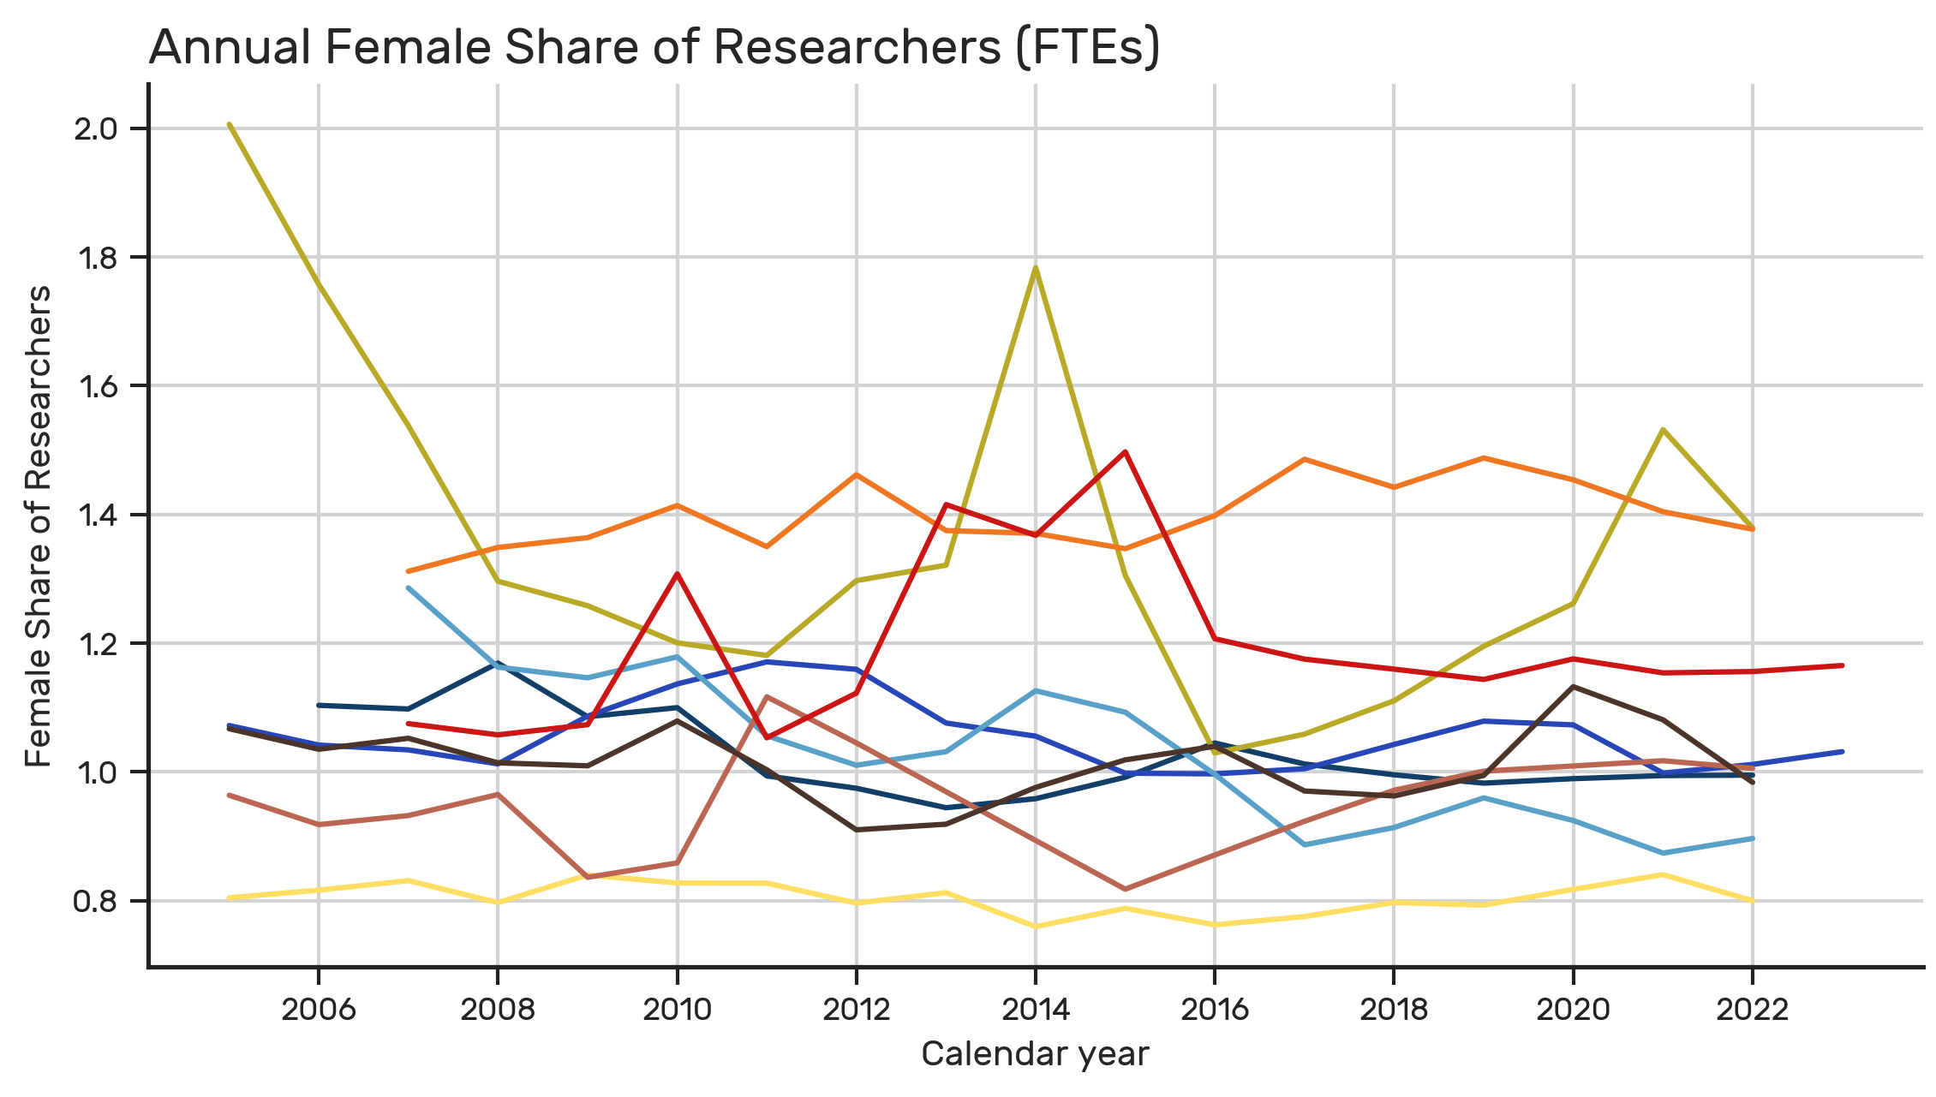
Visualization
Further Approach
O1: Dataset preprocessing
O1.1 Loading datasets and metadata
O1.2 Filterng and renaming dataset variables
O1.3 Missing data review and country selection
O2: Analysing chosen efficency metrics
O2.1 Calculating Annual Spending Efficiency across countries
O2.2 Calculating Annual Labor Intensity across countries
O3: Analysing participation of female researchers
O3.1 Calculating Share of Female Researchers in all Researchers
O3.2 Spending Efficiency vs. Female Researchers Share
O3.3 Calculating Growth Rates of chosen metrics
INSIGHT Female Share: the proportion of female researchers in all researcher FTEs.
A small rise for Poland, Italy and Portugal. Only for Poland was it combined with an increase in spending efficiency and a decrease in labor intensity.
Both Portugal and Croatia recorded a rapid increase in female researcher FTEs between 2013 and 2015 that could be caused by EU-funded gender-inclusion projects (e.g., Horizon 2020).

Slide 17
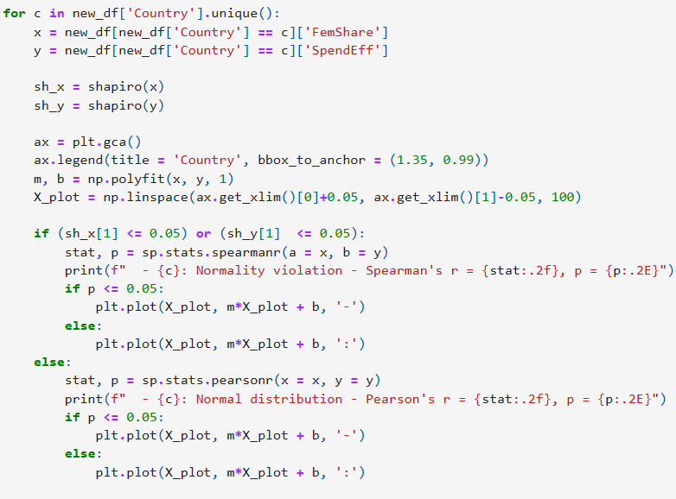
Example – correlation analysis
Further Approach
O1: Dataset preprocessing
O1.1 Loading datasets and metadata
O1.2 Filterng and renaming dataset variables
O1.3 Missing data review and country selection
O2: Analysing chosen efficency metrics
O2.1 Calculating Annual Spending Efficiency across countries
O2.2 Calculating Annual Labor Intensity across countries
O3: Analysing participation of female researchers
O3.1 Calculating Share of Female Researchers in all Researchers
O3.2 Spending Efficiency vs. Female Researchers Share
O3.3 Calculating Growth Rates of chosen metrics
SOLUTION I used NumPy, scipy, matplotlib and seaborn libraries to perform and visualise the correlation test between two chosen metrics.
Before performing a correlation (Pearson’s or Spearman’s) on each country, I have checked the test assumptions related to the normality of data distribution (Shapiro-Wilk test).

Slide 18
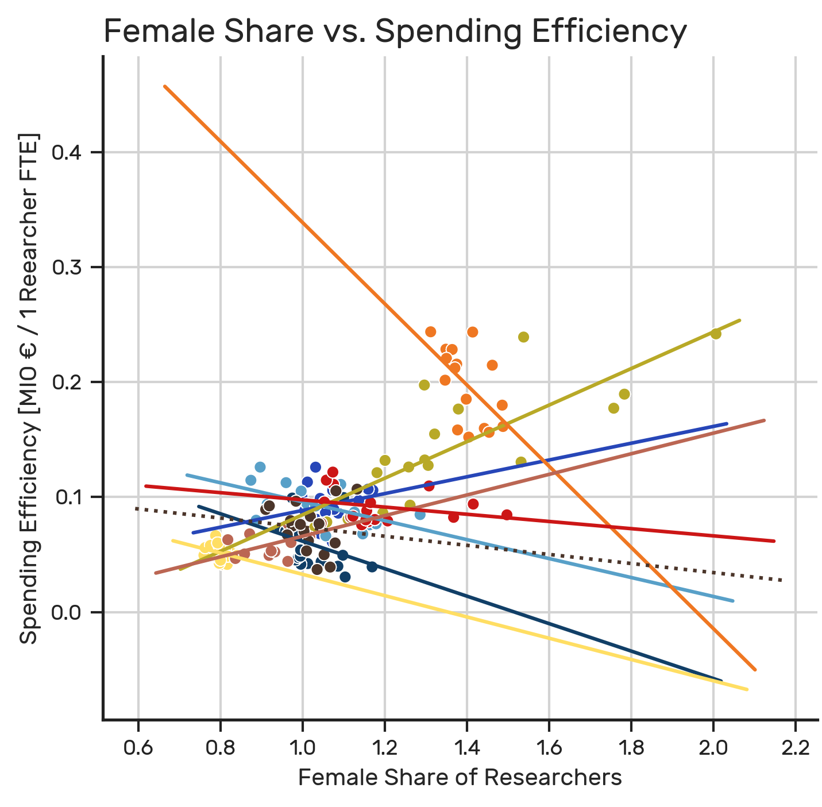
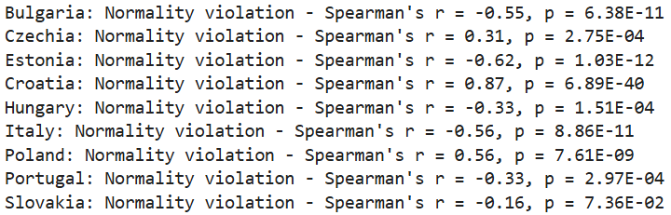
Visualization
Further Approach
O1: Dataset preprocessing
O1.1 Loading datasets and metadata
O1.2 Filterng and renaming dataset variables
O1.3 Missing data review and country selection
O2: Analysing chosen efficency metrics
O2.1 Calculating Annual Spending Efficiency across countries
O2.2 Calculating Annual Labor Intensity across countries
O3: Analysing participation of female researchers
O3.1 Calculating Share of Female Researchers in all Researchers
O3.2 Spending Efficiency vs. Female Researchers Share
O3.3 Calculating Growth Rates of chosen metrics
INSIGHT A positive correlation: Croatia, Czechia and Poland.
A negative correlation: Italy, Portugal, Estonia, Hungary and Bulgaria.

Slide 19
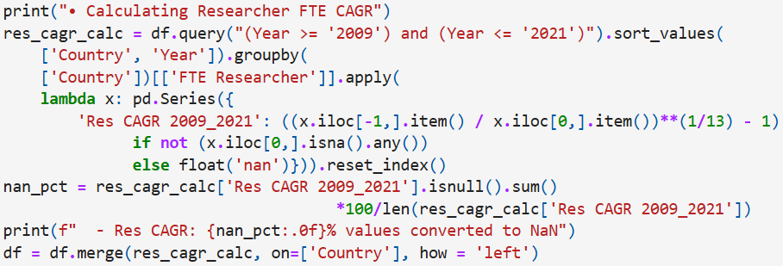
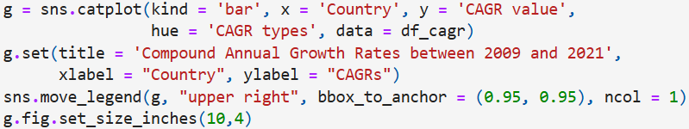
Example – CAGR calculation
Further Approach
O1: Dataset preprocessing
O1.1 Loading datasets and metadata
O1.2 Filterng and renaming dataset variables
O1.3 Missing data review and country selection
O2: Analysing chosen efficency metrics
O2.1 Calculating Annual Spending Efficiency across countries
O2.2 Calculating Annual Labor Intensity across countries
O3: Analysing participation of female researchers
O3.1 Calculating Share of Female Researchers in all Researchers
O3.2 Spending Efficiency vs. Female Researchers Share
O3.3 Calculating Growth Rates of chosen metrics
SOLUTION I used pandas library to calculate compound annual growth rates of chosen metrics in a previusly established 2009-2021 period. After reshaping the dataset, I used matplotlib and seaborn to plot the comparison of all CAGR metrics between countries.

Slide 20
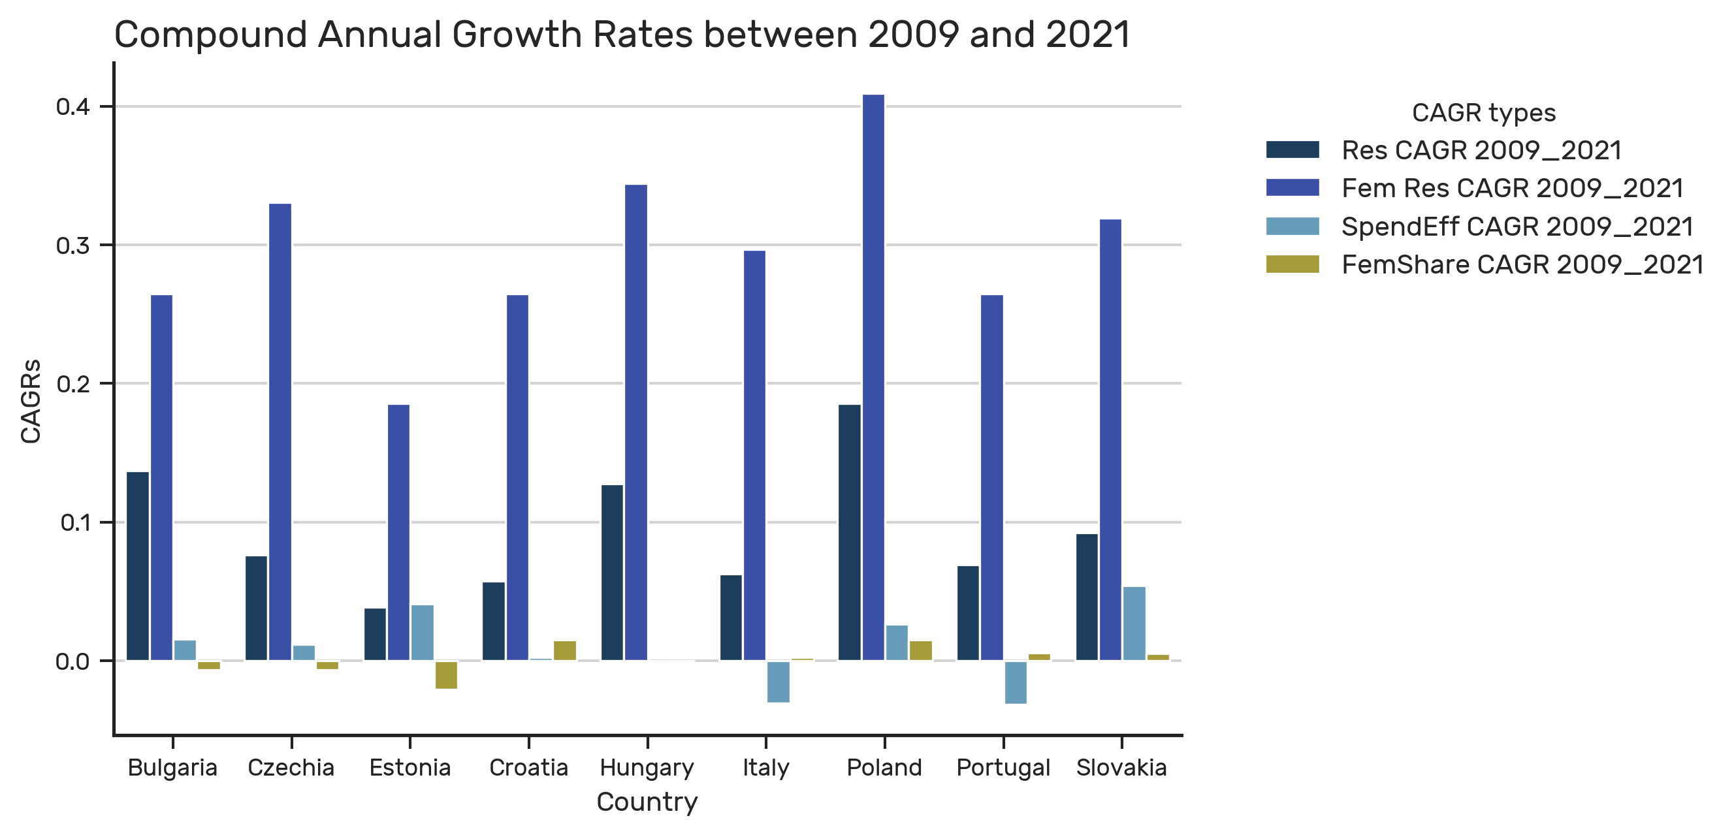
Visualization
Further Approach
O1: Dataset preprocessing
O1.1 Loading datasets and metadata
O1.2 Filterng and renaming dataset variables
O1.3 Missing data review and country selection
O2: Analysing chosen efficency metrics
O2.1 Calculating Annual Spending Efficiency across countries
O2.2 Calculating Annual Labor Intensity across countries
O3: Analysing participation of female researchers
O3.1 Calculating Share of Female Researchers in all Researchers
O3.2 Spending Efficiency vs. Female Researchers Share
O3.3 Calculating Growth Rates of chosen metrics
INSIGHT Positive growth rates for spending efficiency and female share observed only for Poland and Slovakia.
Croatia presented a stagnant spending efficiency.
Bulgaria, Czechia and Estonia: increasing growth rates in spending efficiency with decreased female share.
Despite a growing workforce, Italy and Portugal recorded a decrease in spending efficiency.
Hungary presented a stagnant spending efficiency and share of female researcher positions.

Slide 21
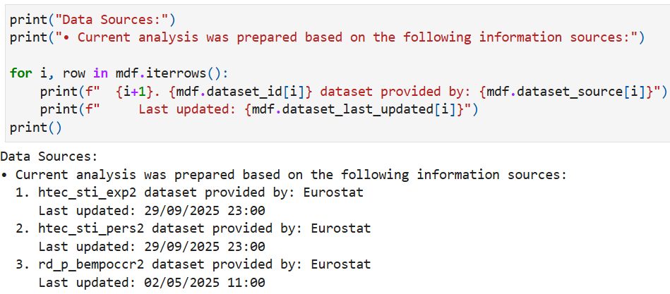
Source metadata
Further Approach
O1: Dataset preprocessing
O1.1 Loading datasets and metadata
O1.2 Filterng and renaming dataset variables
O1.3 Missing data review and country selection
O2: Analysing chosen efficency metrics
O2.1 Calculating Annual Spending Efficiency across countries
O2.2 Calculating Annual Labor Intensity across countries
O3: Analysing participation of female researchers
O3.1 Calculating Share of Female Researchers in all Researchers
O3.2 Spending Efficiency vs. Female Researchers Share
O3.3 Calculating Growth Rates of chosen metrics
SOLUTION I display the metadata related to web-scraped datasets used during the analysis to inform future data interpretations

Slide 22
Summary – analysis limitations
Data Coverage: missing data exists before 2008 and after 2022, with optimal metric comparability limited to the 2009-2021 period.
Country selection: only 9 countries met data quality criteria (at least 80% completeness).
Sector heterogeneity: NACE G–N covers multiple service subsectors that can influence spending and hiring patterns.
Correlation: does not imply causation, therefore observed links between female share and efficiency may reflect confounders.
Important note: Offered insights are not based on a structured academic knowledge about EU policy or geo-political structure of discussed countries. My aim was to simply demonstrate my ability to understand complex datasets, data characteristics and measures that lay outside my primary academic expertise.

Slide 23
Summary – key findings
GENERAL TRENDS
2005 – 2023: spending efficiency generally increased and female researcher representation gradually improved.
2009 – 2021: number of female researchers grew faster than overall employment.
COUNTRY-WISE OBSERVATIONS
Poland: stable but relatively low spending efficiency, paired with high but stable labor intensity.
Croatia, Czechia, Poland: female inclusion coincided with more effective use of R&D resources.
Italy, Portugal, Estonia, Hungary, Bulgaria: female inclusion coincided with less effective use of R&D resources.
Poland, Slovakia: simultaneous increases in spending efficiency, female share, and workforce size.
Croatia, Italy, Portugal: stagnant or declining efficiency but strong female inclusion.
Bulgaria, Czechia, Estonia: improved efficiency but declines in female share.

Slide 24
Summary – Categorization
GENERAL TRENDS
2005 – 2023: spending efficiency generally increased and female researcher representation gradually improved.
2009 – 2021: number of female researchers grew faster than overall employment.
COUNTRY-WISE OBSERVATIONS
Poland: stable but relatively low spending efficiency, paired with high but stable labor intensity.
Croatia, Czechia, Poland: female inclusion coincided with more effective use of R&D resources.
Italy, Portugal, Estonia, Hungary, Bulgaria: female inclusion coincided with less effective use of R&D resources.
Poland, Slovakia: simultaneous increases in spending efficiency, female share, and workforce size.
Croatia, Italy, Portugal: stagnant or declining efficiency but strong female inclusion.
Bulgaria, Czechia, Estonia: improved efficiency but declines in female share.
Balanced growth (Poland, Slovakia)
Business Insight: diversity initiatives combined
with targeted funding and organizational change
could result in a stable growth.
Initial investment (Italy, Portugal, Croatia) Business Insight: rising female participation can cause declining spending efficiency (initial integration costs) but may also bring long-term efficiency benefits.
Efficiency prioritization (Bulgaria, Czechia, Estonia) Business Insight: Without corresponding diversity policies, improved spending efficiency may have favored male-dominated recruitment or sub-sectors.
〽️
〽️
〽️

Slide 25
Final results
References
eu_efta_countries.csv
list of EU and EFTA countries for filtering data;
scraper_data.csv
main dataset merged from the extrenal data sources {htec_sti_exp2, htec_sti_pers2, rd_p_bempoccr2};
scraper_metadata.csv
metadata from external data sources including dataset IDs, source, title and the date of their last update;
scraper_code.ipynb / scraper_code.py
Python codes that can be re-used in the future in case of an Eurostat database update.
analysis_data.csv
main preprocessed dataset ready for data anlaysis;
cagr_analysis_data.csv
CAGR metrics dataset ready for data anlaysis;
analysis_code.ipynb / analysis_code.py
the Python codes that can be re-used in the future in case of an Eurostat database update.
Carucci, R. (2024) One More Time: Why Diversity Leads to Better Team Performance. Forbes
Hoogendoorn, S., Oosterbeek, H., & van Praag, M. (2019) When Gender Diversity Makes Firms More Productive. Harvard Business Review
Niederle, M., Segal, C., & Vesterlund, L. (2008) How Costly is Diversity? Affirmative Action in Light of Gender Differences in Competitiveness. NBER Working Paper
Phillips, K. (2014) How Diversity Makes Us Smarter.
Scientific American
Wearden, G. (2011)
EU debt crisis: Italy hit with rating downgrade.
The Guardian

