Slide 1




Olist - Brazilian E-Commerce Platform
Strategic Audit (2016–2018)
Does the platform's rapid volume growth outpace its logistical infrastructure?
Is the long-term growth sustainable, or rather dependent on a highly concentrated group of Market Leaders and High-Yield product categories?
BY DOMINIKA DRĄŻYK MARCH, 2026

Slide 2
Introduction
How much can we learn from a major Brazilian marketplace during its primary expansion phase? This comprehensive audit extracts actionable business intelligence from a dataset of nearly 100,000 orders.
〽️ PRACTICAL BUSINESS QUESTIONS
How does the merchant structure impact operational reliability?
Is extreme revenue concentration threatening the platform’s stability?
How significant is the variance between delivery estimates and actual logistics performance?
What does the current momentum say about the platform’s overall scalability?

Slide 3
Data source:
How much can we learn from a major Brazilian marketplace during its primary expansion phase? This comprehensive audit extracts actionable business intelligence from a dataset of nearly 100,000 orders.
〽️ PRACTICAL BUSINESS QUESTIONS
How does the merchant structure impact operational reliability?
Is extreme revenue concentration threatening the platform’s stability?
How significant is the variance between delivery estimates and actual logistics performance?
What does the current momentum say about the platform’s overall scalability?
Olist E-Commerce Public Dataset via. Kaggle
Authored by A. Sionek (2018) [ link ]
{ olist_customers_dataset.csv }
{ olist_geolocation_dataset.csv }
{ olist_order_items_dataset.csv }
{ olist_order_payments_dataset.csv }
{ olist_order_reviews_dataset.csv }
{ olist_orders_dataset.csv }
{ olist_products_dataset.csv }
{ olist_sellers_dataset.csv }
{ product_category_name_translation.csv }
publicly available
structured, but requires pre-processing

Slide 4
Approach
Phase 1: Pre-Staging Pipeline
Step 1: Unicode normalization & encoding correction
Language: Python (pandas, unidecode, pathlib)
Code: ecommerce_converter.py
Phase 2: Relational ETL Process
Step 2: Staging tables (raw data ingestion)
Step 3: DQ checks (null handling, anomaly detection)
Step 4: Idempotent load (standardizing data types, cleaning)
Step 5: Relationships, indexes, foreign keys (schema optimization)
Language: SQL (PostgreSQL)
Environment: pgAdmin
Code: ecommerce_ETL.sql

Slide 5
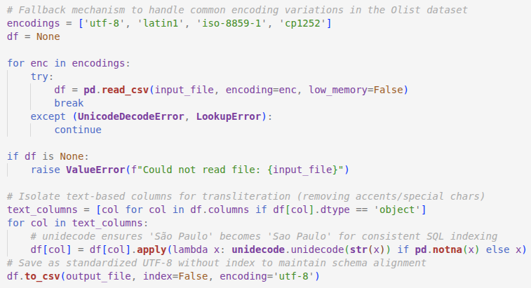
Example – encoding correction
Phase 1: Pre-Staging Pipeline
Step 1: Unicode normalization & encoding correction
Language: Python (pandas, unidecode, pathlib)
Code: ecommerce_converter.py
Phase 2: Relational ETL Process
Step 2: Staging tables (raw data ingestion)
Step 3: DQ checks (null handling, anomaly detection)
Step 4: Idempotent load (standardizing data types, cleaning)
Step 5: Relationships, indexes, foreign keys (schema optimization)
Language: SQL (PostgreSQL)
Environment: pgAdmin
Code: ecommerce_ETL.sql
SOLUTION The script iteratively tests multiple encodings to ingest raw data without read errors. Then, it applies ASCII transliteration to neutralize Brazilian Portuguese characters, outputting a standardized UTF-8.

Slide 6
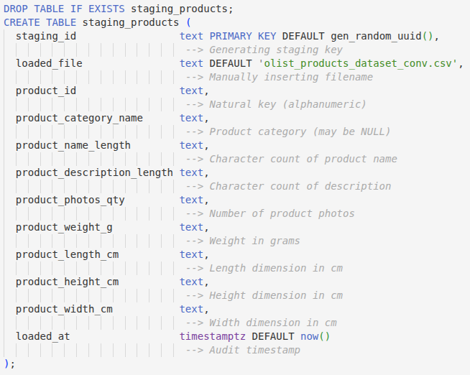
Example – raw data ingestion
Phase 1: Pre-Staging Pipeline
Step 1: Unicode normalization & encoding correction
Language: Python (pandas, unidecode, pathlib)
Code: ecommerce_converter.py
Phase 2: Relational ETL Process
Step 2: Staging tables (raw data ingestion)
Step 3: DQ checks (null handling, anomaly detection)
Step 4: Idempotent load (standardizing data types, cleaning)
Step 5: Relationships, indexes, foreign keys (schema optimization)
Language: SQL (PostgreSQL)
Environment: pgAdmin
Code: ecommerce_ETL.sql
SOLUTION By defining all source fields as text, the staging phase prevents premature type-casting errors during the initial .csv ingestion. For traceability, I added automated audit metadata (unique identifiers, timestamps, source file names).

Slide 7
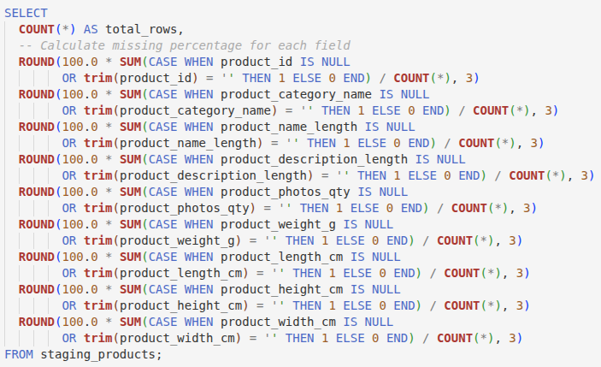
Example – null handling
Phase 1: Pre-Staging Pipeline
Step 1: Unicode normalization & encoding correction
Language: Python (pandas, unidecode, pathlib)
Code: ecommerce_converter.py
Phase 2: Relational ETL Process
Step 2: Staging tables (raw data ingestion)
Step 3: DQ checks (null handling, anomaly detection)
Step 4: Idempotent load (standardizing data types, cleaning)
Step 5: Relationships, indexes, foreign keys (schema optimization)
Language: SQL (PostgreSQL)
Environment: pgAdmin
Code: ecommerce_ETL.sql
SOLUTION This query calculates the percentage of NULL or empty values for every field, identifying critical gaps before any structural transformations are applied.

Slide 8
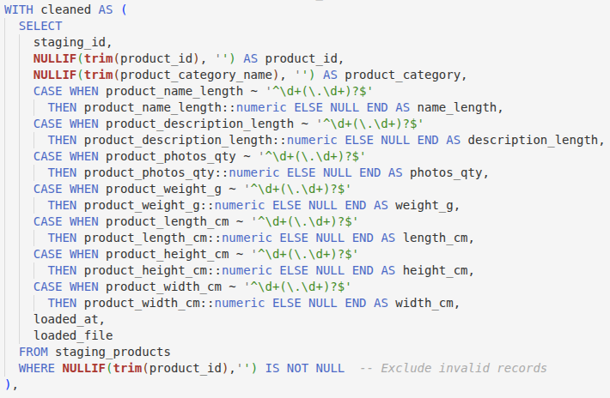
Example – standardizing
Phase 1: Pre-Staging Pipeline
Step 1: Unicode normalization & encoding correction
Language: Python (pandas, unidecode, pathlib)
Code: ecommerce_converter.py
Phase 2: Relational ETL Process
Step 2: Staging tables (raw data ingestion)
Step 3: DQ checks (null handling, anomaly detection)
Step 4: Idempotent load (standardizing data types, cleaning)
Step 5: Relationships, indexes, foreign keys (schema optimization)
Language: SQL (PostgreSQL)
Environment: pgAdmin
Code: ecommerce_ETL.sql
SOLUTION The CTE utilizes regex pattern matching to validate numeric strings before casting them to their proper types, trimming whitespace and converting empty strings into NULL values.

Slide 9
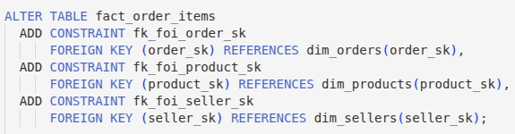
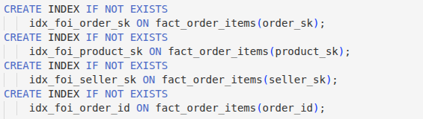
Example – schema optimization
Phase 1: Pre-Staging Pipeline
Step 1: Unicode normalization & encoding correction
Language: Python (pandas, unidecode, pathlib)
Code: ecommerce_converter.py
Phase 2: Relational ETL Process
Step 2: Staging tables (raw data ingestion)
Step 3: DQ checks (null handling, anomaly detection)
Step 4: Idempotent load (standardizing data types, cleaning)
Step 5: Relationships, indexes, foreign keys (schema optimization)
Language: SQL (PostgreSQL)
Environment: pgAdmin
Code: ecommerce_ETL.sql
SOLUTION The query enforces constraints (foreign keys and their references) and indexes to establish a formal star-schema architecture.

Slide 10


Intermediate results
{ olist_customers_dataset_conv.csv } …
{ olist_geolocation_dataset_conv.csv }
{ olist_order_items_dataset_conv.csv } { olist_order_payments_dataset_conv.csv }
{ olist_order_reviews_dataset_conv.csv }
{ olist_orders_dataset_conv.csv }
{ olist_products_dataset_conv.csv }
{ olist_sellers_dataset_conv.csv } { product_category_name_translation_conv.csv }
Olist datasets converted (pre-staging) before loading;
ecommerce_converter.py
Python pre-staging code that can be reused in future;
ecommerce_ETL.sql
PostgreSQL ETL code that can be reused in future;

Slide 11
Approach
{ olist_customers_dataset_conv.csv } …
{ olist_geolocation_dataset_conv.csv }
{ olist_order_items_dataset_conv.csv } { olist_order_payments_dataset_conv.csv }
{ olist_order_reviews_dataset_conv.csv }
{ olist_orders_dataset_conv.csv }
{ olist_products_dataset_conv.csv }
{ olist_sellers_dataset_conv.csv } { product_category_name_translation_conv.csv }
Olist datasets converted (pre-staging) before loading;
ecommerce_converter.py
Python pre-staging code that can be reused in future;
ecommerce_ETL.sql
PostgreSQL ETL code that can be reused in future;
Q1: Seller Performance & Delivery Delays Over Time
Q1.1 Quarterly Order Volume by Seller Performance Tier
Q1.2 Seller Distribution across Delivery Delay Tiers
Q1.3 Trailing 6 Months Late Delivery Rate
Q1.4 Dynamic Rank of Seller Delivery Delay Risk
Q2: Product Category Profitability & Price Sensitivity
Q2.1 Category Portfolio: Revenue, Volume and Price
Q2.2 Global and Internal Revenue Share by Price Tier
Q3: Geographic Impact on Delivery Performance
Q3.1 Median Delivery Time by Geographical State Q3.2 Delivery Reliability by Geographical State
Q3.3 Revenue at Risk Due to Late Deliveries
Q4: Market Growth Trajectory & Revenue Momentum
Q4.1 Monthly Revenue of Market Leaders
Q4.2 MoM Growth Rate of Market Leaders
Q4.3 Trailing 3 Month Revenue of Market Leaders
Language: Python {pandas, matplotlib, seaborn, SQLAlchemy}
Environment: Jupyter Notebook
Code: ecommerce_analysis.ipynb

Slide 12
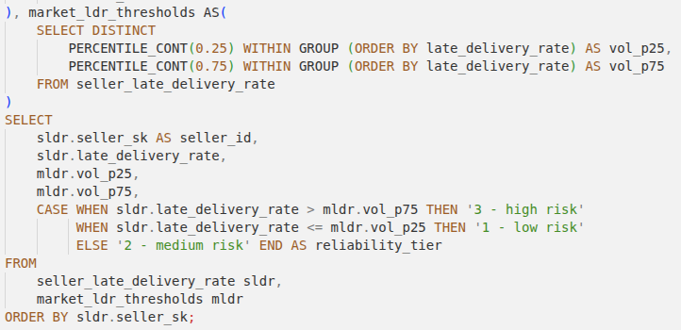
Example – dynamic thresholding
Q1: Seller Performance & Delivery Delays Over Time
Q1.1 Quarterly Order Volume by Seller Performance Tier
Q1.2 Seller Distribution across Delivery Delay Tiers
Q1.3 Trailing 6 Months Late Delivery Rate
Q1.4 Dynamic Rank of Seller Delivery Delay Risk
Q2: Product Category Profitability & Price Sensitivity
Q2.1 Category Portfolio: Revenue, Volume and Price
Q2.2 Global and Internal Revenue Share by Price Tier
Q3: Geographic Impact on Delivery Performance
Q3.1 Median Delivery Time by Geographical State Q3.2 Delivery Reliability by Geographical State
Q3.3 Revenue at Risk Due to Late Deliveries
Q4: Market Growth Trajectory & Revenue Momentum
Q4.1 Monthly Revenue of Market Leaders
Q4.2 MoM Growth Rate of Market Leaders
Q4.3 Trailing 3 Month Revenue of Market Leaders
Language: Python {pandas, matplotlib, seaborn, SQLAlchemy}
Environment: Jupyter Notebook
Code: ecommerce_analysis.ipynb
SOLUTION Using the Interquartile Range (IQR) I establish self-adjusting thresholds at the 25th and 75th percentiles to objectively categorize merchants into reliability tiers. This approach avoids hardcoded KPIs, allowing the business to tier based on current market reality.

Slide 13
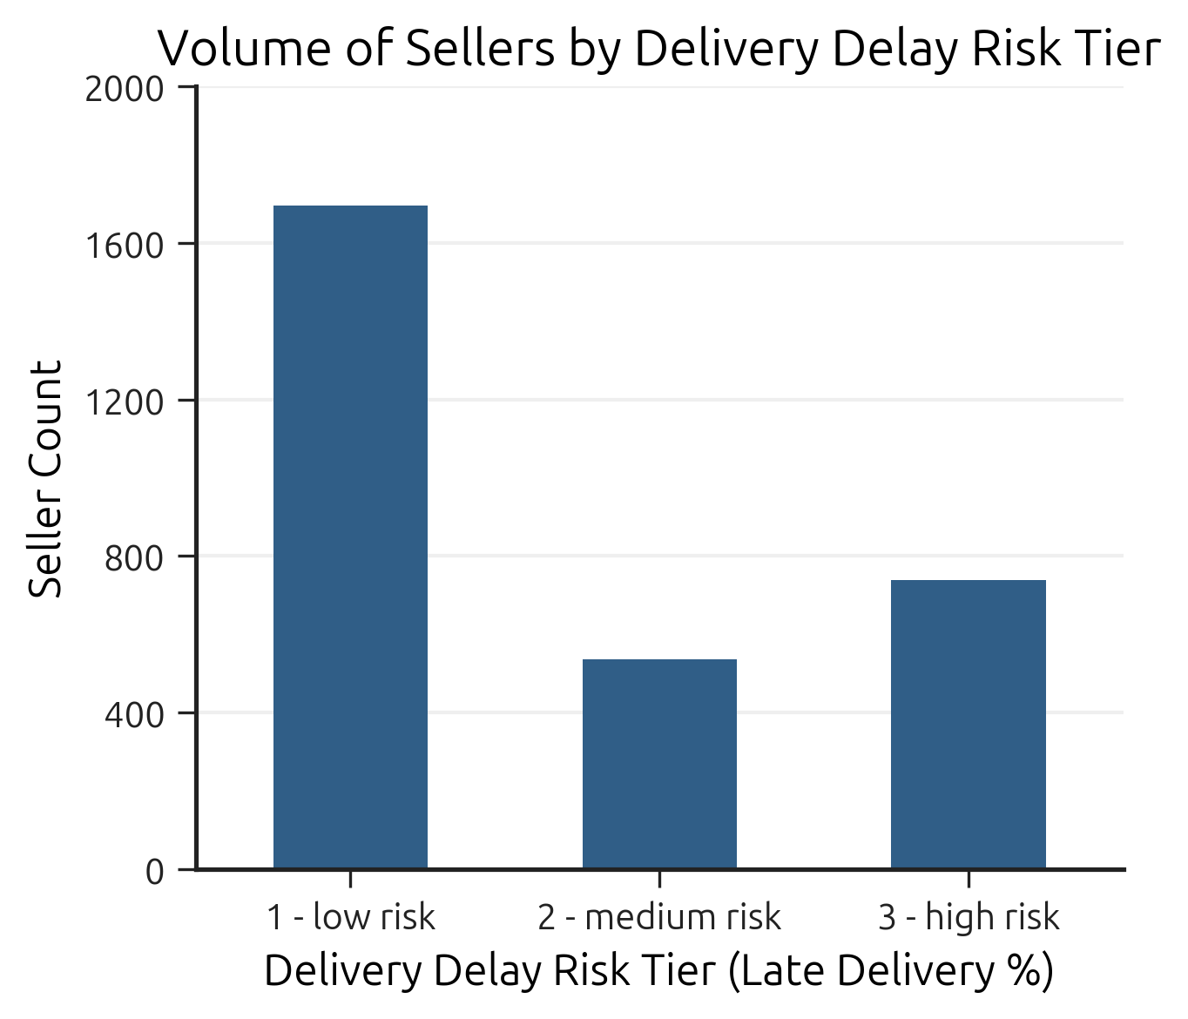
Example – dynamic thresholding
Q1: Seller Performance & Delivery Delays Over Time
Q1.1 Quarterly Order Volume by Seller Performance Tier
Q1.2 Seller Distribution across Delivery Delay Tiers
Q1.3 Trailing 6 Months Late Delivery Rate
Q1.4 Dynamic Rank of Seller Delivery Delay Risk
Q2: Product Category Profitability & Price Sensitivity
Q2.1 Category Portfolio: Revenue, Volume and Price
Q2.2 Global and Internal Revenue Share by Price Tier
Q3: Geographic Impact on Delivery Performance
Q3.1 Median Delivery Time by Geographical State Q3.2 Delivery Reliability by Geographical State
Q3.3 Revenue at Risk Due to Late Deliveries
Q4: Market Growth Trajectory & Revenue Momentum
Q4.1 Monthly Revenue of Market Leaders
Q4.2 MoM Growth Rate of Market Leaders
Q4.3 Trailing 3 Month Revenue of Market Leaders
Language: Python {pandas, matplotlib, seaborn, SQLAlchemy}
Environment: Jupyter Notebook
Code: ecommerce_analysis.ipynb
Business Insight
The prevalence of Low Risk sellers suggests that the platform's delivery infrastructure and the logic of estimating delivery time are well-aligned for the majority of merchants.

Slide 14
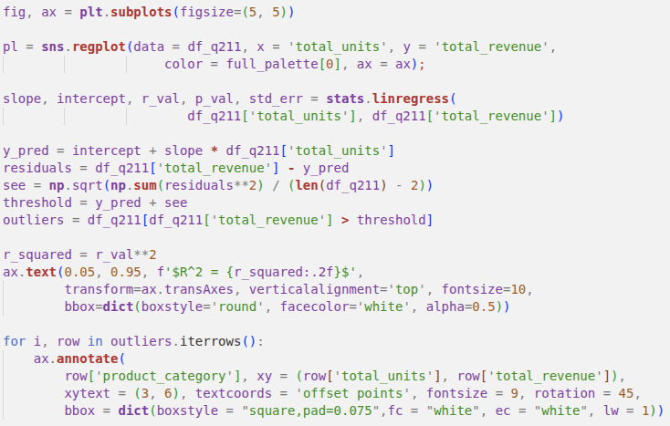
Example – complex visualizations
Q1: Seller Performance & Delivery Delays Over Time
Q1.1 Quarterly Order Volume by Seller Performance Tier
Q1.2 Seller Distribution across Delivery Delay Tiers
Q1.3 Trailing 6 Months Late Delivery Rate
Q1.4 Dynamic Rank of Seller Delivery Delay Risk
Q2: Product Category Profitability & Price Sensitivity
Q2.1 Category Portfolio: Revenue, Volume and Price
Q2.2 Global and Internal Revenue Share by Price Tier
Q3: Geographic Impact on Delivery Performance
Q3.1 Median Delivery Time by Geographical State Q3.2 Delivery Reliability by Geographical State
Q3.3 Revenue at Risk Due to Late Deliveries
Q4: Market Growth Trajectory & Revenue Momentum
Q4.1 Monthly Revenue of Market Leaders
Q4.2 MoM Growth Rate of Market Leaders
Q4.3 Trailing 3 Month Revenue of Market Leaders
Language: Python {pandas, matplotlib, seaborn, SQLAlchemy}
Environment: Jupyter Notebook
Code: ecommerce_analysis.ipynb
SOLUTION Using a regression-based anomaly detection, I identify product categories that significantly outperform the market baseline. The code establishes a dynamic threshold to isolate positive outliers and incorporates an R2 coefficient to validate the model's fit.

Slide 15
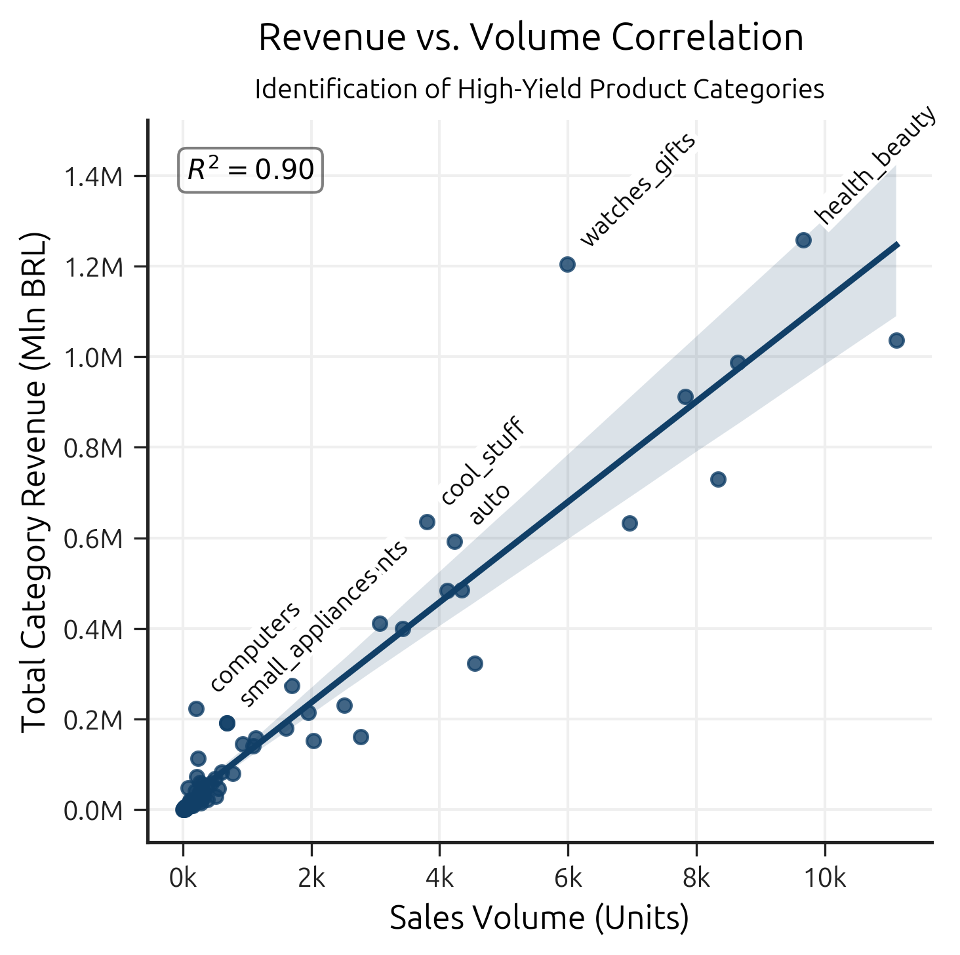
Example – complex visualizations
Q1: Seller Performance & Delivery Delays Over Time
Q1.1 Quarterly Order Volume by Seller Performance Tier
Q1.2 Seller Distribution across Delivery Delay Tiers
Q1.3 Trailing 6 Months Late Delivery Rate
Q1.4 Dynamic Rank of Seller Delivery Delay Risk
Q2: Product Category Profitability & Price Sensitivity
Q2.1 Category Portfolio: Revenue, Volume and Price
Q2.2 Global and Internal Revenue Share by Price Tier
Q3: Geographic Impact on Delivery Performance
Q3.1 Median Delivery Time by Geographical State Q3.2 Delivery Reliability by Geographical State
Q3.3 Revenue at Risk Due to Late Deliveries
Q4: Market Growth Trajectory & Revenue Momentum
Q4.1 Monthly Revenue of Market Leaders
Q4.2 MoM Growth Rate of Market Leaders
Q4.3 Trailing 3 Month Revenue of Market Leaders
Language: Python {pandas, matplotlib, seaborn, SQLAlchemy}
Environment: Jupyter Notebook
Code: ecommerce_analysis.ipynb
Business Insight
The Watches_Gifts is the standout performer - it produces nearly as much revenue as Health_Beauty but requires significantly less logistical throughput. This category represents the ideal balance of high margin and manageable volume.

Slide 16
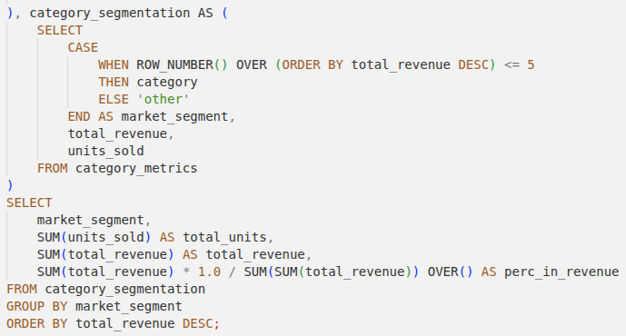
Example – window functions
Q1: Seller Performance & Delivery Delays Over Time
Q1.1 Quarterly Order Volume by Seller Performance Tier
Q1.2 Seller Distribution across Delivery Delay Tiers
Q1.3 Trailing 6 Months Late Delivery Rate
Q1.4 Dynamic Rank of Seller Delivery Delay Risk
Q2: Product Category Profitability & Price Sensitivity
Q2.1 Category Portfolio: Revenue, Volume and Price
Q2.2 Global and Internal Revenue Share by Price Tier
Q3: Geographic Impact on Delivery Performance
Q3.1 Median Delivery Time by Geographical State Q3.2 Delivery Reliability by Geographical State
Q3.3 Revenue at Risk Due to Late Deliveries
Q4: Market Growth Trajectory & Revenue Momentum
Q4.1 Monthly Revenue of Market Leaders
Q4.2 MoM Growth Rate of Market Leaders
Q4.3 Trailing 3 Month Revenue of Market Leaders
Language: Python {pandas, matplotlib, seaborn, SQLAlchemy}
Environment: Jupyter Notebook
Code: ecommerce_analysis.ipynb
SOLUTION In this CTE, I use window function to isolate the top five revenue-generating categories from the market’s residual (other). Then I calculate their share in combined platform’s revenue (perc_in_revenue).

Slide 17
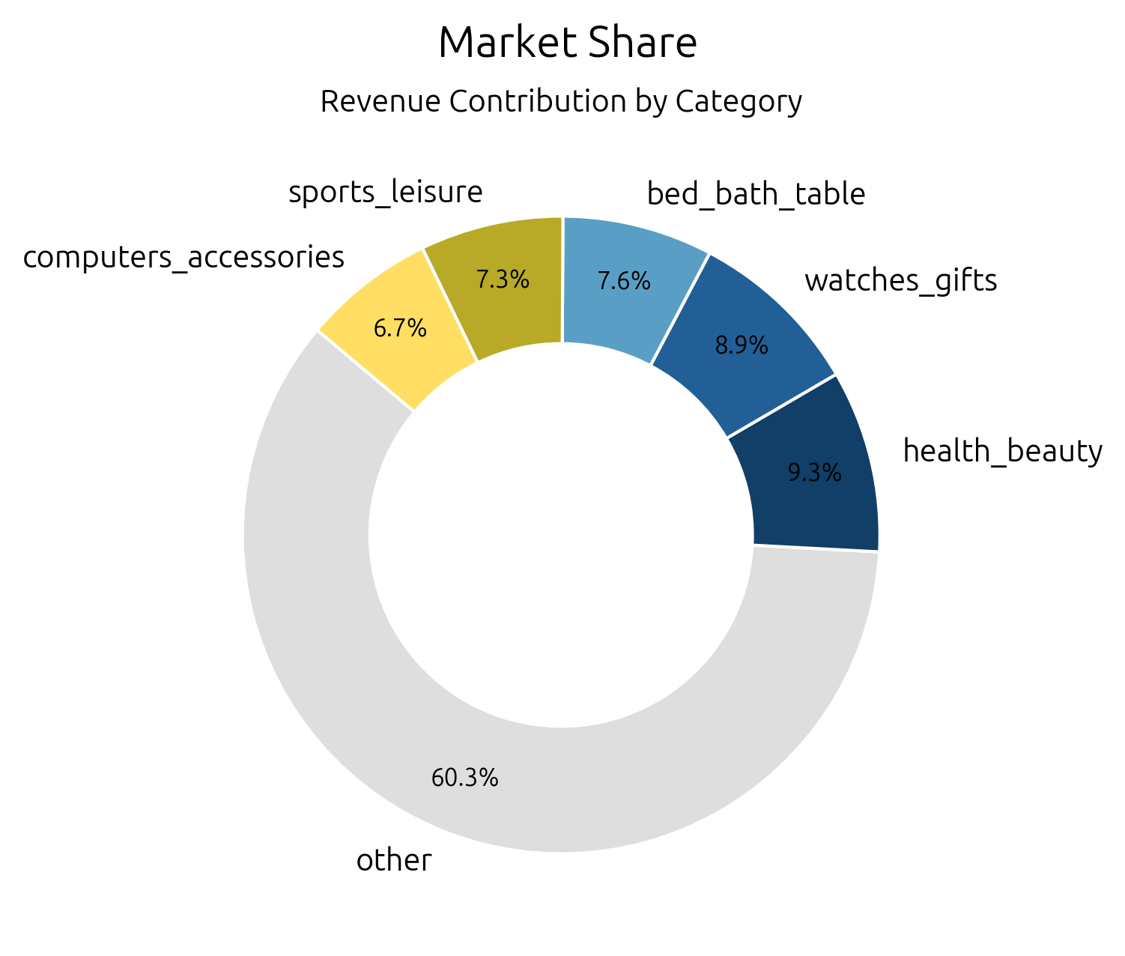
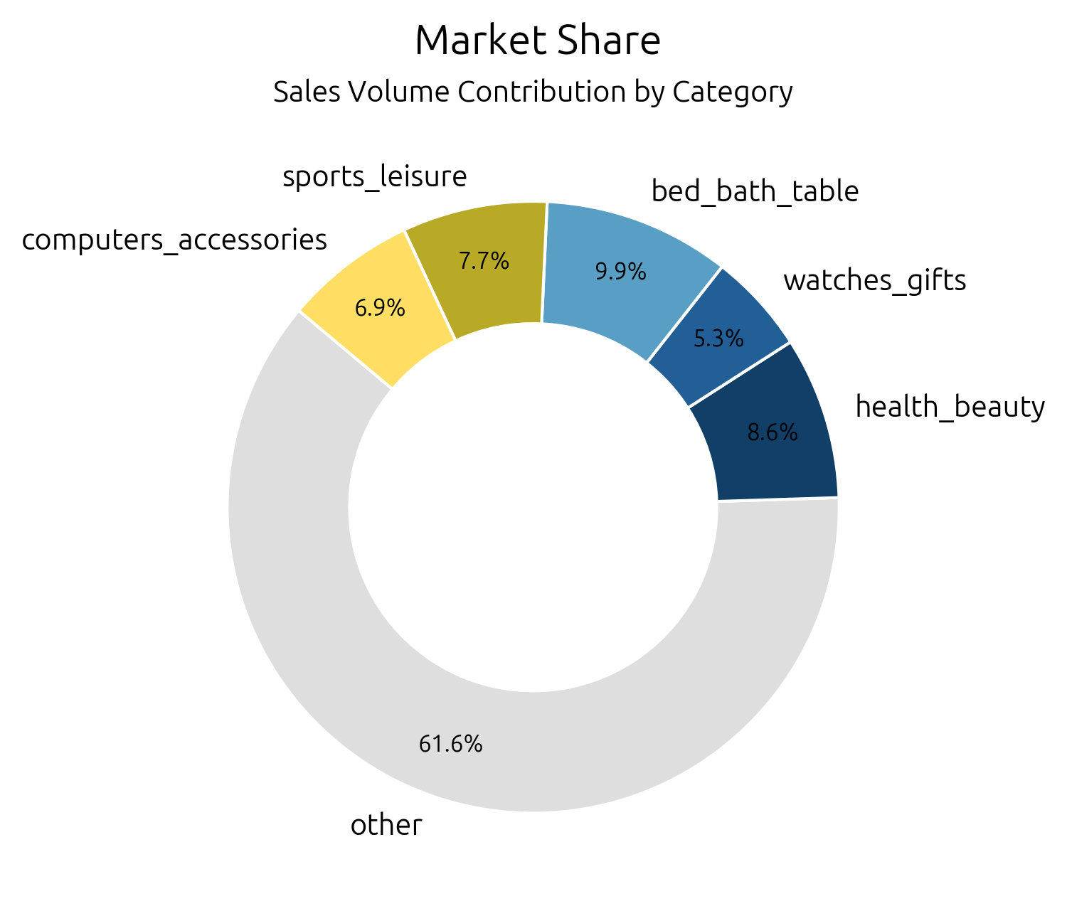
Example – window functions
Q1: Seller Performance & Delivery Delays Over Time
Q1.1 Quarterly Order Volume by Seller Performance Tier
Q1.2 Seller Distribution across Delivery Delay Tiers
Q1.3 Trailing 6 Months Late Delivery Rate
Q1.4 Dynamic Rank of Seller Delivery Delay Risk
Q2: Product Category Profitability & Price Sensitivity
Q2.1 Category Portfolio: Revenue, Volume and Price
Q2.2 Global and Internal Revenue Share by Price Tier
Q3: Geographic Impact on Delivery Performance
Q3.1 Median Delivery Time by Geographical State Q3.2 Delivery Reliability by Geographical State
Q3.3 Revenue at Risk Due to Late Deliveries
Q4: Market Growth Trajectory & Revenue Momentum
Q4.1 Monthly Revenue of Market Leaders
Q4.2 MoM Growth Rate of Market Leaders
Q4.3 Trailing 3 Month Revenue of Market Leaders
Language: Python {pandas, matplotlib, seaborn, SQLAlchemy}
Environment: Jupyter Notebook
Code: ecommerce_analysis.ipynb
Business Insight
The high revenue-to-volume ratio of Watches_Gifts suggests that marketing spend in this category is highly efficient, yielding more dollars per unit shipped than any other top category.

Slide 18
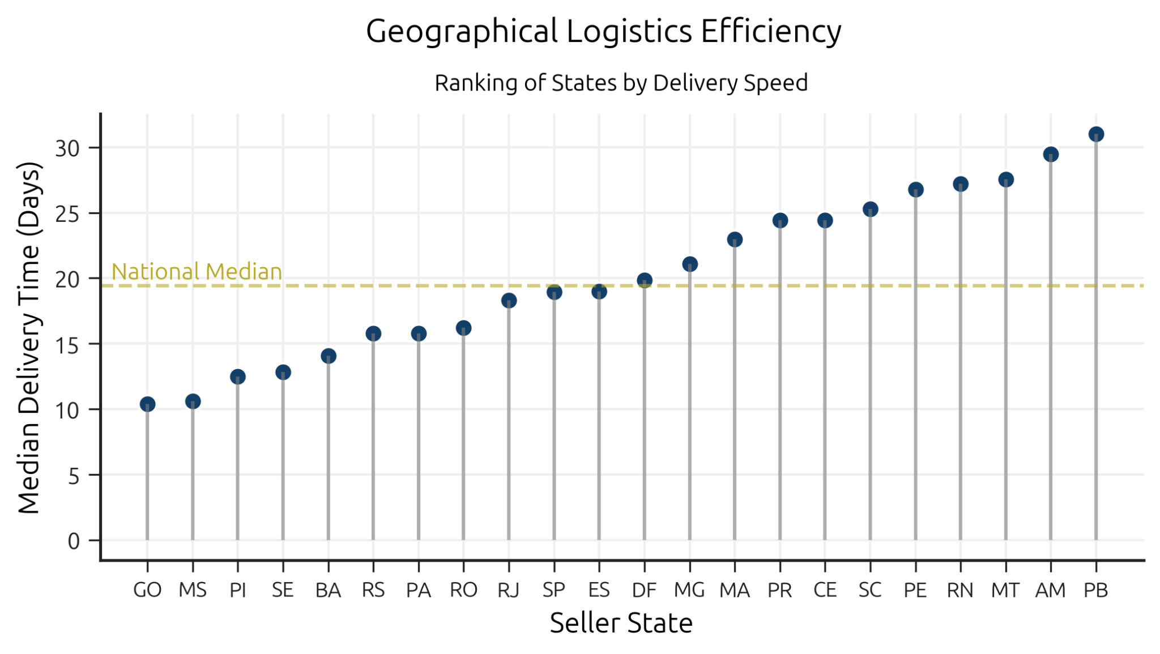
Example – complex visualizations
Q1: Seller Performance & Delivery Delays Over Time
Q1.1 Quarterly Order Volume by Seller Performance Tier
Q1.2 Seller Distribution across Delivery Delay Tiers
Q1.3 Trailing 6 Months Late Delivery Rate
Q1.4 Dynamic Rank of Seller Delivery Delay Risk
Q2: Product Category Profitability & Price Sensitivity
Q2.1 Category Portfolio: Revenue, Volume and Price
Q2.2 Global and Internal Revenue Share by Price Tier
Q3: Geographic Impact on Delivery Performance
Q3.1 Median Delivery Time by Geographical State Q3.2 Delivery Reliability by Geographical State
Q3.3 Revenue at Risk Due to Late Deliveries
Q4: Market Growth Trajectory & Revenue Momentum
Q4.1 Monthly Revenue of Market Leaders
Q4.2 MoM Growth Rate of Market Leaders
Q4.3 Trailing 3 Month Revenue of Market Leaders
Language: Python {pandas, matplotlib, seaborn, SQLAlchemy}
Environment: Jupyter Notebook
Code: ecommerce_analysis.ipynb
Business Insight
The platform should adjust the delivery time estimate to specific regions: for an AM, the delivery time estimate needs to be significantly extended, while for a GO, it could be shortened to drive competitiveness.

Slide 19
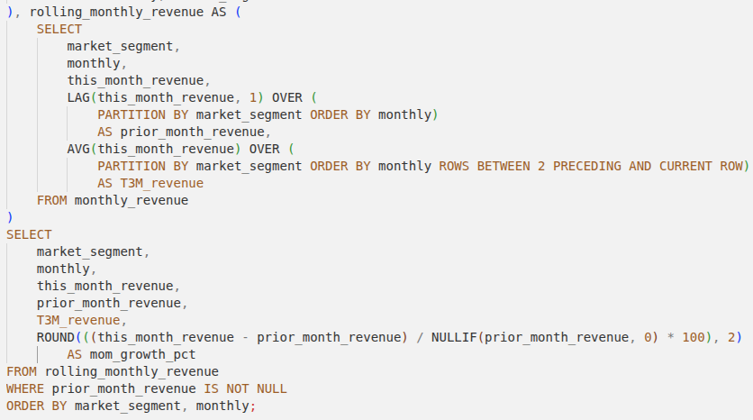
Example – rolling measures
Q1: Seller Performance & Delivery Delays Over Time
Q1.1 Quarterly Order Volume by Seller Performance Tier
Q1.2 Seller Distribution across Delivery Delay Tiers
Q1.3 Trailing 6 Months Late Delivery Rate
Q1.4 Dynamic Rank of Seller Delivery Delay Risk
Q2: Product Category Profitability & Price Sensitivity
Q2.1 Category Portfolio: Revenue, Volume and Price
Q2.2 Global and Internal Revenue Share by Price Tier
Q3: Geographic Impact on Delivery Performance
Q3.1 Median Delivery Time by Geographical State Q3.2 Delivery Reliability by Geographical State
Q3.3 Revenue at Risk Due to Late Deliveries
Q4: Market Growth Trajectory & Revenue Momentum
Q4.1 Monthly Revenue of Market Leaders
Q4.2 MoM Growth Rate of Market Leaders
Q4.3 Trailing 3 Month Revenue of Market Leaders
Language: Python {pandas, matplotlib, seaborn, SQLAlchemy}
Environment: Jupyter Notebook
Code: ecommerce_analysis.ipynb
SOLUTION Using window functions, I implement a time-series smoothing and growth analysis to evaluate the platform's revenue momentum across different market segments. I also include Zero-Division Protection (NULIFF()) in calculations.

Slide 20
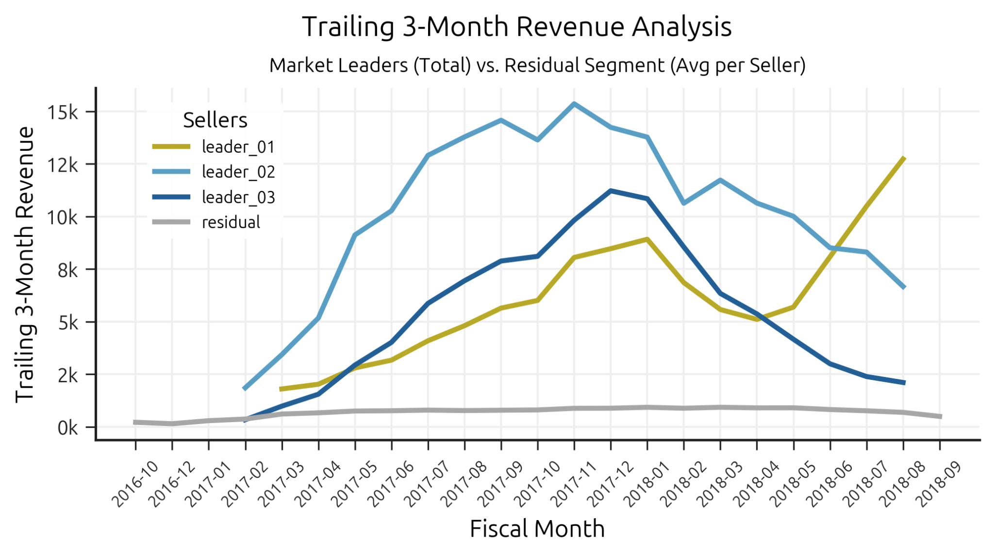
Example – rolling measures
Q1: Seller Performance & Delivery Delays Over Time
Q1.1 Quarterly Order Volume by Seller Performance Tier
Q1.2 Seller Distribution across Delivery Delay Tiers
Q1.3 Trailing 6 Months Late Delivery Rate
Q1.4 Dynamic Rank of Seller Delivery Delay Risk
Q2: Product Category Profitability & Price Sensitivity
Q2.1 Category Portfolio: Revenue, Volume and Price
Q2.2 Global and Internal Revenue Share by Price Tier
Q3: Geographic Impact on Delivery Performance
Q3.1 Median Delivery Time by Geographical State Q3.2 Delivery Reliability by Geographical State
Q3.3 Revenue at Risk Due to Late Deliveries
Q4: Market Growth Trajectory & Revenue Momentum
Q4.1 Monthly Revenue of Market Leaders
Q4.2 MoM Growth Rate of Market Leaders
Q4.3 Trailing 3 Month Revenue of Market Leaders
Language: Python {pandas, matplotlib, seaborn, SQLAlchemy}
Environment: Jupyter Notebook
Code: ecommerce_analysis.ipynb
Business Insight
The divergence between Leader 01 and the other segments in 2018 suggests a fundamental difference in operational strategy. The "Residual Stagnation" is a significant strategic concern; it suggests a lack of "growth engine" for small-to-medium sellers.

Slide 21
Summary – key findings
The platform’s growth was defined by high volatility and structural concentration, failing to achieve the sustained, linear expansion of the broader seller base required for long-term ecosystem health.
Core vulnerabilities:
Revenue Polarisation: few High-Yield product categories and Market Leaders paired with the stagnation of the Residual segment.
Logistical Disconnect: high order volume does not correlate with operational excellence. Market Leaders are highly susceptible to supply chain friction.
Regional Asymmetry: deeply fragmented logistical landscape (revenue-dominant São Paulo versus low-volume Amazonas).

Slide 22
Summary – key findings
The platform’s growth was defined by high volatility and structural concentration, failing to achieve the sustained, linear expansion of the broader seller base required for long-term ecosystem health.
Core vulnerabilities:
Revenue Polarisation: few High-Yield product categories and Market Leaders paired with the stagnation of the Residual segment.
Logistical Disconnect: high order volume does not correlate with operational excellence. Market Leaders are highly susceptible to supply chain friction.
Regional Asymmetry: deeply fragmented logistical landscape (revenue-dominant São Paulo versus low-volume Amazonas).
Business Insight:
〽 ️The platform must introduce a growth engine for middle-class sellers.
〽 Growth strategies of Leaders must be paired with mandatory logistical upgrades.
〽 Logistics recovery efforts must be prioritized in highest-density revenue streams first.

Slide 23
Summary – analysis limitations
The 100,000-order snapshot is a historical "frozen" dataset (2016–2018) and may not reflect recent post-pandemic shifts in Brazilian e-commerce behavior or logistics;
Models do not account for external macroeconomic factors (e.g., BRL exchange rate volatility, national strikes, changes in postal service pricing) during the window;
The SQL views treat cancelled orders as lost revenue but cannot distinguish between seller-fault cancellations and customer-driven returns;
The T3M and MoM growth models assume a degree of continuity that may overlook micro-seasonal events (e.g., local holidays).
Important note:
Offered insights are entirely focused on internal marketplace dynamics and are not based on academic knowledge of Brazilian macroeconomics.
My aim was to demonstrate the ability to architect data, design robust ETL processes, and extract actionable business intelligence from complex relational datasets.

Slide 24
Final results
The 100,000-order snapshot is a historical "frozen" dataset (2016–2018) and may not reflect recent post-pandemic shifts in Brazilian e-commerce behavior or logistics;
Models do not account for external macroeconomic factors (e.g., BRL exchange rate volatility, national strikes, changes in postal service pricing) during the window;
The SQL views treat cancelled orders as lost revenue but cannot distinguish between seller-fault cancellations and customer-driven returns;
The T3M and MoM growth models assume a degree of continuity that may overlook micro-seasonal events (e.g., local holidays).
Important note: Offered insights are entirely focused on internal marketplace dynamics and are not based on academic knowledge of Brazilian macroeconomics.
My aim was to demonstrate the ability to architect data, design robust ETL processes, and extract actionable business intelligence from complex relational datasets.
{ olist_customers_dataset_conv.csv } …
Olist datasets converted (pre-staging) before loading;
ecommerce_converter.py
Python pre-staging code that can be reused in future;
ecommerce_ETL.sql
PostgreSQL ETL code that can be reused in future;
ecommerce_analysis.ipynb
queries and visualizations that can be reused in future;
{ int_leaders_late_delivery_count } …
{ int_market_leaders }
{ rpt_q1_leaders_l6m_late_delivery_rate }
{ rpt_q1_leaders_market_share }
{ rpt_q1_leaders_market_share_delay_risk }
{ rpt_q1_leaders_monthly_ldr_segmentation }
{ rpt_q1_seller_delivery_delay_segmentation }
{ rpt_q1_seller_quarterly_performance }
{ rpt_q2_product_category_performance }
{ rpt_q2_top_categories_in_revenue }
{ rpt_q2_top_categories_in_revenue_priceband }
{ rpt_q3_state_delivery_estimation_reliability }
{ rpt_q4_leaders_mom_growth }
a set of intermediate and report-ready SQL views;

Slide 25
Key skills
Data modelling & engineering
Designing a star-schema model (fact & dimension tables) within a PostgreSQL environment.
Creating robust one-to-many and one-to-one relationships across complex relational datasets.
Resolving data ambiguity and category mapping using lookup and bridging tables.
Building advanced aggregation measures (e.g., T3M smoothing, MoM growth, percentile-based thresholds).
Data visualization & storytelling
Translating a strategic business narrative into a functional, highly readable analytical report.
Highlighting high-impact segments (e.g., Market Leaders, high-yield categories, and at-risk regions) visually.
Organizing metrics and visuals into purposeful analytical chapters aligned with an executive audit scenario.
Preparing comprehensive documentation to effectively communicate methodology.
Translating data into actionable business insights.

