Slide 1






The comprehensive roadmap for the European energy transition. It provides lobbyists and policy advocates with the empirical evidence needed to bridge the gap between climate ambition and economic reality.
BY DOMINIKA DRĄŻYK APRIL, 2026

Slide 2
Introduction
This strategic data engine is designed to transform complex Eurostat datasets into actionable political leverage in the Renewable Energy discourse.
〽️ INTENDED AUDIENCE
Lobbyists: seeking to anchor their renewable energy pitches in validated, cross-border statistics;
Policymakers and Advisors: requiring a high-level overview of national progress relative to EU-wide benchmarks;
Publicists and Analysts: looking to debunk common myths regarding the costs and stability of the green energy transition.

Slide 3

Data source:
This strategic data engine is designed to transform complex Eurostat datasets into actionable political leverage in the Renewable Energy discourse.
〽️ INTENDED AUDIENCE
Lobbyists: seeking to anchor their renewable energy pitches in validated, cross-border statistics;
Policymakers and Advisors: requiring a high-level overview of national progress relative to EU-wide benchmarks;
Publicists and Analysts: looking to debunk common myths regarding the costs and stability of the green energy transition.
[ ten00124 ] Final energy consumption by sector
[ nrg_ind_ren ] Share of energy from renewable sources
[ nrg_pc_204 ] Electricity prices for household consumers (bi-annual)
publicly available
regularly updated
structured, but requires pre-processing

Slide 4
Approach
Phase 1: Data Extraction & Web Scraping
Step 1: Extracting datasets via official API and web scraping
Step 2: Performing the outer merge for the obtained datasets
Language: Python (BeautifulSoup, selenium, pyjstat)
Code: scraper_code.py
Phase 2: Preprocessing & Data Audit
Step 3: Renaming dimension codes to user-friendly labels
Step 4: Systematic missing-data audit
Language: Python (pandas, numpy)
Code: preproc_code.py
Phase 3: Visualizations & Dashboard
Step 5: Preparing data visualizations
Step 6: Rendering an ineractive dashboard to present results
Language: Python (seaborn, matplotlib, Streamlit)
Code: figures.py, dashboard.py

Slide 5
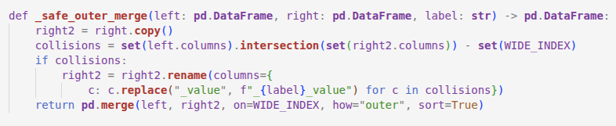
Example – outer merge
Phase 1: Data Extraction & Web Scraping
Step 1: Extracting datasets via official API and web scraping
Step 2: Performing the outer merge for the obtained datasets
Language: Python (BeautifulSoup, selenium, pyjstat)
Code: scraper_code.py
Phase 2: Preprocessing & Data Audit
Step 3: Renaming dimension codes to user-friendly labels
Step 4: Systematic missing-data audit
Language: Python (pandas, numpy)
Code: preproc_code.py
Phase 3: Visualizations & Dashboard
Step 5: Preparing data visualizations
Step 6: Rendering an ineractive dashboard to present results
Language: Python (seaborn, matplotlib, Streamlit)
Code: figures.py, dashboard.py
SOLUTION This function executes a sorted outer merge between two DataFrames while resolving potential naming collisions.

Slide 6
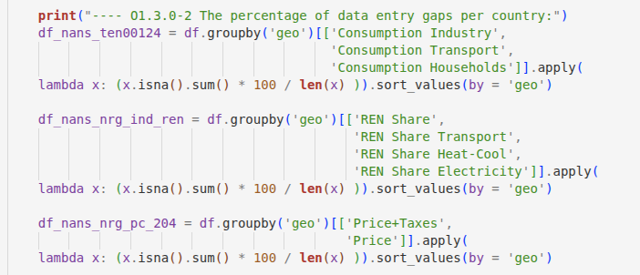
Example – missing data audit
Phase 1: Data Extraction & Web Scraping
Step 1: Extracting datasets via official API and web scraping
Step 2: Performing the outer merge for the obtained datasets
Language: Python (BeautifulSoup, selenium, pyjstat)
Code: scraper_code.py
Phase 2: Preprocessing & Data Audit
Step 3: Renaming dimension codes to user-friendly labels
Step 4: Systematic missing-data audit
Language: Python (pandas, numpy)
Code: preproc_code.py
Phase 3: Visualizations & Dashboard
Step 5: Preparing data visualizations
Step 6: Rendering an ineractive dashboard to present results
Language: Python (seaborn, matplotlib, Streamlit)
Code: figures.py, dashboard.py
SOLUTION The script performs a data completeness audit by calculating the percentage of missing values for each energy indicator, grouped and sorted by geographic code across the three source datasets.

Slide 7
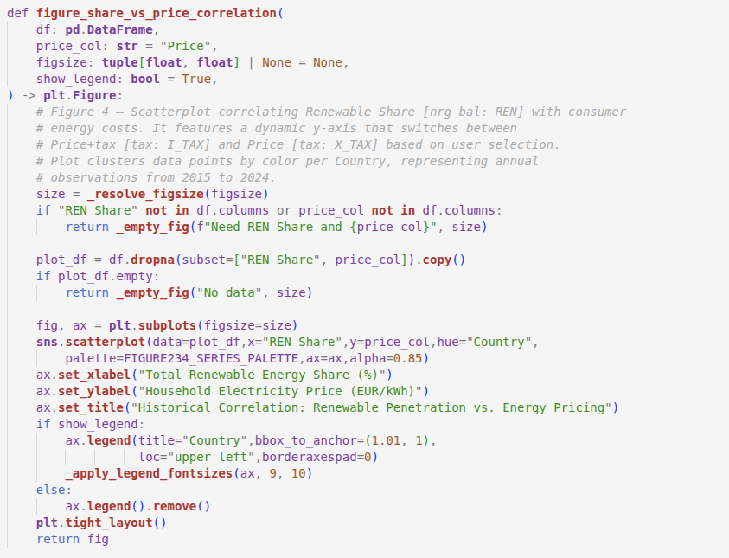
Example – visualizations
Phase 1: Data Extraction & Web Scraping
Step 1: Extracting datasets via official API and web scraping
Step 2: Performing the outer merge for the obtained datasets
Language: Python (BeautifulSoup, selenium, pyjstat)
Code: scraper_code.py
Phase 2: Preprocessing & Data Audit
Step 3: Renaming dimension codes to user-friendly labels
Step 4: Systematic missing-data audit
Language: Python (pandas, numpy)
Code: preproc_code.py
Phase 3: Visualizations & Dashboard
Step 5: Preparing data visualizations
Step 6: Rendering an ineractive dashboard to present results
Language: Python (seaborn, matplotlib, Streamlit)
Code: figures.py, dashboard.py
SOLUTION The script generates a scatterplot correlating Total Renewable Energy Share with consumer energy costs.

Slide 8
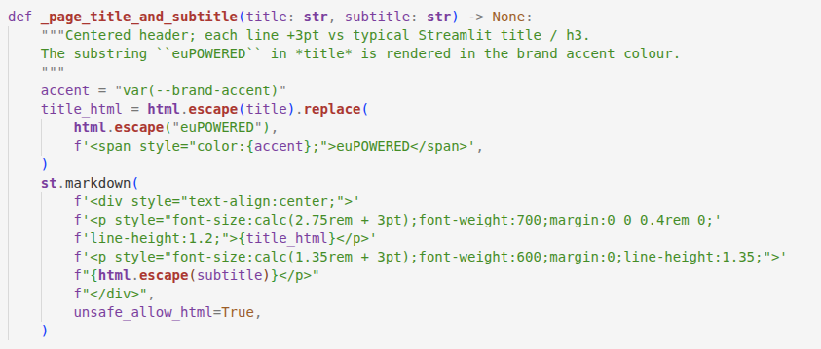
Example – visualizations
Phase 1: Data Extraction & Web Scraping
Step 1: Extracting datasets via official API and web scraping
Step 2: Performing the outer merge for the obtained datasets
Language: Python (BeautifulSoup, selenium, pyjstat)
Code: scraper_code.py
Phase 2: Preprocessing & Data Audit
Step 3: Renaming dimension codes to user-friendly labels
Step 4: Systematic missing-data audit
Language: Python (pandas, numpy)
Code: preproc_code.py
Phase 3: Visualizations & Dashboard
Step 5: Preparing data visualizations
Step 6: Rendering an ineractive dashboard to present results
Language: Python (seaborn, matplotlib, Streamlit)
Code: figures.py, dashboard.py
SOLUTION The script renders a centered, custom-styled header for the dashboad precisely scaling the font sizes of the title and subtitle via injected HTML.

Slide 9
AI-augumented workflow
The project was built through an AI-augmented workflow, using the Cursor IDE and Claude.
Data extraction, preprocessing, and analytical figure logic were written by the Author and optimized by Cursor. Presentation layer (Streamlit, CSS branding, HTML rendering, code refactoring) were implemented by Cursor under the following rules:
Author-driven design decisions: All visual design choices (e.g, color palette, layout proportions, typography), content, and analytics (e.g, how to group RES Shares) originated from the Author;
AI-assisted implementation: Cursor translated high-level instructions into working code, handling the CSS specificity with Streamlit's internal styles, HTML templating, and Matplotlib API details;
Continuous review: The Author verified every change and provided feedback. The Author also made direct edits to the Streamlit code independently between Cursor sessions. Large structural improvements were first proposed by Cursor, then selectively approved or rejected by the Author before implementation.

Slide 10
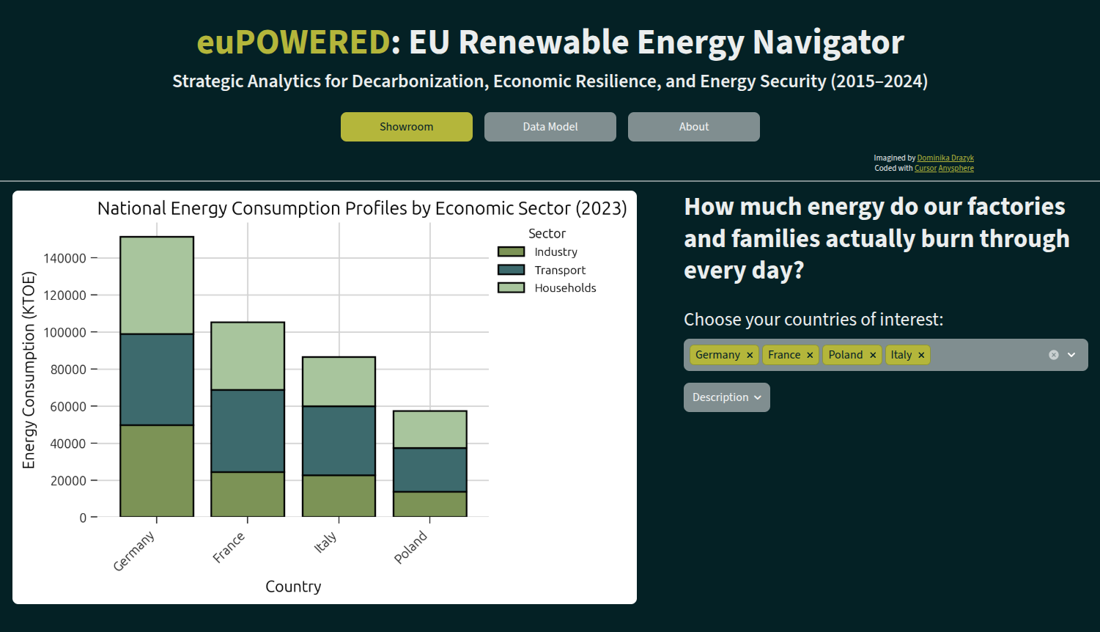
The Dashboard
Navigation Buttons to switch between dashboard pages.

Slide 11
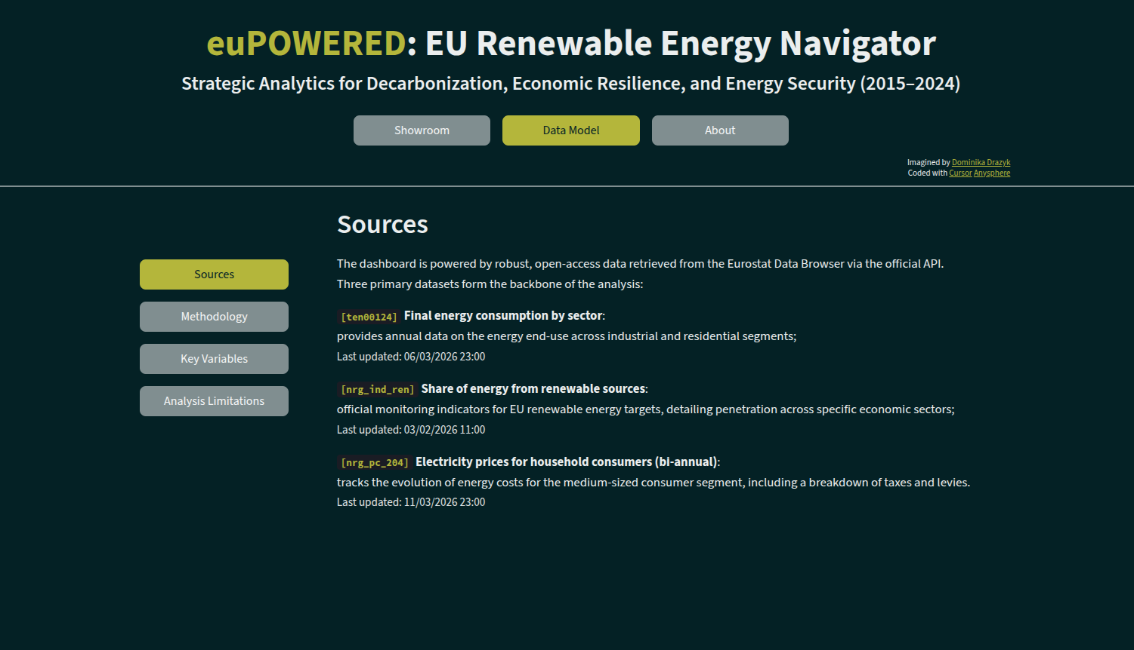
The Dashboard
The Data Model page that synchronizes after dataset update including Eurostat [Links] and metadata (Last updated).

Slide 12
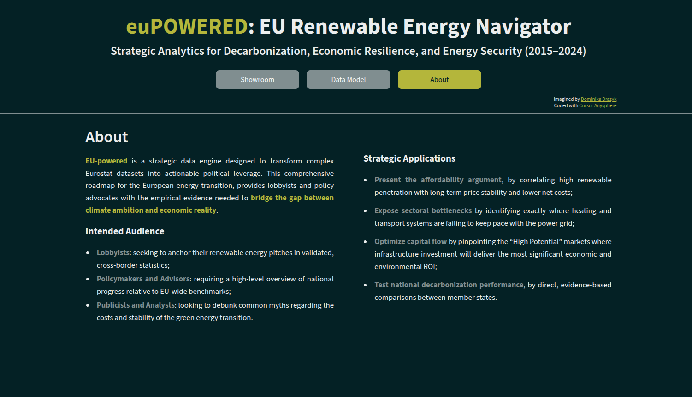
The Dashboard
The About page including basic project information and data-driven strategic insights.

Slide 13
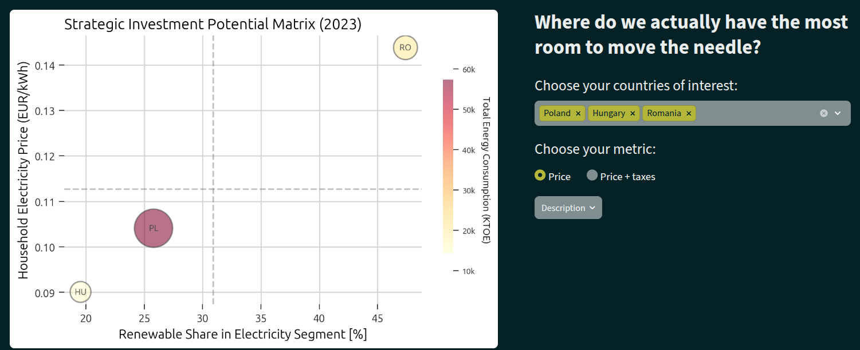
The Dashboard
In the Showroom page, each data visualization changes in real time, depending on chosen parameters...

Slide 14
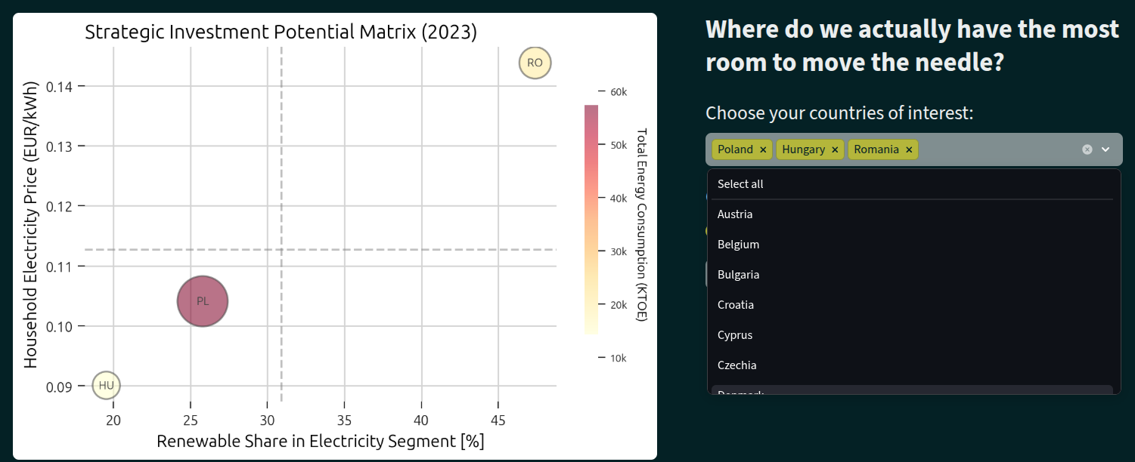
The Dashboard
… Countries of interest, ...

Slide 15
The Dashboard
… or chosen Price calculation.

Slide 16
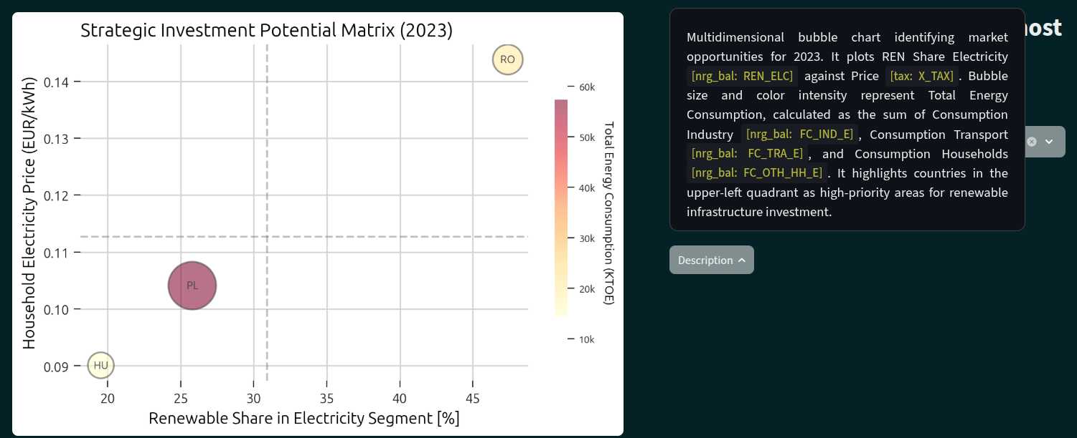
The Dashboard
Description buttons provide technical information and data sources for each visualization.

Slide 17
Practical business aplications
〽 Present the affordability argument, by correlating high renewable penetration with long-term price stability and lower net costs;
〽 Expose sectoral bottlenecks by identifying exactly where heating and transport systems fail to keep pace with the power grid;
〽 Optimize capital flow by pinpointing the “High Potential” markets where infrastructure investment will deliver the most significant economic and environmental ROI;
〽 Test national decarbonization performance, by direct, evidence-based comparisons between member states.

Slide 18
Analysis limitations
〽 Present the affordability argument, by correlating high renewable penetration with long-term price stability and lower net costs;
〽 Expose sectoral bottlenecks by identifying exactly where heating and transport systems fail to keep pace with the power grid;
〽 Optimize capital flow by pinpointing the “High Potential” markets where infrastructure investment will deliver the most significant economic and environmental ROI;
〽 Test national decarbonization performance, by direct, evidence-based comparisons between member states.
By design, the pipeline omits the Commercial and Public Services. Total figures represent Industry, Transport, and Households sectors (covering the vast majority of consumption), not the absolute national total;
Pricing data is anchored to the DC Band from 2500 to 4999 kWh (median EU household). It may not reflect the costs faced by low-income households or heavy industrial users;
An “Outer Merge” strategy is used to accommodate countries with incomplete records for specific years. Consequently, some figures may appear fragmented for specific Member States.
Important note:
The insights provided are focused on the strategic application of energy metrics for policy advocacy and are not based on formal academic expertise in energy economics or legislative drafting.
My aim was to demonstrate the ability to architect data, design robust ETL processes, and extract actionable business intelligence from complex relational datasets.

Slide 19


Results
{ scraper_data.csv } { scraper_metadata.csv }
{ eu_efta_countries.csv }
Eurostat-related datasets, extracted via API or scraped;
{ preprocessed_data.csv }
main preprocessed dataset ready for data anlaysis;
scraper_code.py
Python data extraction code;
preproc_code.py
Python preprocessing code;
figures.py
Python code for figure generation;
dashboard.py
Python dashboard rendering code;
brand.css
stylesheet for the dashboard;

Slide 20
Key skills
Data modelling & engineering
Developing custom web scrapers to automate the extraction of public datasets and metadata.
Preparing and cleaning datasets (synchronizing semi-annual series, mapping technical codes to human-readable labels).
Executing systematic missing-data audits and diagnostic visualizations to maintain the structural integrity of the unified data model.
Leveraging AI-augmented development while maintaining strict authorial oversight of analytical logic and visual proportions.
Data visualization & storytelling
Imagining an interactive dashboard with a custom-branded CSS design system for reporting.
Translating abstract statistics into a strategic lobbyist narrative focused on affordability and decarbonization progress.
Utilizing advanced visual analytics, to identify high-yield investment opportunities and sectoral bottlenecks.
Preparing comprehensive documentation to effectively communicate methodology and limitations.

