Slide 1
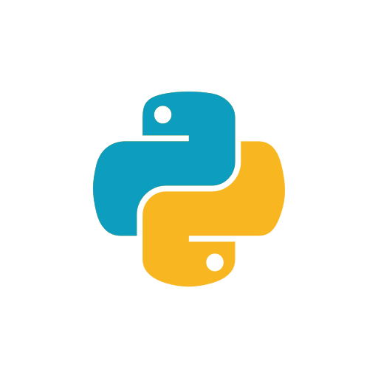
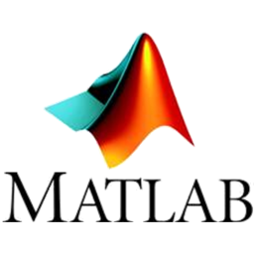




MLW PROJECT – KWIK 2018-2019
Celem projektu jest porównanie możliwości analizy danych, zarówno statystycznej oraz z użyciem mechanizmów AI.
PAWEŁ CIŚLIK
DOMINIKA DRĄŻYK

Slide 2
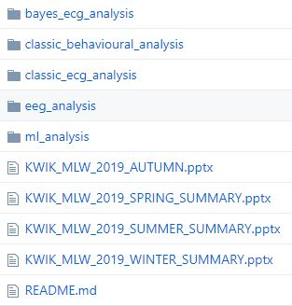
MLW PROJECT – GitHub
Classic biosignal data approach
Bayes biosignal data approach
Bayes behavioural data approach
EEG data approach (preprocessing)
Machine learning biosignals approach
Semestral summaries (presentations)

Slide 3
MLW PROJECT – GitHub
Classic biosignal data approach
Bayes biosignal data approach
Bayes behavioural data approach
EEG data approach (preprocessing)
Machine learning biosignals approach
presentation/doc explaining the content
small summay README
initial dataset
transient dataset
analysis code
Semestral summaries (presentations)
MLW_PROJECT_2019

Slide 4
CLASSIC BIOSIGNAL DATA APPROACH
data import
definition of variables and outliers removal
descriptive analysis and histograms
hypothesis testing
(ANOVA, regression, t-test, multi comp)
data and results visualization

Slide 5

FINDING No. 1
R better for beginners – code is less elegant
- but easier to comprehend
- output as ready-to go interpretation
- tidyverse package
Python (pandas) better to preprocess biosignals
- code is clear (for programmers)
- the output is ‘just numbers’
- preprocessing and the stat analysis in one code

Slide 6
BAYES BIOSIGNAL DATA APPROACH
data import
definition of variables and outliers removal
descriptive analysis and histograms
hypothesis testing
(BRMS models, bayes factor)
data and results visualization

Slide 7
FINDING No. 2
Jupyter goes not so well with STAN …
- troubles setting kernel with STAN
- BRMS model compilation longer
RStudio mor stable with STAN
- but still we recommend to shut down all the background memory occupants before compiling

Slide 8
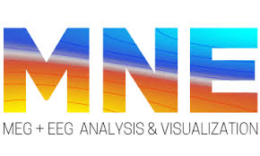


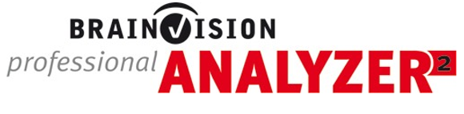
EEG DATA APPROACH
data import (file format transformations)
epochs definitions
preprocessing (is a hell whatever you do)
ICA /PCA and results visualization

Slide 9
FINDING No. 3
For mor complicated epoch definitions:
you have to use Matlab + FieldTrip / EEGLab syntax or MNE Python
For data preprocessing:
non-programmers:
the good is MNE Python or EEGLab GUI (free)
the best is Brain Vision Analyzer (~12 000$ one year license)
programmers:
Matlab + FieldTrip/EEGLab syntax (free) (you can do things the 12 000 $ licence cannot )

Slide 10
FINDING No. 3
B VA and EEGLab GUI
needs specified data type, otherwise may create problems
BVA
lacks some functions
you have to follow the path of consecutive steps, a mistake
sometimes requires starting all over again
non-flexible when doing data visualization
Matlab + FieldTrip
hell for non-programmers,
the most powerfull tool

Slide 11
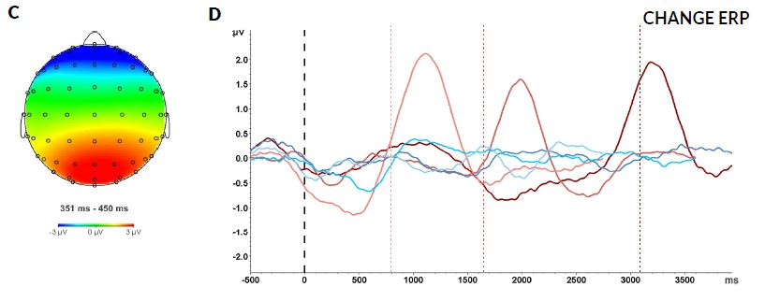
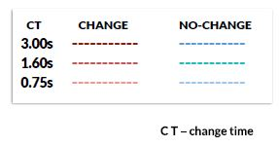
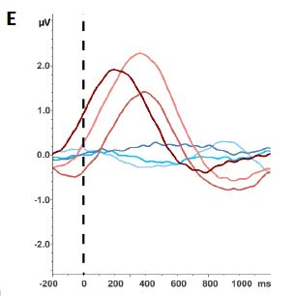
A PROOF
elements of graphics powered by Photoshop
legend powered by Office 365
onset line powered
by Paint
aprox. time spent on searching for those functions in BVA – 5 hours
it all looks better when done in Matlab anyway

Slide 12

MACHNE LEARNING BIOSIGNAL DATA APPROACH
data import
transforming bio-data to plots (images)
creating training – testing data
hypothesis testing
(sequential models, basic neural network)
results evaluation (accuracy)

Slide 13
MACHNE LEARNING BIOSIGNAL DATA APPROACH
data import
transforming bio-data to vectors (still numbers)
creating training – testing data
hypothesis testing
(sequential models, basic neural network)
results evaluation (accuracy)

Slide 14
FINDING No. 4
Colaboratory has poor data storage idea
mounting with Drive also bad idea…
better use with GitHub
bio-data as images analysis
super-easy to do
something is computing … then numbers pop-up
accuracy seems obscenely high …
… so something is wrong, we probably have no idea what is going on
bio-data as vectors analysis
hell to prepare data that way
then : something is computing -> no idea whats going on
ML is hard.

Slide 15
FINDING No. 5 – a tale of two tools
Anaconda Environment / Jupiter Notebook (python, R)
good idea to start your programming adventure
does not support Matlab
has troubles with STAN for R
you need internet connection
Colaboratory Environment / Jupiter Notebook (python, R)
good idea for creating group work space
you can create workshops, presentations, tutorials that way
poor big-data storage
you need internet connection
To be honest after all, we are still using Rstudio, PyCharm and Matlab with Git version control …

Slide 16
WHAT WE'VE BEEN DOING THE WHOLE TIME …
We have been participating in several projects as interns
the results are the EEG data analysis qpproaches
We have been doing our own data analysis
the results are the bio-signal data analysis approaches
We have been participating in some workshops
the results are the bayes data analysis approach
We have been leading some workshops ourselves
the results are the behavioural data analysis approach
We have been in KWIK_2018/19 course
the results are the machine learning data analysis approach,
familiarization with Colaboratory, Jupiter Notebook, GitHub,
our own approach to data form ‘Depresjon’ project,
creating the consistent Repository from all above with useful ready-to-go code examples and our summaries and findings

Slide 17
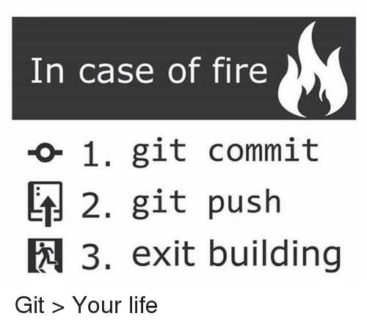
END.

