Slide 1
HYPOTHESIS 3
there is a possibility of specifying the patterns of sleep motor activity for every of the mental health conditions based on the values of motor activity measurement (activity) and the classification of the participant's mental health status (afftype);

Slide 2
STEP 1:
import the csv files path (both control and condition group)
from the google drive to a list
requires mounting google drive account to a colaboratory
MLW2019_H3_image_generator.ipynb (GitHub)

Slide 3
STEP 2:
proper reading of csv files with the choice of each day‘s 18:00 - 9:00 period (night)
each night' data is then plotted via matplotlib, then saved as .png in google drive with the proper label ("condition"/"control")

Slide 4
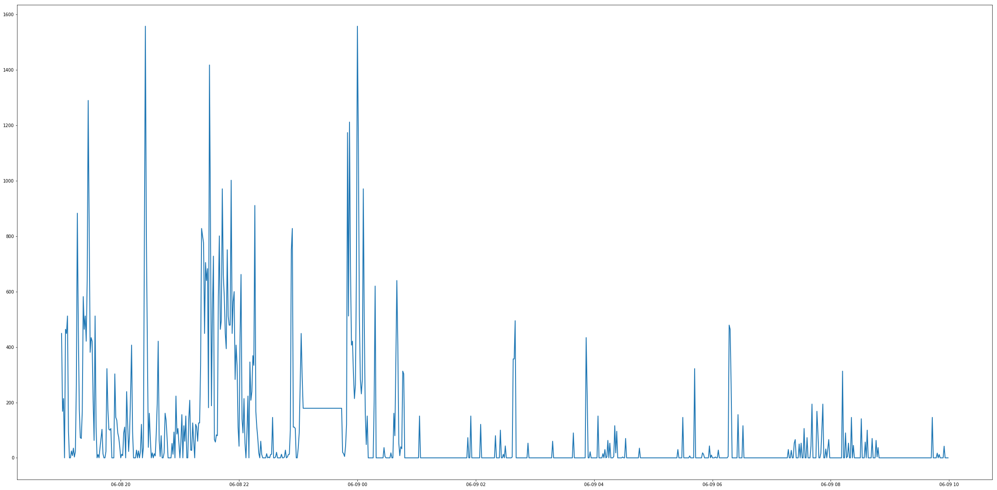
STEP 2:
„condition”

Slide 5
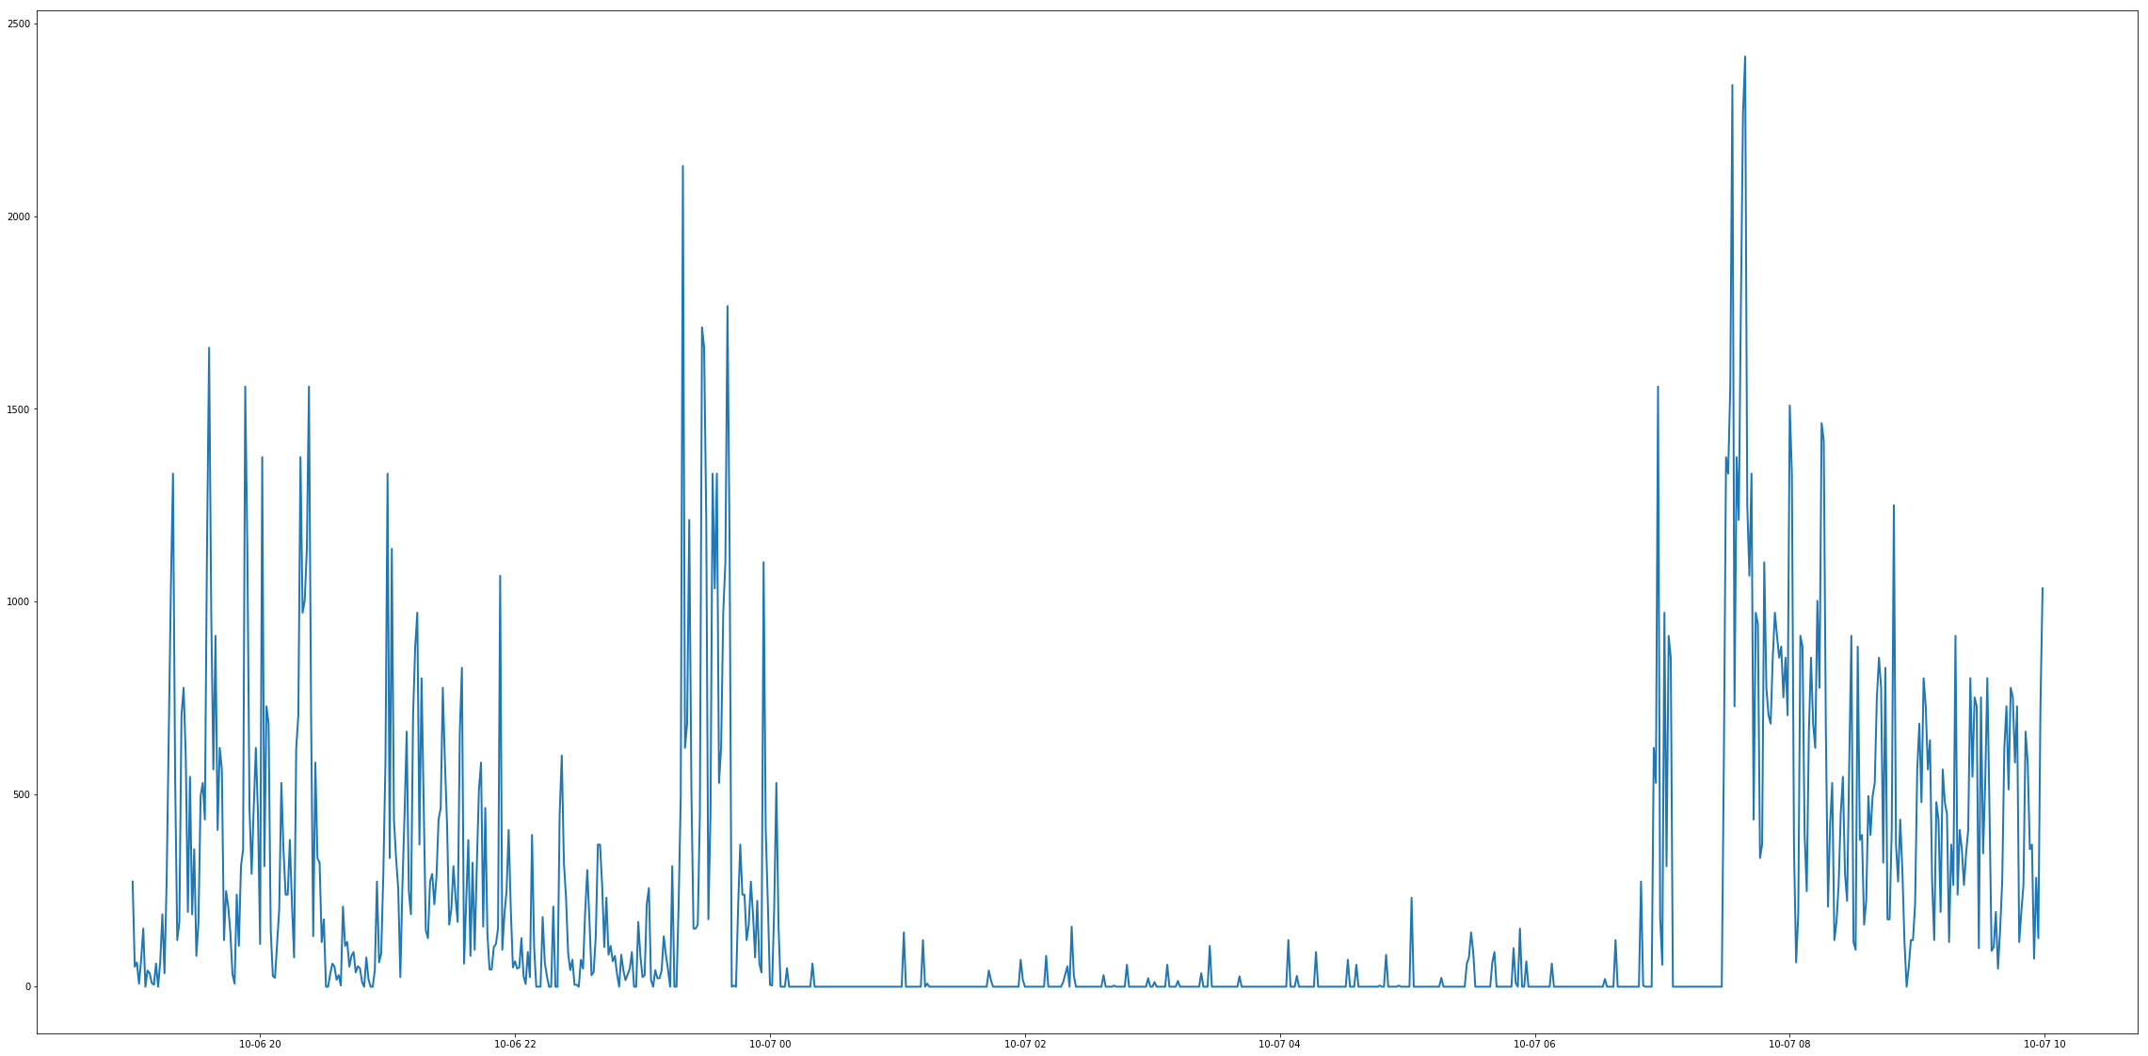
STEP 2:
„control”

Slide 6

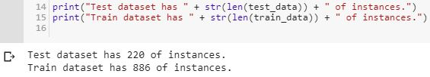
STEP 3:
proper loading each picture with the label („condition”/”control”)
to an array [ image, label ]
assesing 20% of each class to TEST group, and the rest to TRAIN group
MLW2019_H3_classifier.ipynb (GitHub)

Slide 7
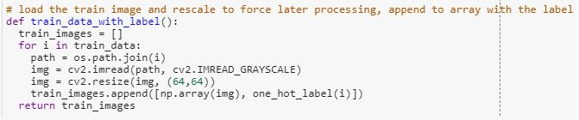
STEP 4:
rescaling each of image to a 64 x 64 format to unify it and allow the kernel inspection

Slide 8
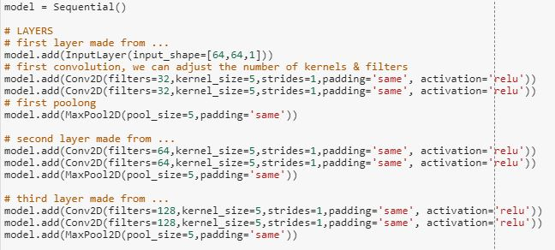
STEP 5:
Making the model : final form consisting of 3 layers, each starts with the double convolutional layer, then pooling

Slide 9
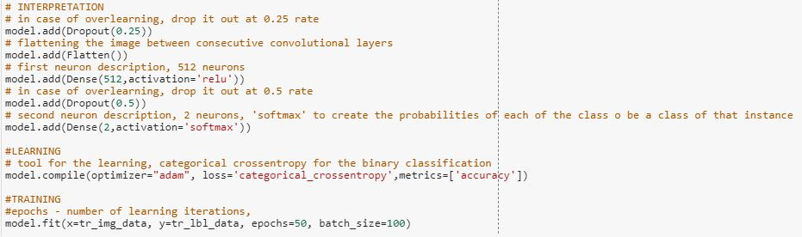
STEP 6:
Interpretation: what to do between the layers (flatten), what to do when overfitting ( dropout) and the neuron section (dense):

Slide 10
STEP 7:
Interpretation: what to do between the layers (flatten), what to do when overfitting ( dropout) and the neuron section (dense)
Method of training (adam is default) and setting the number of iterations.

Slide 11
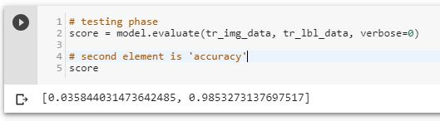
STEP 8:
Checking the accuracy in the test phase:
The score after:
adding the third layer,
doubling each convolutional one,
changing hardware interpreter from default to GPU (accelerator)

Slide 12
HYPOTHESIS 2
there is a posiibility of the effective prediction of participant's mental health status (afftype) based on the values of motor activity measurement (activity);

Slide 13
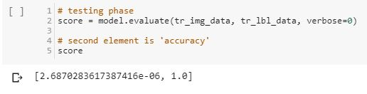
CHANGES:
proper reading of csv files with the day’s cutting
The score after:
adding the third layer,
doubling each convolutional one,
changing hardware interpreter from default to GPU (accelerator)

