Slide 1
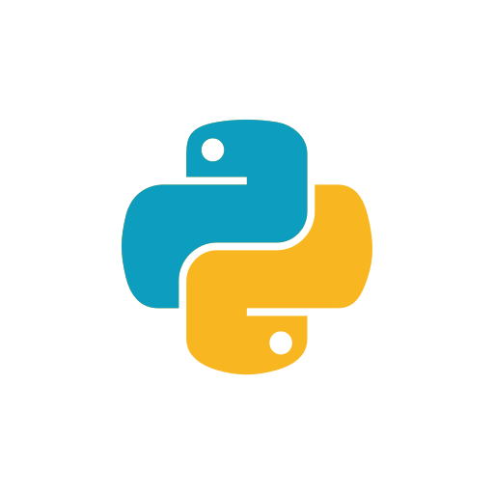
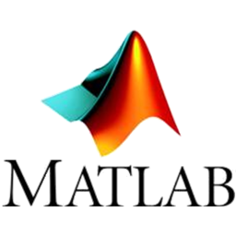

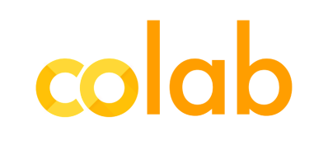

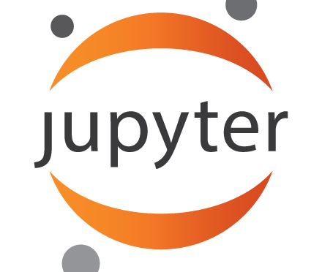
MLW PROJECT – KWIK 2018-2019
Celem projektu jest porównanie możliwości analizy danych, zarówno statystycznej oraz z użyciem mechanizmów AI.
PAWEŁ CIŚLIK
DOMINIKA DRĄŻYK

Slide 2
MLW PROJECT – GitHub
Classic biosignal data approach
Bayes biosignal data approach
Bayes behavioural data approach
EEG data approach (preprocessing)
Machine learning biosignals approach
Semestral summaries (presentations)
MLW_PROJECT_2019

Slide 3
MLW PROJECT – GitHub
Classic biosignal data approach
Bayes biosignal data approach
Bayes behavioural data approach
EEG data approach (preprocessing)
Machine learning biosignals approach
presentation/doc explaining the content
small summay README
initial dataset
transient dataset
analysis code
Semestral summaries (presentations)
MLW_PROJECT_2019

Slide 4
CLASSIC BIOSIGNAL DATA APPROACH
data import
definition of variables and outliers removal
descriptive analysis and histograms
hypothesis testing
(ANOVA, regression, t-test, multi comp)
data and results visualization

Slide 5

FINDING No. 1
R better for beginners – code is less elegant
- but easier to comprehend
- output as ready-to go interpretation
- tidyverse package
Python (pandas) better to preprocess biosignals
- code is clear (for programmers)
- the output is ‘just numbers’
- preprocessing and the stat analysis in one code

Slide 6
BAYES BIOSIGNAL DATA APPROACH
data import
definition of variables and outliers removal
descriptive analysis and histograms
hypothesis testing
(BRMS models, bayes factor)
data and results visualization

Slide 7
FINDING No. 2
Jupyter goes not so well with STAN …
- troubles setting kernel with STAN
- BRMS model compilation longer
RStudio mor stable with STAN
- but still we recommend to shut down all the background memory occupants before compiling

Slide 8
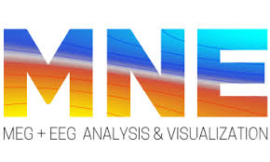


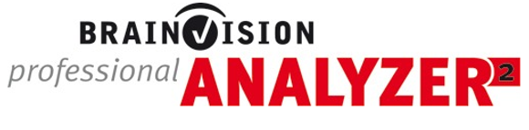
EEG DATA APPROACH
data import (file format transformations)
epochs definitions
preprocessing (is a hell whatever you do)
ICA /PCA and results visualization

Slide 9
FINDING No. 3
For mor complicated epoch definitions:
you have to use Matlab + FieldTrip / EEGLab syntax or MNE Python
For data preprocessing:
non-programmers:
the good is MNE Python or EEGLab GUI (free)
the best is Brain Vision Analyzer (~12 000$)
programmers:
Matlab + FieldTrip/EEGLab syntax (free) (you can do things the 12 000 $ licence cannot )

Slide 10
FINDING No. 3
B VA and EEGLab GUI
needs specified data type, otherwise may create problems
BVA
lacks some functions
you have to follow the path of consecutive steps, a mistake
sometimes requires starting all over again
non-flexible when doing data visualization
Matlab + FieldTrip
hell for non-programmers,
the most powerfull tool

Slide 11
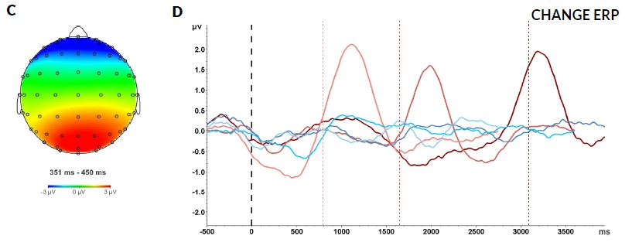
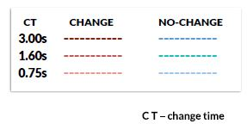
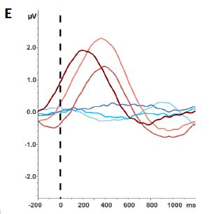
A PROOF
elements of graphics powered by Photoshop
legend powered by Office 365
onset line powered
by Paint
aprox. time spent on searching for those functions in BVA – 5 hours
it all looks better when done in Matlab anyway

Slide 12

MACHNE LEARNING BIOSIGNAL DATA APPROACH
data import
transforming bio-data to plots (images)
creating training – testing data
hypothesis testing
(sequential models, basic neural network)
results evaluation (accuracy)

Slide 13
MACHNE LEARNING BIOSIGNAL DATA APPROACH
data import
transforming bio-data to vectors
creating training – testing data
hypothesis testing
(sequential models, basic neural network)
results evaluation (accuracy)

Slide 14
FINDING No. 4
Colaboratory has poor data storage idea
mounting with Drive also bad idea…
better use with GitHub
bio-data as images analysis
super-easy to do
something is computing … then numbers pop-up
accuracy seems obscenely high …
… so something is wrong, we probably have no idea what is going on
bio-data as vectors analysis
hell to prepare data that way
then : something is computing -> no idea whats going on

Slide 15
FINDING No. 5 – a tale of two tools
Anaconda Environment / Jupiter Notebook (python, R)
good idea to start your programming adventure
does not support Matlab
has troubles with STAN for R
you need internet connection
Colaboratory Environment / Jupiter Notebook (python, R)
good idea for creating group work space
you can create workshops, presentations, tutorials that way
poor big-data storage
you need internet connection
To be honest after all, we are still using Rstudio, PyCharm and Matlab with GitHub version control …

Slide 16
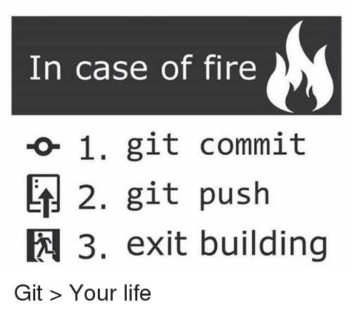
END.

