Slide 1
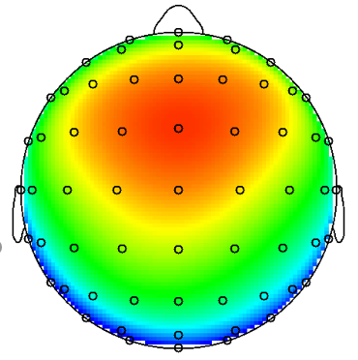
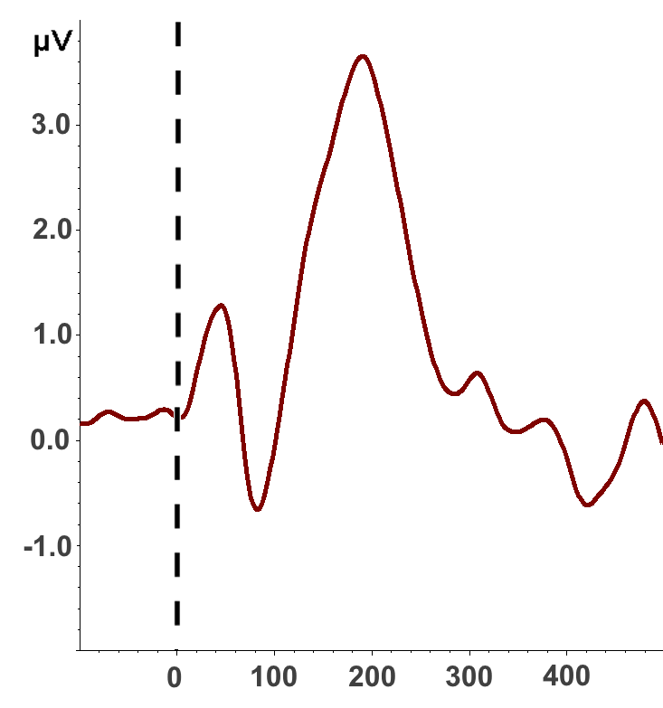

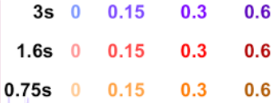
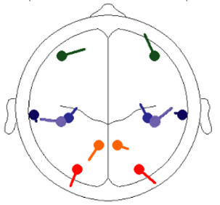
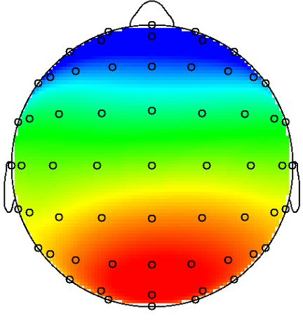
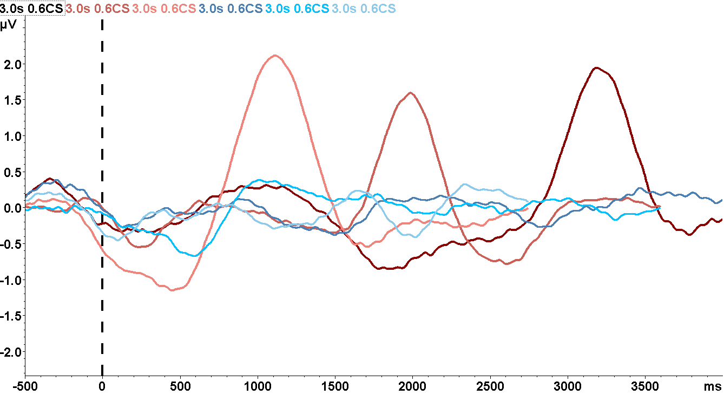
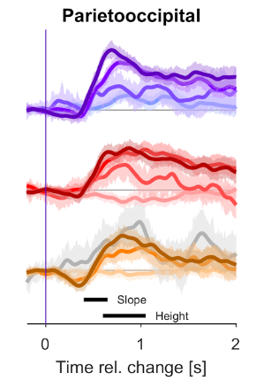

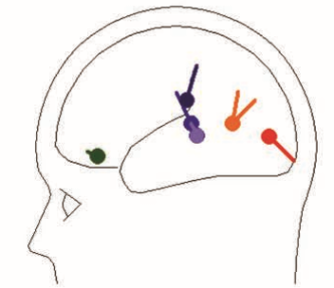
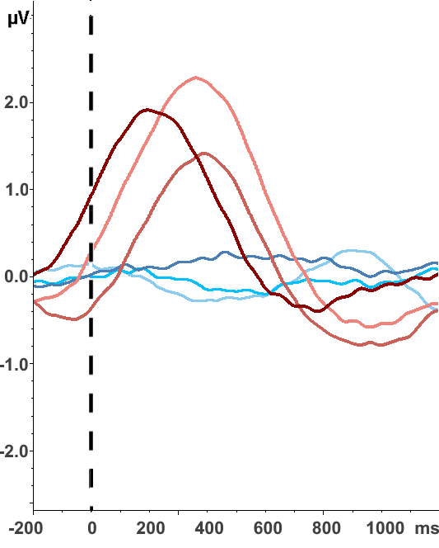
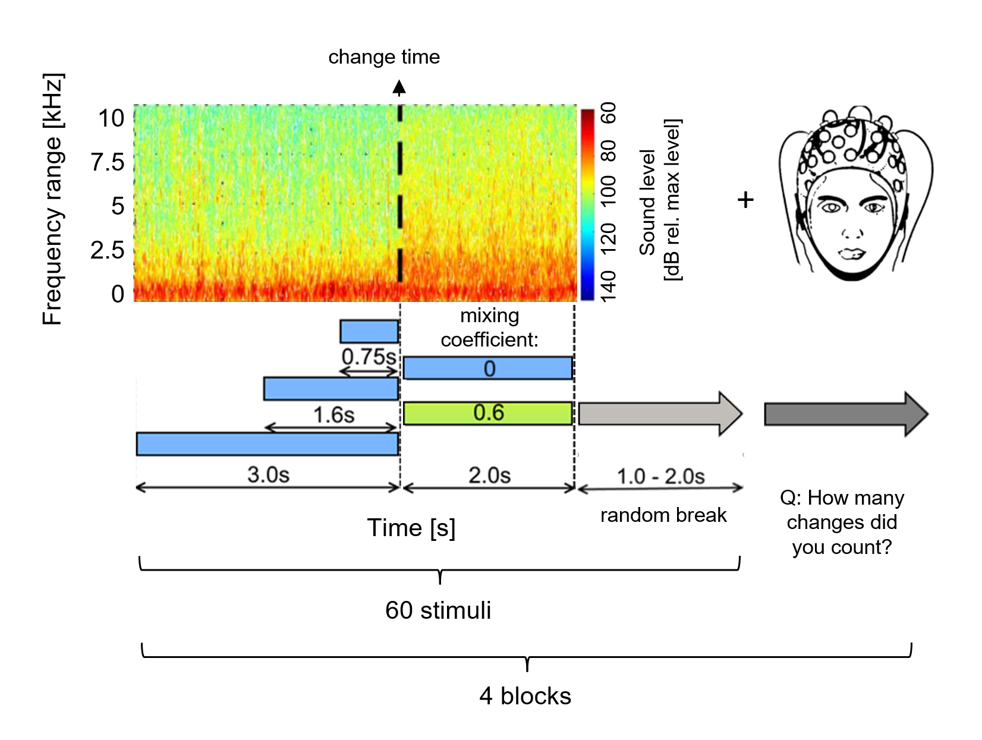





COUNTING CHANGES IN COMPLEX ACOUSTIC ENVIRONMENTS.
Paweł CIŚLIK ¹, Dominika DRĄŻYK ², Bernhard ENGLITZ ³, Urszula GÓRSKA ^{3,4}
¹ Institute of Psychology, Jagiellonian University, Krakow, Poland
² Cognitive Science Laboratory, Institute of Philosophy, Jagiellonian University, Krakow, Poland
³ Department of Neurophysiology, Donders Institute, Radboud University Nijmegen, The Netherlands
⁴ Psychophysiology Laboratory, Institute of Psychology, Jagiellonian University, Krakow, Poland
−
Background

Results
WHAT IS AN NATURAL AUDITORY TEXTURE?
A
B
P2
ONSET ERP
Natural sound (e.g. wind or rain), that could be characterized on the statistical level (Boubenec et al., 2016; Kelly & O'Connell, 2013) and, although having variable spectro- temporal profile, can be easily classified by human (McDermott & Simoncelli, 2011).
A. The scalp distribution of the P2 component (180-219ms) is centered with a slight asymmetry towards the front.
Data were averaged over all stimuli.
B. An onset of an auditory stimulus creates classical complex, with a negative component (N1, peak at 82 ms) followed by a positive component (P2, peak at191 ms).
CHANGE DETECTION
ERP analysis
N1
During the change detection tasks, textures evoke late parieto-occipital (PO) potential (related to: O’Connell et al., 2012) that scales with the amount of evidence given (Boubenec et al., 2017).
Longer sampling time was found associated with its increasing slope and amplitude. PO activity depends also on the level of active processing (Gorska et al., 2018).
MC – mixing coefficient
C
D
CHANGE ERP
Source analysis
From Gorska et al., 2018.
E
CT CHANGE NO-CHANGE
3.00s ----------- -----------
1.60s ----------- -----------
0.75s ----------- -----------

Methods
OUR APPROACH:
to verify change detection process during active engagement in counting task, by investigating the occurrence and the characteristics of late parieto-occipital (PO) potential
C T – change time
Participants:
13 healthy volunteers (mean age 27.2 SD 5.3; 8 females, higher education). All of them did not reported any known hearing problem.
Table. PO potential amplitude and delay in different change-time and change/no-change conditions.
 | 0.75s | 1.60s | 3.00s | 0.75s | 1.60s | 3.00s
AMPLITUDE [𝞵V] | 0.05 | 0.4 | 0.1 | 2.2 | 1.6 | 2.0
DELAY [ms] | 750 | 1000 | 900 | 1100 | 2000 | 3200
Stimuli:
240 natural auditory textures stimuli with slightly different statistics; half of them changed their statistics (e.g. from rain to bubbles) at the random time (0.75s, 1.6s or 3.0s)
C. The scalp distribution of the parieto-occipital potential (351 - 450 ms the change). Data were averaged over all stimuli from 0.75s change condition.
D. Parieto-occipital electrodes aligned to stimulus onset. Change in statistics leads to premature ERP with the greater amplitude comparing to trials where there was no change.
E. Parieto-occipital electrodes aligned to change in statistics. The amplitude and slope of the PO potential varies for different change times; amplitude is the greatest for 0.75s, lower for 3.0s and the lowest for 1.6s, while the 3.0s condition starts faster, 0.75s later and the 1.6s last.
Procedure:

Discussion
BioSemi 64 electrodes system (10-20 system),
The amplitude of the PO potential tends to reversely scale with the time the texture was sampled.
The increase in cognitive load and the time of rote rehearsal could cause the attenuation of the response for the longest change times .
Subject could form expectation of maximal sound duration and consequently expect more the change that occur later than sooner (as in Boubenec et al., 2017) and moreover of the time of the change as the multiple of the most common CTs, what was reflected by a continued accumulation of evidence even before the change.
The current paradigm served as one of the tests of change detection in naturalistic stimuli towards the method for diagnosing patients with disorders of consciousness (PDOC)
Data analysis:
Preprocessing: downsampling to 512Hz, average reference, artifact rejection (amplitude limits +/- 200µV, maximal voltage step 250µV/ms), 0.1 Hz high-pass to 40 Hz low-pass filters,
Epochs segmentation :
relative to stimulus onset: -500 to 2000 ms (baseline -200 to 0 ms) from ‘Cz’, ‘C1’, ‘C2’ channels;
relative to change: -200 ms to 2000 ms (baseline -200 to 0 ms) from ‘Pz’ and ‘POz’ channels.
The analysis was performed in Brain Vision Analyzer 2 (Brain Products, Gilching, DE)
REFERENCES:
Boubenec, Y., Lawlor, J., Górska, U., Shamma, S., Englitz, B., 2017. Detecting changes in dynamic and complex acoustic environments. elife 6.
Górska U., Rupp A., Boubenec Y., Celikel T., Englitz B. (2018) Evidence Integration in Natural Acoustic Textures during Active and Passive Listening, eNeuro 5(2),
Kelly S. P., O’Connell R. G. (2013) Internal and external influences on the rate of sensory evidence accumulation in the human brain. J Neurosci 33:19434–19441
McDermott J. H., Simoncelli E. P. (2011) Sound texture perception via statistics of the auditory periphery: evidence from sound synthesis. Neuron 71:926–940.
O’Connell, R.G., Dockree, P.M., Kelly, S.P., 2012. A supramodal accumulation-to-bound signal that determines perceptual decisions in humans. Nat. Neurosci. 15, 1729–1735..
C-Lab
→
u.j.gorska@gmail.com

