Slide 1
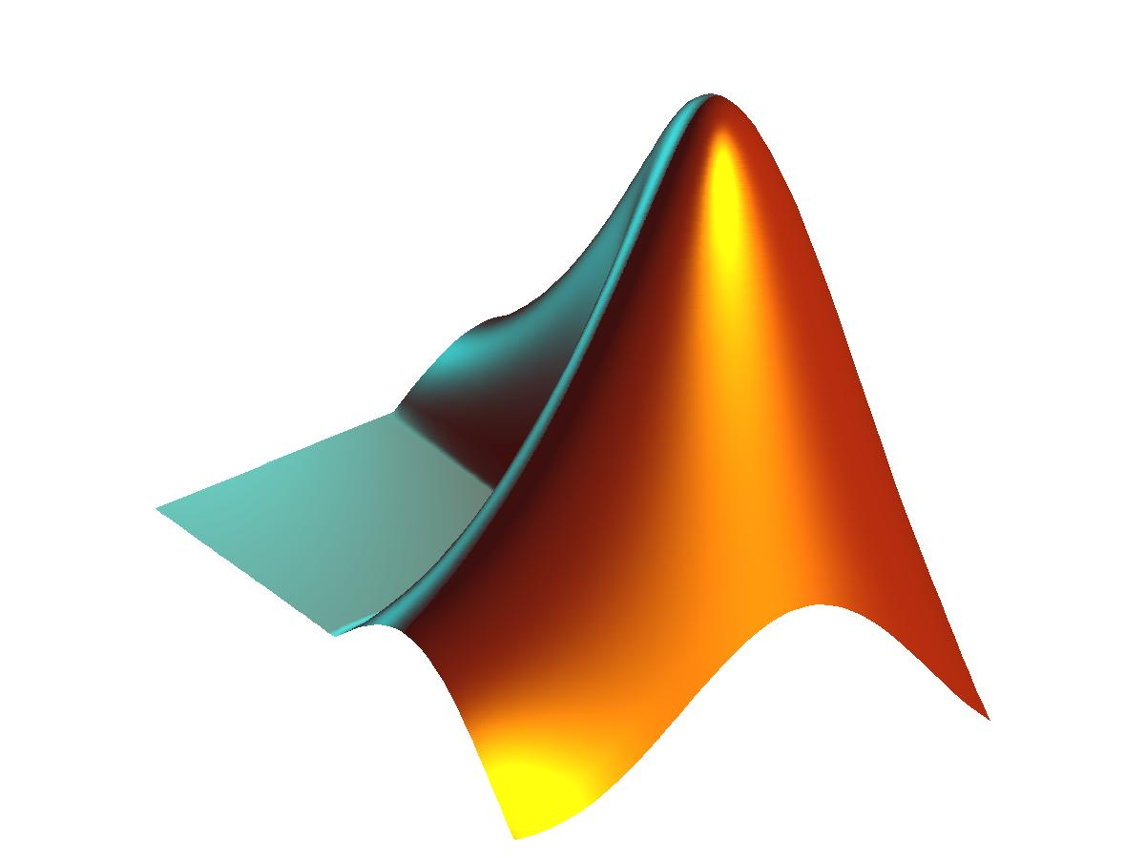
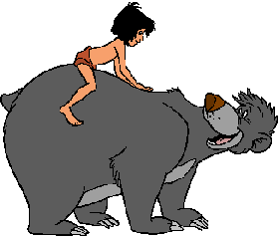
Toolbox Balu
© GRIMA, DCC-UC
http://dmery.ing.puc.cl/index.php/balu/

Slide 2
Tutorial: Toolbox Balu
Domingo Mery
Machine Intelligence Group
Department of Computer Science
Universidad Católica de Chile
http://dmery.ing.puc.cl

Slide 3
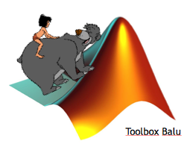
TUTORIAL BALU:
Presentation:
http://bit.ly/1VbNXih
Examples:
http://bit.ly/1FiQVdJ

Slide 4
Toolbox Balu
More than 200 functions for image processing, feature extraction, feature transformation, feature analysis, feature selection, data selection and generation, classification, clustering, performance evaluation, multiple-view analysis, image sequence processing and tracking with geometrical constraints, see examples.
http://dmery.ing.puc.cl/index.php/balu/

Slide 5
Collaboration
Many improvements and codes were developed by:
Sandipan Banerjee
Patricio Cordero
Esteban Cortázar
Rodrigo González
James Kapaldo
German Larrain
Gabriel Leiva
Daniel Maturana
Carlos Mena
Cristobal Moenne
Germán Mondragón
Diego Patiño
Christian Pieringer
Vladimir Riffo
Alvaro Soto
Gabriel Tejeda
Irene Zuccar
If you want to collaborate please send me an e-mail

Slide 6
Copyright
Copyright 2007-2015 by Group of Machine Intelligence (GRIMA), Department of Computer Science, Universidad Catolica - Chile
All rights reserved. This work is licensed under a Creative Commons Attribution-Noncommercial-Share Alike 2.5 Generic License.
Permission to use, copy, or modify these programs and their documentation for educational and research purposes only and without fee is hereby granted, provided that this copyright notice appears on all copies and supporting documentation. For any other uses of this software, in original or modified form, including but not limited to distribution in whole or in part, specific prior permission must be obtained from Pontificia Universidad Catolica de Chile. These programs shall not be used, rewritten, or adapted as the basis of a commercial software or hardware product without first obtaining appropriate licenses from the Pontificia Universidad Catolica de Chile. Pontificia Universidad Catolica de Chile makes no representations about the suitability of this software for any purpose. It is provided "as is" without express or implied warranty.
NOTES:
Certain Balu functions use commands of the followings toolboxes: VLFeat, Image Processing, Bioinformatics, and Neural Netowrks. It is necessary to install this toolboxes if you want to use these Balu functions.
Certain neural network functions were implemented based on NetLab Toolbox: (c) 1996-2001, Ian T. Nabney, All rights reserved. Nabney, I.T. (2003): Netlab: Algorithms for Pattern Recognition, Advances in Pattern Recognition, Springer.
Certain Local Binary Patterns functions were implemented based on code written by Heikkila & Ahonen (see http://www.cse.oulu.fi/MVG/Research/LBP) all rights reserved.
Partial Least Squares Regression was implemented based on code developed by Gelady (see http://www.cdpcenter.org/files/plsr ).

Slide 7
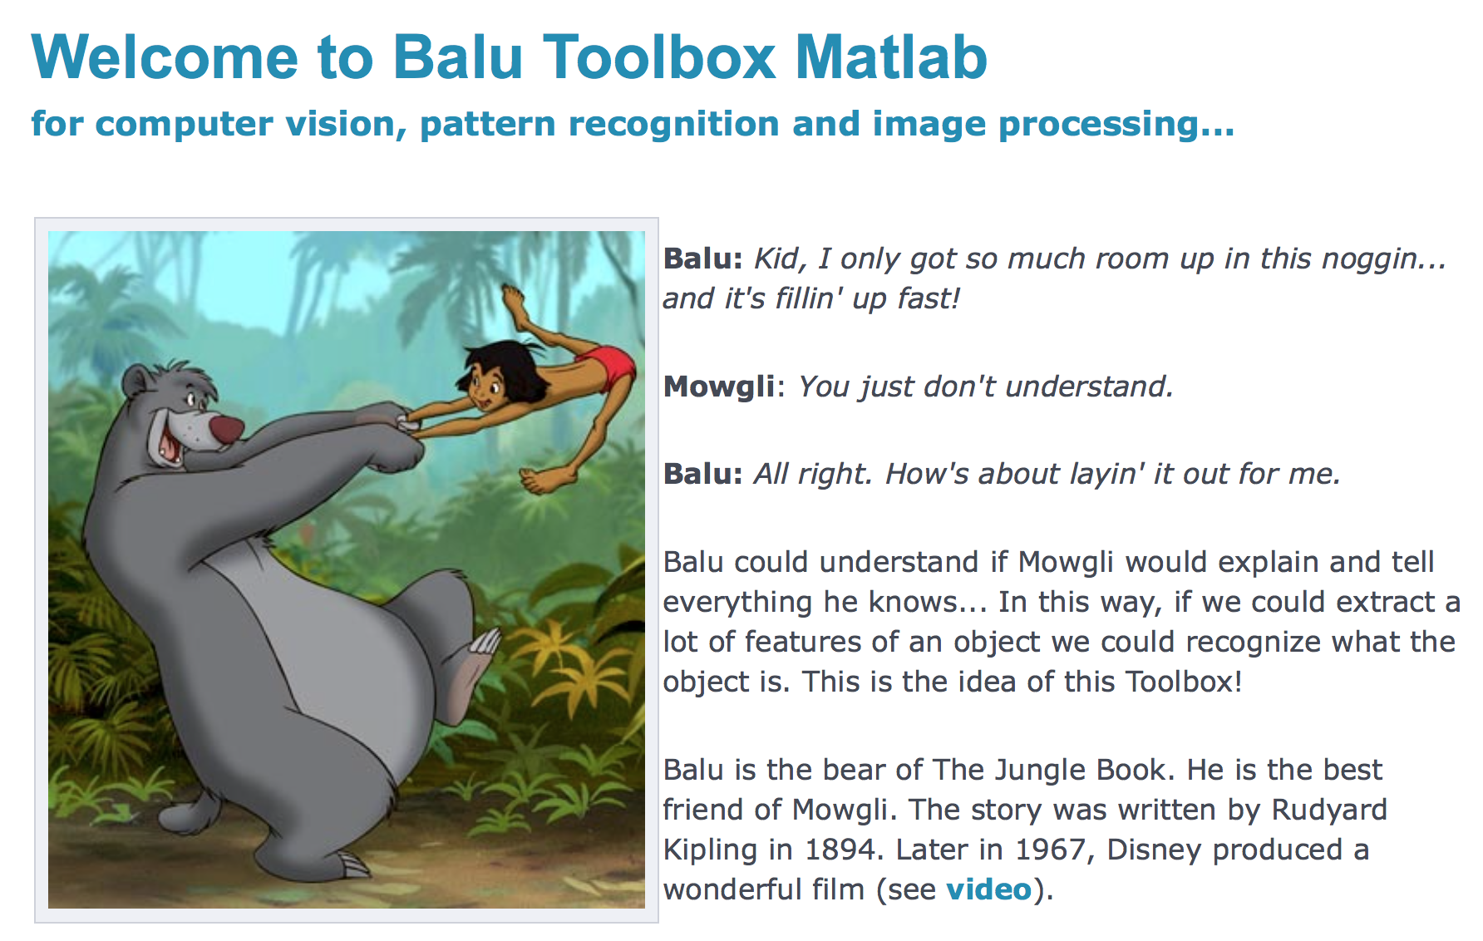

Slide 8
B
im
fx
fs
ft
cl
mv
ct
ev
io
IMAGE PROCESSING
FEATURE EXTRACTION
INPUT & OUTPUT
FEATURE SELECTION
EVALUATION
FEATURE TRANSFORMATION
CLUSTERING
MULTIPLE VIEWS
CLASSIFICATION

Slide 9
B
im
fx
fs
ft
cl
mv
ct
ev
io
IMAGE PROCESSING
FEATURE EXTRACTION
INPUT & OUTPUT
Bfx_gabor
FEATURE SELECTION
EVALUATION
FEATURE TRANSFORMATION
CLUSTERING
MULTIPLE VIEWS
CLASSIFICATION

Slide 10
B
im
fx
fs
ft
cl
mv
ct
ev
io
IMAGE PROCESSING
FEATURE EXTRACTION
INPUT & OUTPUT
FEATURE SELECTION
EVALUATION
FEATURE TRANSFORMATION
CLUSTERING
MULTIPLE VIEWS
CLASSIFICATION

Slide 11
B
im
fx
fs
ft
cl
mv
ct
ev
io
IMAGE PROCESSING
FEATURE EXTRACTION
INPUT & OUTPUT
FEATURE SELECTION
EVALUATION
FEATURE TRANSFORMATION
CLUSTERING
MULTIPLE VIEWS
CLASSIFICATION
Bcl_knn

Slide 12
Feature Extraction

Slide 13
B
im
fx
fs
ft
cl
mv
ct
ev
io
IMAGE PROCESSING
FEATURE EXTRACTION
INPUT & OUTPUT
Bfx_gabor
FEATURE SELECTION
EVALUATION
FEATURE TRANSFORMATION
CLUSTERING
MULTIPLE VIEWS
CLASSIFICATION

Slide 14
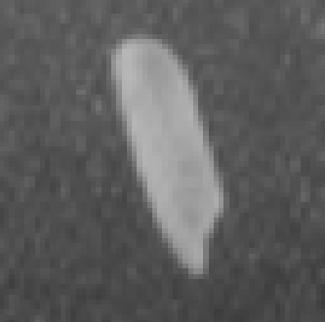
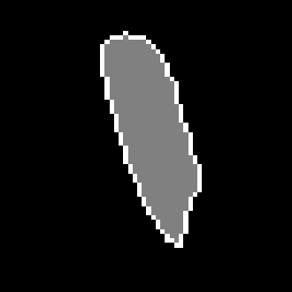
a) Grayscale image b) Segmentation c) 3D representation of a)
There are two categories of features: Geometric Features and
Intensity Features
Geometric Features give information about location, orientation, shape and size.
Intensity Features give information about how are the grayvalues.

Slide 15
How to extract
Geometric Features
with Balu

Slide 16
Command:
[X,Xn] = Bfx_name(R,options);
X: row vector of extracted features
Xn: name of each extracted feature
name: name of the group of features
R: binary image
options: options of features (if any)

Slide 17

Example: BASIC GEOMETRIC FEATURES
I = imread('onerice.bmp');
R = I>120;
[X,Xn] = Bfx_basicgeo(R);
Bio_printfeatures(X,Xn);
1 center of grav i [px] 29.299832
2 center of grav j [px] 33.705193
3 Height [px] 47.000000
4 Width [px] 22.000000
5 Area [px] 601.375000
6 Perimeter [px] 107.500000
7 Roundness 0.653941
8 Danielsson factor 2.253736
9 Euler Number 1.000000
10 Equivalent Diameter [px] 27.570347
11 MajorAxisLength [px] 48.089929
12 MinorAxisLength [px] 16.112265
13 Orientation [grad] -73.896848
14 Solidity 0.937206
15 Extent 0.577369
16 Eccentricity 0.942202
17 Convex Area [px] 637.000000
18 Filled Area [px] 597.000000

Slide 18
Example: HU MOMENTS
I = imread('onerice.bmp');
R = I>120;
[X,Xn] = Bfx_hugeo(R);
Bio_printfeatures(X,Xn);
1 Hu-moment 1 0.269010
2 Hu-moment 2 0.046196
3 Hu-moment 3 0.000291
4 Hu-moment 4 0.000081
5 Hu-moment 5 0.000000
6 Hu-moment 6 0.000013
7 Hu-moment 7 0.000000

Slide 19
Example: ELLIPSE
I = imread('onerice.bmp');
R = I>120;
[X,Xn] = Bfx_fitellipse(R);
Bio_printfeatures(X,Xn);
1 Ellipse-centre i [px] 33.691981
2 Ellipse-centre j [px] 28.915583
3 Ellipse-minor ax [px] 7.380073
4 Ellipse-major ax [px] 24.353387
5 Ellipse-orient [rad] -0.295048
6 Ellipse-eccentricity 0.303041
7 Ellipse-area [px] 564.637741

Slide 20
Example: SEVERAL GEOMETRIC FEATURES
% Input Image
I = imread('rice.png');
% Segmentation
[R,m] = Bim_segmowgli(I,ones(size(I)),40,1.5);
% Definition of features to be extracted
b(1).name = 'hugeo'; b(1).options.show=1; % Hu moments
b(2).name = 'basicgeo'; b(2).options.show=1; % basic geometric fetaures
options.b = b;
% Feature extraction
[X,Xn] = Bfx_geo(R,options);
% Processing after feature extraction
figure; hist(X(:,12));xlabel([Xn(12,:)]) % area histogram
ii = find(abs(X(:,20))<15); % rice orientation
K = zeros(size(R)); % between -15 and 15 grad
for i=1:length(ii);K=or(K,R==ii(i));end
figure; imshow(K);title('abs(orientation)<15 grad')

Slide 21
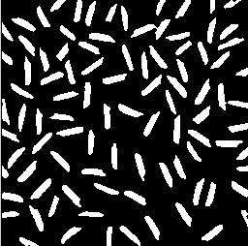
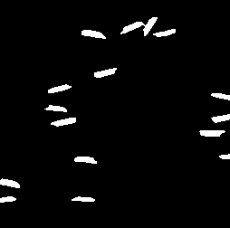

Slide 22
Example: HOW TO WRITE A NEW BALU FUNCTION (for feature extraction)
% [X,Xn] = Bfx_centroid(R,options)
%
% Toolbox: Balu
%
% Centroid of a region.
%
% options.show = 1 display mesagges.
%
% X(1) is centroid-i, X(2) is centroid-j
% Xn is the list of the n feature names.
%
% Example (Centroid of a region)
% I = imread('testimg1.jpg'); % input image
% R = Bim_segbalu(I); % segmentation
% imshow(R);
% options.show = 1;
% [X,Xn] = Bfx_centroid(R,options);
% Bio_printfeatures(X,Xn)
%
function [X,Xn] = Bfx_centroid(R,options)
if options.show == 1
disp('--- extracting centroid...');
end
[Ireg,Jreg] = find(R==1); % pixels in the region
ic = mean(Ireg);
jc = mean(Jreg);
X = [ic jc];
Xn = [ 'Centroid i '
'Centroid j ']; % 24 characters per name
if options.show == 1
clf
imshow(R)
hold on
plot(X(2),X(1),'rx')
enterpause
end
This example show how to
compute the centers of mass

Slide 23
How to extract
Intensity Features
with Balu

Slide 24
Command:
[X,Xn] = Bfx_name(I,R,options);
X: row vector of extracted features
Xn: name of each extracted feature
name: name of the group of features
I: grayscale image
R: binary image -> [ ] for the whole image
options: options of features (if any)

Slide 25
Example: BASIC INTENSITY FEATURES
I = imread('onerice.bmp');
R = I>120;
options.mask = 5; % Gauss mask
options.show = 1; % Display results
[X,Xn] = Bfx_basicint(I,R,options);
Bio_printfeatures(X,Xn);
1 Intensity Mean 161.132328
2 Intensity StdDev 13.082633
3 Intensity Kurtosis 4.044382
4 Intensity Skewness -1.096439
5 Mean Laplacian -6.871022
6 Mean Boundary Gradient 41.875637

Slide 26

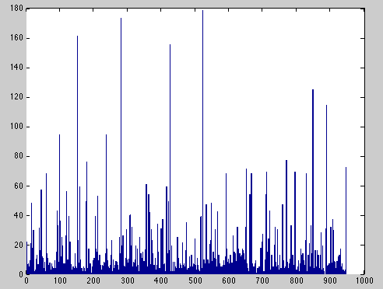
Example: LBP
I = imread(’face0304.bmp');
I = imresize(I,[110 90]);
options.vdiv = 4;
options.hdiv = 4;
options.samples = 8;
options.mappingtype = 'u2';
[X,Xn] = Bfx_lbp(I,[],options);
bar(X)

Slide 27
Example: SEVERAL INTENSITY FEATURES
See help Bfx_int

Slide 28
Graphic User Interface
Bfx_gui
It is used to extract features in many image
1. go to the folder of the images
2. Bfx_gui <Enter>

Slide 29
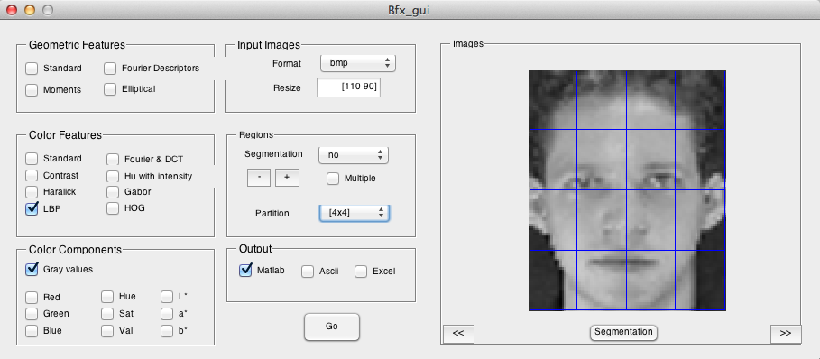
Press go, drink a coffee and wait!
The results will be stored in file Bfx_results.mat

Slide 30
Classification

Slide 31
B
im
fx
fs
ft
cl
mv
ct
ev
io
IMAGE PROCESSING
FEATURE EXTRACTION
INPUT & OUTPUT
FEATURE SELECTION
EVALUATION
FEATURE TRANSFORMATION
CLUSTERING
MULTIPLE VIEWS
CLASSIFICATION
Bcl_knn

Slide 32
How to use
the classifiers
of Balu

Slide 33
YOU NEED:
Training Data X= d=
X: N samples, each sample is a vector of p features
d: Labels, annotations (class for each sample)
p
1
N
N

Slide 34
YOU NEED:
Testing Data Xt= dt=
Xt: Nt samples (of p features)
dt: Nt Labels, annotations
p
1
Nt
Nt

Slide 35
YOU NEED:
Classifier:
Name of the classifier (KNN, LDA, SVM…)
Options of the classifiers (k for KNN, kernel for SVM, etc…)

Slide 36
SYNTAX (Training & Testing)
ds = Bcl_name(X,d,Xt,options)
Example 1: Example 2:
% KNN with k = 5 % LDA with p = (1/4 3/4);
options.k = 5; options.p = [0.25 0.75];
ds = Bcl_knn(X,d,Xt,options); ds = Bcl_lda(X,d,Xt,options);
ds is a Nt x 1 vector with the classification of each testing sample. To compute the performance:
p = Bev_performance(ds,dt);

Slide 37
3. SYNTAX (Training only)
op = Bcl_name(X,d,options)
Example 1: Example 2:
% KNN with k = 5 % LDA with p = (1/4 3/4);
options.k = 5; options.p = [0.25 0.75];
op = Bcl_knn(X,d,options); op = Bcl_lda(X,d, options);
All parameters of the classifier that were estimated

Slide 38
4. SYNTAX (Testing only)
You need the parameters ‘op’ computed in last step.
ds = Bcl_name(Xt,op)
Example 1: Example 2:
% KNN with k = 5 % LDA with p = (1/4 3/4);
ds = Bcl_knn(Xt,op); op = Bcl_lda(Xt,op);

Slide 39
Toolbox Balu
© GRIMA, DCC-UC
http://dmery.ing.puc.cl/index.php/balu/

