Slide 1
Tackling knowledge gaps about food webs with trait-based models
Dominique Caron*, Luigi Maiorano, Wilfried Thuiller, Laura Pollock

Slide 2
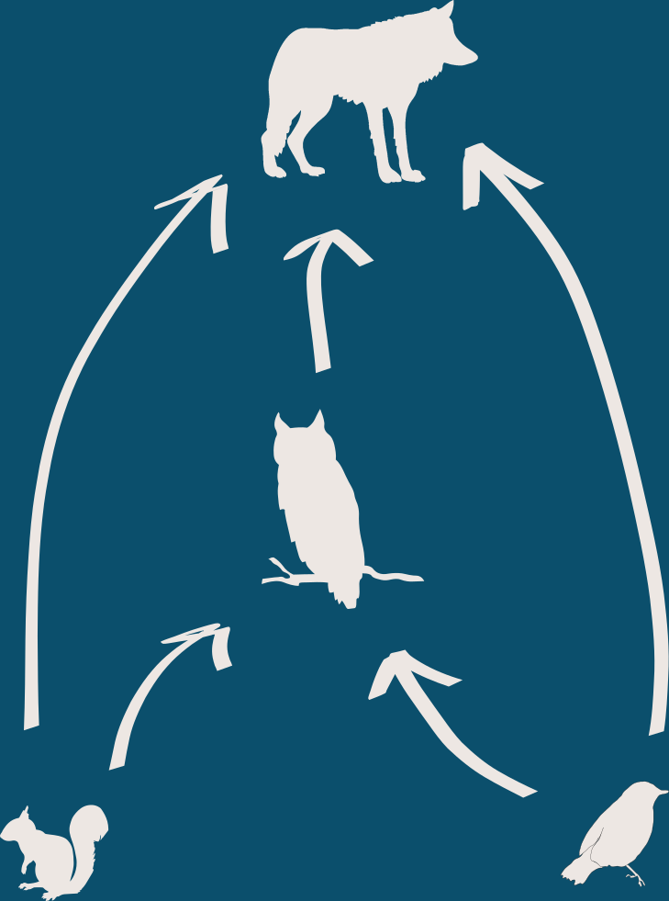
Introduction

Slide 3
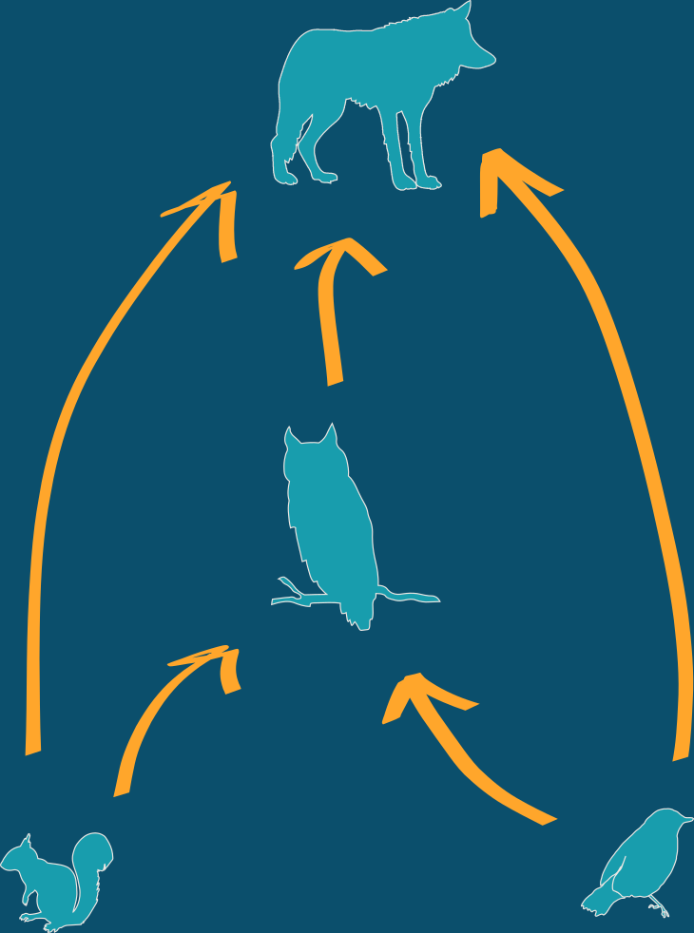
Introduction
Ecosystem functions:
- Stability
- Nutrient cycling
- Energy flow
- Population regulation
Theory:
- Community assembly
- Biogeography
- Niche
- Eco-evolutionary dynamics
Applications:
- Species role
- Trophic cascades
- Co-extinction

Slide 4
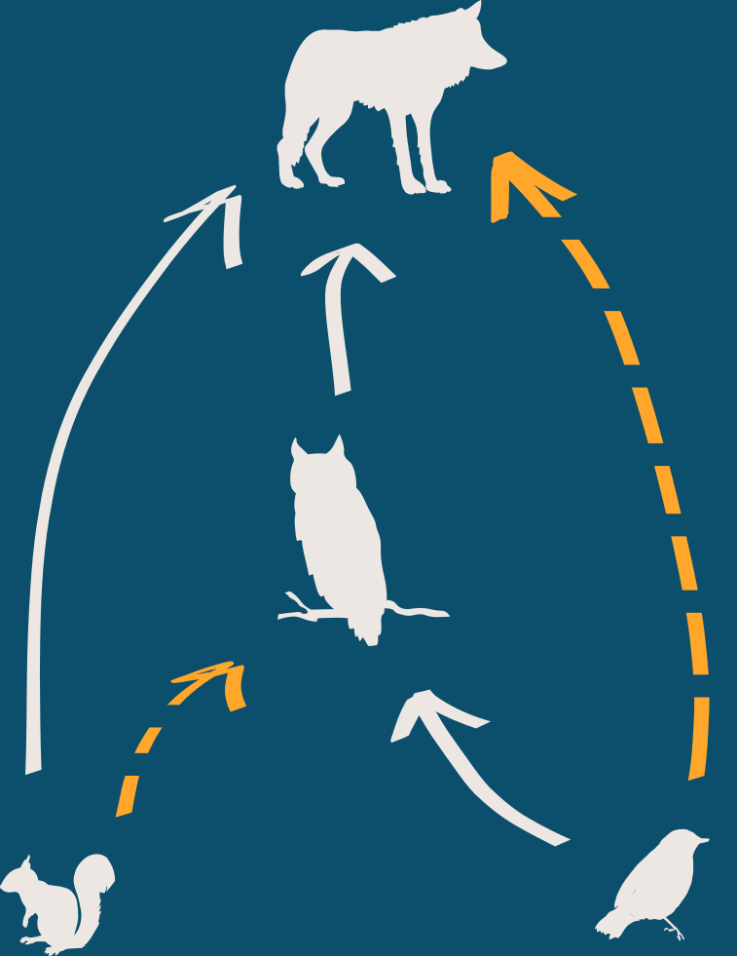
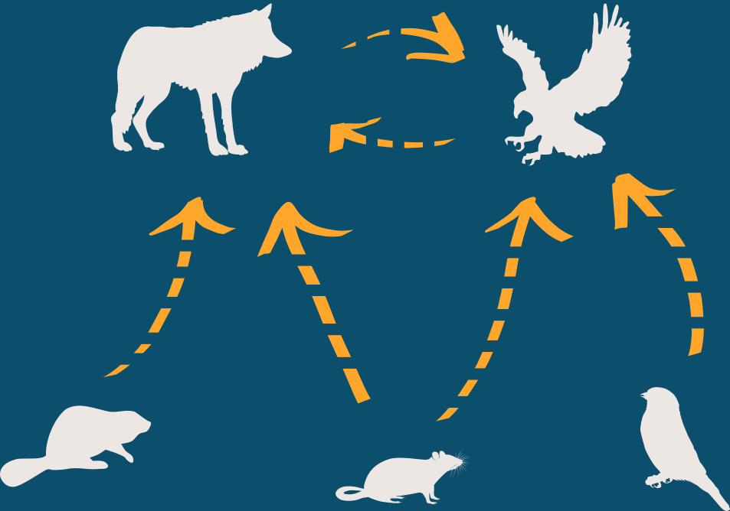
Introduction
Within food web predictions:
Across food web predictions:

Slide 5
Questions
1. How much information are needed to make reliable within food web predictions ?
2. What factors limits across food web predictions?
3. How well can we predict species trophic roles with interaction models?

Slide 6





Methods
Bayesian Generalized Linear Model:
foraging ability of the predator
e.g., foraging strategy
Pr( ) = f( traits+ traits + trait-match )
vulnerability of the prey
e.g., body mass
functional match
e.g., activity time

Slide 7
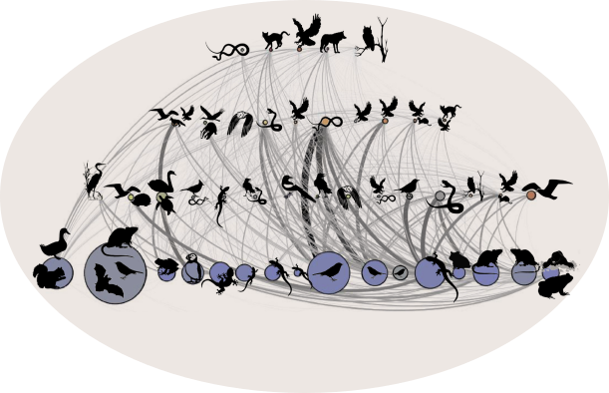
Q1 Within food web predictions ? - Methods
Data
Food web of European tetrapods
~ 1k species
~ 71k pairwise interactions
Variables
Independent variable:
Size of calibration dataset
Dependent variable:
Model performance

Slide 8
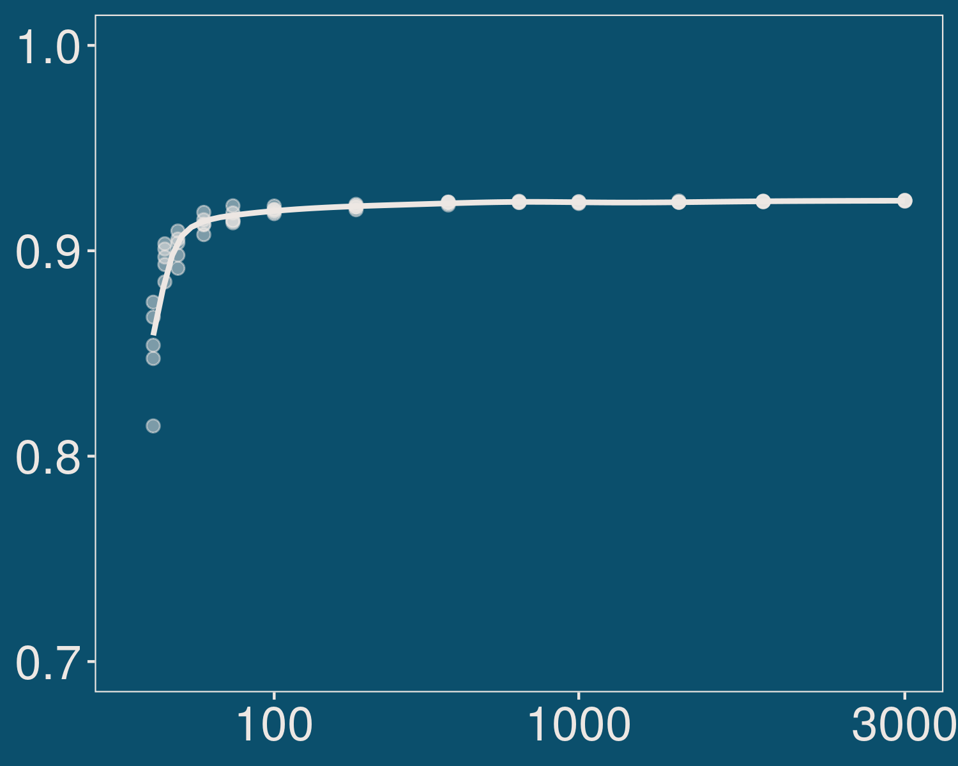
Q1 Within food web predictions ? - Results
- Performance peaks at a very small training dataset
- A relatively simplistic model predicts most interactions well
AUC
# of interactions for calibration

Slide 9
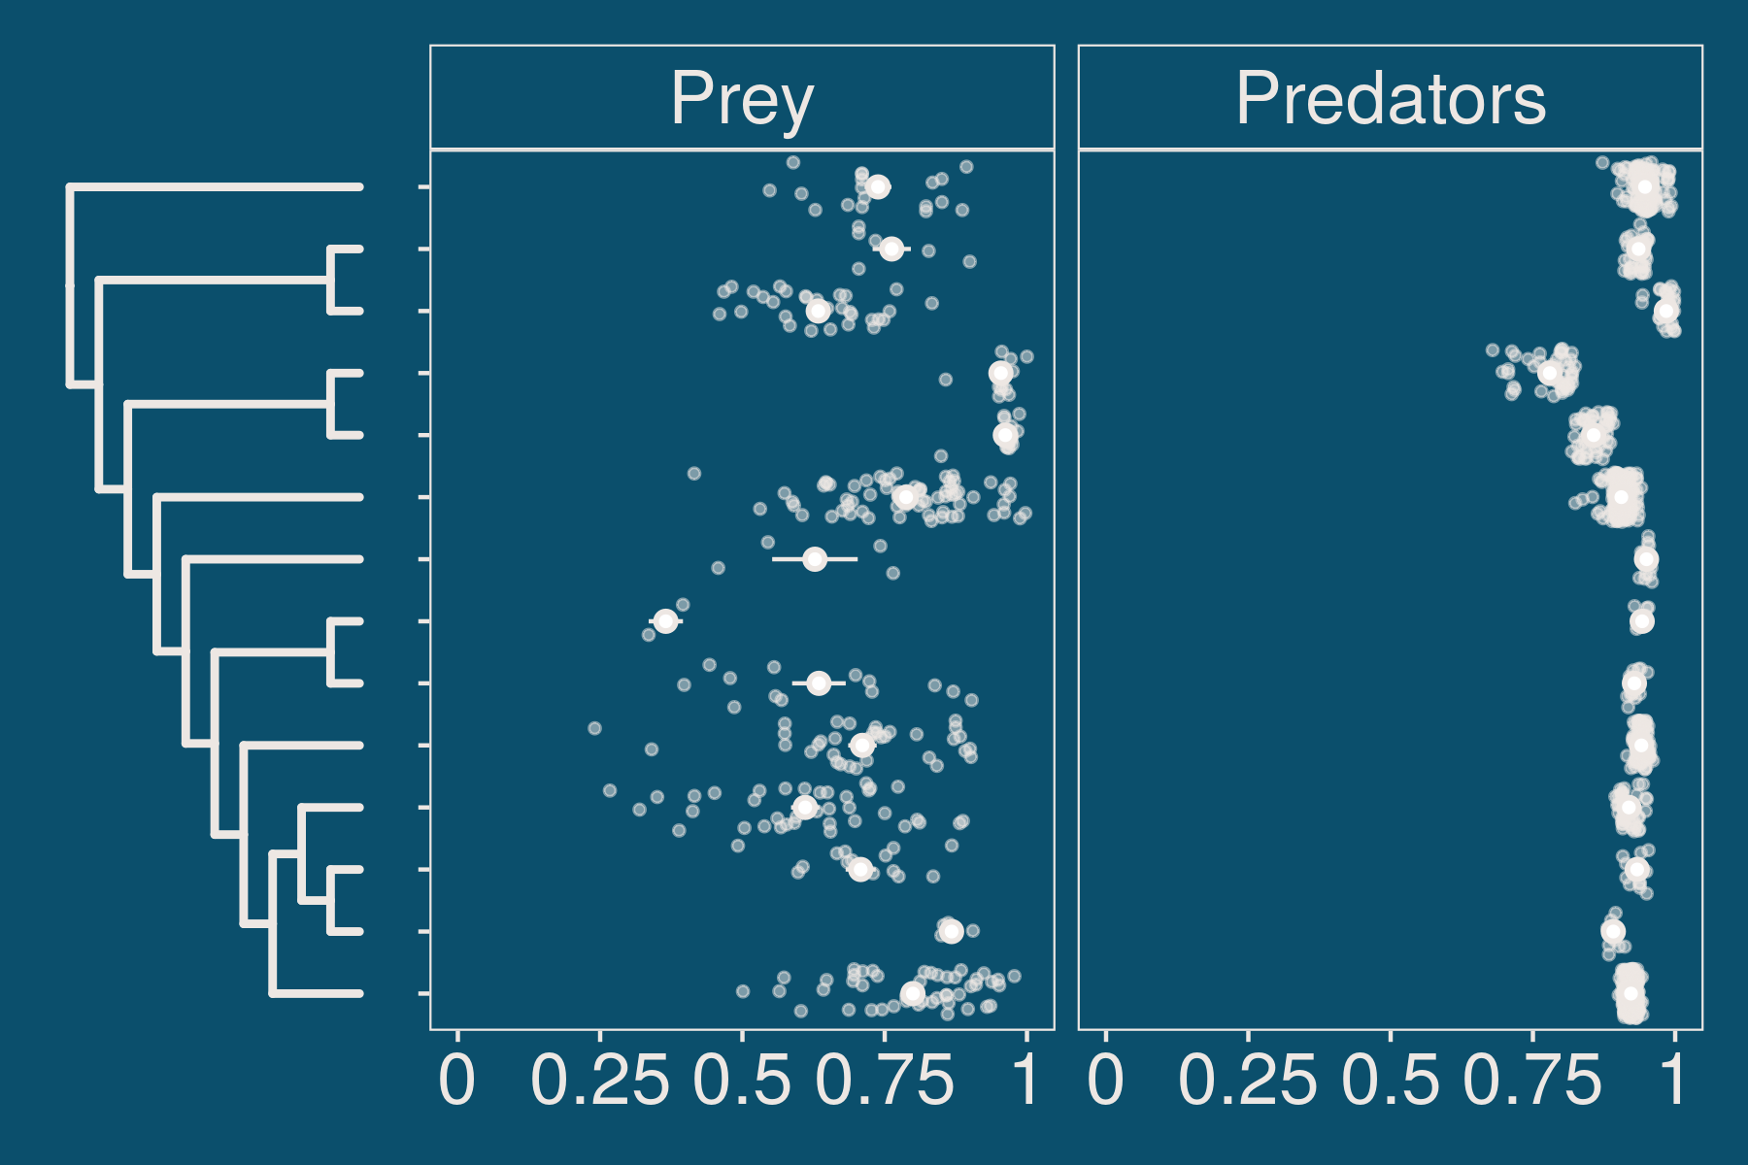
Q1 Within food web predictions ? - Results
- Prey of some species order are not well predicted
- Predators of most species are well predicted
AUC

Slide 10
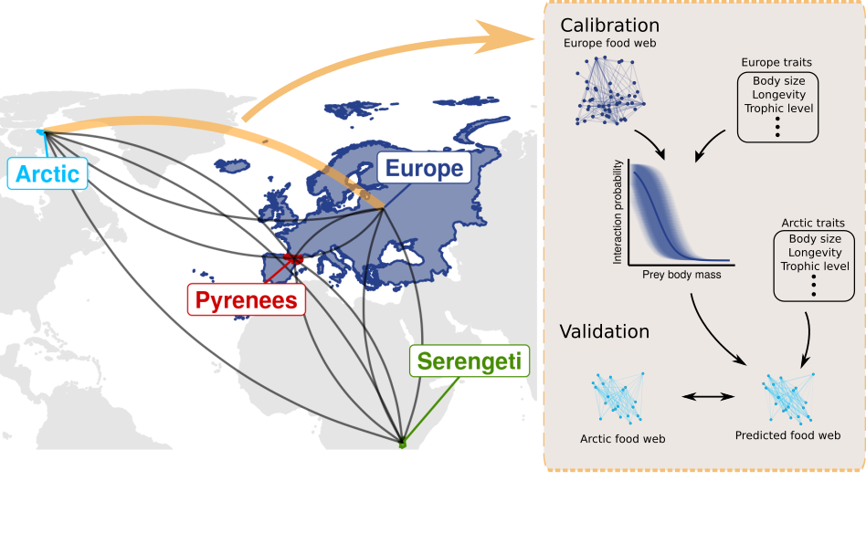
Q2 Across food web predictions - Methods

Slide 11
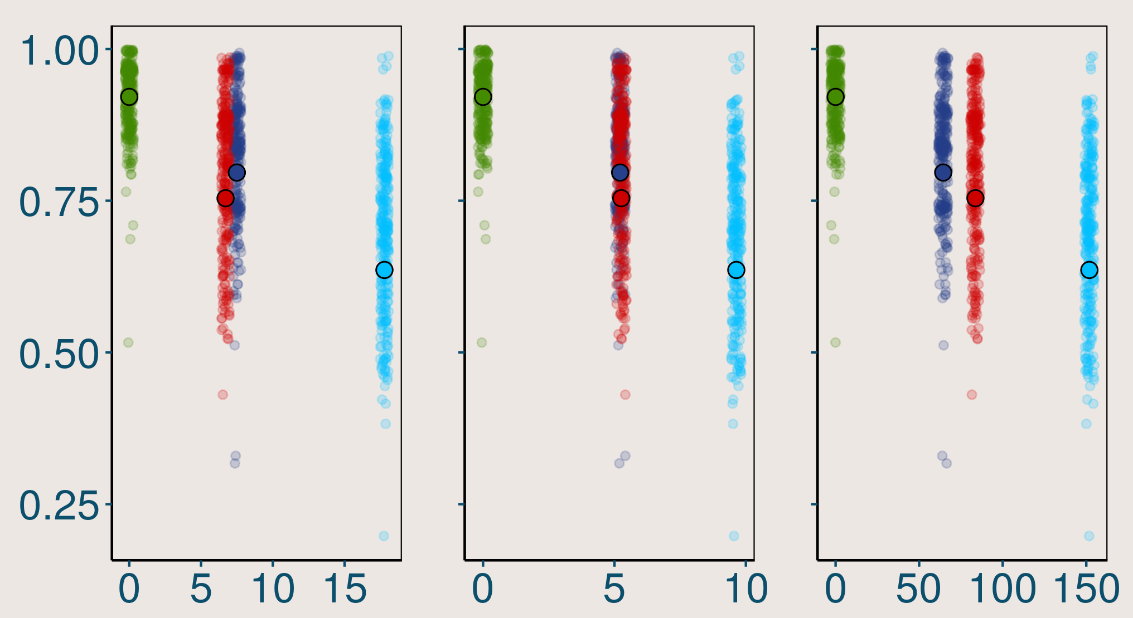
Q2 Across food web predictions - Methods
Predicting the Serengeti food web
Model
#
Arctic
Europe
Pyrenees
AUC
Serengeti
Geo distance
Env distance
Phylo distance

Slide 12

Q3 Trophic role predictions - Methods

Slide 13
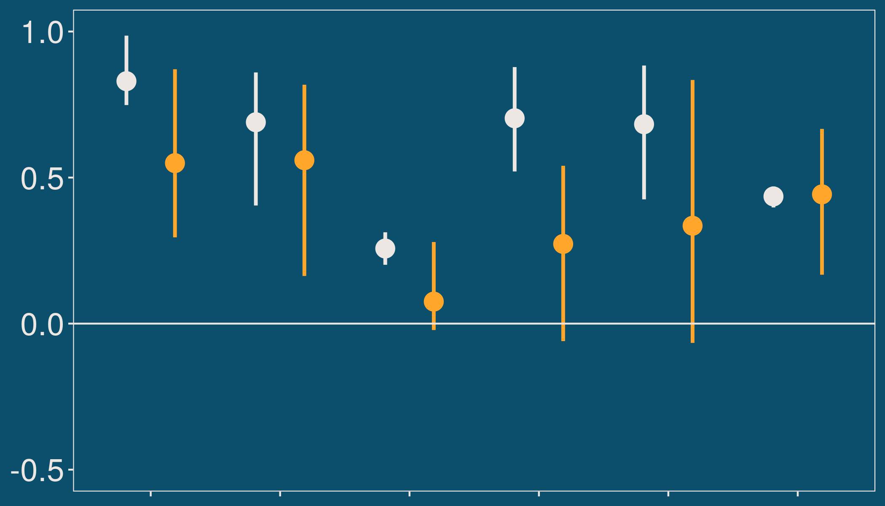
Q3 Trophic role predictions - Results
Within food web
Across food web
# of prey
eigenvector
omnivory
# of predators
betweeness
trophic level

Slide 14
Summary
1. How much information are needed to make reliable within food web predictions ?
We recovered a large food web small fraction (<1%) of all interactions.
2. What factors limits across food web predictions?
We predicted highly contrasting food webs. Environment and shared phylogeny limit transferability.
3. How well can we predict species trophic roles with interaction models?
We can predict some role reasonably well for within food web predictions. Less so for across food web predictions.

Slide 15
Thank you!
Supervisor:
Laura Pollock
Collaborators and comments:
Luigi Maiorano
Wilfried Thuiller
Brian Leung
Miguel Lurgi
Ulrich Brose
Dominique Gravel
Guillaume Blanchet
Francis Banville
Gabriel Dansereau
Timothée Poisot
Marie-Josée Fortin
Ceres Barros
Benjamin Mercier
Louise O’Connor
Victoria Hemming
Funding:
NSERC
CIEE
BiodivERsA
Belmont Forum
Contact
dominique.caron@mail.mcgill.ca
@CardinalCaron
dominiquecaron.github.io

