Slide 1

What are Muad'Dibs eating?
Predicting Dune's metaweb
using functional traits
Art by Jim Tierney
Dominique Caron* & Laura Pollock

Slide 2
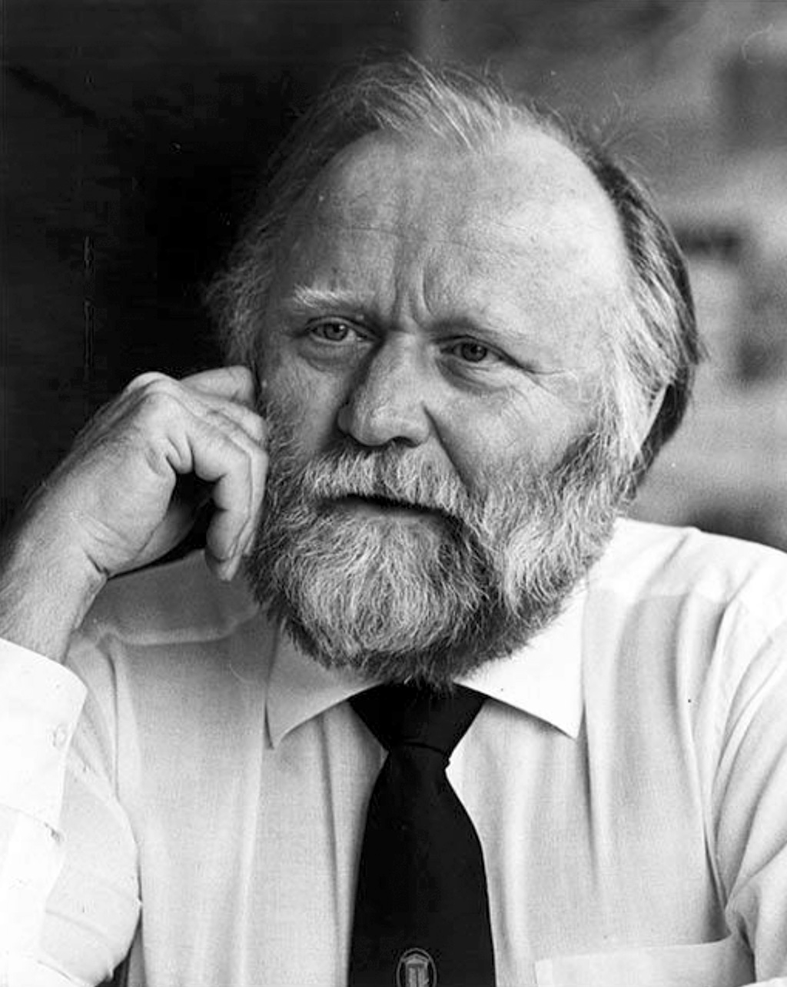

© Berkley Books
© MOHAI

Slide 3
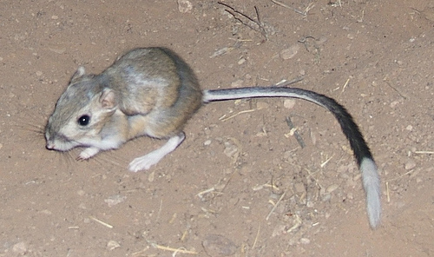
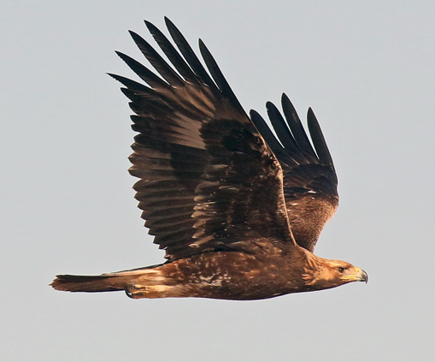
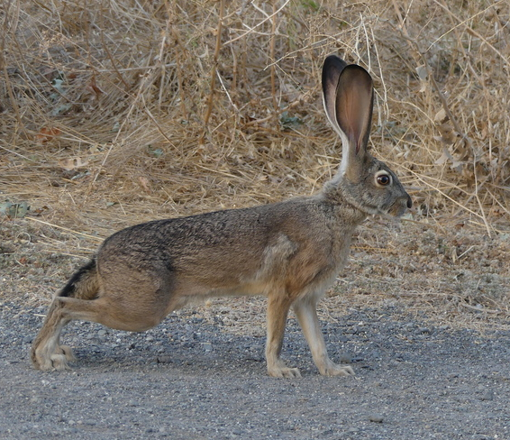
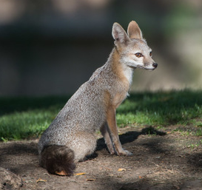
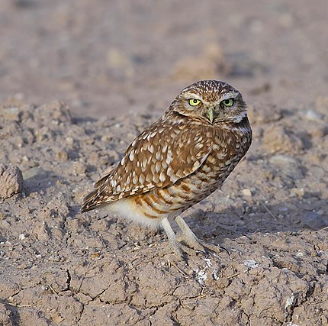
Species on Arrakis (Dune):
(c) ajedelman, Kangaroo Mouse
(c) animalita, Golden Eagle
© Lauren Glevanik, Desert hare
(c) Randy, Kit Fox
(c) Alan Vernon, Burrowing Owl

Slide 4
Is the food web on Arrakis realistic?

Slide 5
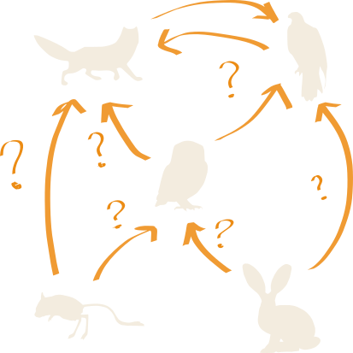

Slide 6
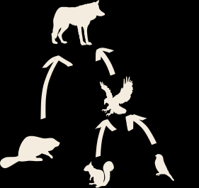
Europe food web

Slide 7
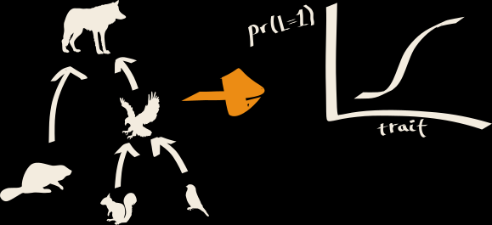
Europe food web
Trait-based model

Slide 8
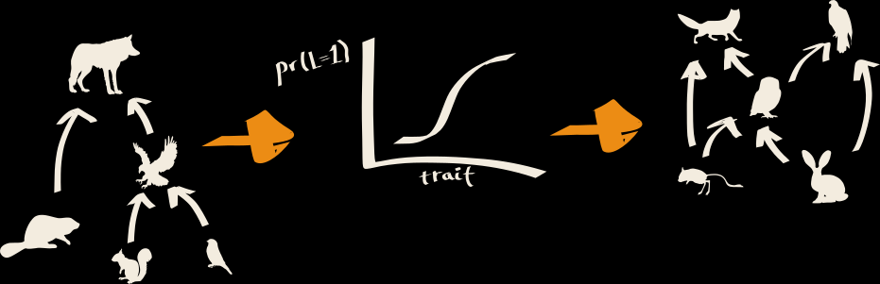
Europe food web
Trait-based model
Arrakis food web

Slide 9
Is the food web on Arrakis realistic?

Slide 10
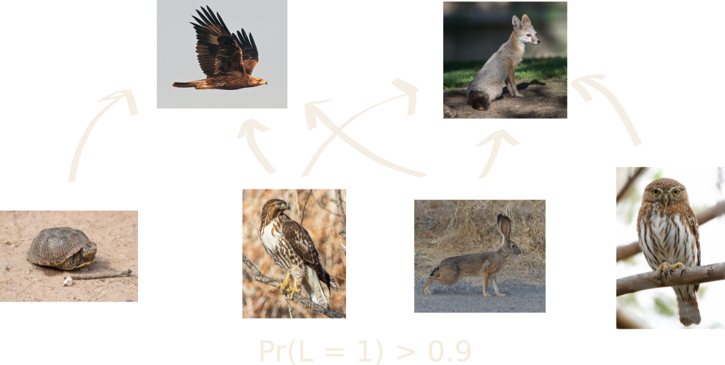
Most probable interactions

Slide 11
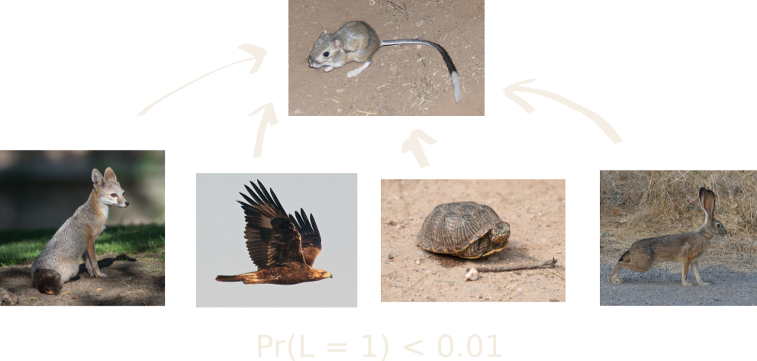
Least probable interactions

Slide 12
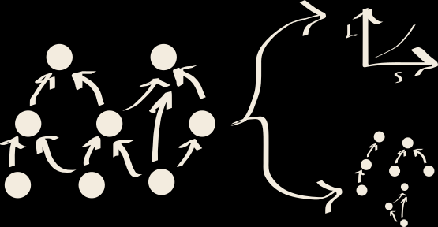
Is the food web structure realistic?
Link-species scaling
Motifs distribution

Slide 13
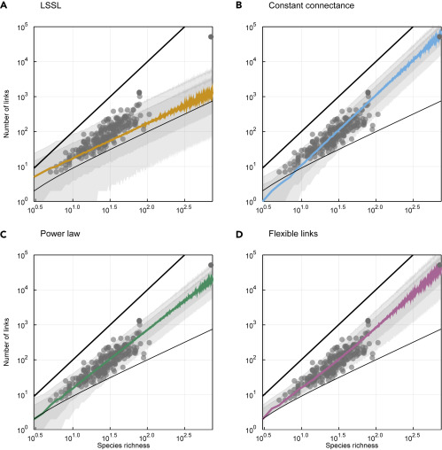
Is the predicted number of links realistic?
MacDonald, Banville & Poisot 2020

Slide 14
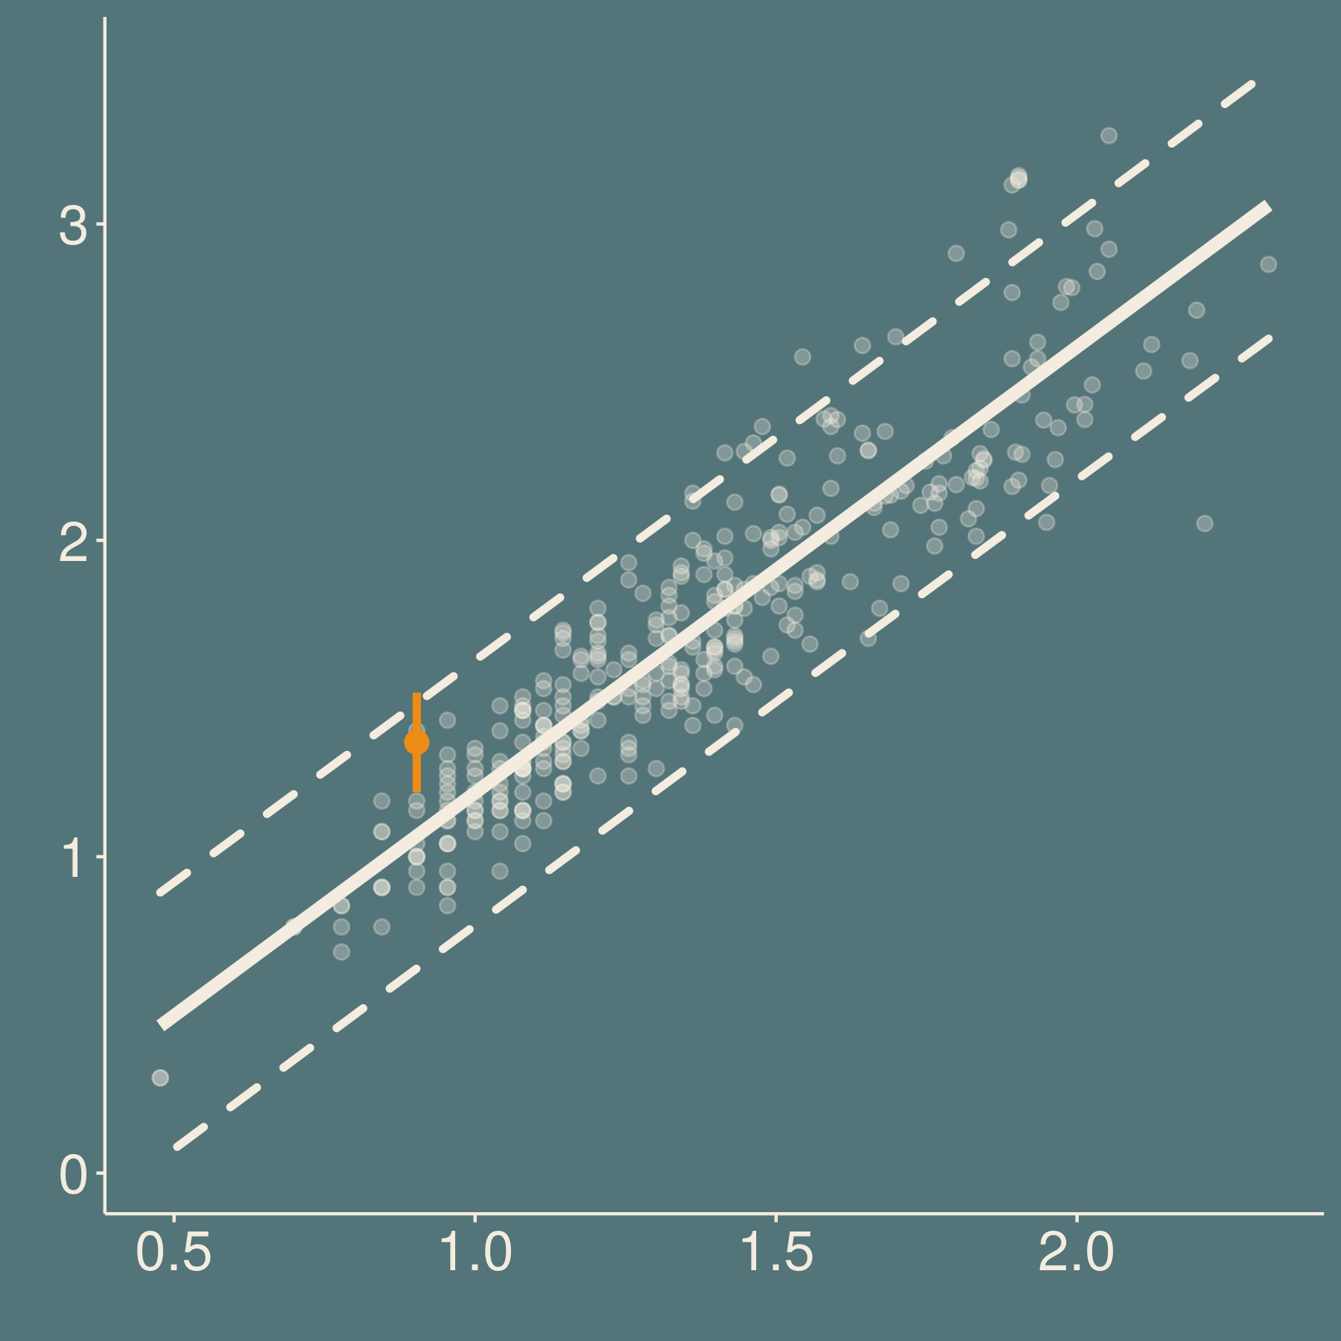
Is the predicted number of links realistic?
10³
10²
# of links
Arrakis food web
10¹
10⁰
10^{0.5}
10¹
10^{1.5}
10²
# of species

Slide 15

Is the motif distribution realistic?
3-node motifs:
Milo et al. 2009
Baiser et al. 2015

Slide 16

Is the motif distribution realistic?
3-node motifs:
Milo et al. 2009
Baiser et al. 2015

Slide 17
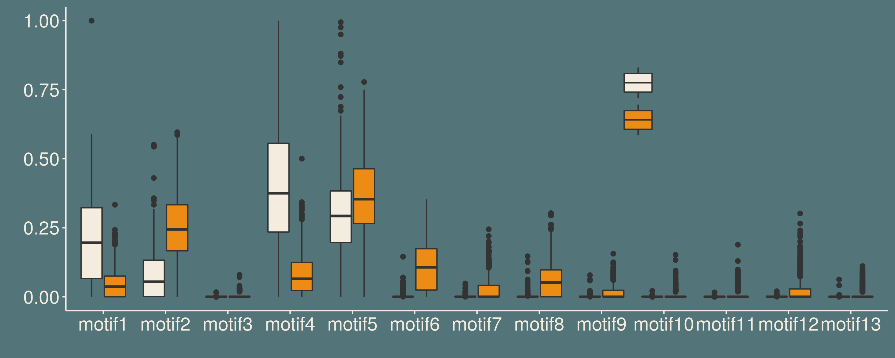
Is the motif distribution realistic?
Earth
Dune
Relative frequency

Slide 18
Is Dune’s food web unrealistic?
OR
Is it the model predictions that are biased?

Slide 19
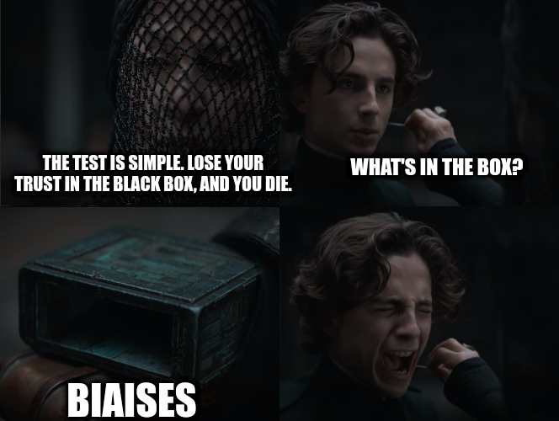

Slide 20
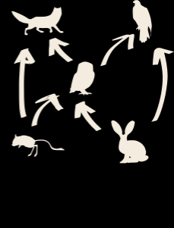

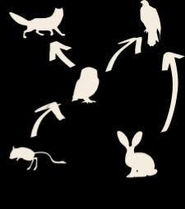

Interaction model
Corrected food web
Bias correction?
Structural model

